Slide 1
Ch2-2 How to improve cache performance (cont.)

Slide 2
How to Improve Cache Performance?
AMAT = HitTime + MissRate×MissPenalty
1. Reduce the time to hit in the cache.--4
——small and simple caches, avoiding address translation, way prediction , and trace caches
2. Increase cache bandwidth .--3
—— pipelined cache access, multibanked caches, non-blocking caches,
3. Reduce the miss penalty--4
——multilevel caches, critical word first, read miss prior to writes, merging write buffers, and victim caches
4. Reduce the miss rate--4
——larger block size, large cache size, higher associativity,and compiler optimizations
5. Reduce the miss penalty and miss rate via parallelism--2
——hardware prefetching,and compiler prefetching

Slide 3
1st Hit Time Reduction Technique: Small and Simple Caches
Using small and Direct-mapped cache
The less hardware that is necessary to implement a cache, the shorter the critical path through the hardware.
Direct-mapped is faster than set associative for both reads and writes.
Fitting the cache on the chip with the CPU is also very important for fast access times.

Slide 4
Hit time varies with size and associativity
Way越大，时间越长

Slide 5
2nd Hit Time Reduction Technique: Way Prediction
Way Prediction (Pentium 4 )
Extra bits are kept in the cache to predict the way, or block within set of the next cache access.
If the predictor is correct, the instruction cache latency is 1 clock clock cycle.
If not, it tries the other block, changes the way predictor, and has a latency of 1 extra clock cycles.
Simulation using SPEC95 suggested set prediction accuracy is excess of 85%, so way prediction saves pipeline stage in more than 85% of the instruction fetches.
Notes:
原来是通过多路选择器来确定哪一路数据命中，需要额外时间。
现在就用附加位来预测下次的命中路数，这个开销低于多路选择器开销。

Slide 6
3rd Hit Time Reduction Technique: Avoiding Address Translation during Indexing of the Cache
Trans-
lation
Main
Memory
VA
PA
miss
Cache
CPU
hit
data
Page table is a large data structure in memory
TWO memory accesses for every load, store, or instruction fetch!!!
Virtually addressed cache?
synonym problem
Cache the address translations?

Slide 7
TLBs
A way to speed up translation is to use a special cache of recently used page table entries -- this has many names, but the most frequently used is Translation Lookaside Buffer or TLB
Virtual Address Physical Address Dirty Ref Valid Access
Really just a cache on the page table mappings
TLB access time comparable to cache access time
(much less than main memory access time)

Slide 8
Translation Look-Aside Buffers
Just like any other cache, the TLB can be organized as fully associative, set associative, or direct mapped
TLBs are usually small, typically not more than 128 - 256 entries even on high end machines. This permits fully associative lookup on these machines. Most mid-range machines use small n-way set associative organizations.
hit
VA
PA
miss
TLB
Lookup
Cache
Main
Memory
CPU
Translation
with a TLB
miss
hit
Trans-
lation
data
1/2 t
t
20 t

Slide 9
Fast hits by Avoiding Address Translation
CPU
CPU
CPU
VA
VA
并行操作
VA
VA
Tags
$
PA
Tags
$
TB
TB
VA
PA
PA
L2 $
Hit时减少一次TB访问
$
TB
MEM
PA
PA
MEM
MEM
Virtual indexed, Physically tagged
Overlap $ access
with VA translation:
requires $ index to
remain invariant
across translation
Conventional
Organization
Virtually Addressed Cache
Translate only on miss
Synonym Problem
Notes:
TB=TLB

Slide 10
Virtual Addressed Cache
Send virtual address to cache? Called Virtually Addressed Cache or
just Virtual Cache (vs. Physical Cache)
Every time process is switched logically must flush the cache; otherwise get false hits
Cost is time to flush + “compulsory” misses from empty cache
Add process identifier tag that identifies process as well as address within process: can’t get a hit if wrong process
Notes:
1个进程的Nv->1P (别名）
多个进程的1v->NP （加进程标志）

Slide 11
Virtual cache

Slide 12
Dealing with aliases
Dealing with aliases (synonyms); Two different virtual addresses map to same physical address
NO aliasing! What are the implications?
HW antialiasing: guarantees every cache block (virtual address) has unique address
verify on miss (rather than on every hit)
cache set size <= page size ?
what if it gets larger?
How can SW simplify the problem? (called page coloring)
I/O must interact with cache, so need virtual address

Slide 13
Aliases problem with Virtual cache
虚拟地址
物理地址
cache
问题1. 两个虚拟对应一个物理；
问题2. 映射到两个cache block, 浪费
软件解决方法
If the index and offset bits of two aliases are forced to be
the same, then the aliases address will map to the same block in cache.

Slide 14
Overlap address translation and cache access (Virtual indexed, physically tagged)
Any limitation ? Cache容量限制
直接映射的index, 确定cacheline
解决了占多个cacheline的问题(别名问题）

Slide 15
What’s the limitation?
查找TLB和cahce并行
IF it’s direct map cache, then
Cache size = 2^{index} * 2^{blockoffset} <= 2 ^{pageoffset}
直接映射时，cache的最大大小就是页大小
How to solve this problem?
Use higher association. Say it’s a 4 way, then cache size can reach 4 times 2^{pageoffset} with change nothing in index or tag or offset.
4路组相连时，cache的4倍页大小，查找时同时比较4路

Slide 16
Example: Virtual indexed, physically tagged cache
Virtual address wide = 43 bits, Memory physical address wide = 38 bits, Page size = 8KB.
Cache capacity =16KB. If a virtually indexed and physically tagged cache is used.
And the cache is 2-way associative write back cache with 32 byte block size.
index block offset
VA
VPN: 30bits 8bits 5bits
VPN PPN
=
V D 30 bits 25 bits
Cache
=
0
V D 25 bits 256 bits
=
bank0
=
TLB
PPN：25bits
255
=
0
V D 25 bits 256 bits
bank1
255
=
Notes:
PPN=25： 物理空间总位数 38，减去页偏移（13）得 25

Slide 17
4th Hit Time Reduction Technique: Trace caches
Find a dynamic sequence of instructions including taken branches to load into a cache block.
The block determined by CPU instead of by memory layout.
Complicated address mapping mechanism
把连续执行的多条指令，一次打包放到cache, 而且是译码后的指令，节省cache空间和译码时间。

Slide 18
Why Trace Cache ?
Bring N instructions per cycle
No I-cache misses
No prediction miss
No packet breaks !
Because branch in each 5 instruction, so cache can only provide a packet in one cycle.

Slide 19
What’s Trace ?
Trace: dynamic instruction sequence
When instructions ( operations ) retire from the pipeline, pack the instruction segments into TRACE, and store them in the TRACE cache, including the branch instructions.
Though branch instruction may go a different target, but most times the next operation sequential will just be the same as the last sequential. ( locality )

Slide 20
Whose propose ?
Peleg Weiser (1994) in Intel corporation
Patel / Patt ( 1996)
Rotenberg / J. Smith (1996)
Paper: ISCA’98

Slide 21
Trace in CPU
译码后的
打包

Slide 22
Instruction segment

Slide 23
Pentium 4: trace cache, 12 instr./per cycle

Slide 24
How to Improve Cache Performance?
AMAT = HitTime + MissRate×MissPenalty
1. Reduce the time to hit in the cache.--4
——small and simple caches, avoiding address translation, way prediction , and trace caches
2. Increase cache bandwidth .--3
—— pipelined cache access, multibanked caches, non-blocking caches,
3. Reduce the miss penalty--4
——multilevel caches, critical word first, read miss prior to writes, merging write buffers, and victim caches
4. Reduce the miss rate--4
——larger block size, large cache size, higher associativity,and compiler optimizations
5. Reduce the miss penalty and miss rate via parallelism--2
——hardware prefetching,and compiler prefetching

Slide 25
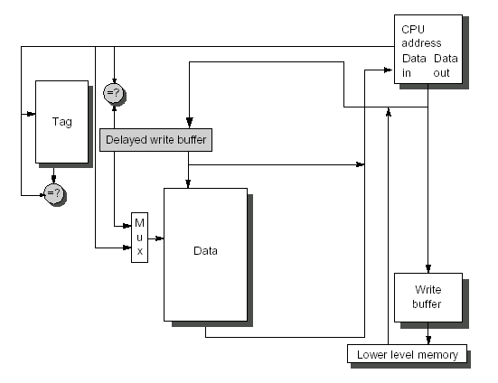
1st Increasing cache bandwidth: Pipelined Caches
本质：cache查找、tag比较、访问数据流水线执行。
What problems for instruction pipeline ?
Hit in multiple cycles,
giving fast clock cycle time
Notes:
通常来说，将数据写入缓存有两步：
使用索引（Index）来定位 Tag Array （我们假设 Tag Array 和 Data Array 是分开的）
检查有效位 Valid Bit 和标签 Tag；如果 Tag 相同，则写入缓存
上述两个步骤可以同时做，但对时钟周期（Clock Cycle）不是那么的友好，因为一个周期里面硬件需要做的事情更多了，可能会违反 Timing。
如果把这两步用时序分开，那么在 Memory Stage 会需要两个时钟周期：
一个周期用来比较标签（Tag）
一个周期用来写入数据（如果命中）
所以，为了让效率最大化，我们就可以使用流水线缓存（Pipelined Cache）来对这两个时序进行 Pipelining。
流水线缓存如何工作？
为了拆分这两个步骤，设计人员在缓存旁边新添加了一个模块，叫做（缓存延迟存储缓冲区 Delayed Cache Store Buffer）。没错，你一定看晕了，为了便于理解，我们可以认为它就是块缓冲区（Buffer），数据将在里面持续等待，直到被写入缓存。
那么数据要等到什么时候呢？答案是当遇到下一个 Store 指令的时候，在其比较标签 Tag 的时候，来自上一个 Store 指令的数据就可以完成第二步：从缓冲区写入缓存。下面的时序图能更直观的展示流水线缓存的工作流程：

Slide 26
2nd Increasing cache bandwidth: Nonblocking Caches
A nonblocking(Lockup-free cache) cache,allows The cache to continues to supply hits while processing read misses ( hit under miss , hit under multiple miss ).
Complex caches can even have multiple outstanding misses ( miss under miss ). It will further lower effective miss penalty
Nonblocking, in conjunction with out-of-order execution, can allow the CPU to continue executing instructions after a data cache miss.
What’s the precondition ?
即使cachemiss, 其他cache访问继续

Slide 27
Performance of Nonblocking cache
Cache能同时服务的miss越多，stall时间越小

Slide 29
3nd Increasing cache bandwidth: Multibanked Caches
Cache is divided into independent banks that can support simultaneous accesses like interleaved memory banks.
E.g.,T1 (“Niagara”) L2 has 4 banks
Banking works best when accesses naturally spread themselves across banks ⇒ mapping of addresses to banks affects behavior of memory system
Simple mapping that works well is “sequential interleaving”

Slide 30
Single banked two bank two bank two bank
consecutive interleaving group interleaving

Slide 31
Summary: Increase Cache Bandwidth
1. Increase bandwidth via pipelined cache access
2. Increase bandwidth via multibanked caches,
3. Increase bandwidth via non-blocking caches,

Slide 32
How to Improve Cache Performance?
AMAT = HitTime + MissRate×MissPenalty
1. Reduce the time to hit in the cache.--4
——small and simple caches, avoiding address translation, way prediction , and trace caches
2. Increase cache bandwidth .--3
—— pipelined cache access, multibanked caches, non-blocking caches,
3. Reduce the miss penalty--4
——multilevel caches, critical word first, read miss prior to writes, merging write buffers, and victim caches
4. Reduce the miss rate--4
——larger block size, large cache size, higher associativity,and compiler optimizations
5. Reduce the miss penalty and miss rate via parallelism--2
——hardware prefetching, compiler prefetching

Slide 33
1st Miss Penalty Reduction Technique: Multilevel Caches
This method focuses on the interface between the cache and main memory.
Add an second-level cache between main memory and a small, fast first-level cache, to make the cache fast and large.
The smaller first-level cache is fast enough to match the clock cycle time of the fast CPU and to fit on the chip with the CPU, thereby lessening the hits time.
The second-level cache can be large enough to capture many memory accesses that would go to main memory, thereby lessening the effective miss penalty.

Slide 34
Parameter about Multilevel cache
The performance of a two-level cache is calculated in a similar way to the performance for a single level cache.
L2 Equations
AMAT = Hit Time_{L1} + Miss Rate_{L1} x Miss Penalty_{L1}
Miss Penalty_{L1} = Hit Time_{L2} + Miss Rate_{L2} x Miss Penalty_{L2}
AMAT = Hit Time_{L1} +
Miss Rate_{L1} x (Hit Time_{L2} + Miss Rate_{L2} * Miss Penalty_{L2})
So the miss penalty for level 1 is calculated using the hit time, miss rate, and miss penalty for the level 2 cache.

Slide 35
Two conceptions for two-level cache
Definitions:
Local miss rate— misses in this cache divided by the total number of memory accesses to this cache (Miss rate_{L2})
Global miss rate—misses in this cache divided by the total number of memory accesses generated by the CPU
Using the terms above, the global miss for the first-level cache is stall just Miss rate_{L1}, but for the second-level cache it is :

Slide 36
2nd Miss Penalty Reduction Technique: Critical Word First and Early Restart
Don’t wait for full block to be loaded before restarting CPU
Critical Word First—Request the missed word first from memory and send it to the CPU as soon as it arrives; let the CPU continue execution while filling the rest of the words in the block. Also called wrapped fetch and requested word first
Early restart—As soon as the requested word of the block arrives, send it to the CPU and let the CPU continue execution
Generally useful only in large blocks,
Spatial locality => tend to want next sequential word, so not clear if benefit by early restart
一个line可能有好几个字，用户只需要一字

Slide 37
Example: Critical Word First
Assume:
cache block＝64-byte
L2: take 11 CLK to get the critical 8 bytes,(AMD Athlon)
and then 2 CLK per 8 byte to fetch the rest of the
block
There will be no other accesses to rest of the block
Calculate the average miss penalty for critical word first.
Then assuming the following instructions read data sequentially 8 bytes at a time from the rest of the block
Compare the times with and without critical word first.

Slide 38
3rd Miss Penalty Reduction Technique: Giving Priority to Read Misses over Writes
If a system has a write buffer, writes can be delayed to come after reads.
The system must, however, be careful to check the write buffer to see if the value being read is about to be written.
Write through: 原来后面的读需要等数据写到Mem后才进行；现在有buffer， 可以在写入buffer后但Mem前可以读出来。//写buffer在cache和mem之间。

Slide 39
Write buffer
Write-back want buffer to hold displaced blocks
Read miss replacing dirty block
Normal: Write dirty block to memory, and then do the read
Instead copy the dirty block to a write buffer, then do the read, and then do the write
CPU stall less since restarts as soon as do read
Write-through want write buffers => RAW conflicts with main memory reads on cache misses
If simply wait for write buffer to empty, might increase read miss penalty (old MIPS 1000 by 50% )
Check write buffer contents before read; if no conflicts, let the memory access continue

Slide 40
4th Miss Penalty Reduction Technique: Merging write Buffer
One word writes replaces with multiword writes, and it improves buffers’s efficiency.
In write-through ,When write misses if the buffer contains other modified blocks,the addresses can be checked to see if the address of this new data matches the address of a valid write buffer entry.If so,the new data are combined with that entry.
The optimization also reduces stalls due to the write buffer being full.

Slide 41
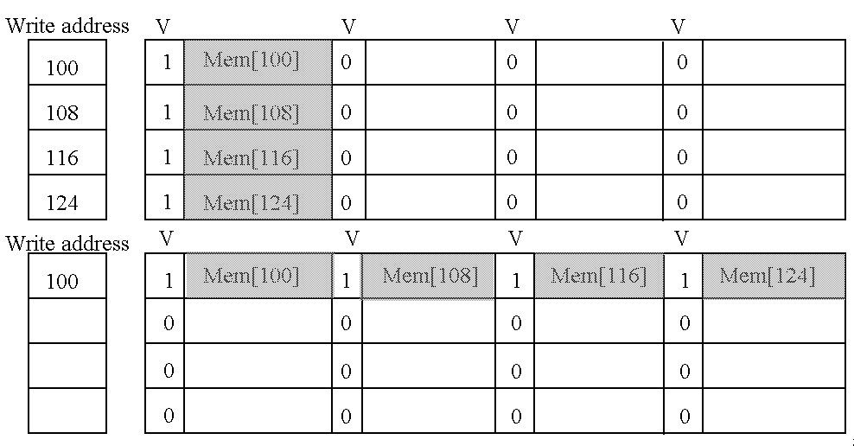
Write merging
1）原来一个一个的写四次；现在一下子写一行、1次
2）原来空间浪费，4行，现在1行

Slide 42
Miss Penalty Reduction Technique: Victim Caches
A victim cache is a small (usually, but not necessarily) fully-associative cache that holds a few of the most recently replaced blocks or victims from the main cache.
This cache is checked on a miss data before going to next lower-level memory(main memory).
to see if they have the desired item
If found, the victim block and the cache block are swapped.
The AMD Athlon has a victim caches (write buffer for write back blocks ) with 8 entries.

Slide 43
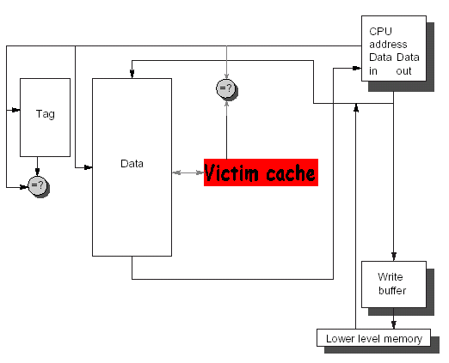
The Victim Cache

Slide 44
How to combine victim Cache ?
How to combine fast hit time of direct mapped yet still avoid conflict misses?
Add buffer to place data discarded from cache
Jouppi [1990]: 4-entry victim cache removed 20% to 95% of conflicts for a 4 KB direct mapped data cache
Used in Alpha, HP machines
TAGS
DATA
Tag and Comparator
One Cache line of Data
Tag and Comparator
One Cache line of Data
Tag and Comparator
One Cache line of Data
Tag and Comparator
One Cache line of Data
To Next Lower Level In
Hierarchy

Slide 45
Summary: Miss Penalty Reduction
1. Reduce penalty via Multilevel Caches
2. Reduce penalty via Critical Word First
3. Reduce penalty via Read Misses over Writes
4. Reducing penalty via Merging write Buffer

Slide 46
How to Improve Cache Performance?
AMAT = HitTime + MissRate×MissPenalty
1. Reduce the time to hit in the cache.--4
——small and simple caches, avoiding address translation, way prediction , and trace caches
2. Increase cache bandwidth .--3
—— pipelined cache access, multibanked caches, non-blocking caches,
3. Reduce the miss penalty--4
——multilevel caches, critical word first, read miss prior to writes, merging write buffers, and victim caches
4. Reduce the miss rate--4
——larger block size, large cache size, higher associativity,and compiler optimizations
5. Reduce the miss penalty and miss rate via parallelism--2
——hardware prefetching,and compiler prefetching

Slide 47
Where misses come from?
Classifying Misses: 3 Cs
Compulsory—The first access to a block is not in the cache, so the block must be brought into the cache. Also called cold start misses or first reference misses. (Misses in even an Infinite Cache)
Capacity—If the cache cannot contain all the blocks needed during execution of a program, capacity misses will occur due to blocks being discarded and later retrieved. (Misses in Fully Associative Size X Cache)
Conflict—If block-placement strategy is set associative or direct mapped, conflict misses (in addition to compulsory & capacity misses) will occur because a block can be discarded and later retrieved if too many blocks map to its set. Also called collision misses or interference misses. (Misses in N-way Associative, Size X Cache)
4th “C”:
Coherence - Misses caused by cache coherence.
Notes:
Intuitive Model by Mark Hill

Slide 48
3Cs Absolute Miss Rate (SPEC92)

Slide 49
3Cs Relative Miss Rate
Flaws: for fixed block size
Good: insight => invention

Slide 50
Reducing Cache Miss Rate
To reduce cache miss rate, we have to eliminate some of the misses due to the three C's.
We cannot reduce capacity misses much except by making the cache larger.
We can, however, reduce the conflict misses and compulsory misses in several ways:

Slide 51
Cache Organization?
Assume total cache size not changed:
What happens if:
Change Block Size:
Change Associativity:
3) Change Compiler:
Which of 3Cs is obviously affected?
Notes:
Ask which affected?
Block size
1) Compulsory
2) More subtle, will change mapping

Slide 52
1st Miss Rate Reduction Technique: Larger Block Size (fixed size&assoc)
Larger blocks decrease the compulsory miss rate by taking advantage of spatial locality.
Drawback--curve is U-shaped
However, they may increase the miss penalty by requiring more data to be fetched per miss.
In addition, they will almost certainly increase conflict misses since fewer blocks can be stored in the cache.
And maybe even capacity misses in small caches
Trade-off
Trying to minimize both the miss rate and the miss penalty.
The selection of block size depends on both the latency and bandwidth of lower-level memory

Slide 53
Miss Rate relates Block size
Block size | Cache size
 | 4K | 16K | 64K | 256K
16 | 8.57% | 3.94% | 2.04% | 1.09%
32 | 7.24% | 2.87% | 1.35% | 0.70%
64 | 7.00% | 2.64% | 1.06% | 0.51%
128 | 7.78% | 2.77% | 1.02% | 0.49%
256 | 9.51% | 3.29% | 1.15% | 0.49%

Slide 54
Performance curve is U-shaped
Reduced
compulsory
misses
Increased
Conflict
Misses
What else drives up block size?

Slide 55
Example: Larger Block Size (C-26)
Assume: memory takes 80 clock cycles of overhead and then delivers 16 bytes every 2 cycles.
1 clock cycle hit time independent of block size.
Which block size has the smallest AMAT for each size in Fig.5.17 ?
Answer:
AMAT_{16-byte block, 4KB} = 1+(8.57%*82)=8.027
AMAT_{256-byte block}, _{256KB}= 1+(0.49%*112)=1.549
查前2页的表就好
Notes:
82=80+2/2*16
112=80+2*256/16=112

Slide 57
2nd Miss Rate Reduction Technique: Larger Caches
Cache Size
rule of thumb: 2 x size => 25% cut in miss rate
What does it reduce ?

Slide 58
Pro. Vs. cons for large caches
Pro.
Reduce capacity misses (表格里无)
Con.
Longer hit time, Higher cost, AMAT curve is U-shaped ？(表格里无，更大size出现)
Popular in off-chip caches
Block size | Miss penalty | Cache size
 |  | 4K | 16K | 64K | 256K
16 | 82 | 8.027 (AMAT) | 4.231 | 2.673 | 1.894
32 | 84 | 7.082 | 3.411 | 2.134 | 1.588
64 | 88 | 7.160 | 3.323 | 1.933 | 1.449
128 | 96 | 8.469 | 3.659 | 1.979 | 1.470
256 | 112 | 11.651 | 4.685 | 2.288 | 1.549

Slide 59
3rd Miss Rate Reduction Technique: Higher Associativity
Conflict misses can be a problem for caches with low associativity (especially direct-mapped).
With higher associativity decreasing Conflict misses to improve miss rate
cache rule of thumb
2:1 rule of thumb a direct-mapped cache of size N has the same miss rate as a 2-way set-associative cache of size N/2.
Eight-way set associative is for practical purposes as effective in reducing misses for these sized cache as fully associative.

Slide 60
Associativity
2:1 rule of thumb
Conflict

Slide 61
组相连问题：Associativity vs Cycle Time
Beware: Execution time is only final measure!
Why is cycle time tied to hit time?
Will Clock Cycle time increase?
Hill [1988] suggested hit time for 2-way vs. 1-way external cache +10%： 片外+10% internal + 2% ：片内+2%
suggested big and dumb caches：笨拙简单的
组相连电路复杂，比较时间长，一个Cycle可能比较不完，周期加长，影响整个效率。

Slide 62
Avg. Memory Access Time vs. Miss Rate (P430)
Example: assume CCT = 1.36 for 2-way, 1.44 for 4-way, 1.52 for 8-way vs. CCT direct mapped
Cache Size Associativity (AMAT)
(KB) 1-way 2-way 4-way 8-way
4 3.44 3.25 3.22 3.28
8 2.69 2.58 2.55 2.62
16 2.33 2.40 2.46 2.53
32 2.06 2.30 2.37 2.45
64 1.92 2.24 2.18 2.25
128 1.52 1.84 1.92 2.00
256 1.32 1.66 1.74 1.82
512 1.20 1.55 1.59 1.66
(Red means A.M.A.T. not improved by more associativity)
Notes:
CCT： Clock Cycle time

Slide 63
4th Miss Rate Reduction Technique: Way Prediction and Pseudo-Associative Cache
Using two Technique reduces conflict misses and yet maintains hit speed of direct-mapped cache
Predictive bit - Pseudo-Associative
Way Prediction (Alpha 21264 )
Extra bits are kept in the cache to predict the way, or block within set of the next cache access.
If the predictor is correct, the instruction cache latency is 1 clock clock cycle.
If not,it tries the other block, changes the way predictor, and has a latency of 3 clock cycles.
Simulation using SPEC95 suggested set prediction accuracy is excess of 85%, so way prediction saves pipeline stage in more than 85% of the instruction fetches.

Slide 64
Pseudo-Associative Cache (column associative)
How to combine fast hit time of Direct Mapped and have the lower conflict misses of 2-way SA (组相关) cache?
Divide cache: on a miss, check other half of cache to see if there, if so have a pseudo-hit (slow hit)
直接：
伪相连：
Drawback: CPU pipeline is hard if hit takes 1 or 2 cycles
Better for caches not tied directly to processor (L2)
Used in MIPS R1000 L2 cache, similar in UltraSPARC
Hit Time
Pseudo Hit Time
Miss Penalty
Time
Notes:
Pseudo-Associative Cache（伪关联缓存）是一种缓存设计技术，它旨在减少直接映射缓存中的冲突失效（conflict misses），同时保持接近直接映射缓存的访问速度。在直接映射缓存中，每个内存块只能映射到一个特定的缓存行，这可能导致多个内存块竞争同一个缓存行，从而引发冲突失效。伪关联缓存通过在发生失效时提供一个或多个后备位置来解决这个问题。
伪关联缓存的工作原理是在缓存失效时，使用一个不同的索引函数来查找另一个可能的缓存行位置。例如，可以通过翻转地址的高位来计算一个新的地址，并将数据存储在那里。这种方法不需要像全关联缓存那样进行复杂的并行比较，因此实现起来成本较低，但同时也引入了额外的访问延迟，因为需要进行第二次缓存访问。
伪关联缓存的其他变体包括V-way cache和Composite Pseudo Associative Cache (CPS)。V-way cache是一种伪关联技术，它可以在不增加缓存大小和集合关联性的情况下，通过增加缓存利用率来提高性能。CPS则是一种结合了伪关联缓存和受害者缓存（Victim Cache）的技术，它通过为最近被替换的缓存行提供额外的存储空间来减少冲突失效。

Slide 65
Pseudo-Associative Cache
还要加一个取反的位
不命中时查找另一个位置
Notes:
Pseudo-Associative Cache（伪关联缓存）是一种缓存设计技术，它旨在减少直接映射缓存中的冲突失效（conflict misses），同时保持接近直接映射缓存的访问速度。在直接映射缓存中，每个内存块只能映射到一个特定的缓存行，这可能导致多个内存块竞争同一个缓存行，从而引发冲突失效。伪关联缓存通过在发生失效时提供一个或多个后备位置来解决这个问题。
伪关联缓存的工作原理是在缓存失效时，使用一个不同的索引函数来查找另一个可能的缓存行位置。例如，可以通过翻转地址的高位来计算一个新的地址，并将数据存储在那里。这种方法不需要像全关联缓存那样进行复杂的并行比较，因此实现起来成本较低，但同时也引入了额外的访问延迟，因为需要进行第二次缓存访问。
伪关联缓存的其他变体包括V-way cache和Composite Pseudo Associative Cache (CPS)。V-way cache是一种伪关联技术，它可以在不增加缓存大小和集合关联性的情况下，通过增加缓存利用率来提高性能。CPS则是一种结合了伪关联缓存和受害者缓存（Victim Cache）的技术，它通过为最近被替换的缓存行提供额外的存储空间来减少冲突失效。

Slide 66
4th Miss Rate Reduction Technique: Compiler Optimizations
The techniques reduces miss rates without any hardware changes and reorders instruction sequence with compiler.
Instructions
Reorder procedures in memory so as to reduce conflict misses
Profiling to look at conflicts (using tools they developed)
Data
Merging Arrays: improve spatial locality by single array of compound elements vs. 2 arrays
Loop Interchange: change nesting of loops to access data in order stored in memory
Loop Fusion: Combine 2 independent loops that have same looping and some variables overlap
Blocking: Improve temporal locality by accessing “blocks” of data repeatedly vs. going down whole columns or rows
Notes:
这四种技术都是优化程序性能的方法，特别是针对数据访问模式进行优化，以提高缓存利用率和减少内存访问延迟。下面我将逐一解释这些技术：
1. **Merging Arrays: improve spatial locality by single array of compound elements vs. 2 arrays**
- **合并数组**：通过将多个数组合并成一个包含复合元素的单一数组，可以提高空间局部性。空间局部性是指程序倾向于访问相邻的内存位置。如果有两个数组，它们分别存储不同类型的数据，但这些数据在逻辑上是相关的，那么将它们合并成一个数组，每个元素包含所有需要的数据，可以减少访问相同数据所需的跳跃次数。例如，如果有两个数组分别存储坐标的X和Y值，合并后每个元素存储一个坐标对（X, Y），这样访问时可以减少跳转，提高缓存命中率。
2. **Loop Interchange: change nesting of loops to access data in order stored in memory**
- **循环交换**：通过改变循环的嵌套顺序来按照数据在内存中存储的顺序访问数据。如果数据是按行存储的，但是循环是先遍历列再遍历行，那么每次迭代都会跳过很多内存位置，这会降低缓存命中率。通过交换循环的顺序，使得外层循环遍历行，内层循环遍历列，可以确保每次迭代都按照数据的物理存储顺序访问，从而提高空间局部性。
3. **Loop Fusion: Combine 2 independent loops that have same looping and some variables overlap**
- **循环融合**：将两个独立的循环合并成一个循环，这两个循环有相同的循环结构，并且有一些变量重叠。如果两个循环访问相同的数据集，并且可以保证不会相互干扰，那么将它们合并可以减少循环的开销，因为每次循环迭代都会执行更多的操作，这样可以减少循环控制的开销，并且可能提高缓存命中率，因为数据被访问得更频繁。
4. **Blocking: Improve temporal locality by accessing “blocks” of data repeatedly vs. going down whole columns or rows**
- **分块**：通过重复访问数据的“块”，而不是一次性遍历整列或整行，来提高时间局部性。时间局部性是指程序倾向于重复访问相同的数据。通过将数据分成块，并在循环中重复访问这些块，可以确保最近访问过的数据仍然在缓存中，从而提高缓存命中率。这种方法通常用于矩阵乘法等操作，其中数据可以被划分为较小的子矩阵，这些子矩阵在计算过程中会被多次访问。
这些技术通常用于优化科学计算和数据处理程序，它们通过改善数据访问模式来减少内存访问延迟，提高程序的运行效率。

Slide 67
Merging Arrays
Combining independent matrices into a single compound array.
Improving spatial locality
Example
/*before*/
Int val[SIZE];
Int key[SIZE];
/*after*/
Struct merge{
int val;
int key;
}
Struct merge merged_array[SIZE]
**合并数组**：通过将多个数组合并成一个包含复合元素的单一数组，可以提高空间局部性。空间局部性是指程序倾向于访问相邻的内存位置。如果有两个数组，它们分别存储不同类型的数据，但这些数据在逻辑上是相关的，那么将它们合并成一个数组，每个元素包含所有需要的数据，可以减少访问相同数据所需的跳跃次数。例如，如果有两个数组分别存储坐标的X和Y值，合并后每个元素存储一个坐标对（X, Y），这样访问时可以减少跳转，提高缓存命中率。

Slide 68
b. Loop Interchange
By switching the order in which loops execute, misses can be reduced due to improvements in spatial locality.
/* Before */
for (k = 0; k < 100; k = k+1)
for (j = 0; j < 100; j = j+1)
for (i = 0; i < 5000; i = i+1)
x[i][j] = 2 * x[i][j];
/* After */
for (k = 0; k < 100; k = k+1)
for (i = 0; i < 5000; i = i+1)
for (j = 0; j < 100; j = j+1)
x[i][j] = 2 * x[i][j];
Sequential accesses instead of striding through memory every 100 words;
循环交换：通过改变循环的嵌套顺序来按照数据在内存中存储的顺序访问数据。如果数据是按行存储的，但是循环是先遍历列再遍历行，那么每次迭代都会跳过很多内存位置，这会降低缓存命中率。通过交换循环的顺序，使得外层循环遍历行，内层循环遍历列，可以确保每次迭代都按照数据的物理存储顺序访问，从而提高空间局部性。

Slide 69
c. Loop fusion
By fusion the code into a single loop, the data that are fetched into the cache can be used repeatedly before being swapped out.
Improving the temporal locality
Example:
/*before*/
/*after*/
For (i=0; i<N; i=i+1) For (i=0; i<N; i=i+1)
For (i=0; j<N; j=i+1) For (j=0; j<N; j=i+1)
a[i][j]=1/b[i][j]*c[i][j]; {
For (i=0; i<N; i=i+1)
a[i][j]=1/b[i][j]*c[i][j];
For (j=0; j<N; j=j+1) d[i][j]=a[i][j]*c[i][j];
d[i][j]=a[i][j]*c[i][j]; }
循环融合：将两个独立的循环合并成一个循环，这两个循环有相同的循环结构，并且有一些变量重叠。如果两个循环访问相同的数据集，并且可以保证不会相互干扰，那么将它们合并可以减少循环的开销，因为每次循环迭代都会执行更多的操作，这样可以减少循环控制的开销，并且可能提高缓存命中率，因为数据被访问得更频繁。
访问数组中同样数据。

Slide 70
分块
通过重复访问数据的“块”，而不是一次性遍历整列或整行，来提高时间局部性。
时间局部性是指程序倾向于重复访问相同的数据。
通过将数据分成块，并在循环中重复访问这些块，可以确保最近访问过的数据仍然在缓存中，从而提高缓存命中率。这种方法通常用于矩阵乘法等操作，其中数据可以被划分为较小的子矩阵，这些子矩阵在计算过程中会被多次访问。

Slide 71
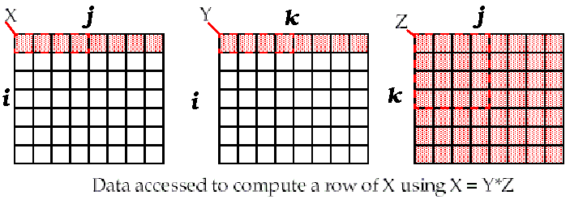
d. Unoptimized Matrix Multiplication
/* Before */
for (i = 0; i < N; i = i+1)
for (j = 0; j < N; j = j+1)
{r = 0;
for (k = 0; k < N; k = k+1)
r = r + y[i][k]*z[k][j];
x[i][j] = r;
};
Two Inner Loops:
Write N elements of 1 row of X[ ]
Read N elements of 1 row of Y[ ] repeatedly
Read all NxN elements of Z[ ]
Capacity Misses a function of N & Cache Size:
2N³ + N² => (assuming no conflict; otherwise …)
Idea: compute on BxB submatrix that fits
x[1][j]
y[1][k]
z[k][j]
((N+N)N+N)N=2N³ + N²
Accessed For N³ operations
X一行计算问题：Y一行和Z矩阵可能非常大，cache装不下，miss

Slide 72
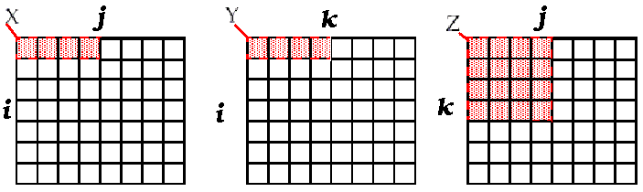
Blocking optimized Matrix Multiplication
Matrix multiplication is
performed by multiplying the
submatrices first.
/* After */
for (jj = 0; jj < N; jj = jj+B)
for (kk = 0; kk < N; kk = kk+B)
for (i = 0; i < N; i = i+1)
for (j = jj; j < min(jj+B-1,N); j = j+1)
{r = 0;
for (k = kk; k < min(kk+B-1,N); k = k+1)
r = r + y[i][k]*z[k][j];
x[i][j] = x[i][j] + r;
};
Y benefits from spatial locality
Z benefits from temporal locality
Capacity Misses from 2N³ + N² to 2N³/B+N²
BN
BN
B×B
B called Blocking Factor
(BN+BN)+B²)×(N/B)²=2N³/B + N²
Accessed For N³ operations
是中间结果，最终是多个分块乘中间结果累加

Slide 73
Reducing Conflict Misses by Blocking
Conflict misses in caches not FA vs. Blocking size
Lam et al [1991] a blocking factor of 24 had a fifth the misses vs. 48 despite both fit in cache
直接映射：Lam等人[1991]发现，当使用24作为分块因子时，缓存未命中的次数是使用48作为分块因子时的五分之一，尽管两者都能装入缓存。
Notes:
全相关没有这个问题。
直接相关：大矩阵计算，后面部分可能替换掉前面cache内容（映射到同一个位置），导致miss

Slide 74
Summary of Compiler Optimizations to Reduce Cache Misses (by hand)

Slide 75
Summary: Miss Rate Reduction
3 Cs: Compulsory, Capacity, Conflict
1. Larger cache
2. Reduce Misses via Larger Block Size
3. Reduce Misses via Higher Associativity
4. Reducing Misses by Compiler Optimizations
5. Pseudo associative cache

Slide 76
How to Improve Cache Performance?
AMAT = HitTime + MissRate×MissPenalty
1. Reduce the time to hit in the cache.--4
——small and simple caches, avoiding address translation, way prediction , and trace caches
2. Increase cache bandwidth .--3
—— pipelined cache access, multibanked caches, non-blocking caches,
3. Reduce the miss penalty--4
——multilevel caches, critical word first, read miss prior to writes, merging write buffers, and victim caches
4. Reduce the miss rate--4
——larger block size, large cache size, higher associativity,and compiler optimizations
5. Reduce the miss penalty and miss rate via parallelism--2
——hardware prefetching,and compiler prefetching

Slide 77
1st Miss Penalty/Rate Reduction Technique: Hardware Prefetching of Inst.and data
The act of getting data from memory before it is actually needed by the CPU.
This reduces compulsory misses by retrieving the data before it is requested.
Of course, this may increase other misses by removing useful blocks from the cache.
Thus, many caches hold prefetched blocks in a special buffer until they are actually needed.
E.g., Instruction Prefetching
Alpha 21064 fetches 2 blocks on a miss
Extra block placed in “stream buffer”
On miss check stream buffer
Prefetching relies on having extra memory bandwidth that can be used without penalty

Slide 78
2nd Miss Penalty/Rate Reduction Technique: Compiler-controlled prefetch
The compiler inserts prefetch instructions to request the data before they are needed
Data Prefetch Load data into register (HP PA-RISC loads)
Cache Prefetch: load into cache (MIPS IV, PowerPC, SPARC v. 9)
Special prefetching instructions cannot cause faults; a form of speculative execution
Prefetching comes in two flavors:
Binding prefetch: Requests load directly into register.
Must be correct address and register!
Non-Binding prefetch: Load into cache.
Can be incorrect. Faults?
Issuing Prefetch Instructions takes time
Is cost of prefetch issues < savings in reduced misses?
Higher superscalar reduces difficulty of issue bandwidth

Slide 79
Example (P307): Compiler-controlled prefetch
for( i=0; i <3; i = i +1)
for( j=0; j<100; j=j+1)
a[i][j] = b[j][0] * b[j+1][0];
16B/block， 8B/element， 2elements/block
A[i][j]: 3*100 the even value of j will miss,
the odd values will hit, total 150 misses
B[i][j]：101*3 the same elements are accessed for each iteration of i
j=0 B[0][0]、B[1][0] 2
j=1 B[1][0]、B[2][0] 1
total 2+99=101 misses
Notes:
A数组，一次加载2个元素，偶数缺失，基数命中。
B数组，取两个，后面miss一次。

Slide 80
Example cont.: Compiler-controlled prefetch
For (j=0; j<100; j=j+1){
Prefetch(b[j+7][0]);
prefetch(a[0][j+7]);
a[0][j]=b[j][0]*b [j+1][0];}; 7 misses for b
4 misses for a
For (I=1; I<3; I=I+1)
For (j=0; j<100; j=j+1){
prefetch(a[i][j+7]);
a[i][j]=b[j][0]*b [j+1][0];};4 misses for a[1][j]
4 misses for a[2][j]
Total: 19 misses
save 232 cache misses at the price of 400 prefetch instructions.
+7保证有足够时间把数据预取进来。

Slide 81
End.

