Slide 1
Estimating the Number of Active Devices Within a Fixed area
Using Wi-Fi Monitoring
Hai Li
Under the guidance of Prof. Chamberland
Electrical and Computer Engineering Department
Texas A&M University
October 18, 2016

Slide 2
Outline
Problem Description
System Model
Estimation Scheme
Simulation and Result
Experimental Implementation and Result
Conclusion

Slide 3
Introduction
Occupancy estimation has several applications
Smart home management
Emergency situation
Camera based approach is costly and limited by resolution
RF signal based approach consumes less power

Slide 4
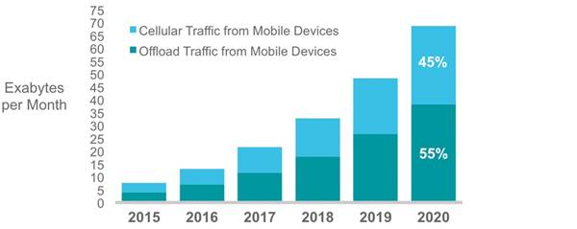
Wi-Fi Traffic Growth
mobile offload increases from 51 percent (3.9 exabytes/month) in 2015 to 55 percent (38.1 exabytes/month) by 2020

Slide 5
Problem Description
Estimating number of active wireless units using Wi-Fi monitoring with statistical inference
Increase the estimation accuracy by deploying proper directional antennas

Slide 6
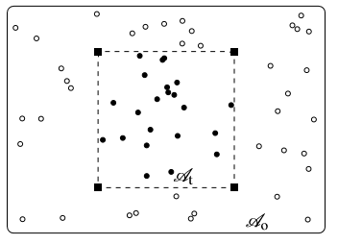


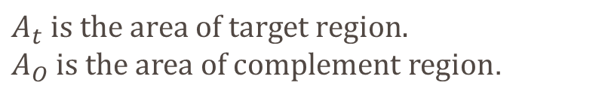
System Model
$$A_{t} is the area of target region.$$
$A_{O}$ is the area of complement region.
Location vector:
Received signal vector:

Slide 7
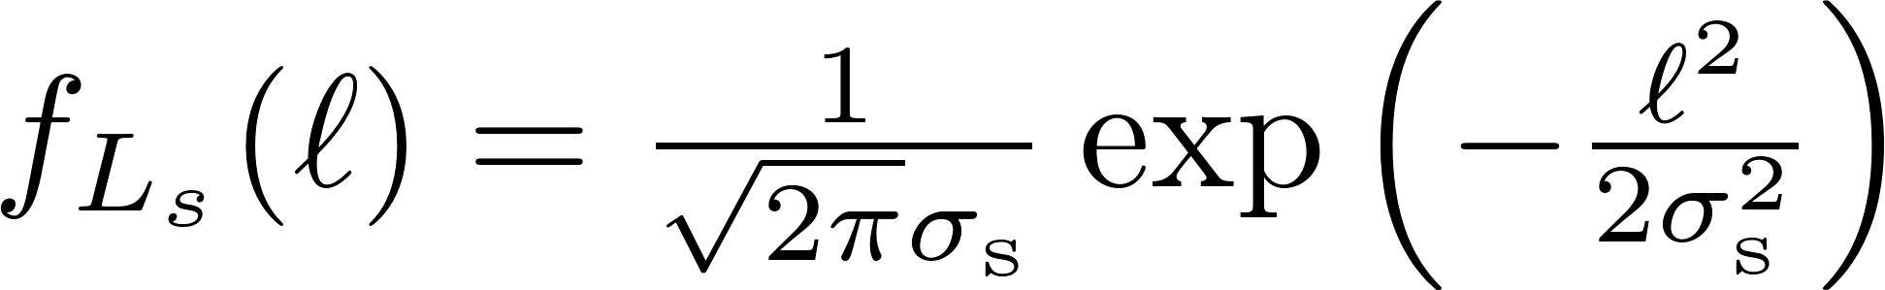
Channel Model
Log-normal channel model:
Log-normal distribution:

Slide 8
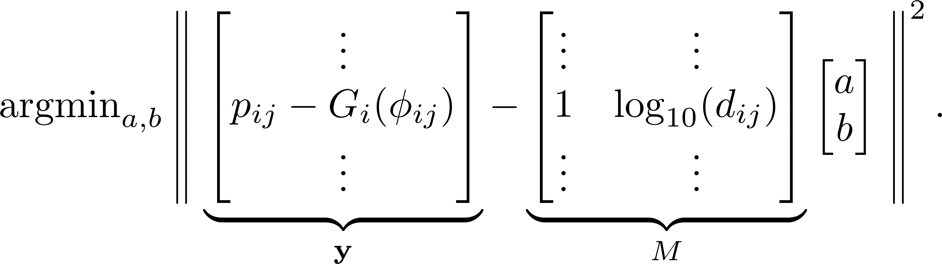
Find Parameter Values
Using least squares method:

Slide 9
System Model
We assume the number and locations of wireless units form a Poisson point process

Slide 10
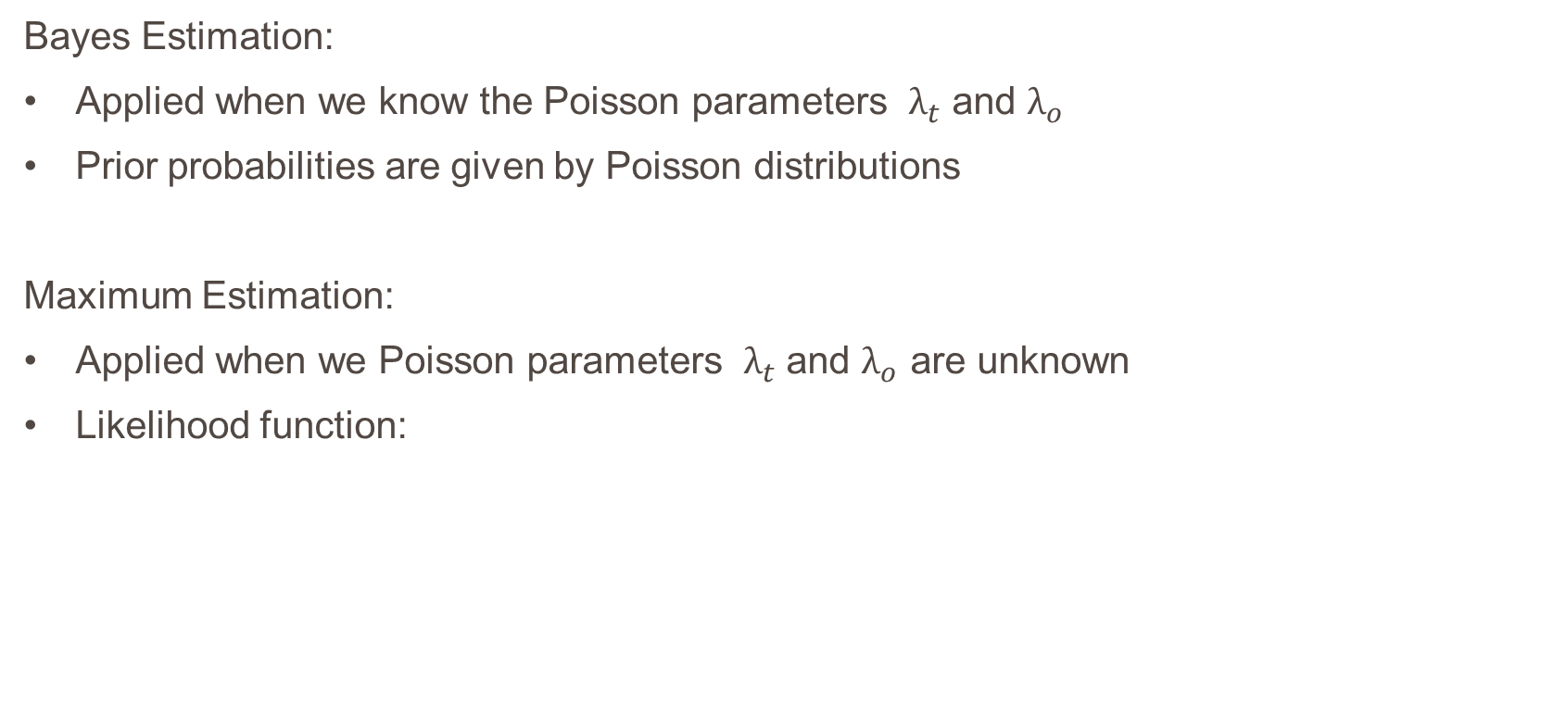
Estimation Scheme
Bayes Estimation:
Applied when we know the Poisson parameters $λ_{t}$ and $λ_{o}$
Prior probabilities are given by Poisson distributions
Maximum Estimation:
Applied when we Poisson parameters $λ_{t}$ and $λ_{o}$ are unknown
Likelihood function:

Slide 11

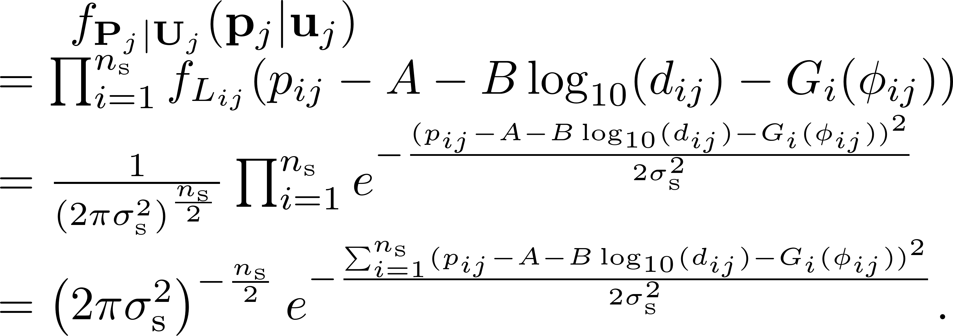

Bayes Estimation
Distribution of
Conditional distribution of $P_{j} given U_{j}$

Slide 12

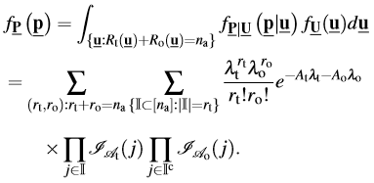
Bayes Estimation
Conditional distribution of given
Marginal distribution of
The integral components

Slide 13
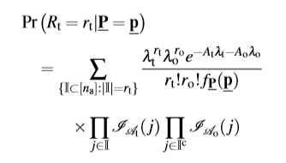
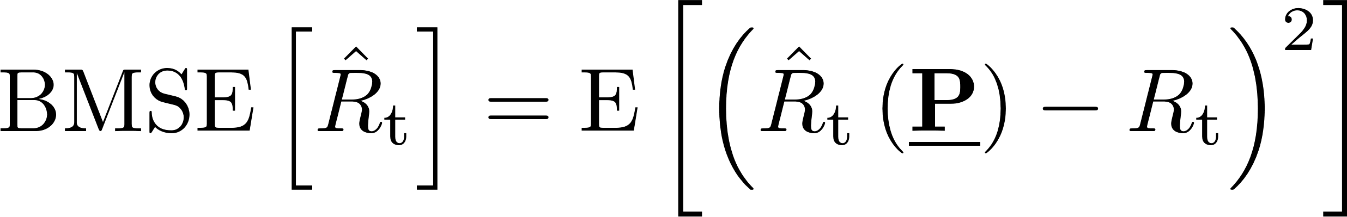

Bayes Estimation
The posterior distribution of $R_{t} given$
Bayes estimator
Performance criterion

Slide 14
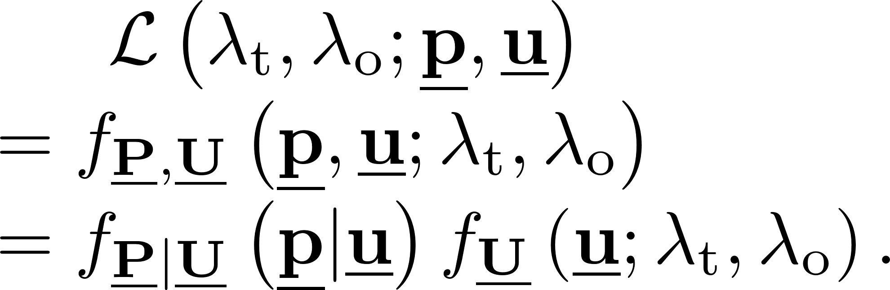
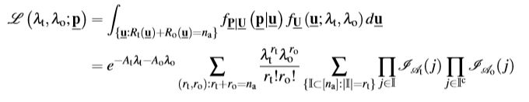
Maximum Likelihood Estimation
Likelihood function
Marginal likelihood function of observed data

Slide 15
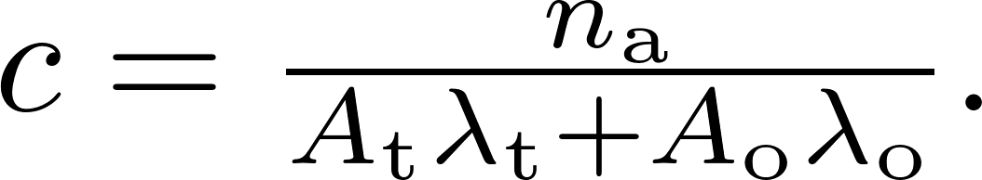
Maximum Likelihood Estimation
Property of likelihood function
Set c

Slide 16
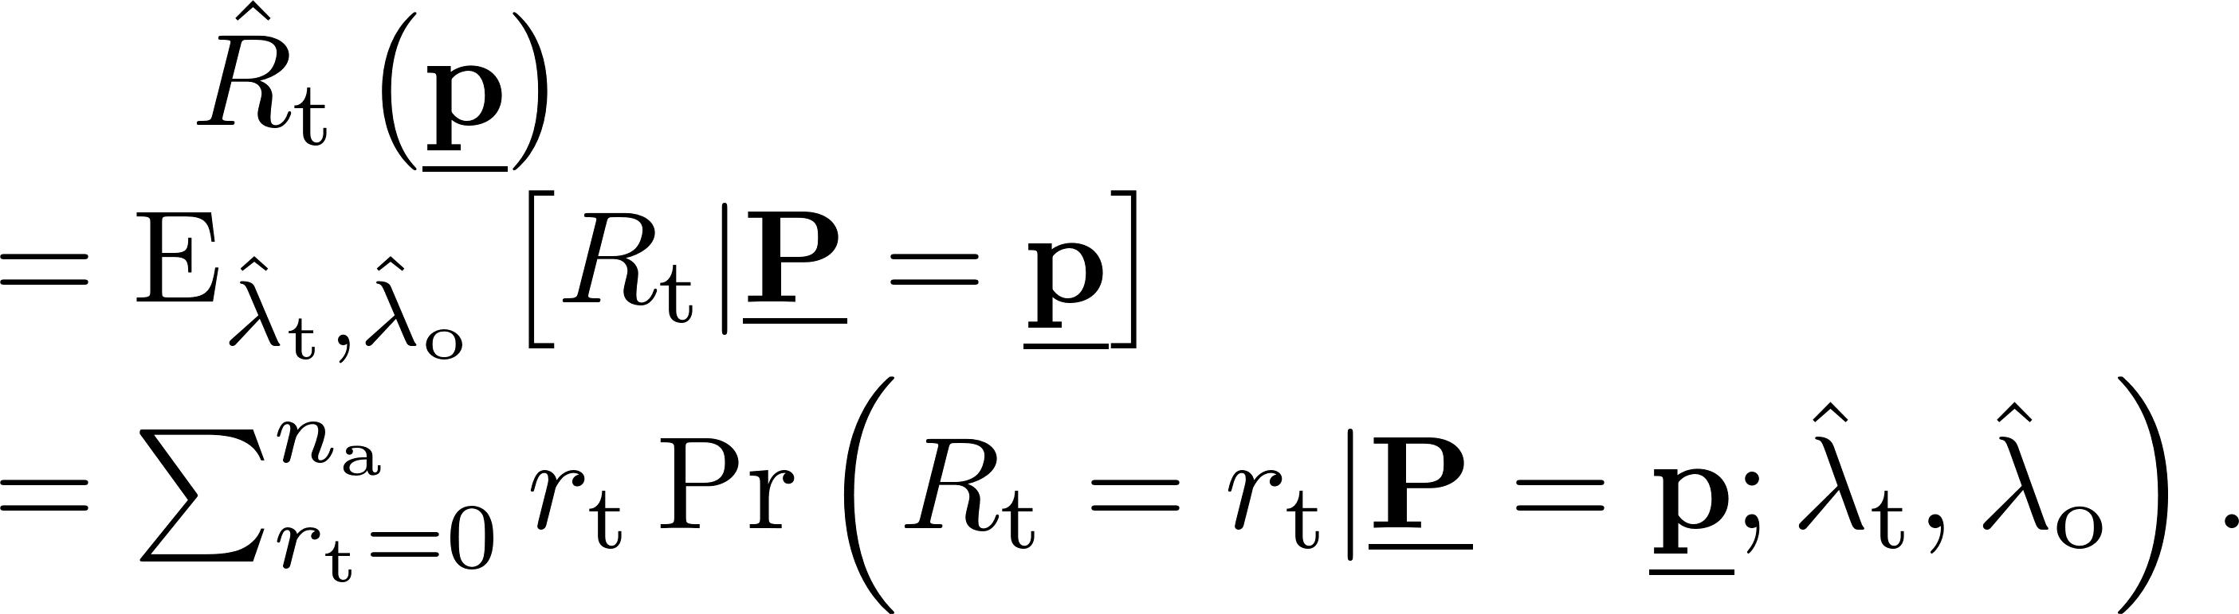
Maximum Likelihood Estimation
Maximum likelihood estimator
Performance criterion

Slide 17
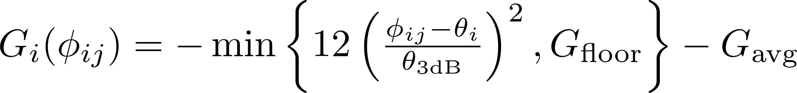
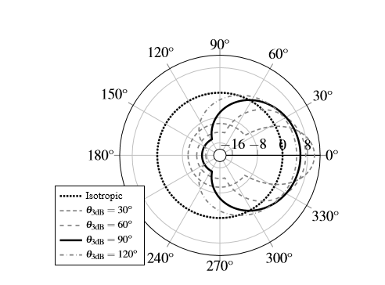
Numerical Simulation
3GPP antenna model

Slide 18
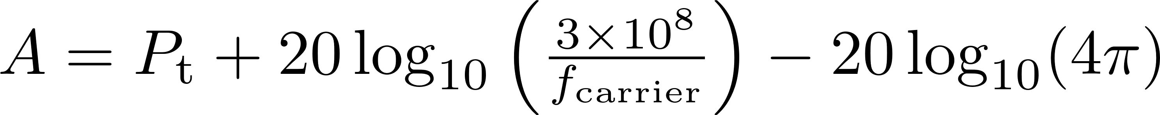

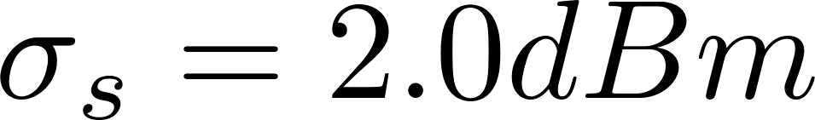
Channel Parameters

Slide 19
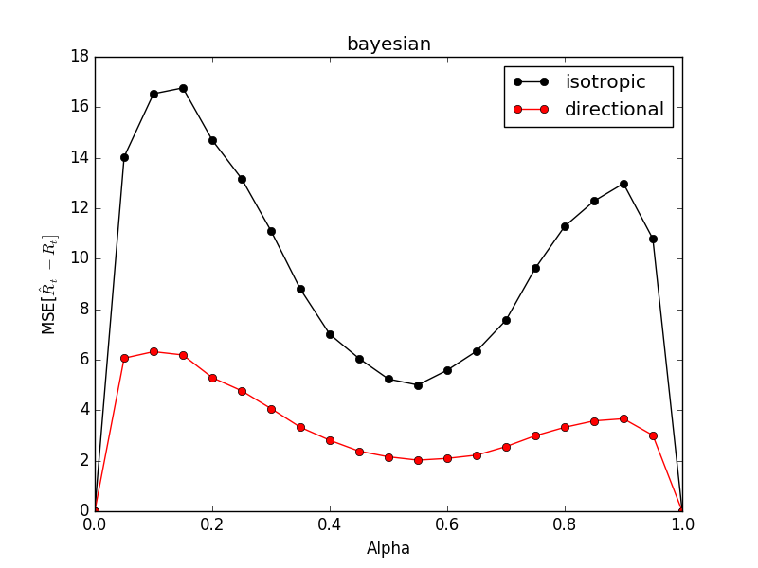
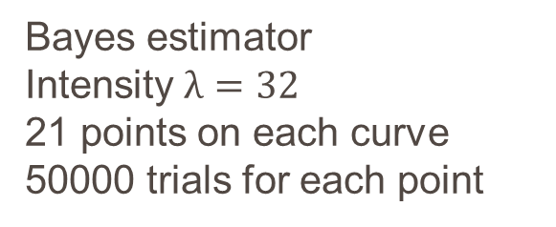
Simulation Results
Bayes estimator
Intensity $λ=32$
21 points on each curve
50000 trials for each point

Slide 20
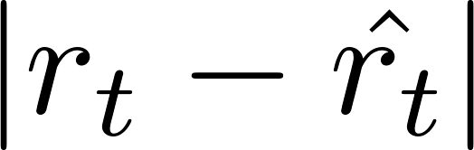

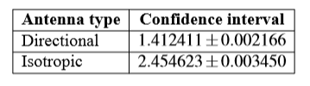
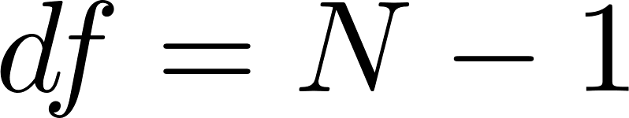
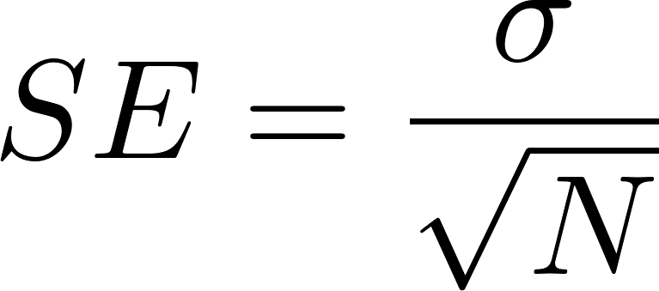
Simulation Results
95% Confidence interval of

Slide 21
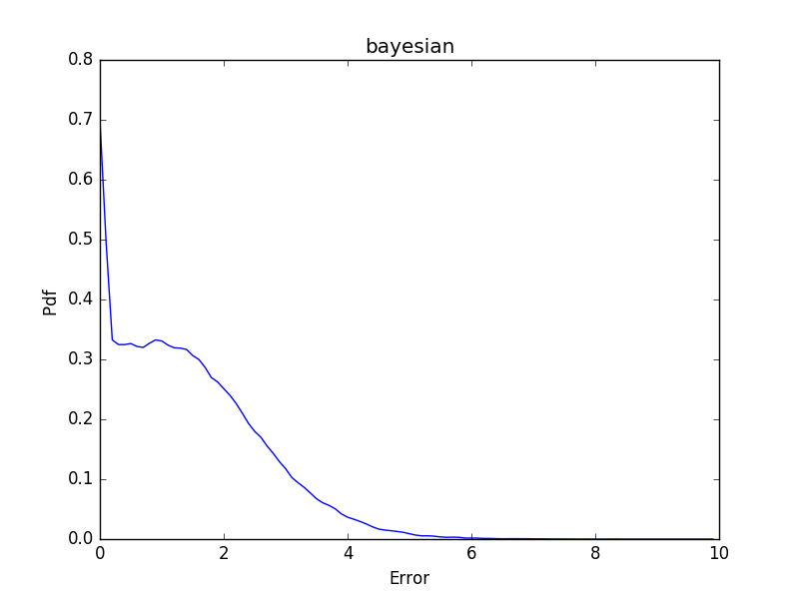
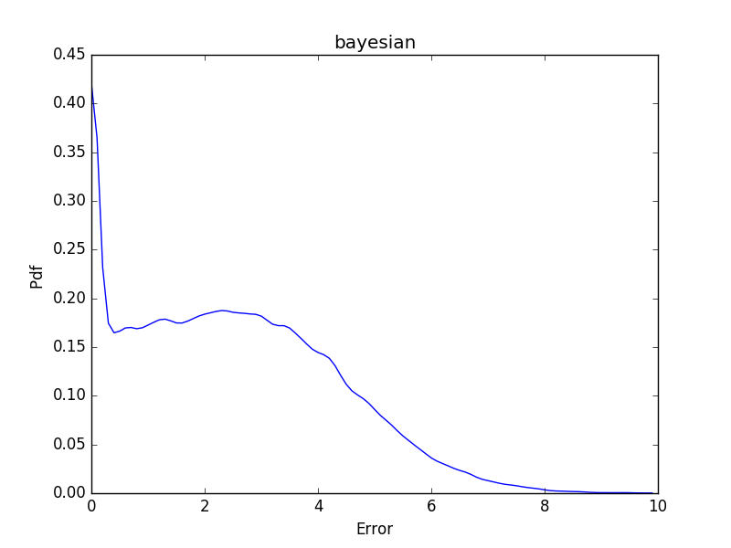
Simulation Results
Pdf of
System with directional antennas
Pdf of
System with isotropic antennas

Slide 22
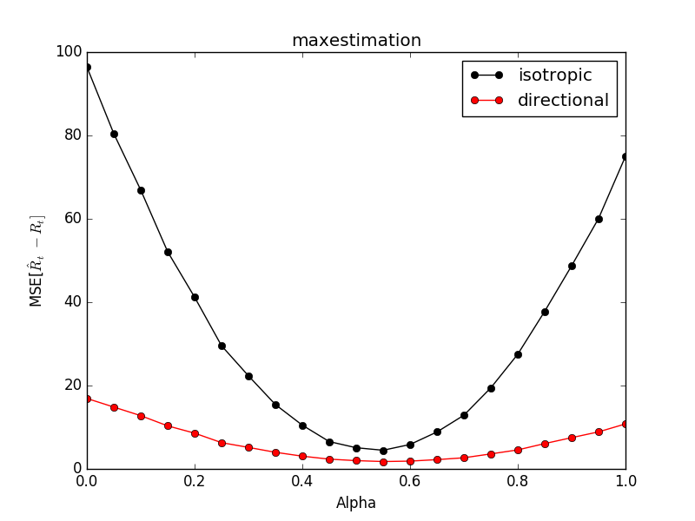

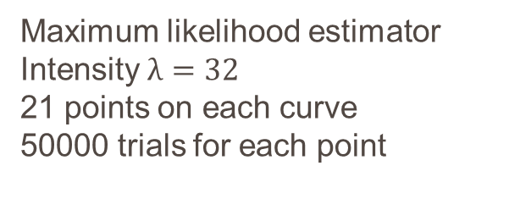
Simulation Results
Maximum likelihood estimator
Intensity $λ=32$
21 points on each curve
50000 trials for each point
95% Confidence interval of

Slide 23
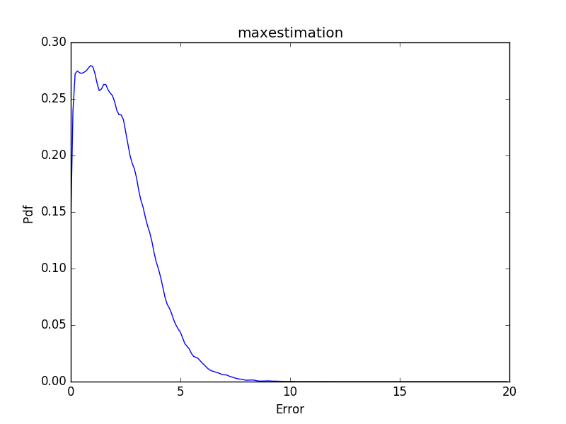
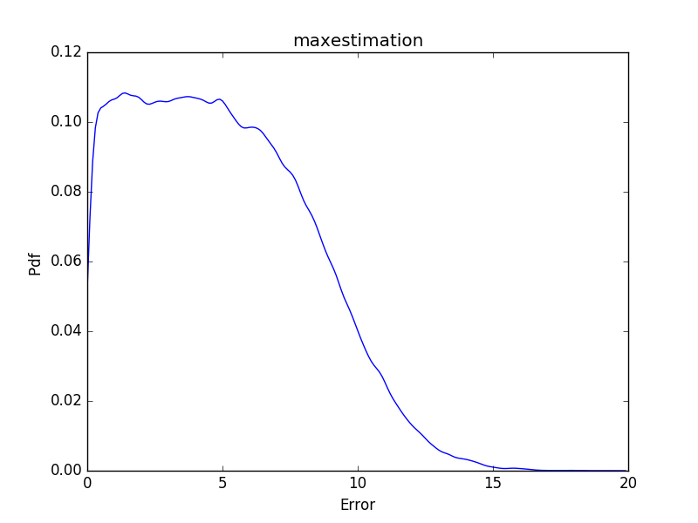
Simulation Results
Pdf of
System with directional antennas
Pdf of
System with isotropic antennas

Slide 24
Simulation results
In both results, BMSE and MSE of directional antennas systems are smaller.
The error is of system with directional antennas distributed more closely to 0.
System with directional antennas perform better.

Slide 25
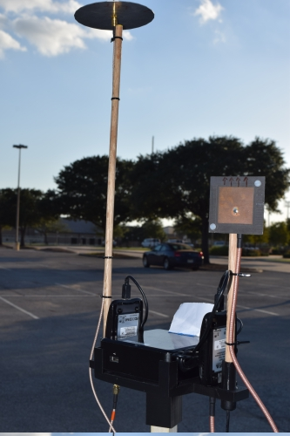
Experimental Implement
Experimental setup consists of three components
Alpha network card AWUS036NHA
Local processing units: Intel Next Unit of Computing
Cloud server
NIC operates in monitor mode to capture Wi-Fi packets
Local processing units parses information: MAC addresses, RSSI values, time stamps
RSSI values are employed as basis for inference

Slide 26
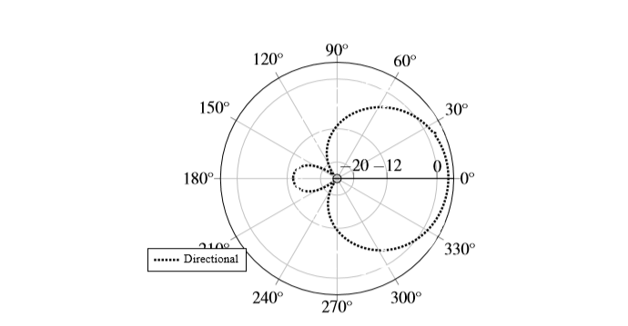
Fig. This graph depicts directional antenna radiation patterns

Slide 27
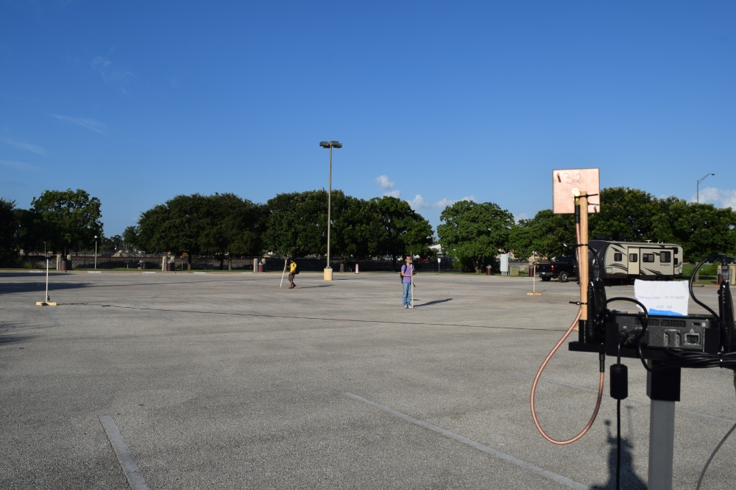
Figure: The place we conduct our experiment

Slide 28
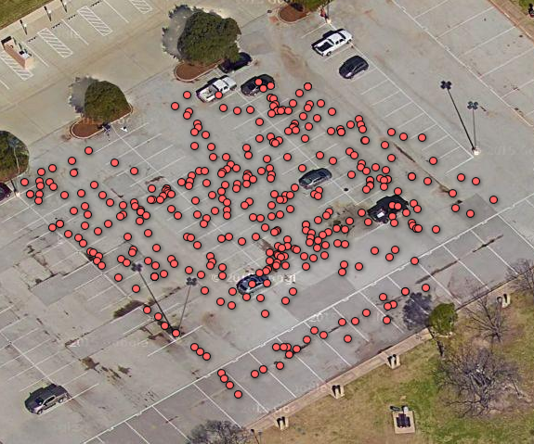
Fig. This figure highlights the site used for the experiments and marks locations of experiment data.

Slide 29
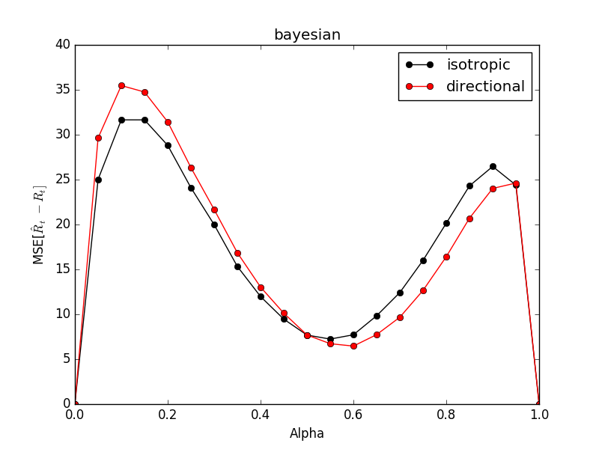

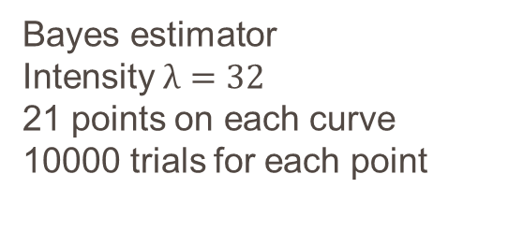
Experiment Results
Bayes estimator
Intensity $λ=32$
21 points on each curve
10000 trials for each point
95% Confidence interval of

Slide 30
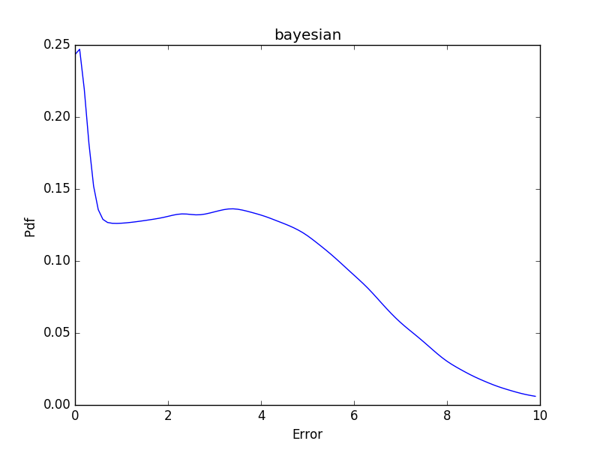
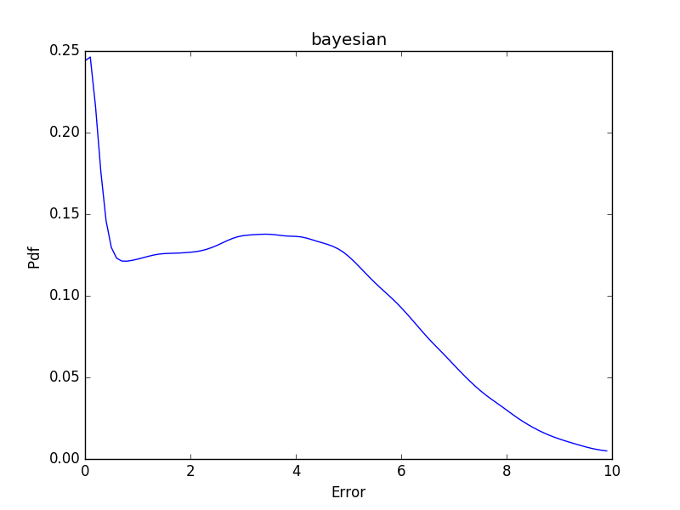

Slide 31
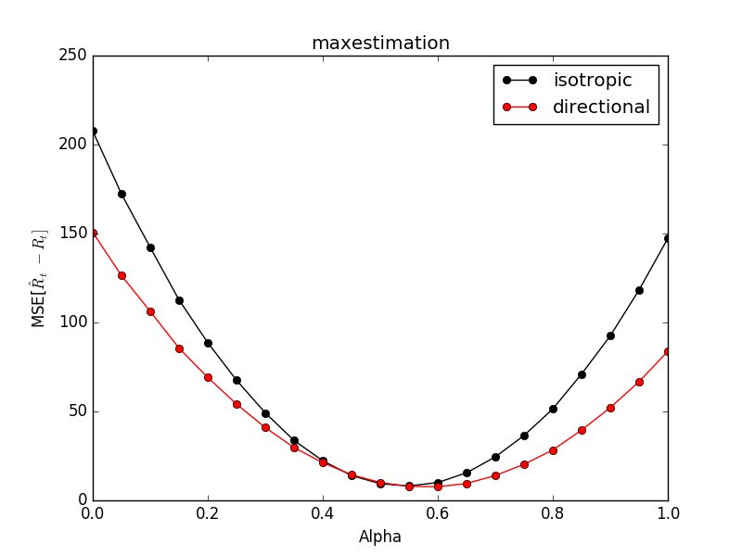
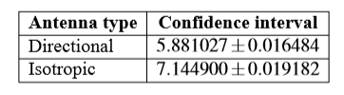
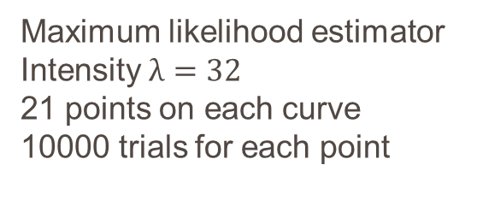
Experiment result
Maximum likelihood estimator
Intensity $λ=32$
21 points on each curve
10000 trials for each point
95% Confidence interval of

Slide 32
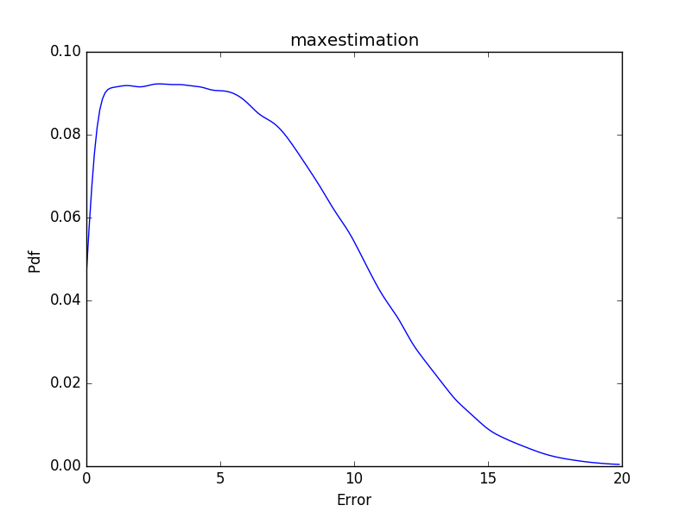
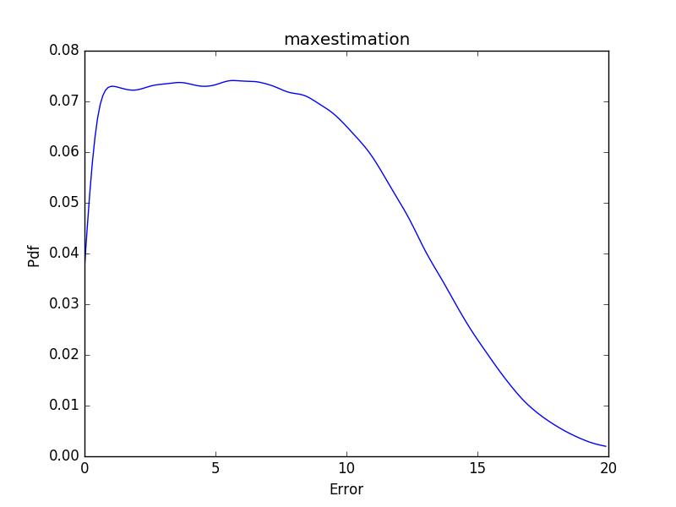
Experiment Results

Slide 33
Conclusion
The directional antenna do improve the performance of estimator accuracy.
This work may extend to be used in track specific device.

Slide 34
Thank You

