Slide 2
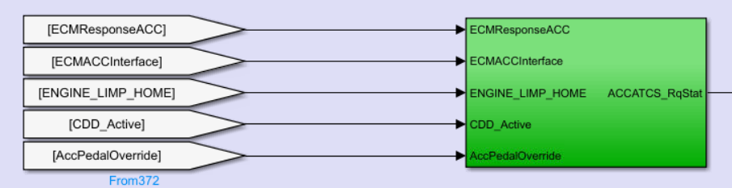
打开链接的库模块
AEB_JASwtReq
FCW_SnvtySet_veh
EPBsts = released/applied/fault
DrvSBR = Driver Seatbelt Attached
TrnsEngdState = Transmission Engaged State
ECMResponseACC =
Adaptive Cruise Control Axle Torque Command Status : Request Status, ACCATCS_RqStat
ECMACCInterface
CIB = collision imminent braking

Slide 3
Transmission Tap Up/Tap Down Mode Status
Manual/Automation
TransTUDMdStat
$0=No Activation; $1=Driver Shift Control Active; $2=Electronic Range Select Active
Brake System Extended Hold Capability Failed
BrkSysExtHldCpbltyFld ESP给的单独的hold失效的状态，也可能反映到ESP fail的状态中
WRS L/R D/ND =
wheel rotation status left/right driven/non driven

Slide 4
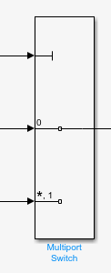
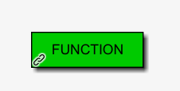
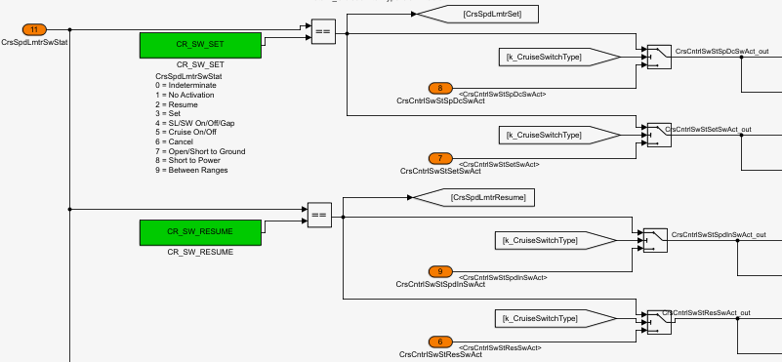
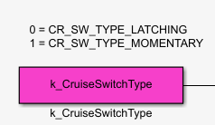
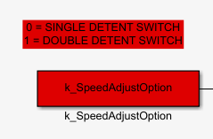
Translator_OUT
H6&F7 VCAN Output
From VCAN、To_VCAN
Host_Speed_kph_CIB
Process_Cruise_Switches

Slide 5
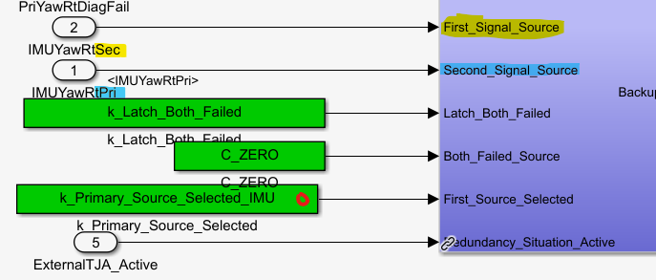
Reduce_Yaw_Rate_Noise

Slide 6
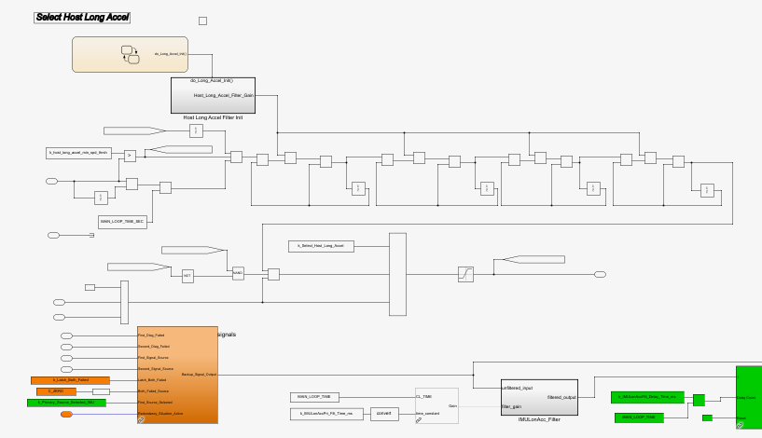
Select Host Long Accel

Slide 7
Low_Speed_Maneuvers ????
Determine Host Heading Angle

Slide 8
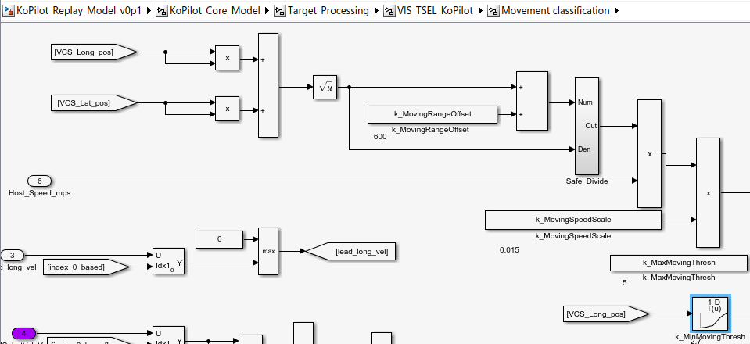
VIS_TSEL_KoPilot
Vision Object Sorting: 意义 (Vector == ID)???
minSel: CIPO=2
计算movable_stationary_threshold
CIP_ME / PCACIPV / PCACIPS
CIPVRU_ME / PCACIPVRU / CIPVRU

Slide 9
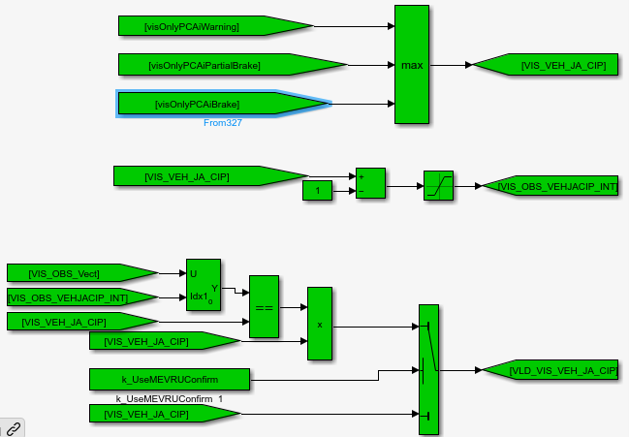
VIS_TSEL_KoPilot
VIS_VEH_JA_CIP
VIS_OBS_CIP_VEHJA_ME
VIS_OBS_CIP_ME
VIS_CurviConv后面再看

Slide 10
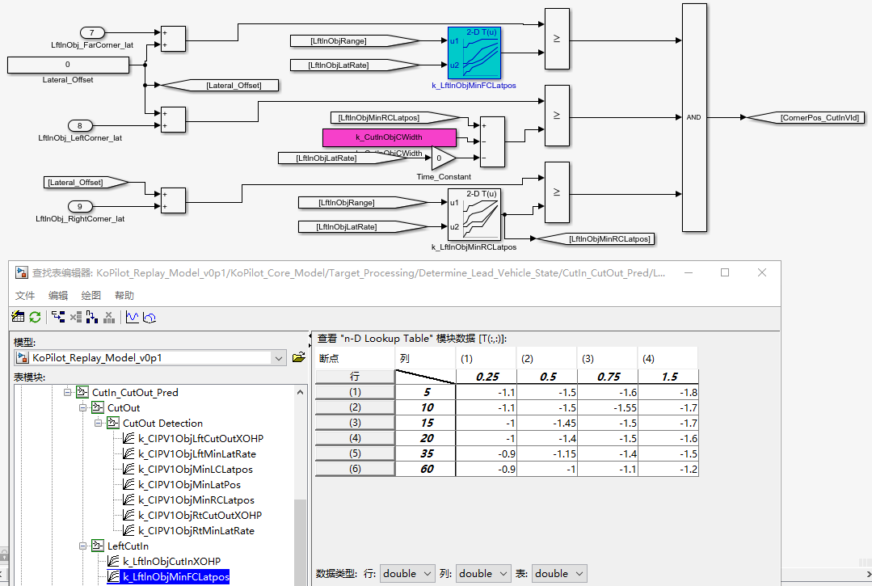
KoPilot_Replay_Model_v0p1/KoPilot_Core_Model/Target_Processing/Determine_Lead_Vehicle_State/CutIn_CutOut_Pred/LeftCutIn
判断cut-in valid
比较corner position和table中的值
Table中的值咋定的？

Slide 11
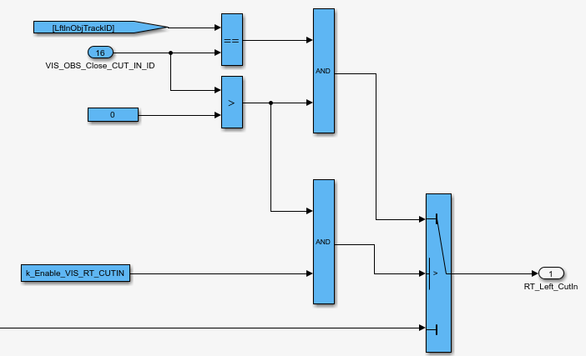
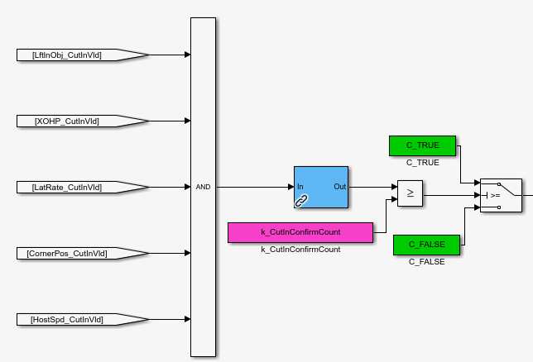
KoPilot_Replay_Model_v0p1/KoPilot_Core_Model/Target_Processing/Determine_Lead_Vehicle_State/CutIn_CutOut_Pred/LeftCutIn
Cut in
VIS_OBS_Close_CUT_IN_ID (Eye)
Radar?
Range<max, CIPVRange …
XOHP
LatRate
CornerPos
HostSpd >= 0.5

Slide 12
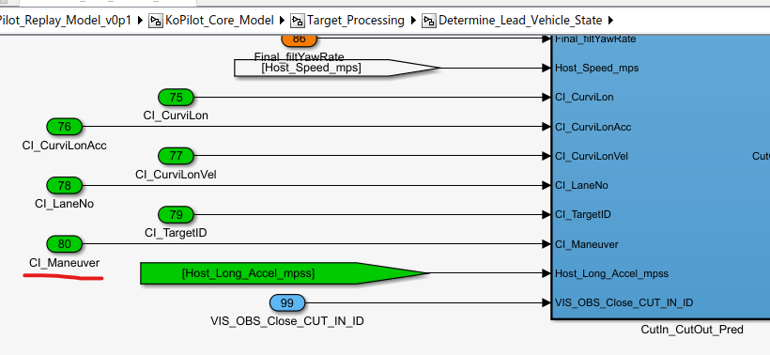
CI_Maneuver等信号没有找到来源

Slide 13
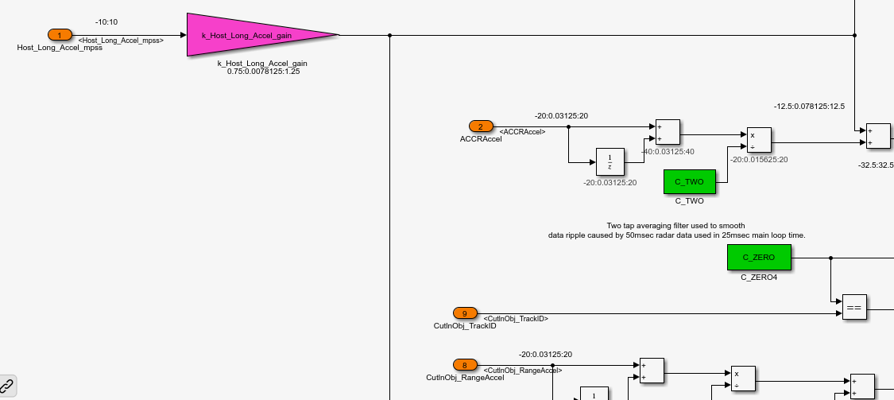
KoPilot_Replay_Model_v0p1/KoPilot_Core_Model/Target_Processing/Determine_Lead_Vehicle_State/ACC_Lead_Vehicle_Acceleration
ACCRAccel, CutInObj_RangeAccel 都是相对加速度吧

Slide 14
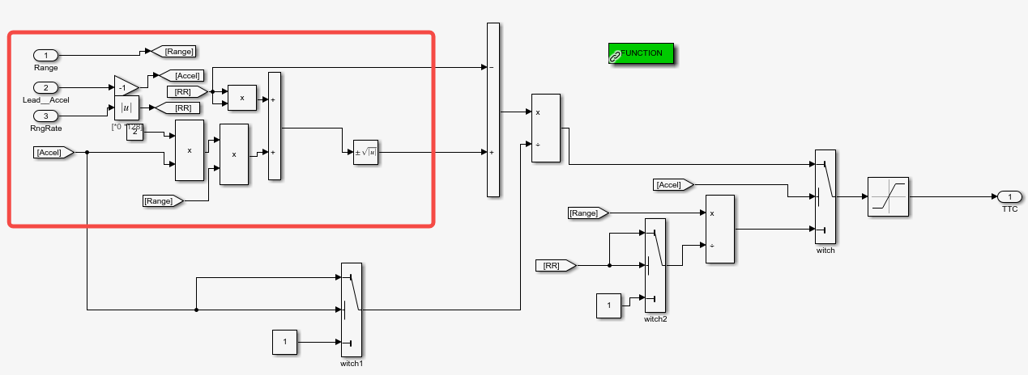
KoPilot_Replay_Model_v0p1/KoPilot_Core_Model/Target_Processing/Determine_Lead_Vehicle_State/Compute_ACC_Time_To_Collision/Calculate_Common_TTC_signed
待理解

Slide 15
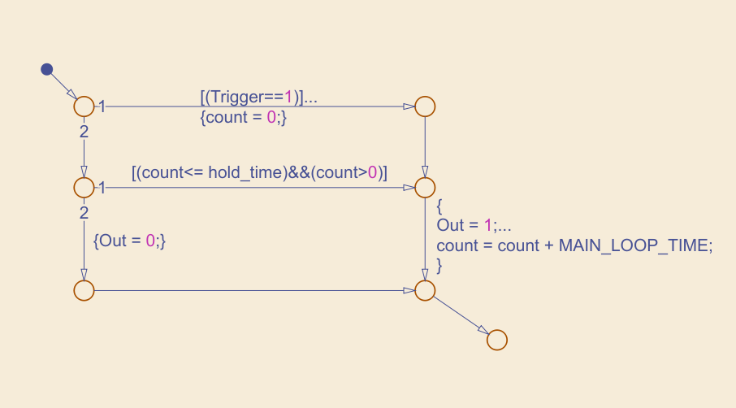

Slide 16
Allowed_Accel(用于最终的PID控制)
desired_accel /*vco_jerk_limiter→Limiter_Core*/
(Limited_desired_speed - allowed_speed_n_1) * k_P_gain(x: Host_Speed)
Or Raw_Accel or MaP_Limited?
Raw_Accel
accel_command
Delta_Speed_Desired(4D table: range, range rate, vehicle speed)

Slide 17
实车问题
弯道降速
稳态速度低于目标速度
加减速不平顺

