Slide 1

MECHENG 590 Presentation
Co-state Neural Network for Realtime Nonlinear Optimal Control with Input Constraints
Presenter: Lihan Lian, Supervisor: Uduak Inyang-Udoh
Nov 21st, 2024

Slide 2

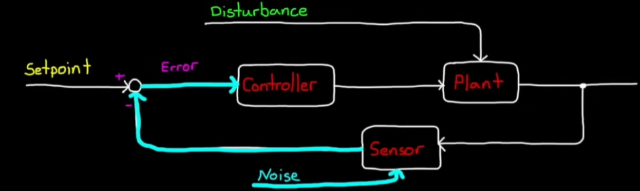
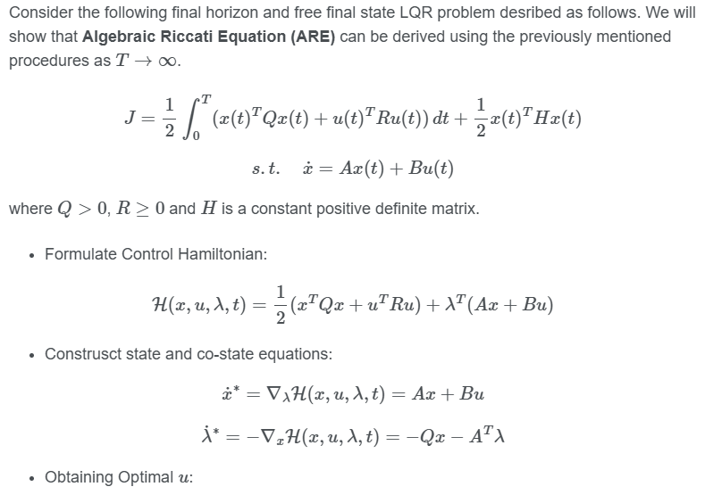
Preliminary
Optimal Feedback Control Approaches:
LQR can be applied by solving ARE, but it does not respect to control input constraints.
MPC suffers from high computational burden for high dimensional and nonlinear systems or constraints.
Pontrygain’s Maximum Principle (PMP)
PMP provides necessary conditions by solving two-point boundary value problems (TPBVPs).
LQR can be viewed as a special case of PMP.
MPC solves finite horizon optimization problem to approximate the solution of the original optimal control problem (OCP) from PMP.
Source: Control Systems in Practice (YouTube) (MATLAB)
Source: From Control Hamiltonian to ARE and PMP (Blog Post)

Slide 3
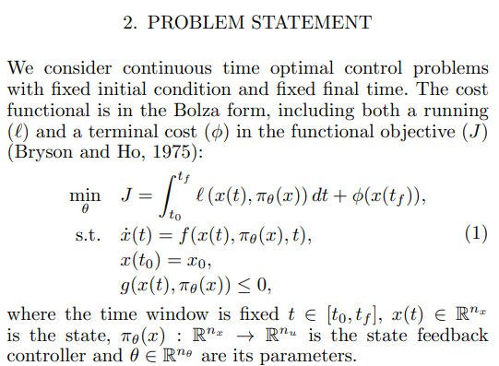
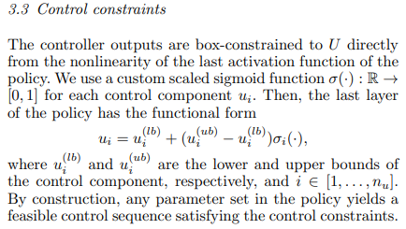
Introduction
Motivation:
MPC does not utilize the fact that patterns from previous solutions may be used to alleviate the computational burden of subsequent solutions.
Indirect method typically cannot be used in real-time.
Related Work
Only for specific initial conditions.
No disturbance in the validation and control policy is applied in a feedforward way.
Difficult for NN training to converge due to the design of satisfying input constraints.
Source: Neural ODEs as Feedback Policies for Nonlinear Optimal Control.

Slide 4
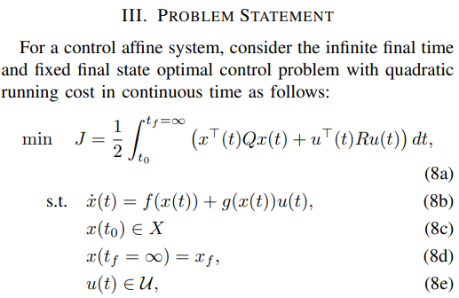
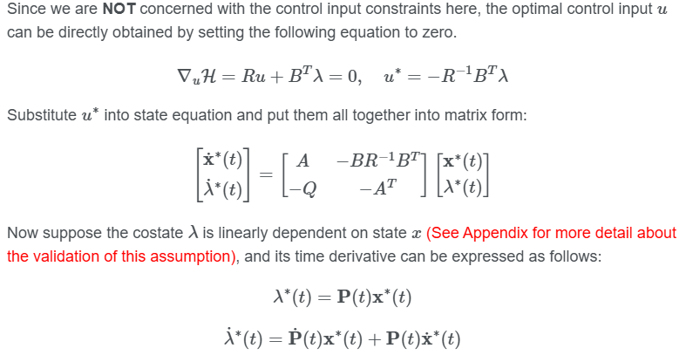
Introduction
Contribution
We present a novel perspective of using neural networks that learns the mapping from an initial state to its corresponding optimal co-state trajectory.
Instead of handling control input constraints directly during the process of training neural network, we propose a framework for handling input constraints by extracting a NN-predicted co-state trajectory and then simply solving a QP.
Realtime feedback validation.
Source: From Control Hamiltonian to ARE and PMP (Blog Post)

Slide 5
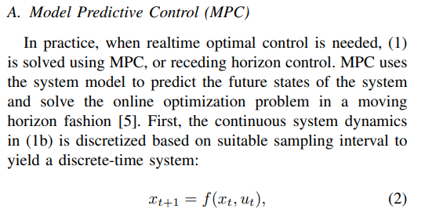
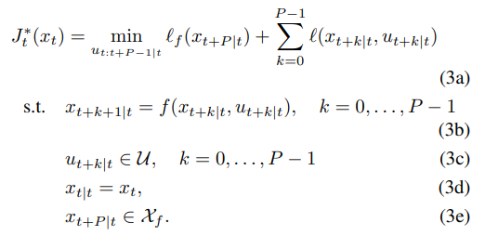
Background
Model Predictive Control
Transcribes OCP into an optimization problem with finite number of decision variables, falls into the paradigm of discretize then optimize.
Solves the similar optimization problem repetitively in a receding horizon fashion.
Normally no guarantee for timely convergence, especially for nonlinear and high-dimensional systems.
In certain cases, explicit-mpc can be used to alleviate the computational burden.

Slide 6
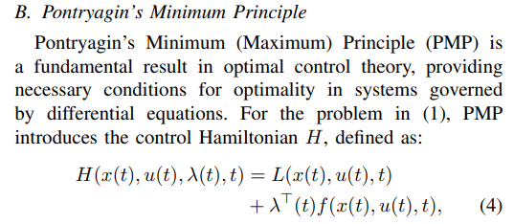
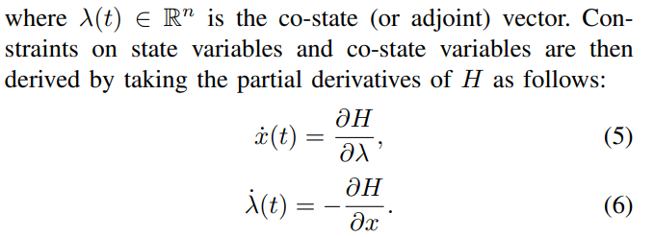
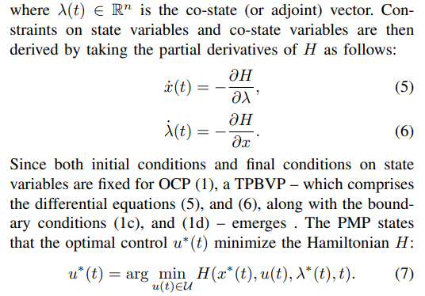
Background
Pontryagin’s Minimum (Maximum) Principle
Can handle input constraints with the use of co-state and control Hamiltonian.
PMP transcribes the OCP to a point-wise optimization to avoid minimizing over a function space.
Belongs to the paradigm of optimize then discretize.

Slide 7
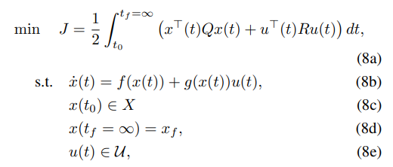
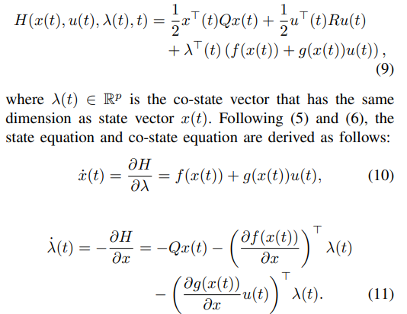
Problem Statement
OCP formulation
Multiple initial conditions, uses numerical solver to compute the optimal solutions off-line, for each initial conditions.
Uses quadratic running cost function and formulates the control Hamiltonian.
The optimal solution obtained from numerical solver is in the unconstrained scenario.
Control input constraint is then imposed by solving an easier QP.

Slide 8
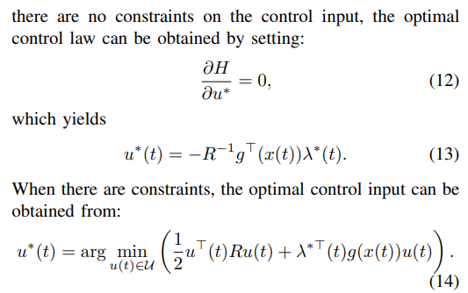
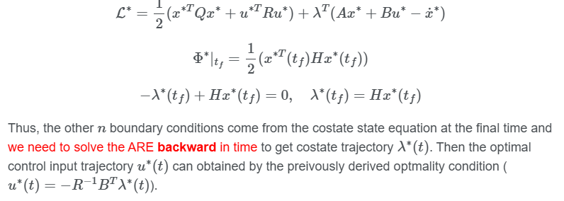
Problem Statement
OCP formulation
Multiple initial conditions, uses numerical solver to compute the optimal solutions off-line, for each initial conditions.
Uses quadratic running cost function and formulates the control Hamiltonian.
The optimal solution obtained from numerical solver is in the unconstrained scenario.
Control input constraint is then imposed by solving an easier QP.
Source: From Control Hamiltonian to ARE and PMP (Blog Post)

Slide 9
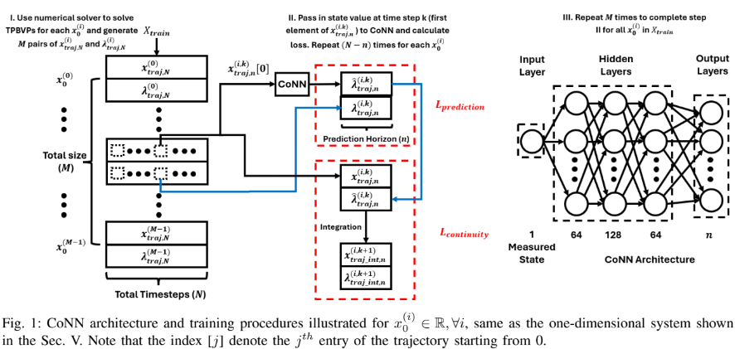
Methodology
Neural Network Architecture
Fully connected linear layers.
Input is state (x), output is a vector with the size of predefined prediction horizon.
Essentially learn a mapping from state to its corresponding optimal co-state trajectory.

Slide 10
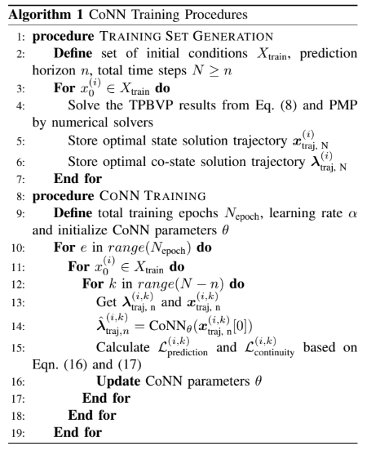

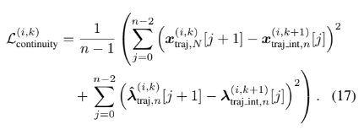
Methodology
Training Procedures
Prediction loss
Continuity loss

Slide 11
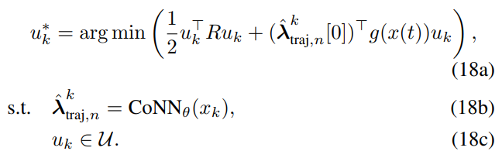
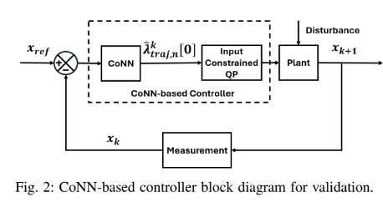
Methodology
Control Input Constraints Handling
Only extract the first element from the predicted optimal co-state trajectory.
Solve a much easier QP to obtain optimal control input that satisfy both constraints and optimality.
CoNN-based Controller Validation
In a real-time feedback control loop manner.
Including disturbance, unseen initial conditions (not in the training data set).

Slide 12
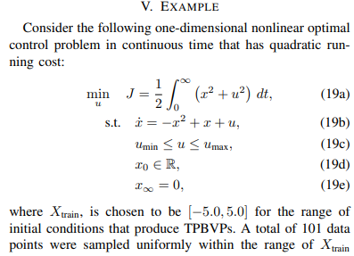
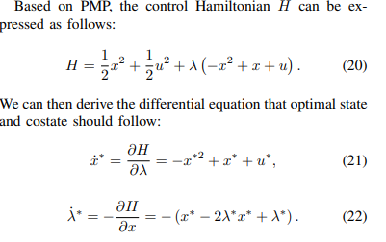
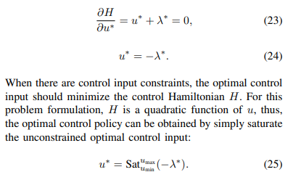
Example
One-Dimensional OCP
Nonlinear, box constraints on control input.
Multiple initial conditions, ranging from [-5, 5] with 0.1 resolution.
Code in Python. Use scipy.solve_bvp function as the numerical solver for TPBVPs.

Slide 13
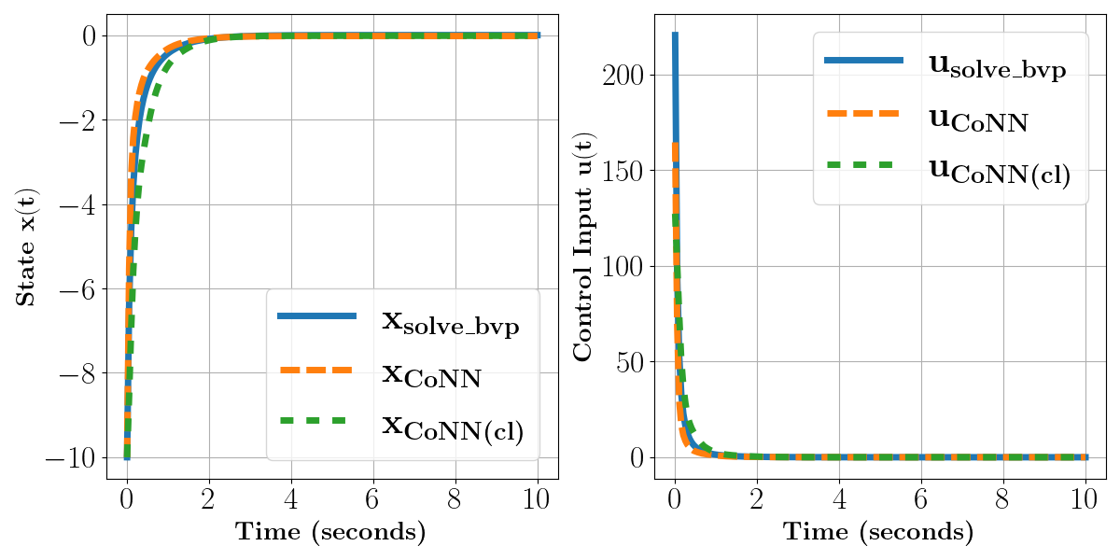
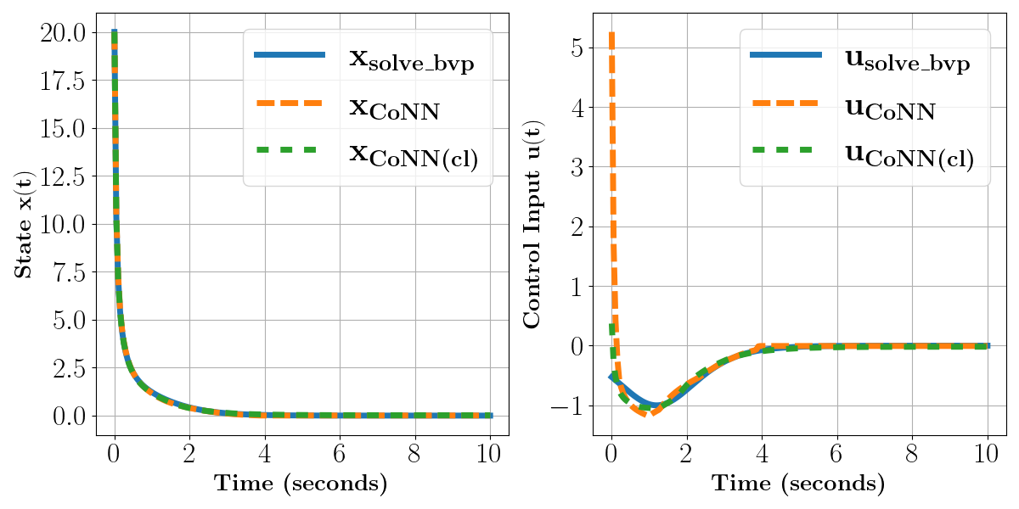
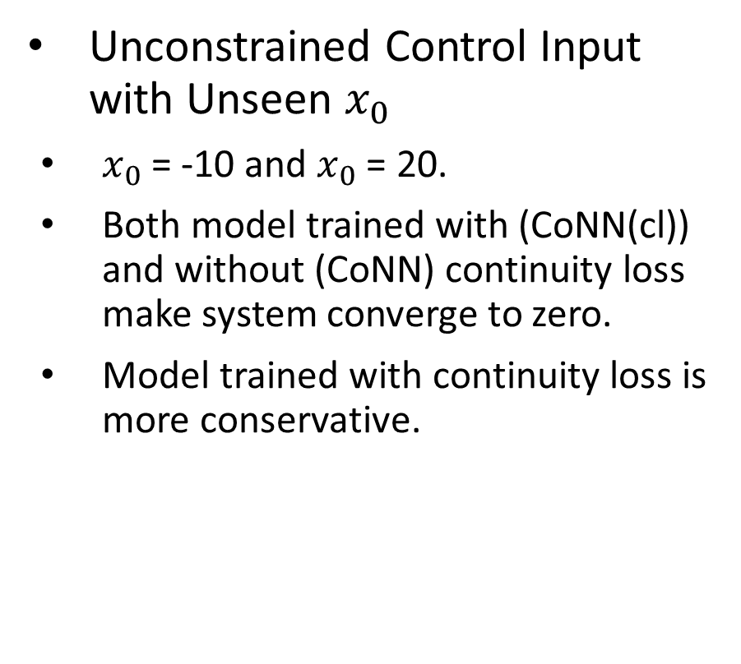
Example
Unconstrained Control Input with Unseen $x_{0}$
$x_{0}$ = -10 and $x_{0}$ = 20.
Both model trained with (CoNN(cl)) and without (CoNN) continuity loss make system converge to zero.
Model trained with continuity loss is more conservative.

Slide 14
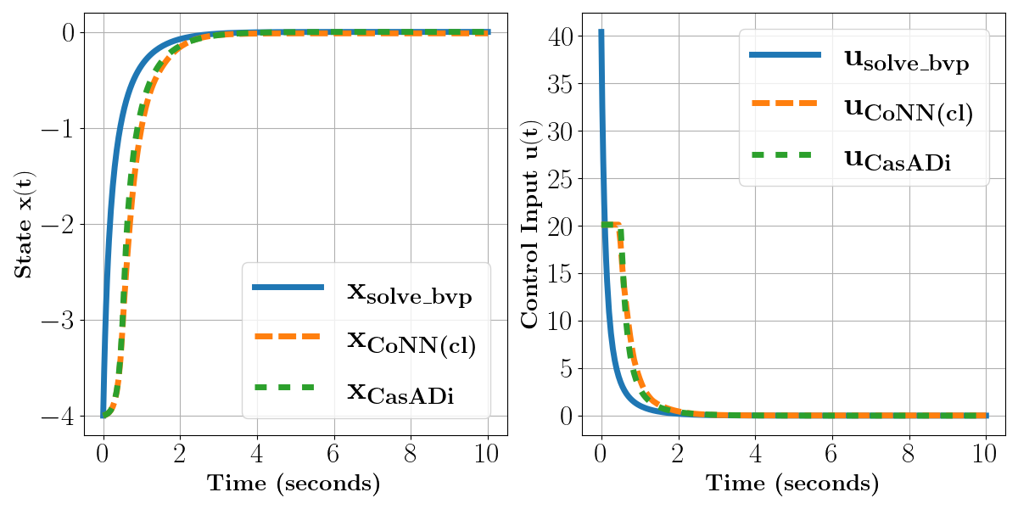
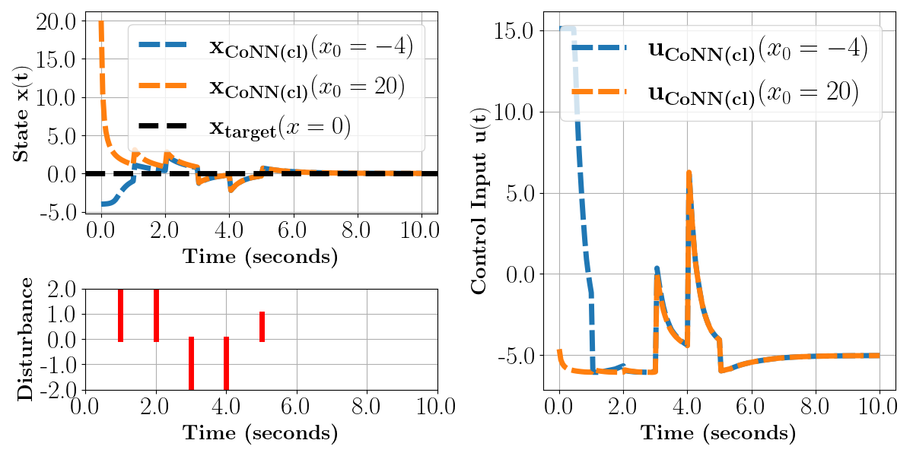
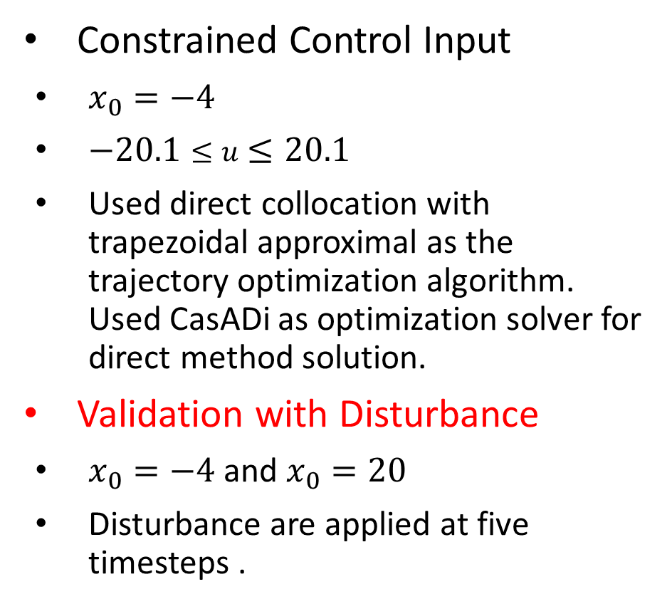
Example
Constrained Control Input
$x_{0}=−4$
$−20.1≤u≤20.1$
Used direct collocation with trapezoidal approximal as the trajectory optimization algorithm. Used CasADi as optimization solver for direct method solution.
Validation with Disturbance
$x_{0}=−4$ and $x_{0}=20$
Disturbance are applied at five timesteps .

Slide 15
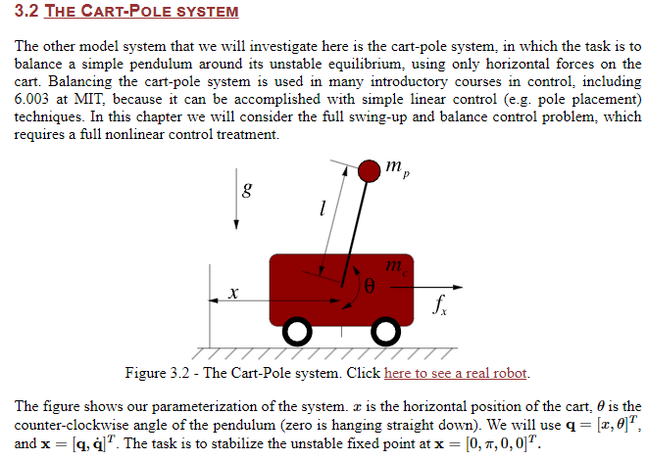
Conclusion
Future Work
Improve the neural network architecture to be better at handling high-dimensional systems.
Integrate state constraints into the design of the loss function.
Provide a comprehensive algorithmic benchmark for MPC and reinforcement learning algorithms, addressing aspects such as sampling efficiency, real-time computational complexity, and performance metrics (e.g., objective cost function).
Source: Underactuated Robotics (Prof. Russ Tedrake)

Slide 16
Thank you! Any questions ?

