Slide 1
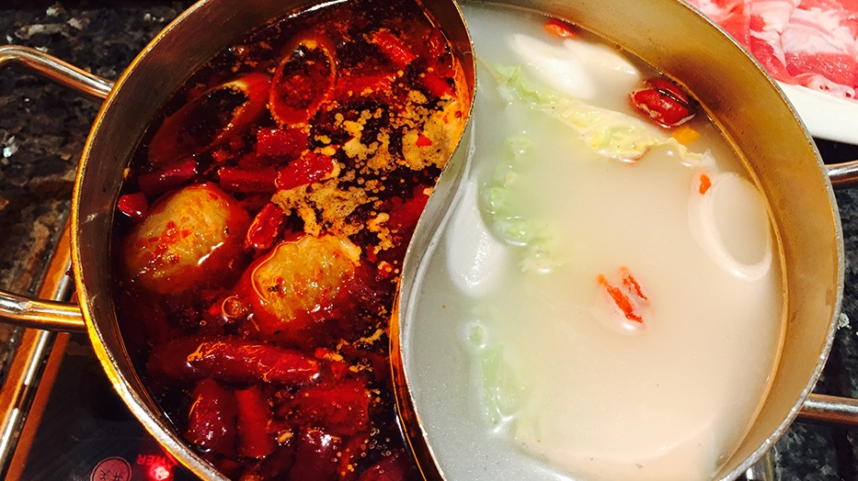

Created by：Jiuqi Wang, Xu Zhao

Slide 2
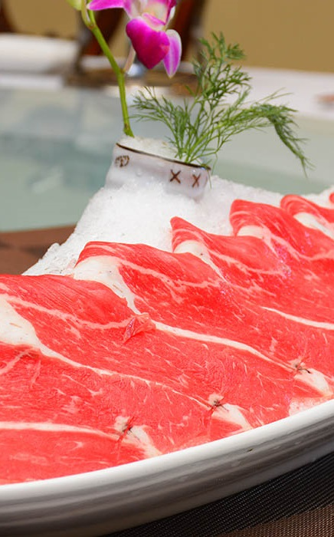
Most Popular
1
Traditional Beijing Hot Pot
2
Chongqing Hotpot

Slide 3
Traditional Beijing Hotpot
01
Origin
Distinguishing feature

Slide 4
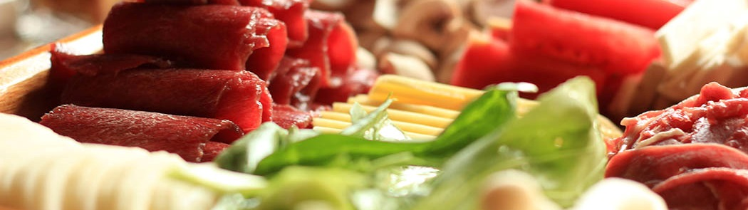
Origin
Yuan Dynasty
Qing Dynasty
Created by Kublai
Spread after Qing Dynasty is founded.
The Boss of Donglaishun stole Hotpot formula from Palace

Slide 5
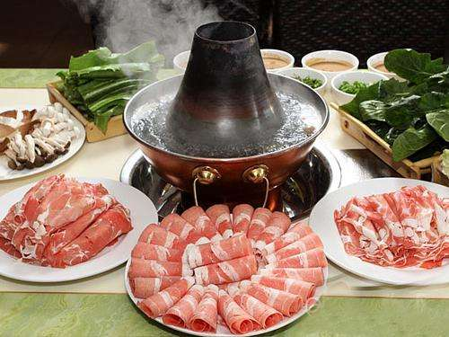
Features
Use the copper Hotpot.
Select Mutton from Inner Mongolia
Hotpot seasoning is clear soup

Slide 6
Chongqing Hotpot
02
Origin
Distinguishing feature

Slide 7
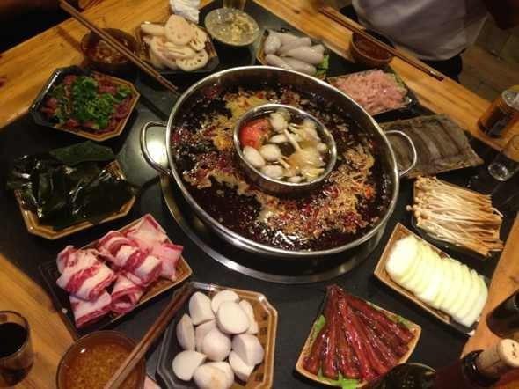
Origin
Originated from folk
Until the Ming and Qing Dynasties, Chonqing hot pot became really popular
Chongqing hot pot restaurants are all over the country now

Slide 8
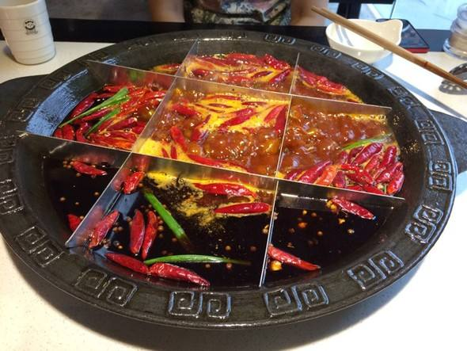
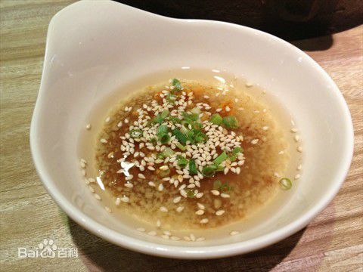
Features
Use the squared Hotpot.
Hotpot seasoning soup is spicy and hot
The ingredients are fresh
Special condiment sauce

Slide 9
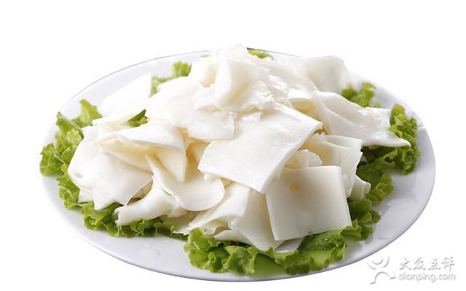
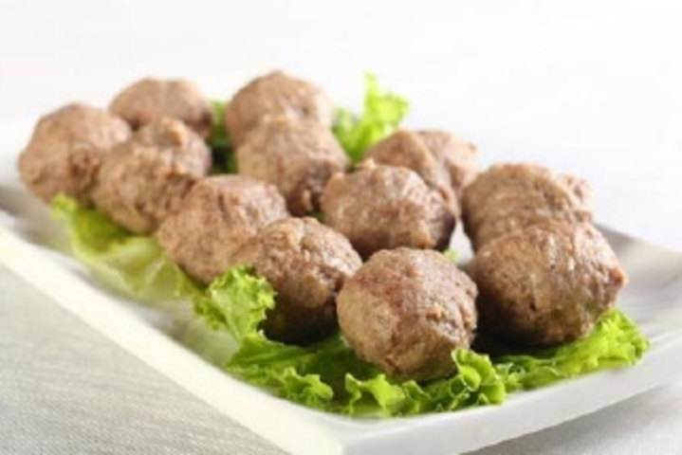
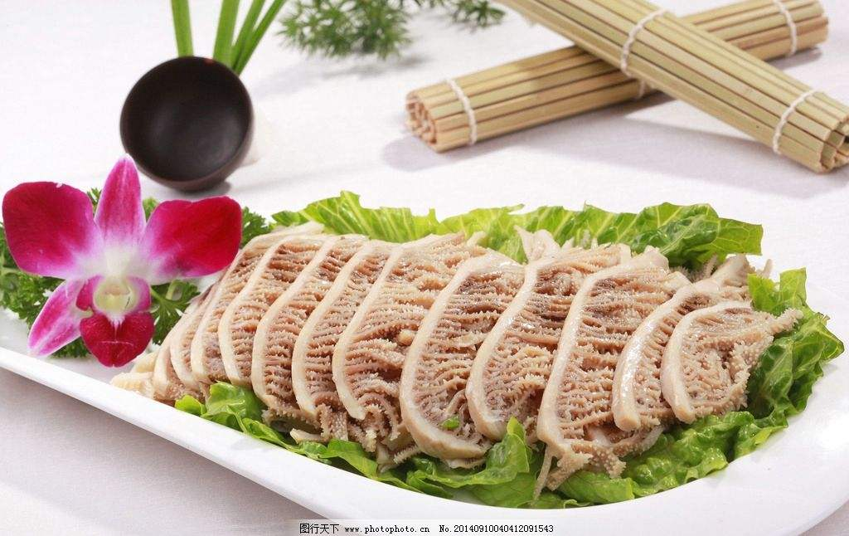
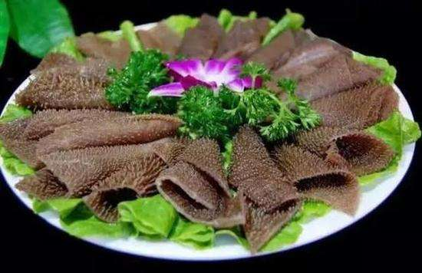
Special ingredients
emberiza elegans
Beef ball
Omasum
beef omasum

Slide 10
03
Recommendation
of Hotpot Resturant in Beijing

Slide 11
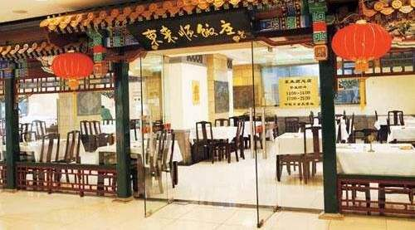
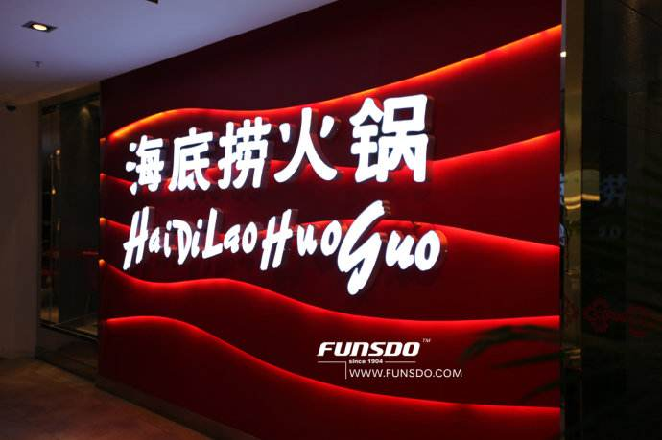
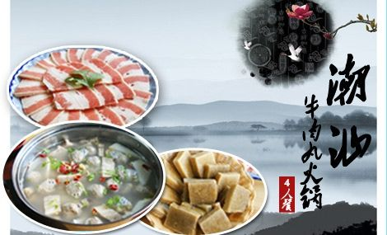
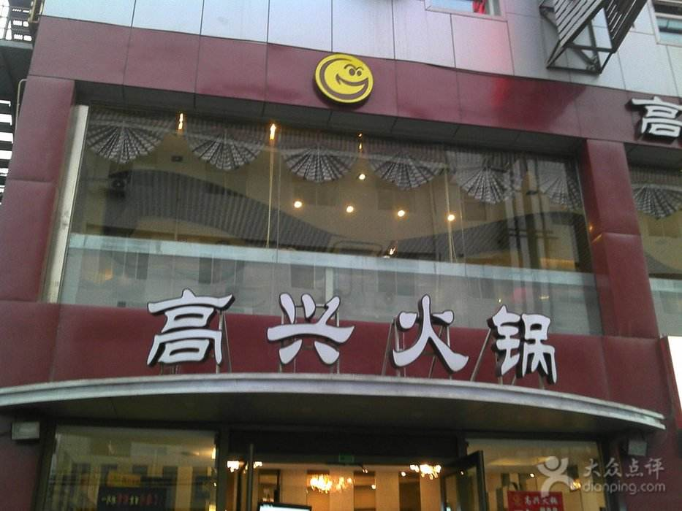
Our Recommendation
Dong Laishun
HaiDiLao
ChaoShan chafing dish
Happy Hotpot

Slide 12
Thanks for listening

