Slide 1
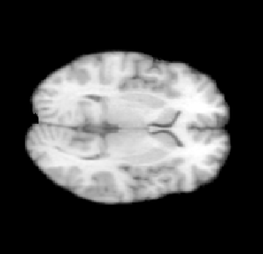
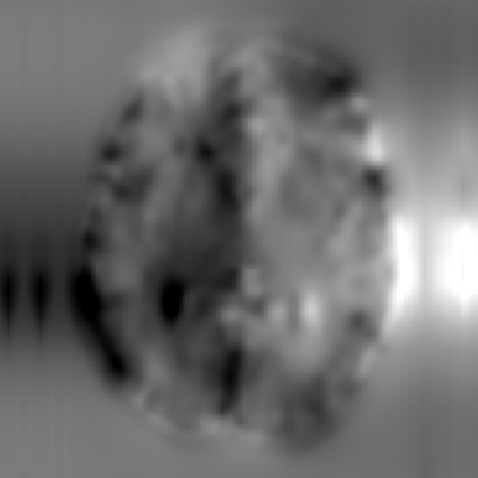
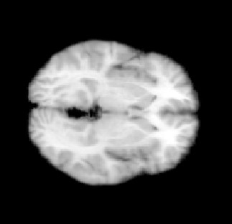
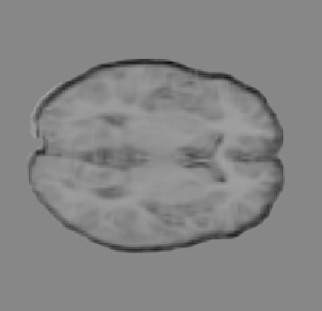
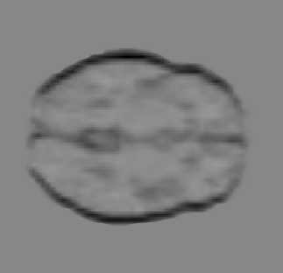
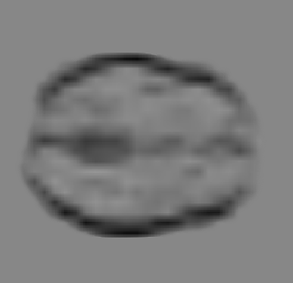
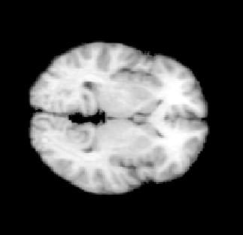












$$F_{x}^{1}$$
$$F_{x}^{2}$$
$$F_{x}^{3}$$
$$F_{x}^{4}$$
latent
variable(z)
registered
image
unaligned
image (x)
Spatial
Transform
Network
Enlarge
Average
reference
image (y)
$$F_{z}^{4}$$
$$F_{z}^{1}$$
$$F_{z}^{2}$$
$$F_{z}^{3}$$
$$F_{y}^{3}$$
$$F_{y}^{4}$$
$$F_{y}^{1}$$
$$F_{y}^{2}$$
four feature-level probabilistic models
Loss(z; x, y)

