Slide 1
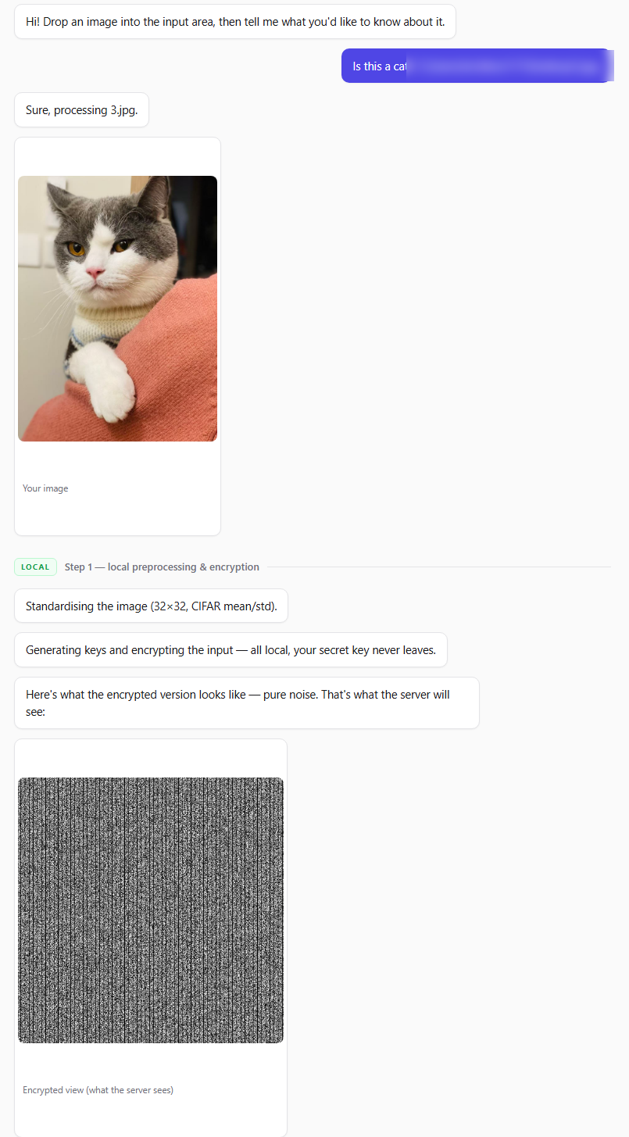
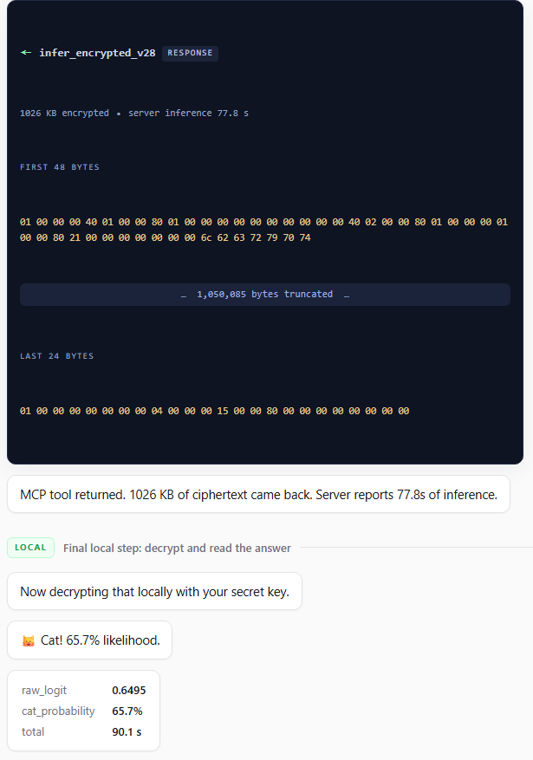


Hackathon: Cat Privacy
• Stack — OpenFHE / CKKS; CNN cat-vs-not-cat on an encrypted 32×32 RGB image; local crypto MCP server (stdio) + remote inference MCP server (HTTP, Docker-deployable) + chat web UI.
• Homomorphic inference: 77.8 s server-side (9-thread CPU).
• End-to-end: 90.1 s (preprocess, encrypt, upload, infer, decrypt).
• Payloads — encrypted input ≈ 192 MB; encrypted output logit ≈ 1 MB.
• Keys — evaluation keys ≈ 1.8 GB, provisioned once, cached via Key Reference.
• This run — “cat”, probability 65.7%.
Scan → the repo
Scan → the draft
Try your own cat on the link: 🐱

