Slide 1
Machine Learning
Learning to teach machines to learn
Nikhil Verma | lih.verma@gmail.com
A recent learner attended ACM | IIT Madras Summer School on Data Science

Slide 2
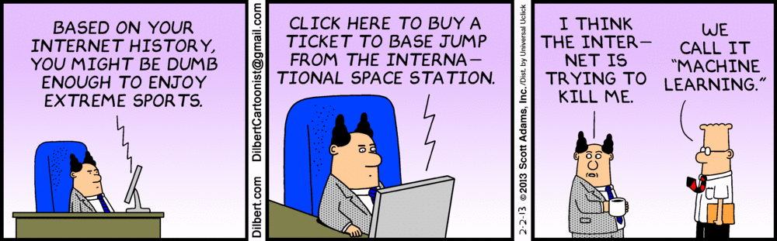
Machine learning

Slide 3
Definition
A computer program is said to learn from
Experience(E), with respect to some
Task(T) & some
Performance measure(P)
if its performance on T, as measured by P improves with experience E
… Tom Mitchell

Slide 4
Definition cont…
Machine learning investigates how computers can learn (or improve their performance) based on data. A main research area is for computer programs to automatically learn to recognize complex patterns and make intelligent decisions based on data.

Slide 5
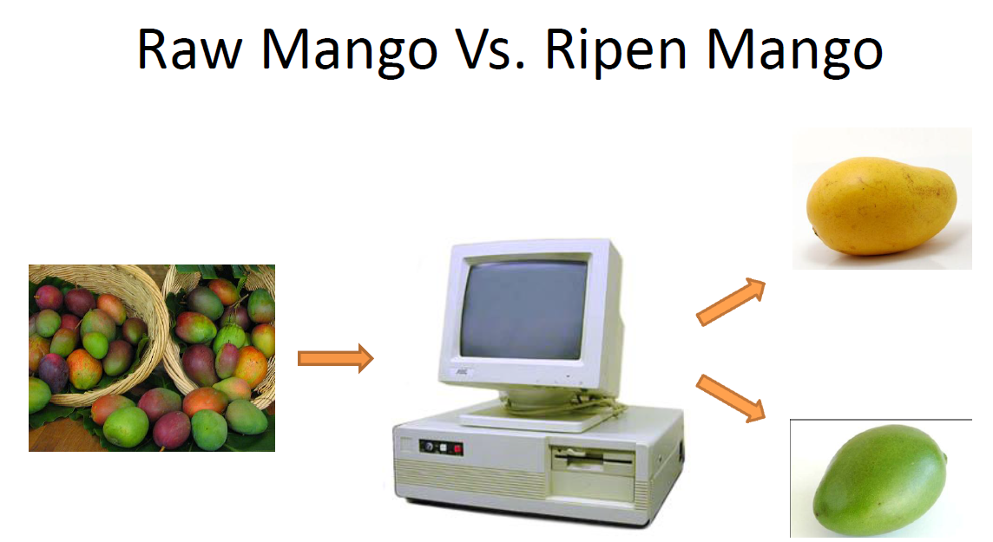

Slide 6

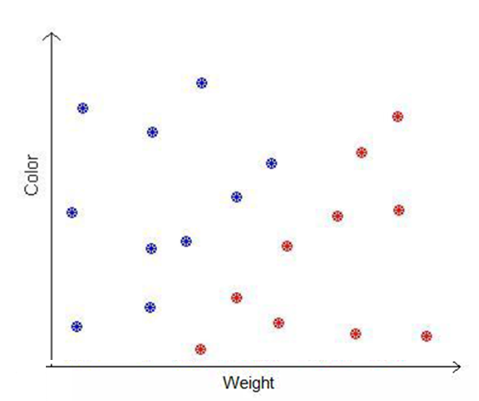
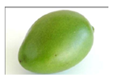
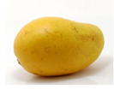

Slide 7
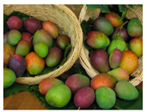
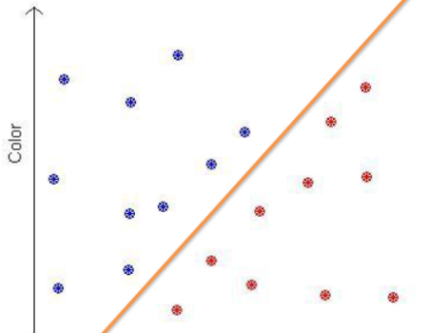
RAW DATASET
Color | Weight | Label
[255-140-10] | 300 | Raw
[10-240-10] | 330 | Ripen
[12-235-8] | 310 | Ripen
[250-130-10] | 307 | Raw
[80-220-20] | 333 | Ripen
FEATURES/LABELS
LEARNING ALGORITHM
MODEL
TEST INSTANCE
FEATURES
MODEL
PREDICTION
Color | Weight
[14-220-10] | 313
Raw !

Slide 8
Type of learning
Supervised
Unsupervised
Labels of the data tuples are known
Ex: Classification
Regression
Labels of data tuples are unknown
Ex: Clustering

Slide 9






Slide 10
Classification
Classification is a form of data analysis that extracts models describing important data classes. Such models, called classifiers, predict categorical (discrete, unordered) class labels.
Classification is the process of finding a model (or function) that describes and distinguishes data classes or concepts. The model are derived based on the analysis of a set of training data (i.e., data objects for which the class labels are known). The model is used to predict the class label of objects for which the class label is unknown.
Ex: we can build a classification model to categorize bank loan applications as either
safe or risky.

Slide 11
Regression
Whereas classification predicts categorical (discrete, unordered) labels, regression models continuous-valued functions. That is, regression is used to predict missing or unavailable numerical data values rather than (discrete) class labels. The term prediction refers to both numeric prediction and class label prediction. Regression analysis is a statistical methodology that is most often used for numeric prediction.
Ex: Suppose that the marketing manager wants to predict how much a given customer will spend during a sale at Amazon

Slide 12
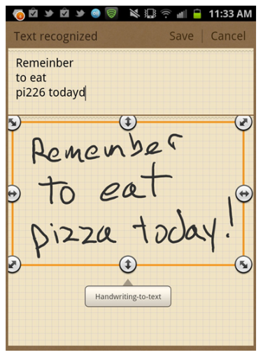


Check out with examples

Slide 13
Some Mathematics and Models

Slide 14
Generalized approach
Data: X{x1, x2, x3,…..,xN } & y{Label if known}
Model: Our approximation of the relation between x and y
Parameter: as weights, regularization, constants etc.
Learning algorithm: How to proceed
Objective/Loss/Error function: how to measure the quality

Slide 15
Data
x1
X =
xm
f1
f2
fn
y1
y2
Y=
ym

Slide 16
Type of Modelling
Discriminative model
Model P(label/feature) i.e., P(y/x) directly
Generative model
Model P(label, feature) i.e, P(x,y)
via P(feature/label) i.e., P(x/y) and P(label) i.e., P(y)

Slide 17
Classification

Slide 18


Binary classification
Input features
Output label

Slide 19
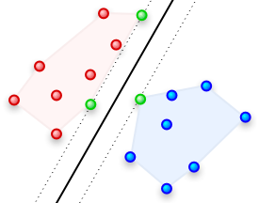
Support vector machine

Slide 20
SVM cont…
It uses a nonlinear mapping to transform the original training data into a higher dimension. Within this new dimension, it searches for the linear optimal separating hyperplane (i.e., a “decision boundary” separating the tuples of one class from another). With an appropriate nonlinear mapping to a sufficiently high dimension, data from two classes can always be separated by a hyperplane. The SVM finds this hyperplane using support vectors (“essential” training tuples) and margins (defined by the support vectors).

Slide 21
SVM cont…

Slide 22
SVM cont…
Classification Rule : The classfication rule induced by a hyperplane is
g(x) = sgn(w’x + b)
Learning: Given D, we need to find out w and b(bias) to define optimal separating hyperplane
h(x) = w’x + b

Slide 23
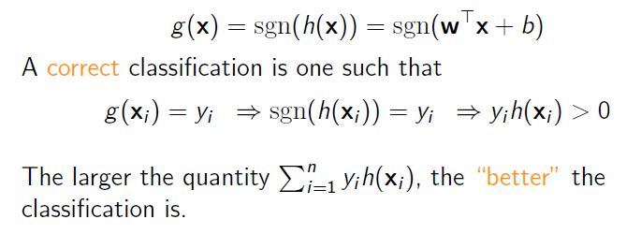
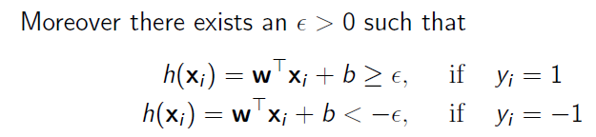
SVM cont…

Slide 24
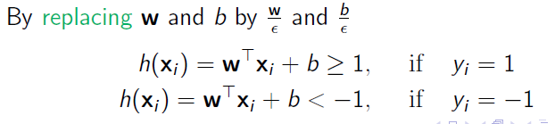
SVM cont…

Slide 25
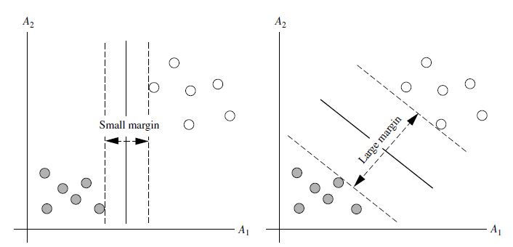
SVM cont…

Slide 26
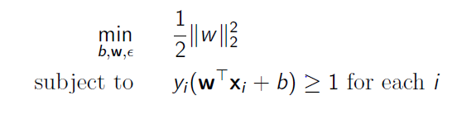
Maximum margin hyperplane

Slide 27
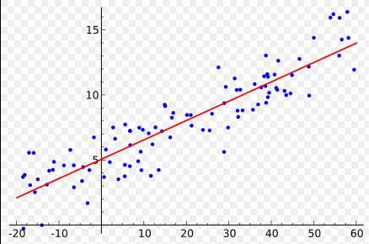
Regression

Slide 28



Linear Regression
Feature space –
Label space –
Goal
Performance measure
Dataset:
Performance on dataset:

Slide 29


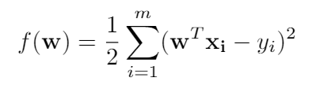
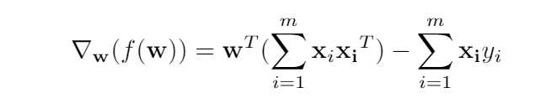
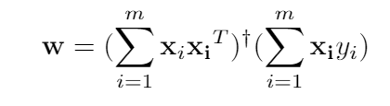
Linear Regression

Slide 30
Geometric View
Y =
Best Orthogonal Projection of label vector onto the subspace spanned by rows of X
W’X

Slide 31
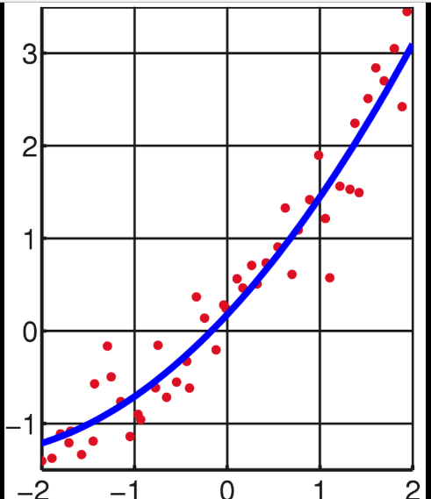
What if to Fit a non linear curve !

Slide 32


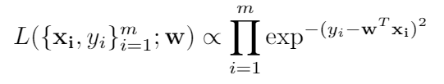
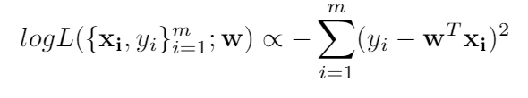
Maximizing likelihood View of Linear regression
Maximizing this log likelihood is equivalent to minimizing least squares loss!

Slide 33

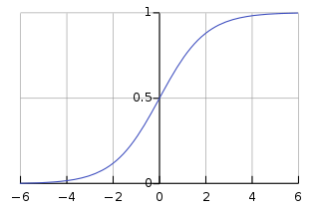


Logistic
Prediction
If z > 0.5, predict 1, else 0

Slide 34
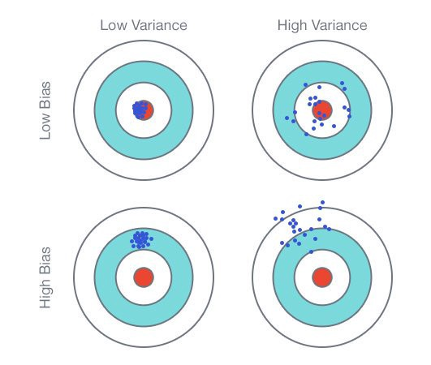
Bias-variance trade off

Slide 35
Underfitting vs Overfitting

Slide 36
Feature selection
Machine learning works on a simple rule – if you put garbage in, you will only get garbage to come out. By garbage here, we mean noise in data.
This becomes even more important when the number of features are very large. You need not use every feature at your disposal for creating an algorithm/model.

Slide 37
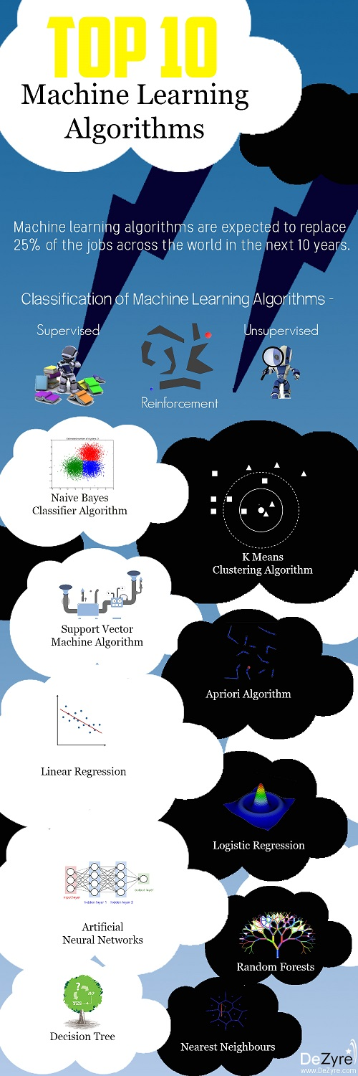

Slide 38
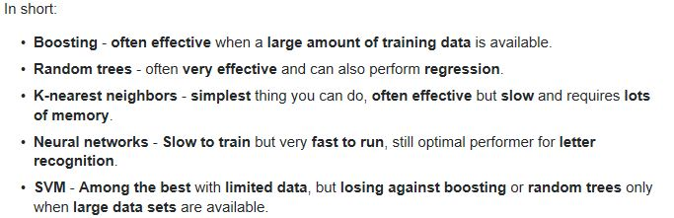

Slide 39
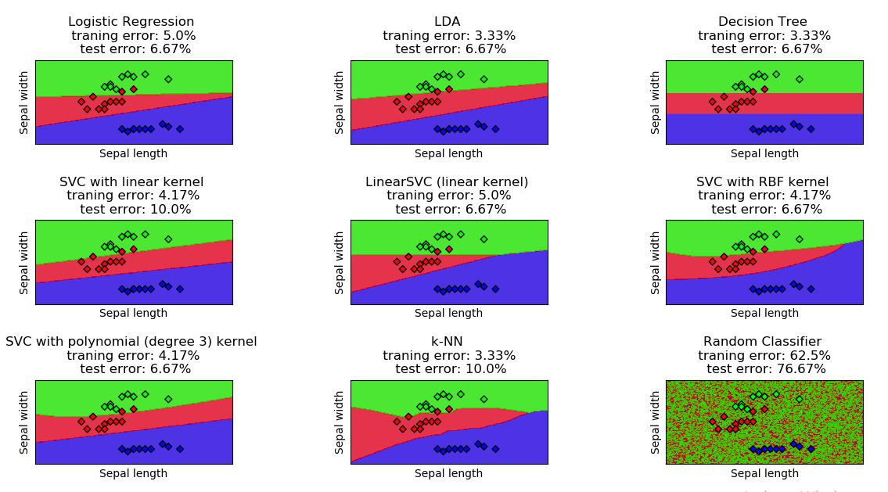
Model comparison on Iris dataset

Slide 40
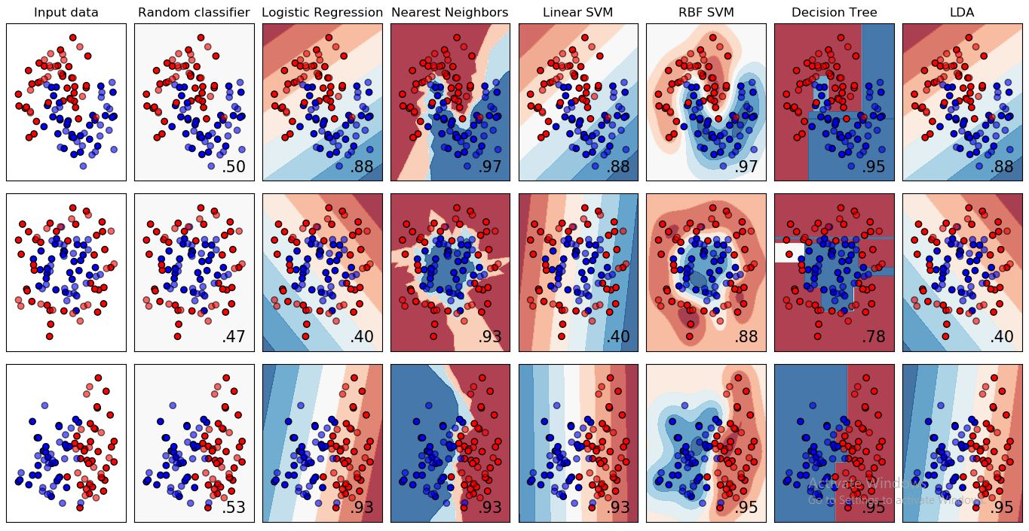
Model comparison on various datasets

Slide 41
Speaker
Nikhil Verma
Mob:- 7508377468
Email:- nverma_be15@thapar.edu | lih.verma@gmail.com
B.E. Computer Science & Engineering Department
Thapar Institute of Engineering & Technology
Patiala, Punjab
Thankful to Dr. Prashant Singh Rana
Follow at GitHub:- www.github.com/lihkinVerma

