Slide 1
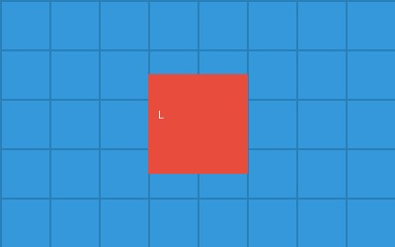
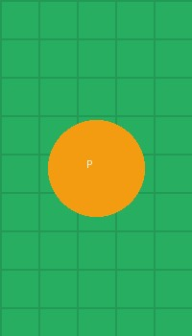
object-fit: fill (default)
Image stretches to fill container, may distort aspect ratio
Landscape in square
Landscape in portrait
Portrait in square

Slide 2
object-fit: contain
Image scales to fit inside container, preserves aspect ratio
Landscape in wide
Portrait in wide
Landscape in tall
Portrait in square

Slide 3
object-fit: cover
Image scales to cover container, crops edges if needed
Landscape in wide
Portrait in wide
Landscape in tall
Portrait in square

Slide 4

object-fit: none
Image at natural size, centered (may overflow)
Small image
Large image (centered)

Slide 5
object-fit: scale-down
Like contain but never enlarges image
Small stays small
Large scales down
Large scales down

