Slide 1
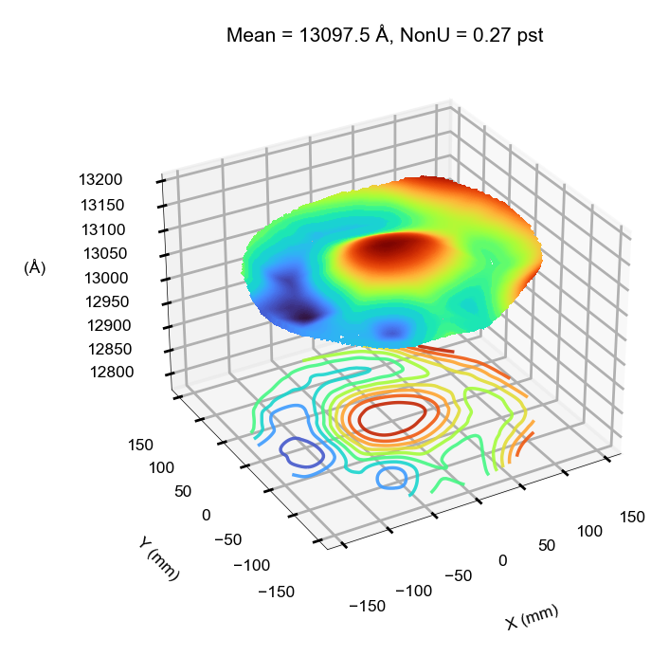
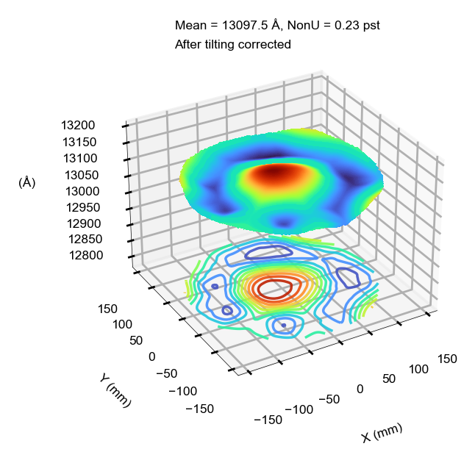
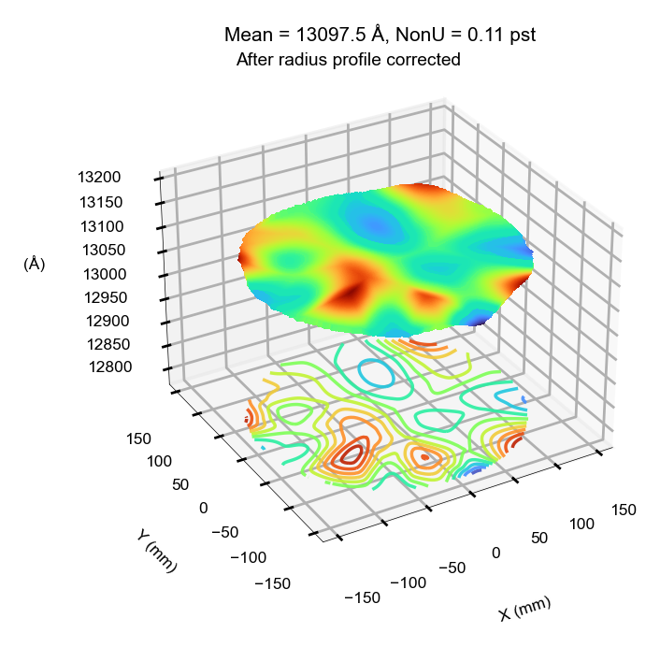
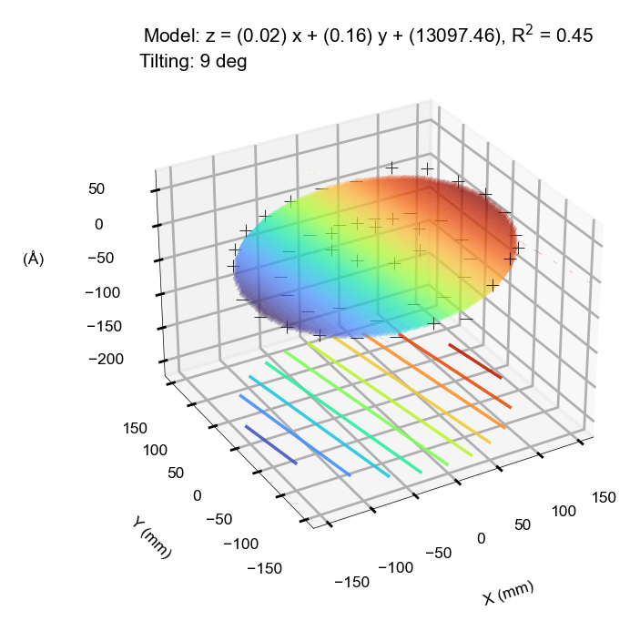
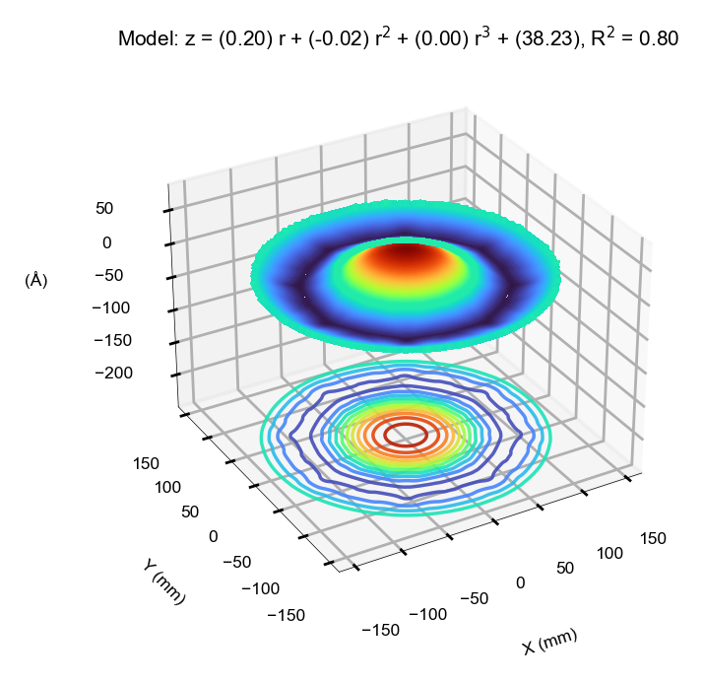
Original
After tilting is removed
Residual left after both tilting and radius profile are removed
Two possible system errors: tilting and radius profile from chamber design (ESC, RF coils, etc.)

Slide 2
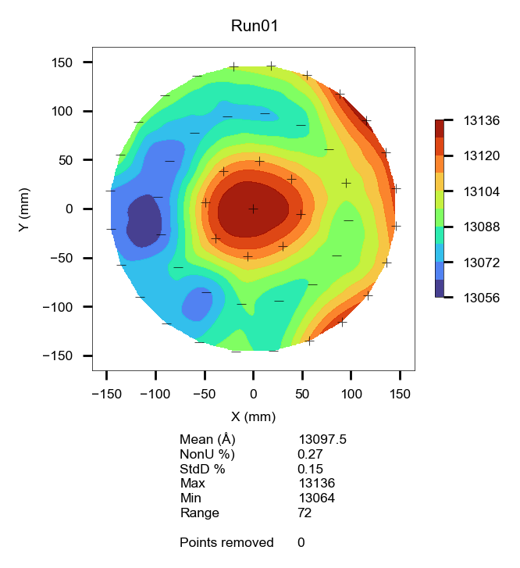
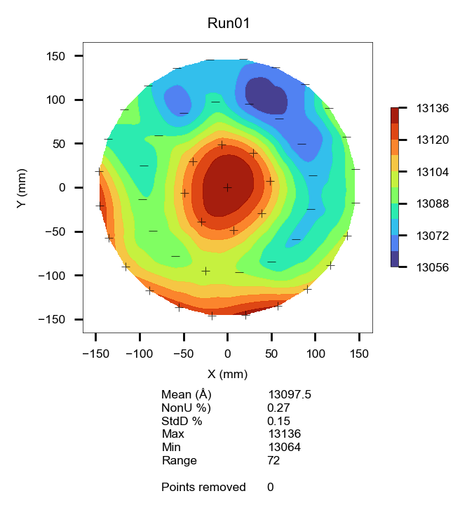
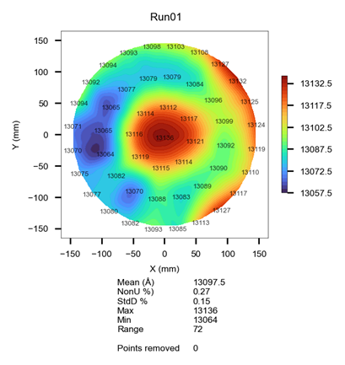
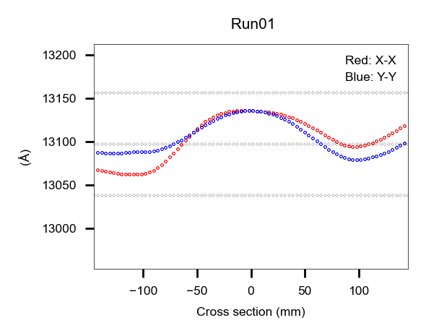
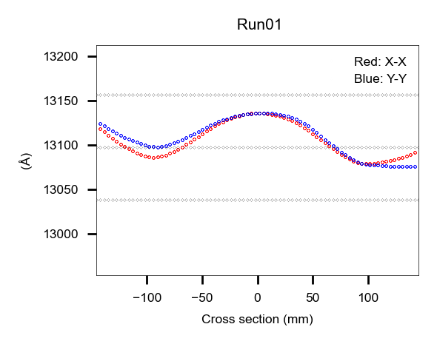
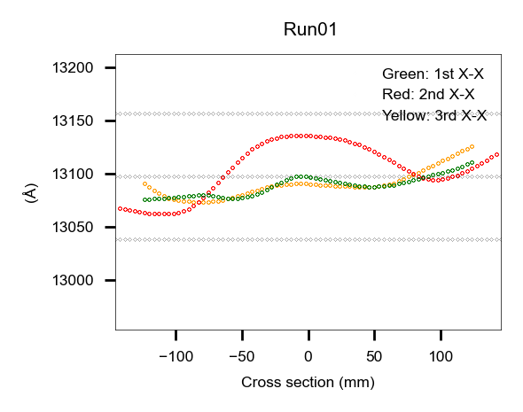
Original
After rotated 120°
Original with different format
1st X-X
2nd X-X
X-X
3rd X-X
Y-Y
Original
After rotated 120°
Original

Slide 3
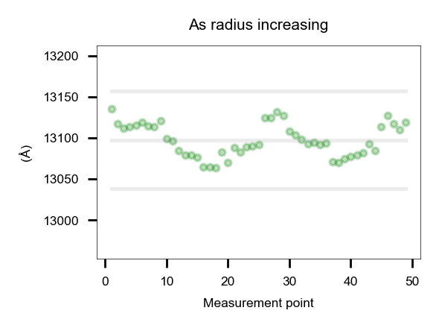
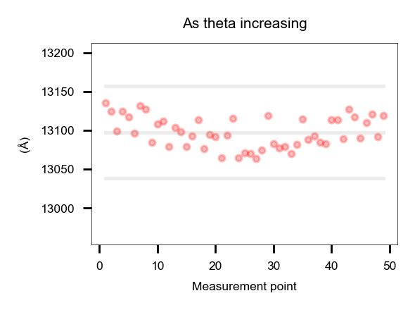
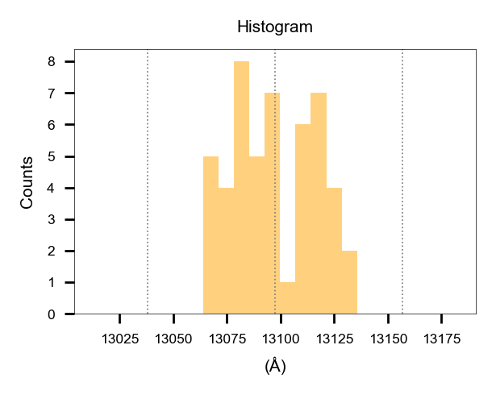
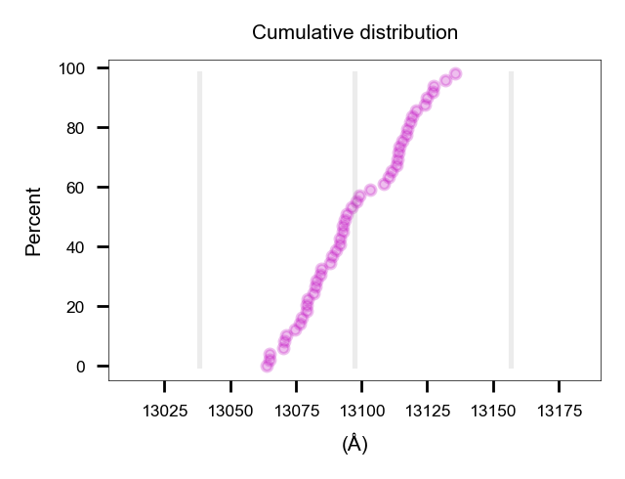







$$r (x,y)$$
θ =$arctan(y/x)$
.
.
.
.
.
$$r$$
$$$$
$$a=1$$
$$b=0.1$$
$$a=0.1$$
$$b=1$$
$$u=a∗\sqrt{x^{2}+y^{2}}+b∗arctan(y/x)$$
$$The \text{"}\text{Measurement} \text{point}\text{"} \text{is} \text{sort}\text{ed} \text{by} \text{a}\text{scending} \text{o}\text{rder} \text{of}\text{ "}\text{u}\text{"}$$

Slide 4
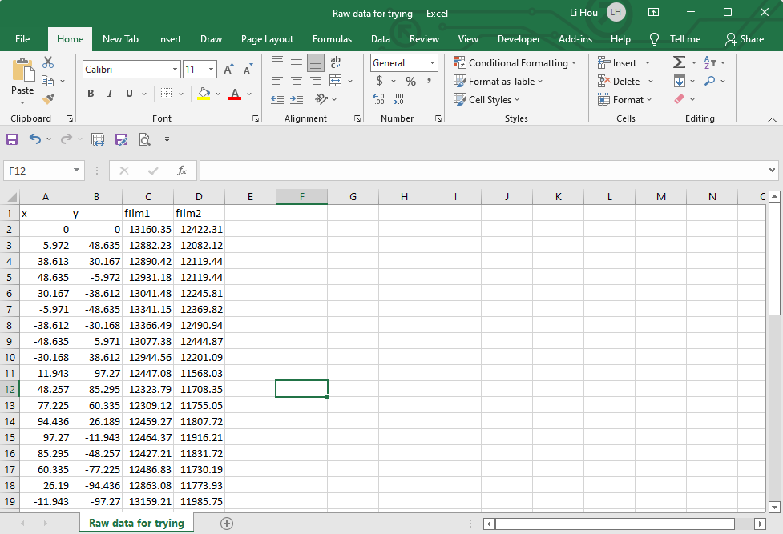
Row1 can be written in anything for note
Columns starting from A2 and B2 are reserved for x, y coordination
Leave unused columns blank without any elements

Slide 5
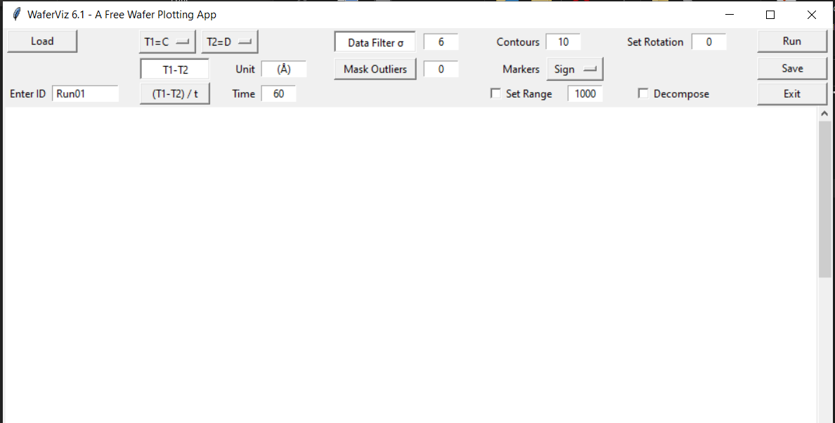
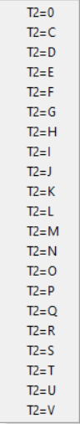
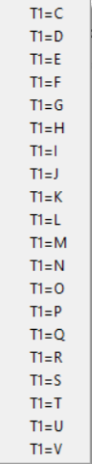
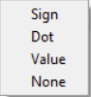
For axis label other units can be entered, e.g., Ohm/sq, °C
Either set sigma or points to be removed
For rate input time in second and click button “(T1-T2)/t”
For fair comparison set a range for maps to be compared
In single-film case select "0" from dropdown button "T2=D"

Slide 6
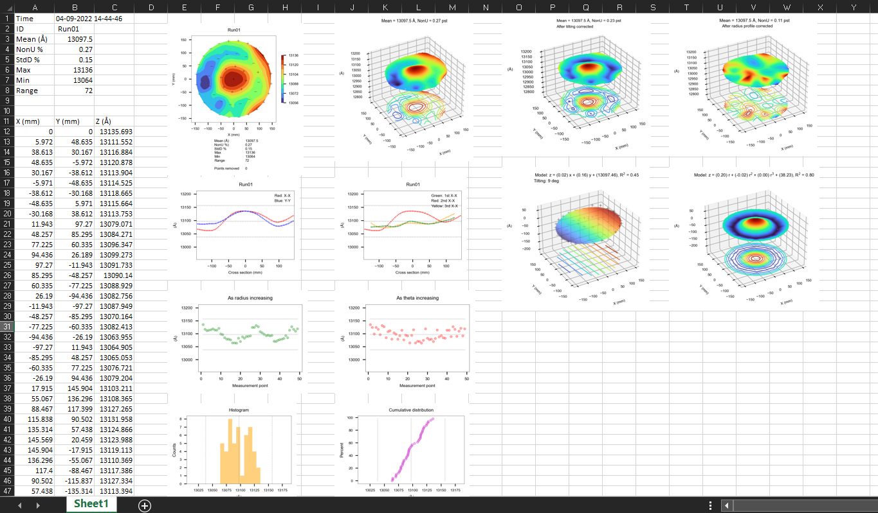
Auto-generated summary page in Excel

