Slide 1
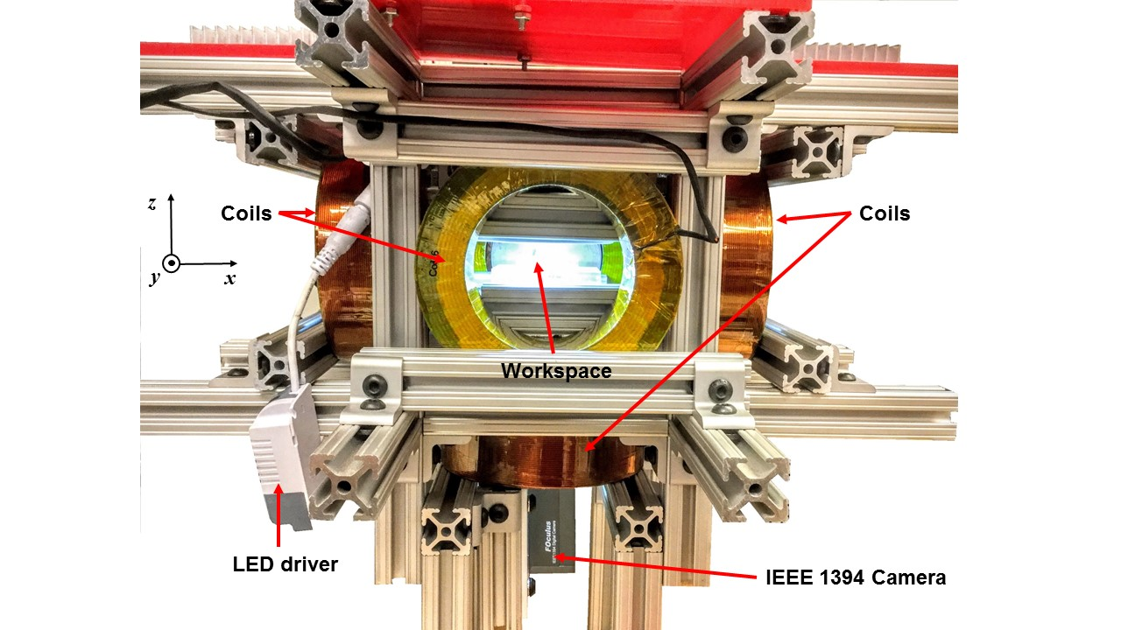
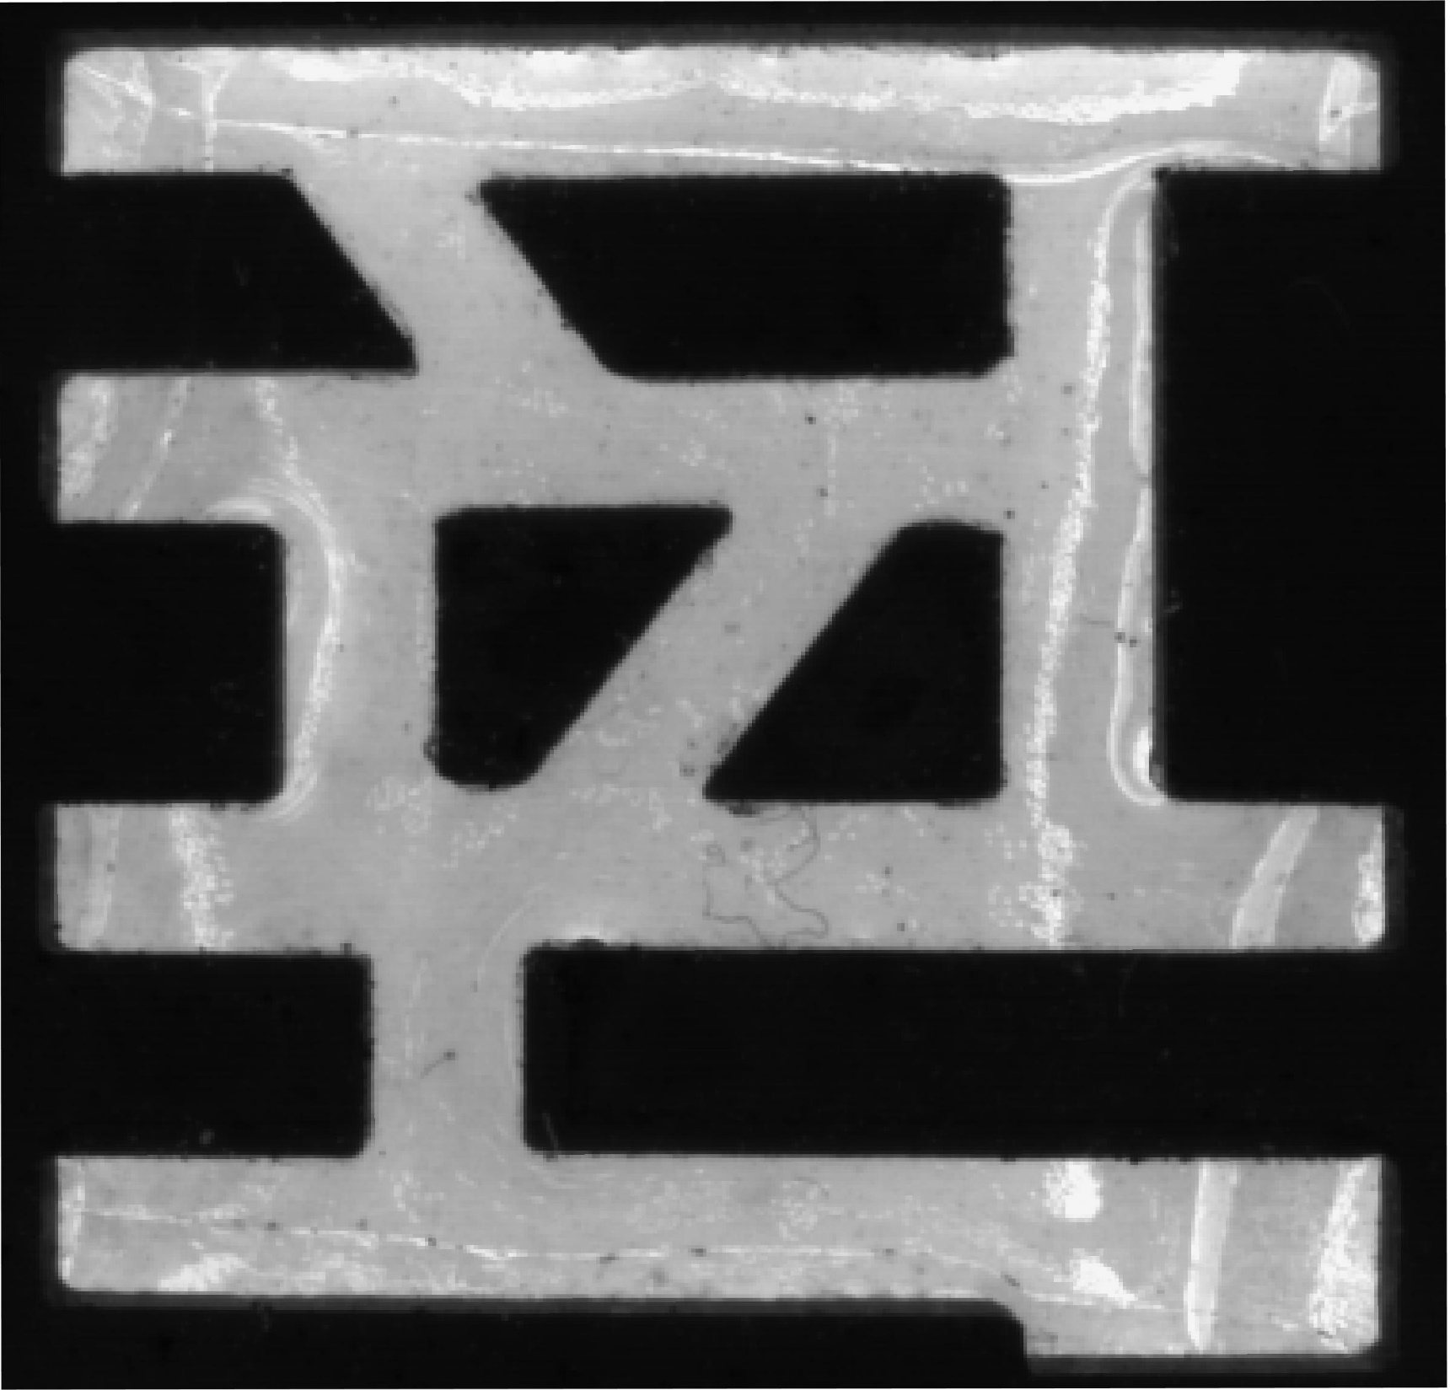
Coils
Coils
Workspace
2 mm
5 cm
LED drive
Camera
(a)
(b)

