Slide 1
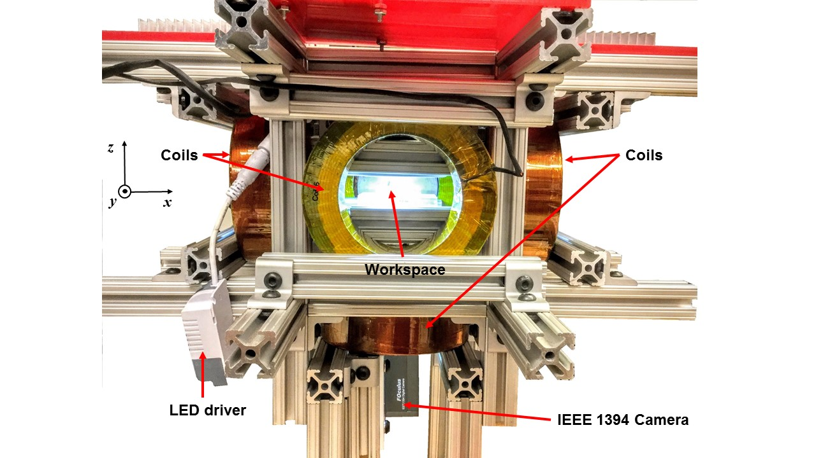
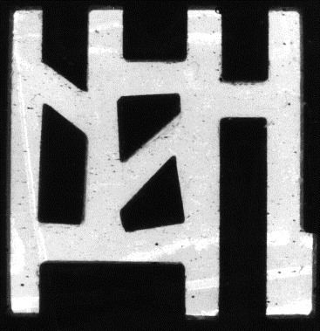




Coils
Coils
Workspace
2 mm
5 cm
LED drive
Camera
(a)
(b)
(c)
(d)
(e)
(f)

