Slide 1
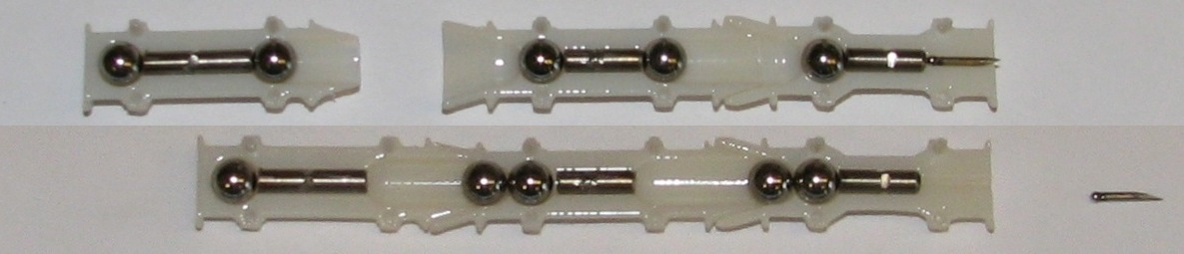
MRI-powered Millirobots Penetrate Tissue Using a Self-Assembled Gauss Gun
Aaron Becker¹, Ouajdi Felfoul², & Pierre Dupont²
¹University of Houston, ²Boston Children’s Hospital & Harvard Medical School, USA
Clinical need: MRI can image & move multiple robots, but cannot push through tissue
Navigate robots to goal, self-assembly triggers magnetic potential energy http://youtu.be/uJ4rFA8x2Js
before
after
needle

