Slide 1
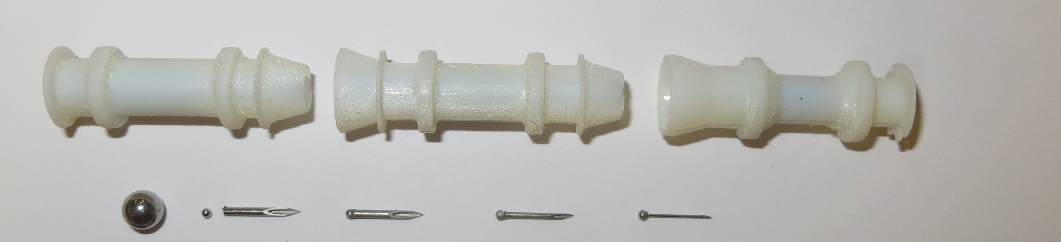
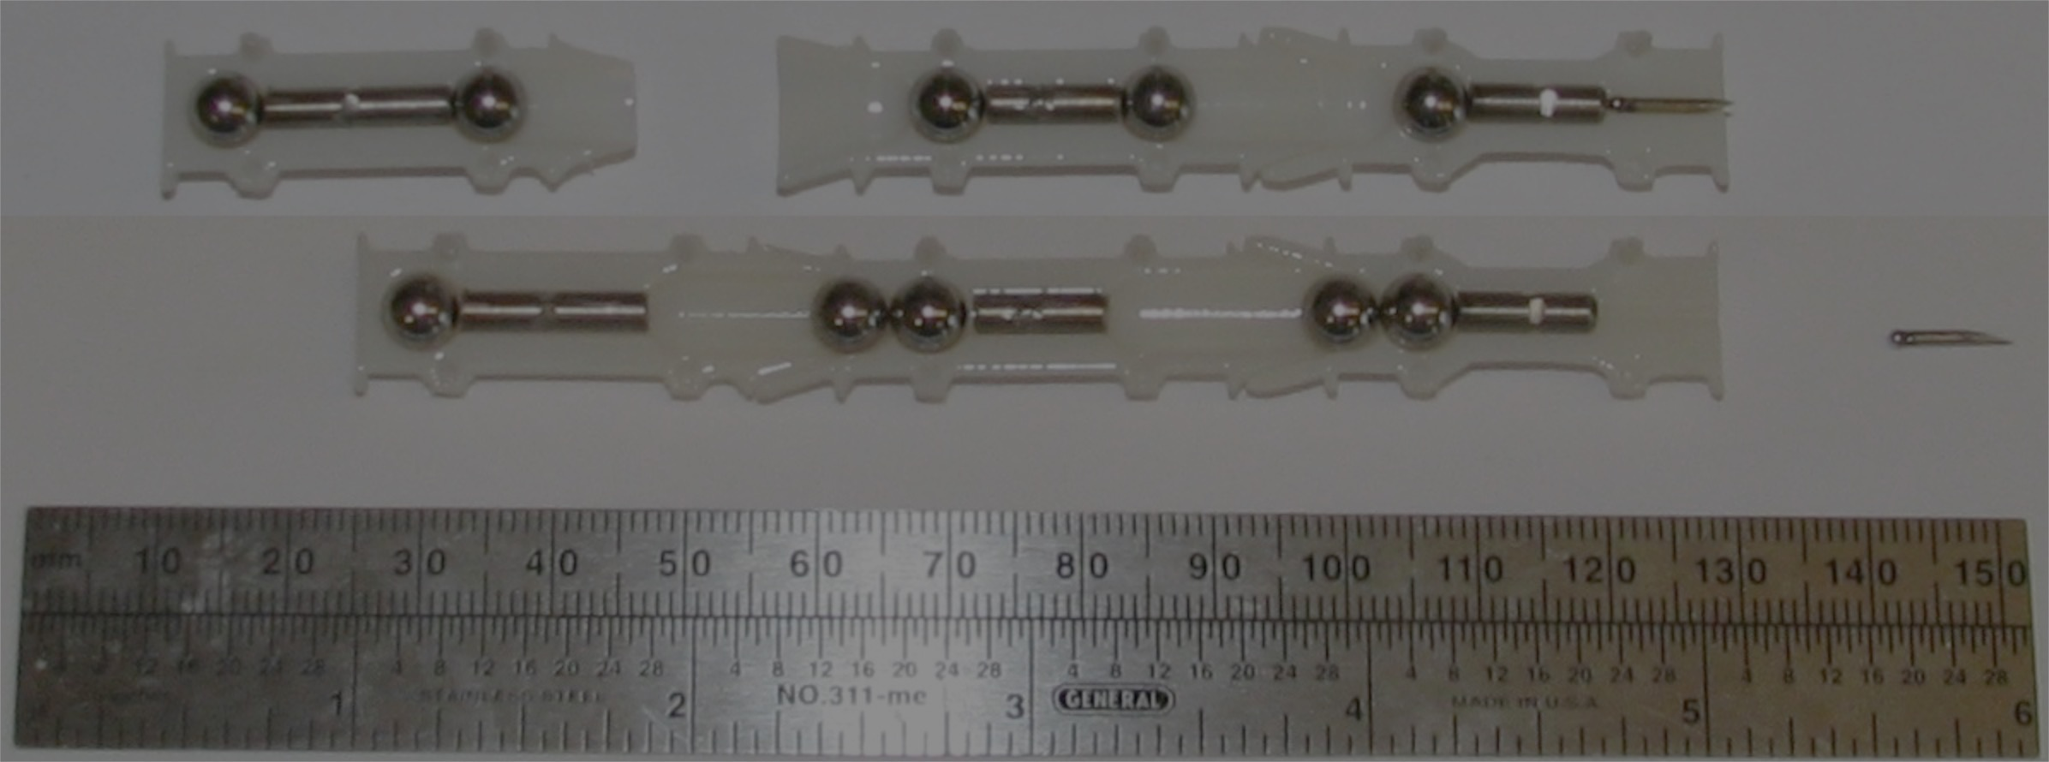
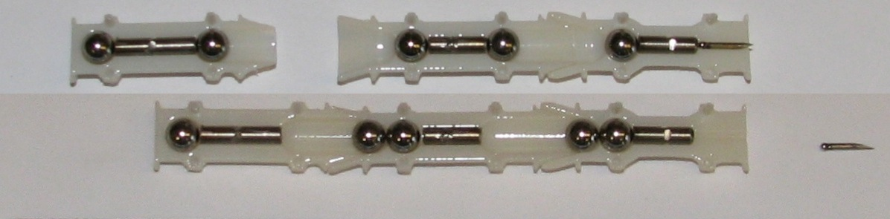
trigger
barrel
delivery
6mm
1mm
18 gauge
20 gauge
26 gauge
MRI Self-Assembled Gauss Gun

