Slide 1
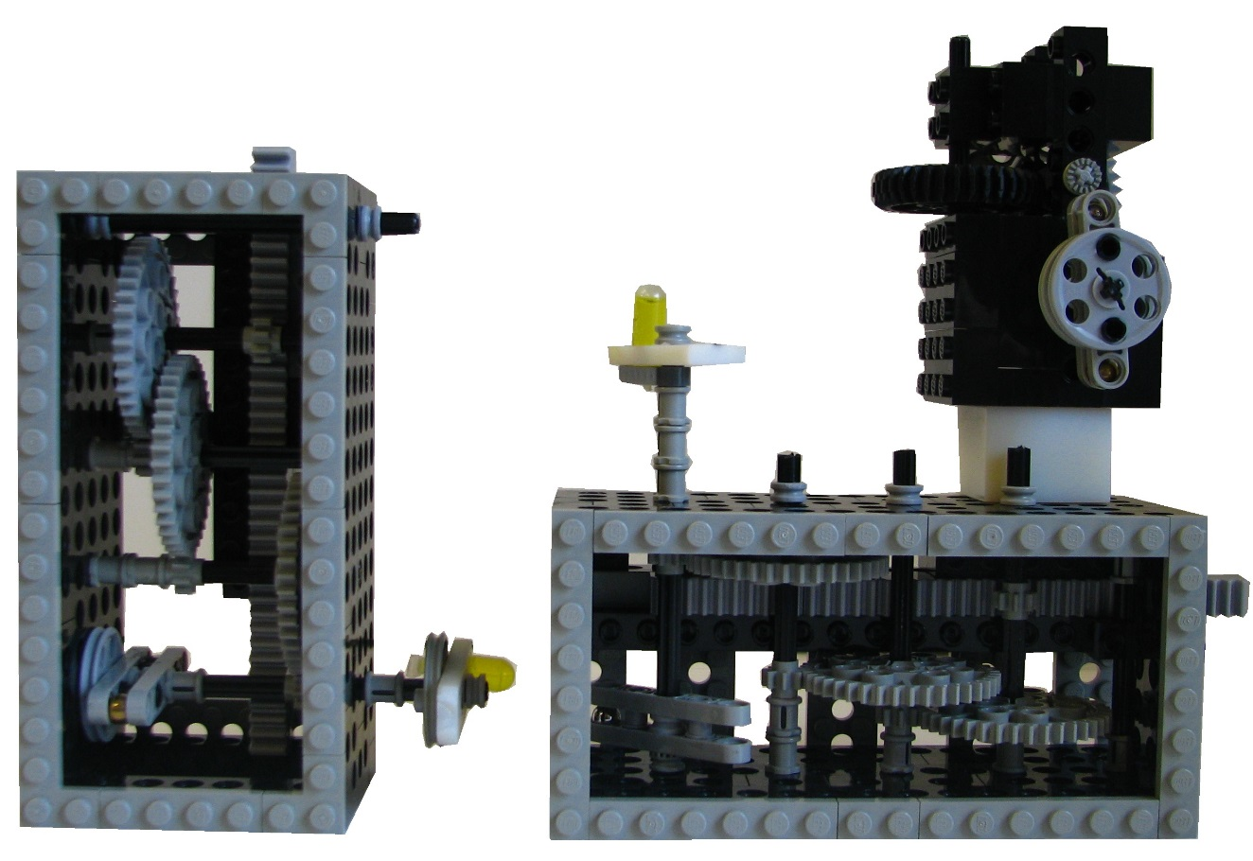
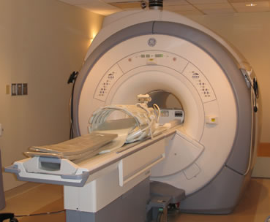



Non-ferrous counterweight
MRI marker
$$y$$
Ferrous mass
$$x$$
$$z$$

