Slide 1
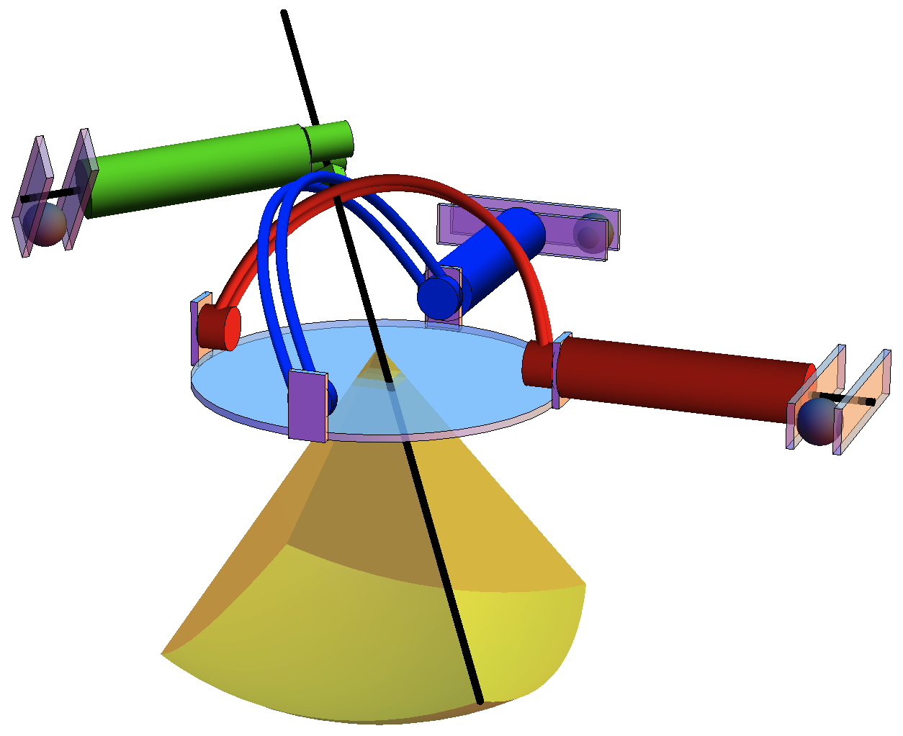
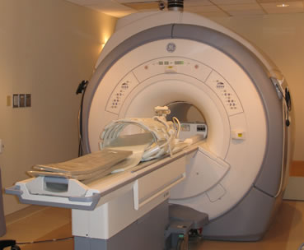





ferrous spheres
$$y$$
$$x$$
$$z$$
robot
workspace
actuator
needle

