Slide 1
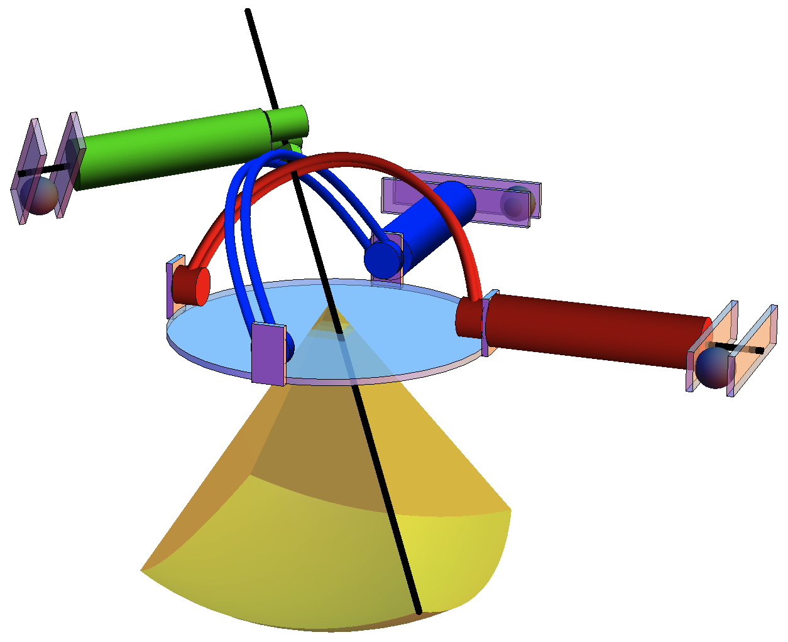
ferrous spheres
robot
workspace
actuator
needle

