Slide 1
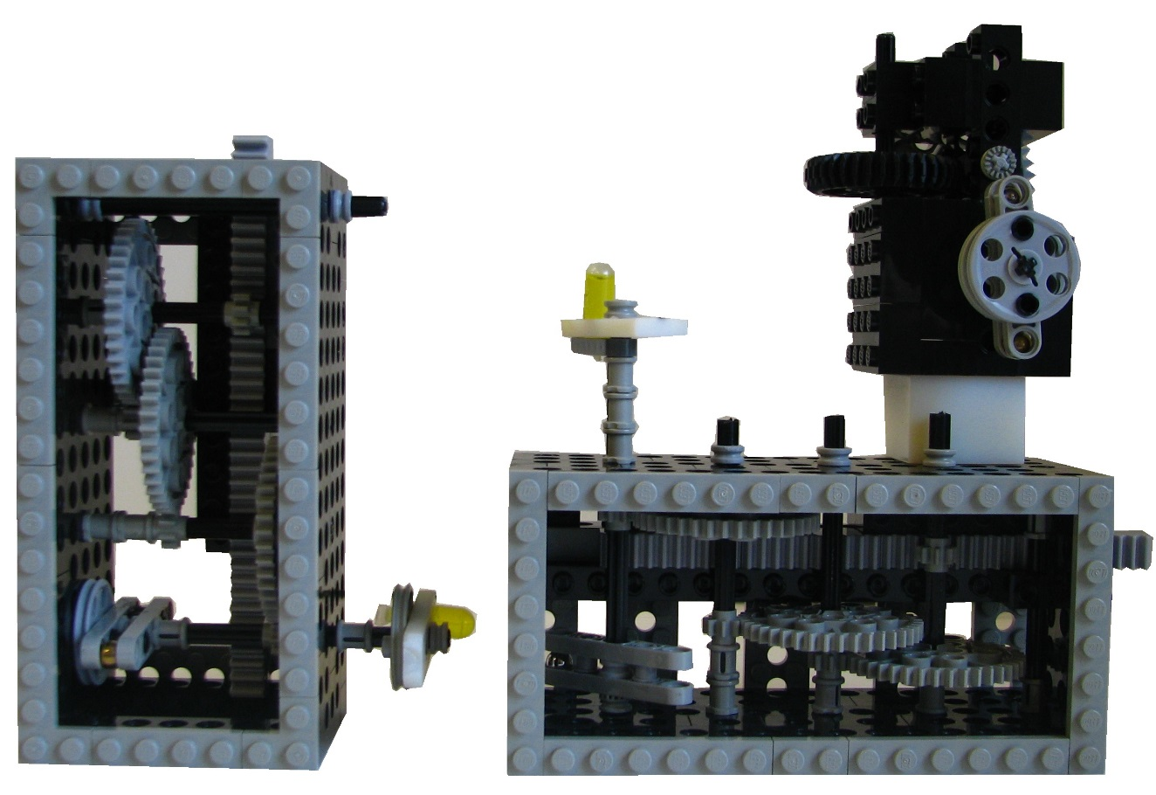






$$F$$
$$r_{i}$$
$${F∙p}_{i}$$
$$θ_{i},{\dot{θ}}_{i}$$
$$p_{i}$$

