Slide 1
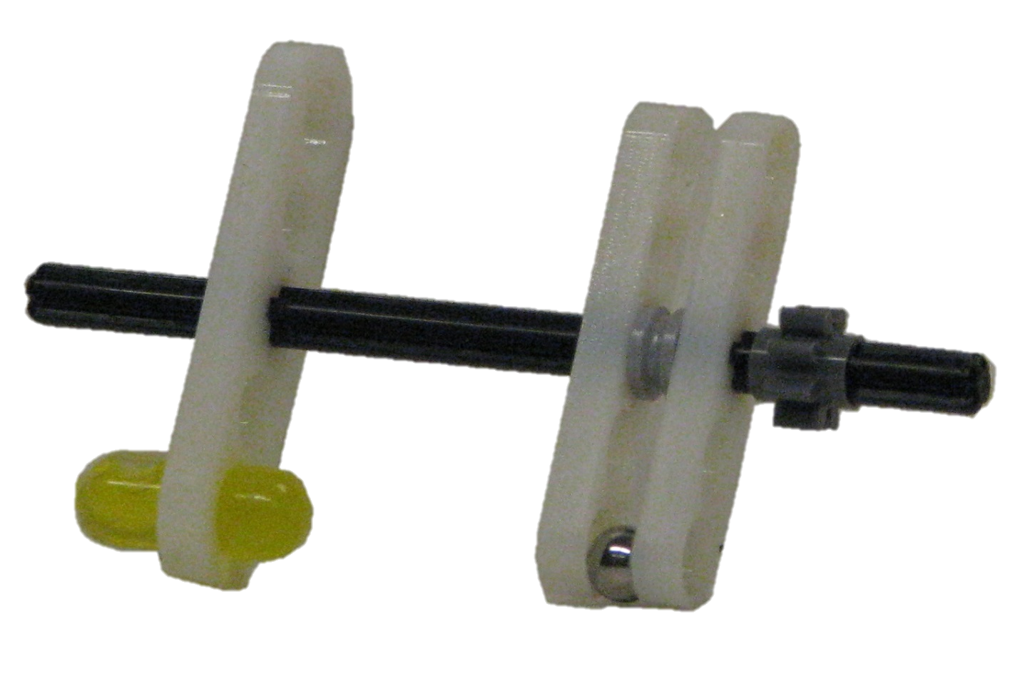






gear
$$θ_{i},{\dot{θ}}_{i}$$
$$a_{i}$$
$${F∙p}_{i}$$
fiducial
marker
$$r_{i}$$
$$F$$
$$p_{i}$$
ferrous
sphere

