Slide 1
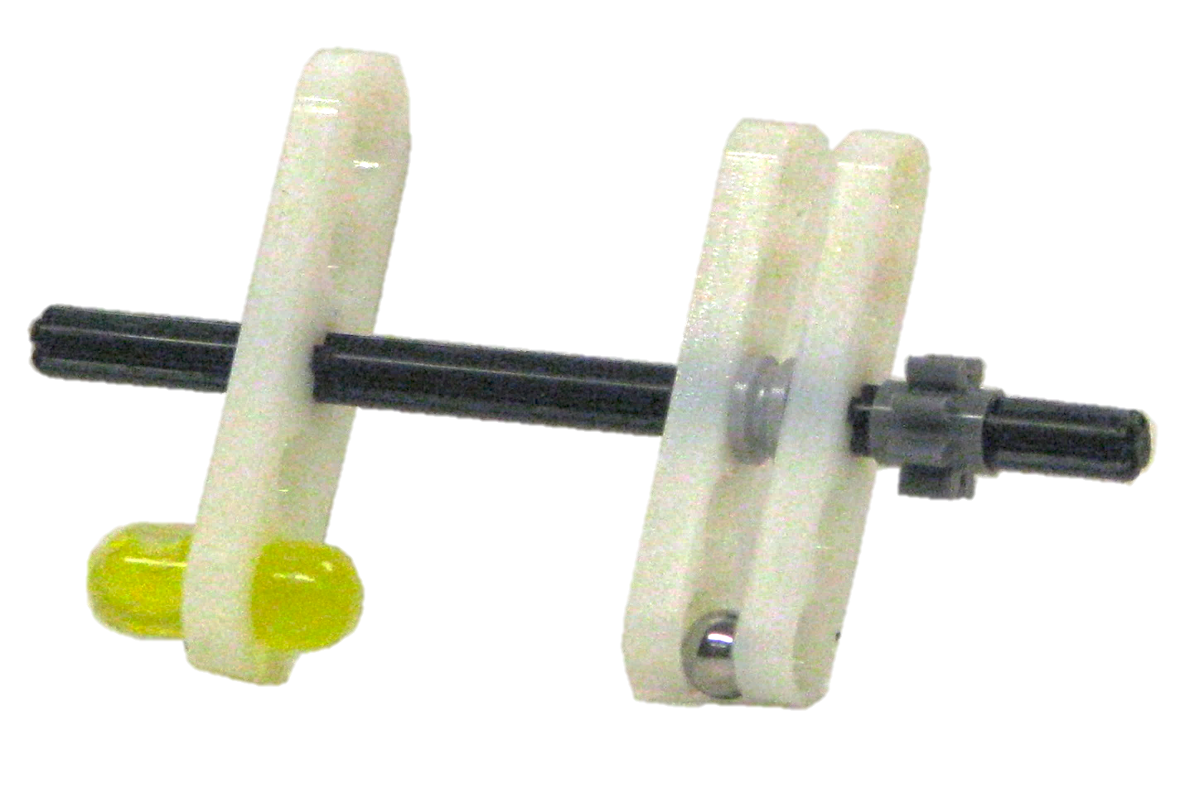

gear
fiducial
marker
ferrous
sphere

