Slide 1
Formalization · Lean 4 + Mathlib
The Identifiability Limit
How much of this work is human?
Now 163 machine-checked theorems.
163
0
13
proved theorems
sorry, added axioms
formalized modules

Slide 2
CONTENTS
What This Deck Covers
01
The Bird You Miss
Not detected is not the same as absent
02
The Detection Ceiling
Effort never passes that ceiling
03
Truth Is Not a Point
The protocol decides what you can see
04
The Sign Is Unidentified
One estimator cannot fix its own sign
05
Claims Become Theorems
163 Lean 4 proofs, zero sorry, zero added axioms
02

Slide 3
01
The Bird You Miss
Ecologists said this long before AI.
03

Slide 4

ECOLOGY · AN OLD STORY
The Bird You Never See
Unseen ≠ Absent
The bird is not in this stand
It is there, but too dark, too dense
It is there, but wind and distance
Under one protocol, look-alike states are lumped together. More sampling raises detection; what the protocol cannot separate, it never will.
Repeated surveys raise detection, never to 1.
The ceiling is set by the protocol.
04

Slide 5
THE PROBLEM · ONE MISTAKE
AI Repeats This Mistake
Ecologists
AI-assisted research today
Unseen → recorded as undetected
Undetected → taken as absent
Reference: the true species distribution
Reference: the published record
Change protocol → conclusion changes
Change model → conclusion flips
Repeat surveys → detection rises
More rounds → actually more accurate?
AI research treats model output as the observation itself.
05

Slide 6

02
The Detection Ceiling
Not new. A theorem from decades ago, rarely pushed.
06

Slide 7
CONTENT LAYER · RESULT 1
The Best Detector Is Already Computed
TV / 2
(1 − TV) / 2
Best any detector beats a coin flip
Smallest error rate of the best detector
TV = how far apart two distributions are, 0 to 1. TV = 0 means you cannot tell them apart.
Example: reference p=(0.42, 0.28, 0.18, 0.12), model q=(0.10, 0.20, 0.40, 0.30)
TV = 0.40 → at best 0.20 above chance, error rate 0.30.
Source: Fig. 1: the Neyman-Pearson / Le Cam two-point lemma, not our result
07

Slide 8
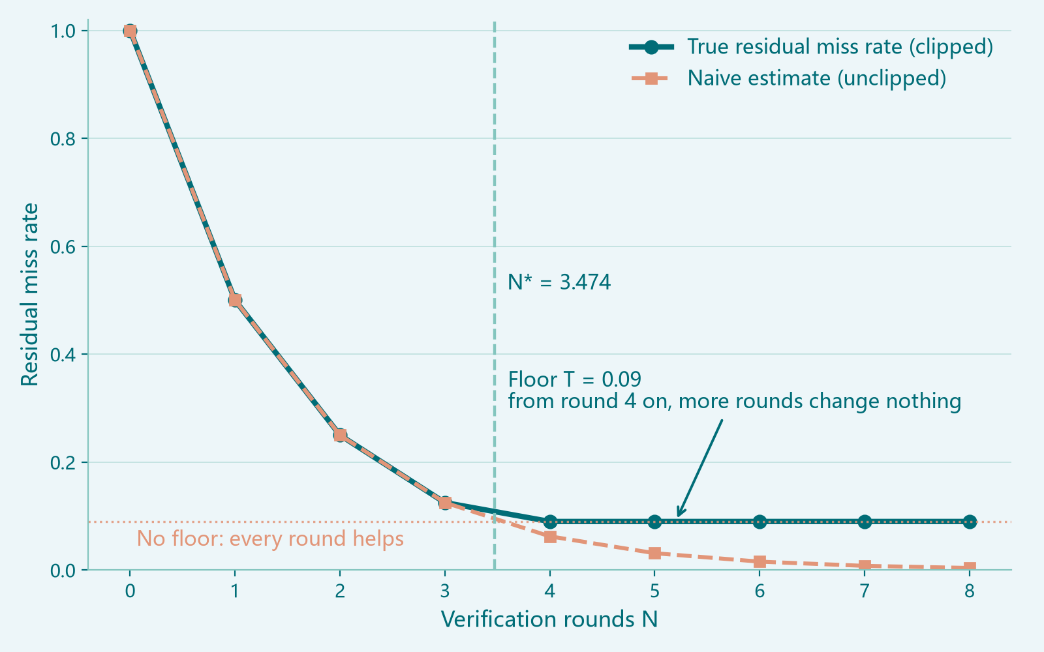
CONTENT LAYER · RESULT 2
More Verification Is Not Better
Miss rate falls, then stops
Each round multiplies the miss probability: geometric decay
But there is a floor it never falls below
Floor = λ × TV: how separable the two are
Floor T = 0.09: more reviewers stop here
Parameters: TV = 0.09, q = 0.5, λ = 1 (as in Fig. 2)
08

Slide 9
CONTENT LAYER · RESULT 2 (CONT.)
Where the Budget Sticks: Three Numbers
N_c
N_0
N*
3.793
3.474
3.474
Set by reviewer reliability
Hard cap, no human in it
The smaller: here N_0
Perfect reviewers still cap the budget at 3.474.
The remaining misses no headcount can recover.
In 83.97% of parameter sets the detector binds, not the person.
Parameters: TV = 0.09, q = 0.5, λ = 1, as in Fig. 2 (N_c: another reviewer p)
09

Slide 10
03
Truth Is Not a Point
Change the protocol and the truth moves.
10

Slide 11
SYSTEM LAYER · CONCEPT
Truth Is a Class, Not a Point
Old way: the answer is one point; estimate the distance.
Strict
Our way: which states look identical under this protocol?
Medium
They form a class [s*]. Error becomes a function of the protocol.
Loose
The same truth mixes different states under different protocols.
11

Slide 12

SYSTEM LAYER · RESULT 3
Two Accounts of Credit
Human credit: change the layer
Ask a better question
Formally: change Φ(α) itself
Gain has no ceiling
AI credit: compress within the layer
AI hits a wall inside the layer; a human changes layer.
Push error toward Φ(α)
Marginal gain shrinks, hard cap
“AI helps” holds only when the layer is fixed, the state with no human credit.
12

Slide 13

SYSTEM LAYER · REBUTTAL
Influence ≠ Value
+M
−M
Two outputs, identical |influence|.
One is +M, the other −M, and M is arbitrary.
KL and mutual information measure magnitude only.
Influence cannot stand in for value.
That is a defect of definition.
Value needs a sign.
13

Slide 14
SYSTEM LAYER · VERDICT
Incommensurable Has Two Regimes
When the floor binds
When the floor is slack
Incommensurable
Commensurable
Reviewers of any reliability: same budget.
Not even a ranking survives.
Who is stronger is visible.
But the rate is not proportional.
The exact claim: not linearly convertible.
The stronger version is refuted; formalization rewrote our claim.
14

Slide 15
04
Sign Is Not Identified
The problem is direction, not precision.
15

Slide 16
CALIBRATION LAYER · PROBLEM
The Standard Estimator Has No Human
φ̂ = 1 − τ̄ / s̄
τ̄ = the fitted plausibility bar
s̄ = mean surprisal of the output
The human input x is not in the formula.
It measures how surprising the output is, not how human.
16

Slide 17
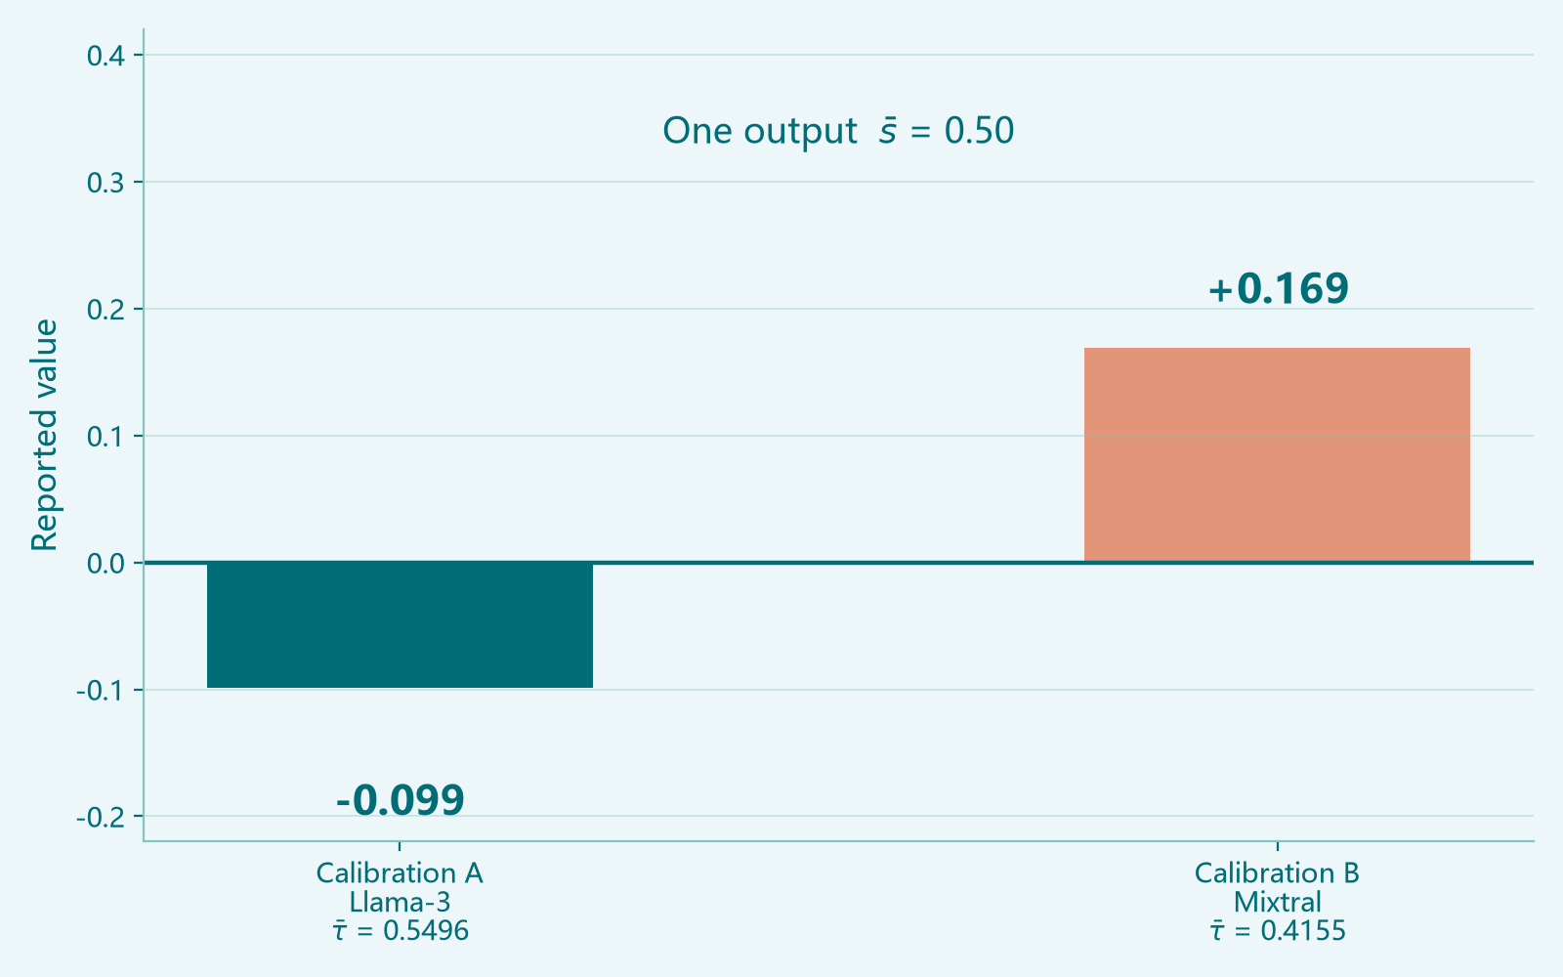
CALIBRATION LAYER · THEOREM
One Output, Two Signs
Fix the output: s̄ = 0.50
Calibration A · Llama-3: τ̄ = 0.5496
Reports −0.099: almost no human
Calibration B · Mixtral: τ̄ = 0.4155
Reports +0.169: human present
Same text, same data, opposite verdicts.
Only the bar moved, and it was fitted on 2500 unrelated chat prompts.
τ̄ from Xie et al. (ACL 2026), Appendix A.5
17

Slide 18
CALIBRATION LAYER · CONSEQUENCE
It Is Not Even a Proportion
Bounded above
No lower bound
φ̂ < 1 always.
More surprising → closer to 1.
φ̂ goes below 0.
More predictable → further down.
Reading it as a proportion in [0,1] fails in the estimator.
The authors saw these negatives and explained them inside their own framework:
“could plausibly have been generated with minimal or negligible human contribution” Xie et al., §5.5
18

Slide 19
05
Claims Become Theorems
163 theorems, zero sorry, zero added axioms.
19

Slide 20
FORMALIZATION
163 Theorems, 13 Modules
Total variation
Contamination
Coverage
Basic
Contamination
Coverage
Hypothesis testing
Refinement and observation
Influence and value
HypothesisTest
Refinement
Value
Verification budget
Incommensurability
Unidentified calibration
VerifyBudget
Incommensurable
Calibration
Fragmentation
Corpus as selection
Package root
Fragmentation
Corpus
Provenance
Lean 4 v4.15.0 + Mathlib · 163 theorems + 20 worked examples · zero sorry, zero added axioms
20

Slide 21
WHAT THE FORMALIZATION WAS WORTH
It Caught Us First
An inequality was backwards
The residual had no floor
The proof failed. Lean killed our own modelling error.
“More verification is better” refuted; miss rate has a floor.
Two monotonicities reversed
“Fully incommensurable” too strong
We expected the budget to fall with TV. It does not.
Forced to the exact claim: not linearly convertible.
A modelling error that survives the prover will not survive a coauthor.
21

Slide 22
CLOSING
What We Proved
Unseen ≠ absent. AI treats model output as the observation.
Detection has a ceiling. Effort does not move it.
The verification budget has a cap with no human in it.
Influence does not measure value. Value needs a sign.
The sign is not identified either; an out-of-distribution bar decides it.
163 theorems, zero sorry, zero added axioms, reproducible build.
We do not attack existing measures; they work for their stated purpose.
We turned their prose warnings into theorems a machine can check.
22

