Slide 1



Docu-Genius: AI-Powered Document System
Demo Overview
AI + DOCUMENTS
An end-to-end, scalable, AI-driven document insight platform
Presenter: Hui Li
GitHub: lihuiniu/docu-genius
Open Source
FastAPI
_{LangCha}M_{in}ade with G_{M}e_{i}n_{lv}sp_{u}a_{s}rk

Slide 2
Demo Agenda
1
What is Docu-Genius?
2
Key Features
3
Architecture Overview
4
Model Choices: OpenAI + Seq2Seq + LangChain
5
Workflow & Controller: LangGraph
6
Technical Details & API Usage
7
Demo Highlights
8
Q&A
Slide 2/8
github.com/lihuin^{M}iu^{ad}/d^{e} o^{w}c^{it}u^{h}-^{G}g^{e}e^{n}n^{s}i^{p}uªs^{rk}

Slide 3



What is Docu-Genius?
AI-powered system for document chunking, semantic search, summarization, and evaluation
FastAPI-powered async backend
LLM-powered summarization & evaluation
High-performance, scalable server with asynchronous processing
Advanced AI for content generation and quality control
Semantic retrieval & caching
Flexible storage & interfaces
Milvus vector search with Redis caching for fast access
Local & cloud storage support with CLI & API access

Slide 4






Key Features
Flexible Storage
Local, S3, Azure, Delta Lake
Semantic Search
Milvus vector database
Fast Cache
AI Evaluation
Redis 8.0 for quick retrieval
OpenAI LLMs (v1.x), LangChain LLMChain
Workflow Orchestration
Async & Scalable
FastAPI + Hypercorn server
LangGraph StateGraph workflows
CLI Utility
Batch/parallel reindexing with resume support

Slide 5
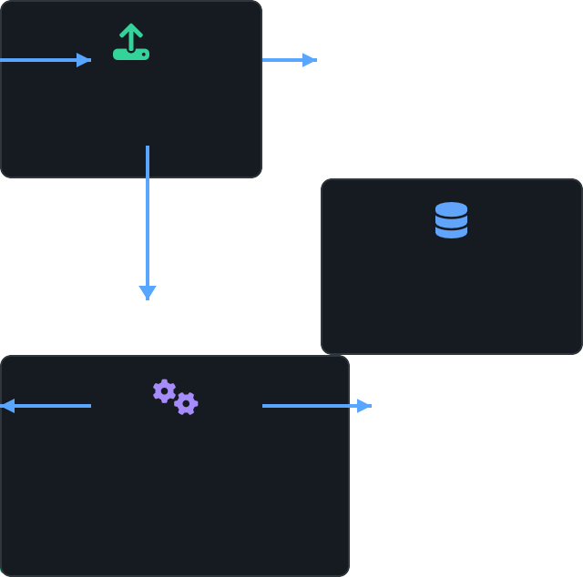


System Architecture
Upload
FastAPI Endpoint
Storage
S3/Azure/Local/Delta
Chunking & Summarization
OpenAI + LangChain
FastAPI server as application entrypoint
LangGraph for stateful workflow orchestration
OpenAI + LangChain for embeddings & summarization
Milvus + Redis for semantic retrieval & caching
CLI utility for batch operations & admin tasks
Async pipeline for scalable processing
ex

Slide 6








Model Choices & Pipeline
Integrated AI components for document understanding and evaluation
OpenAI
Seq2Seq
LangChain
Embeddings for semantic search Document summarization OpenAI API v1.x integration
Text transformation approach Via OpenAI's API
Abstracted through LangChain
Workflow integration LLMChain for evaluation Modular component chaining
Quality Control Pipeline
Auto Resummarize (if low quality)
Document
Summarization
LLM Evaluation
Quality Check

Slide 7








Workflow Orchestration: LangGraph
StateGraph-based workflow for complex document processing pipelines
LangGraph StateGraph Workflow
Summarization Evaluation
Chunking
Quality Check
Indexing
Resummarize
Modular & Conditional Flows
Unified Orchestration
Dynamic routing based on quality evaluations
Same workflow powers CLI batch jobs & API requests
Async Execution
Extensible Architecture
Non-blocking processing for high throughput
Easy to add new states or decision logic
Slide 7/8
github.com/lihuin^{M}iu^{ad}/d^{e} o^{w}c^{it}u^{h}-^{G}g^{e}e^{n}n^{s}i^{p}uªs^{rk}

Slide 8



Technical Implementation & Demo
Setup
API Usage Examples
Python virtual environment + requirements.txt
Upload document:
FastAPI + Hypercorn for async API
curl -F "file=@./example.txt" http://localhost:8000/upload/local
Milvus 2.6 for vector storage
Redis 8.0 for caching
Summarize document:
OpenAI API key for LLM functionality
curl -X POST http://localhost:8000/summarize \
-H "Content-Type: application/json" \
-d '{"doc_id": "your_doc_id", "storage": "local"}'
Testing
Query similar chunks:
Unit & integration tests with pytest
curl -X POST http://localhost:8000/query \
-H "Content-Type: application/json" \
-d '{"keyword": "example", "top_k": 5}'
Async testing with pytest-asyncio
Continuous integration via GitHub Actions
Batch reindex via CLI:
Test coverage reporting
python cli/reindex.py --doc-ids doc1 doc2 --storage local --concurrency
Perfect for real-time document intelligence in modern applications
Slide 8/8
github.com/lihuin^{M}iu^{ad}/d^{e} o^{w}c^{it}u^{h}-^{G}g^{e}e^{n}n^{s}i^{p}uªs^{rk}

