Slide 1
Stingy Sketch:
A Sketch Framework for Accurate and Fast Frequency Estimation
Qizhi Chen
Joint work with: Haoyu Li, Yixin Zhang, Tong Yang, Bin Cui
Peking University, China

Slide 2
Content
① Background: Frequency Estimation
② Strawman Solution: Count-min Sketch
③ Prior Art
④ Motivation
⑤ Stingy Sketch
⑥ Experimental results

Slide 3
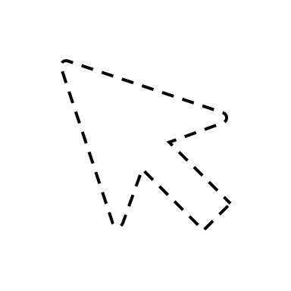
①
Background: Frequency Estimation
Now
Item(s)
Upcoming
Coming
Has come
Data Stream
1
2
1

Slide 4
①
Background: Frequency Estimation
Now
Item(s)
Upcoming
Coming
Has come
Data Stream
1
2
1

Slide 5
①
Background: Frequency Estimation
Now
Item(s)
Upcoming
Coming
Has come
Data Stream
1
2
1

Slide 6
①
Background: Frequency Estimation
Now
Item(s)
Upcoming
Coming
Has come
Data Stream
1
2
1

Slide 7

①
Background: Frequency Estimation
Now
Item(s)
Upcoming
Coming
Has come
Data Stream
1
3
1

Slide 8
①
Background: Frequency Estimation
Now
Item(s)
Upcoming
Coming
Has come
Data Stream
2
3
1

Slide 9
①
Background: Frequency Estimation
Now
Item(s)
Upcoming
Coming
Has come
Data Stream
2
4
1

Slide 10
①
Background: Frequency Estimation
Now
High Speed
Large Volume
Limited Space
Item(s)
Upcoming
Coming
Has come
Data Stream
2
4
1

Slide 11
①
Background: Frequency Estimation
Now
High Speed
Large Volume
Limited Space
Item(s)
Upcoming
Coming
Has come
Approximate
Data Stream
2
4
1

Slide 12
①
Background: Frequency Estimation
Now
High Speed
Large Volume
Limited Space
Item(s)
Upcoming
Coming
Has come
Approximate
Data Stream
2
4
1
Sketch

Slide 13
①
Background: Frequency Estimation
Now
Applications:
Finding Top-k items
Joining Tables
Multi-set Querying
Net Cache
…
Item(s)
Upcoming
Coming
Has come
Data Stream
2
4
1

Slide 14
Content
① Background: Frequency Estimation
② Strawman Solution: Count-min Sketch
③ Prior Art
④ Motivation
⑤ Stingy Sketch
⑥ Experimental results

Slide 15
②
Strawman Solution: Count-min Sketch
Coming Item
Map & Add
Hash1
Hash2
Hash3
Array[0]
+1
Array[1]
+1
Array[2]
+1
a. Insert orange item

Slide 16
②
Strawman Solution: Count-min Sketch
Error: Hash collision
Coming Item
Coming Item
Map & Add
Map & Add
Hash1
Hash1
Hash2
Hash2
Hash3
Collide!
X
Hash3
Array[0]
+1
+1
Array[1]
+1
+1
X
Array[2]
+1
+1
Collide!
a. Insert orange item
b. Insert blue item

Slide 17
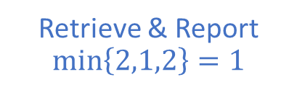
②
Strawman Solution: Count-min Sketch
Output the min value
Error: Hash collision
Coming Item
Retrieve & Report $min\left\{2,1,2\right\}=1$
Map & Add
Hash1
Hash1
Hash2
Hash2
Hash3
Collide!
X
Hash3
Array[0]
2
+1
Array[1]
1
+1
X
Array[2]
2
+1
Collide!
c. Query orange item
b. Insert blue item

Slide 18
Content
① Background: Frequency Estimation
② Strawman Solution: Count-min Sketch
③ Prior Art
④ Motivation
⑤ Stingy Sketch
⑥ Experimental results

Slide 19
③
Prior Art
Count-min Sketch (CMS)
Count Sketch (CS)
Conservative Update Sketch (CUS)
Classical
Speed
Speed-oriented
Pyramid
Augment
CMS
Stingy
(Ours)
SAC
Speed-
oriented
Accuracy-
oriented
CUS
CS
SALSA
Accuracy-oriented
Augment Sketch
Pyramid Sketch
Self-adjusting Counters (SAC)
Self-adjusting Lean Streaming Analytics (SALSA)
Classical
Accuracy
(Rough comparison)

Slide 20
Content
① Background: Frequency Estimation
② Strawman Solution: Count-min Sketch
③ Prior Art
④ Motivation
⑤ Stingy Sketch
⑥ Experimental results

Slide 21
④
Motivation
Allocating appropriate counter size
More counters
Lower error

Slide 22
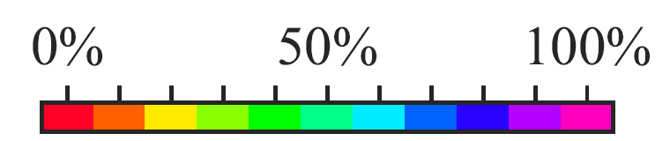
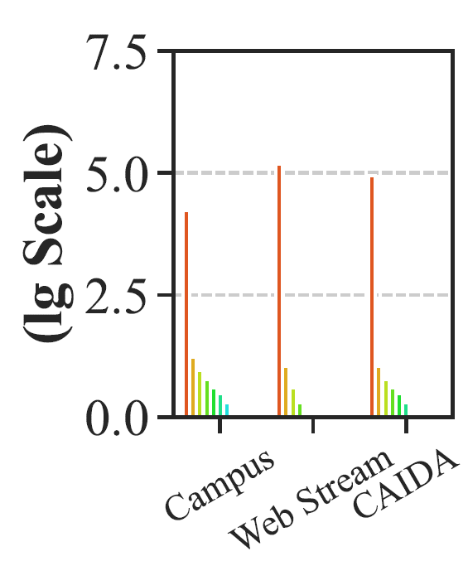
④
Motivation
Flow Size Distribution
Allocating appropriate counter size
The numbers (the logarithm to base 10) of items of the top 0% (the max), 10%, 20%, ..., 90%, 100% (the min) flows in each dataset.
Web Stream dataset: http://fimi.ua.ac.be/data/.
CAIDA dataset: http://www.caida.org/data/overview/.
More counters
The max flow appears more than 100,000 times.
Lower error
Most flows appear less than 10 times.

Slide 23
Content
① Background: Frequency Estimation
② Strawman Solution: Count-min Sketch
③ Prior Art
④ Motivation
⑤ Stingy Sketch
⑥ Experimental results

Slide 24
⑤
Stingy Sketch
Technique #1: Bit-pitching counter tree (BCTree)
Hierarchical data structure to reduce memory overhead.
: 0 level counter.
: Carry direction.
: nonzero level counter.
32 bits
...
...
Address
Inlay Carry Mode (ICM)

Slide 25
⑤
Stingy Sketch
Technique #1: Bit-pitching counter tree (BCTree)
Hierarchical data structure to reduce memory overhead.
: 0 level counter.
: Carry direction.
: nonzero level counter.
Counter Level
...
...
Address
Inlay Carry Mode (ICM)

Slide 26
⑤
Stingy Sketch
Technique #1: Bit-pitching counter tree (BCTree)
Hierarchical data structure to reduce memory overhead.
: 0 level counter.
: Carry direction.
: nonzero level counter.
...
...
Counter Level
3-level
2-level
1-level
0-level
...
...
Address
Inlay Carry Mode (ICM)

Slide 27
⑤
Stingy Sketch
Technique #1: Bit-pitching counter tree (BCTree)
Hierarchical data structure to reduce memory overhead.
: 0 level counter.
: Carry direction.
: nonzero level counter.
...
...
Counter Level
3-level
2-level
1-level
0-level
...
...
Address
Inlay Carry Mode (ICM)

Slide 28
⑤
Stingy Sketch
Technique #1: Bit-pitching counter tree (BCTree)
Hierarchical data structure to reduce memory overhead.
: 0 level counter.
: Carry direction.
: nonzero level counter.
...
...
Counter Level
3-level
2-level
1-level
0-level
...
...
Address
Inlay Carry Mode (ICM)

Slide 29
⑤
Stingy Sketch
Technique #1: Bit-pitching counter tree (BCTree)
Hierarchical data structure to reduce memory overhead.
: 0 level counter.
: Carry direction.
: nonzero level counter.
...
...
Counter Level
3-level
2-level
1-level
0-level
...
...
Address
Inlay Carry Mode (ICM)

Slide 30
⑤
Stingy Sketch
Technique #1: Bit-pitching counter tree (BCTree)
Hierarchical data structure to reduce memory overhead.
: 0 level counter.
: Carry direction.
: nonzero level counter.
...
...
Counter Level
3-level
2-level
1-level
0-level
...
...
Address
Inlay Carry Mode (ICM)

Slide 31
⑤
Stingy Sketch
Technique #1: Bit-pitching counter tree (BCTree)
Hierarchical data structure to reduce memory overhead.
: 0 level counter.
: Carry direction.
: nonzero level counter.
...
begin
...
Counter Level
3-level
14
0
1
2
…
15
2-level
1-level
begin
0-level
...
...
0
1
2
…
14
15
Address
Inlay Carry Mode (ICM)
Normal Counting Process
We suppose every counter costs 4 bits.

Slide 32
⑤
Stingy Sketch
Technique #1: Bit-pitching counter tree (BCTree)
Hierarchical data structure to reduce memory overhead.
: 0 level counter.
: Carry direction.
: nonzero level counter.
Carry Terminator
...
begin
...
Counter Level
3-level
14
0
1
2
…
15
2-level
1-level
begin
0-level
...
...
0
1
2
…
14
15
Address
Inlay Carry Mode (ICM)
Counting State Machine (CSM)
We suppose every counter costs 4 bits.

Slide 33
⑤
Stingy Sketch
Technique #1: Bit-pitching counter tree (BCTree)
Hierarchical data structure to reduce memory overhead.
Every mapped counter cannot be zero!
: 0 level counter.
: Carry direction.
: nonzero level counter.
...
begin
...
Counter Level
3-level
14
0
1
2
…
15
2-level
1-level
begin
0-level
...
...
0
1
2
…
14
15
Address
Inlay Carry Mode (ICM)
Counting State Machine (CSM)
We suppose every counter costs 4 bits.

Slide 34
⑤
Stingy Sketch
Technique #1: Bit-pitching counter tree (BCTree)
Example 1
True val | Estimated val
0 | 0
: 0 level counter.
: Carry direction.
: nonzero level counter.
...
begin
...
Counter Level
3-level
1
0
1
2
…
14
15
2-level
1
1-level
begin
0
1
0-level
...
0
1
...
0
1
2
…
14
15
e
Address
Inlay Carry Mode (ICM)
Counting State Machine (CSM)
We suppose every counter costs 4 bits.

Slide 35
⑤
Stingy Sketch
Technique #1: Bit-pitching counter tree (BCTree)
Example 1
True val | Estimated val
0 | 0
: 0 level counter.
: Carry direction.
: nonzero level counter.
...
begin
...
Counter Level
3-level
1
0
1
2
…
14
15
2-level
1
1-level
begin
0
1
0-level
...
0
1
...
0
1
2
…
14
15
e
Address
Inlay Carry Mode (ICM)
Counting State Machine (CSM)
We suppose every counter costs 4 bits.

Slide 36
⑤
Stingy Sketch
Technique #1: Bit-pitching counter tree (BCTree)
Example 1
True val | Estimated val
1 | 1
: 0 level counter.
: Carry direction.
: nonzero level counter.
...
begin
...
Counter Level
3-level
1
0
1
2
…
14
15
2-level
1
1-level
begin
0
1
0-level
...
1
1
...
0
1
2
…
14
15
e
Address
Inlay Carry Mode (ICM)
Counting State Machine (CSM)
We suppose every counter costs 4 bits.

Slide 37
⑤
Stingy Sketch
Technique #1: Bit-pitching counter tree (BCTree)
Example 2
True val | Estimated val
15 | 15
: 0 level counter.
: Carry direction.
: nonzero level counter.
...
begin
...
Counter Level
3-level
1
0
1
2
…
14
15
2-level
0
1
1-level
begin
0
1
0-level
...
15
1
...
0
1
2
…
14
15
e
Address
Inlay Carry Mode (ICM)
Counting State Machine (CSM)
We suppose every counter costs 4 bits.

Slide 38
⑤
Stingy Sketch
Technique #1: Bit-pitching counter tree (BCTree)
Example 2
True val | Estimated val
15 | 15
: 0 level counter.
: Carry direction.
: nonzero level counter.
...
begin
...
Counter Level
3-level
1
0
1
2
…
14
15
2-level
0
1
1-level
begin
0
1
0-level
...
15
1
...
0
1
2
…
14
15
e
Address
Inlay Carry Mode (ICM)
Counting State Machine (CSM)
We suppose every counter costs 4 bits.

Slide 39
⑤
Stingy Sketch
Technique #1: Bit-pitching counter tree (BCTree)
Example 2
True val | Estimated val
16 | 16=1+1×15
: 0 level counter.
: Carry direction.
: nonzero level counter.
...
begin
...
Counter Level
3-level
1
0
1
2
…
14
15
2-level
0
1
1-level
begin
1
1
0-level
...
1
1
...
0
1
2
…
14
15
e
Address
Inlay Carry Mode (ICM)
Counting State Machine (CSM)
We suppose every counter costs 4 bits.

Slide 40
⑤
Stingy Sketch
Technique #1: Bit-pitching counter tree (BCTree)
Example 3
True val | Estimated val
240 | 240=15+15×15
: 0 level counter.
: Carry direction.
: nonzero level counter.
0
...
begin
...
Counter Level
3-level
1
0
1
2
…
14
15
2-level
0
1
1-level
begin
15
1
0-level
...
15
1
...
0
1
2
…
14
15
e
Address
Inlay Carry Mode (ICM)
Counting State Machine (CSM)
We suppose every counter costs 4 bits.

Slide 41
⑤
Stingy Sketch
Technique #1: Bit-pitching counter tree (BCTree)
Example 3
True val | Estimated val
240 | 240=15+15×15
: 0 level counter.
: Carry direction.
: nonzero level counter.
0
...
begin
...
Counter Level
3-level
1
0
1
2
…
14
15
2-level
0
1
1-level
begin
15
1
0-level
...
15
1
...
0
1
2
…
14
15
e
Address
Inlay Carry Mode (ICM)
Counting State Machine (CSM)
We suppose every counter costs 4 bits.

Slide 42
⑤
Stingy Sketch
Technique #1: Bit-pitching counter tree (BCTree)
Example 3
True val | Estimated val
241 | 3616=1+15+15×15+15×15×15
: 0 level counter.
: Carry direction.
: nonzero level counter.
0
...
begin
...
Counter Level
3-level
1
0
1
2
…
14
15
2-level
1
Collide!
1
begin
1-level
1
In paper, we provide some tricks, even though time consuming, to avoid high level collision.
1
0-level
...
1
1
...
0
1
2
…
14
15
e
Address
Inlay Carry Mode (ICM)
Counting State Machine (CSM)
We suppose every counter costs 4 bits.

Slide 43
⑤
Stingy Sketch
Technique #2: Prophet Queue (PQueue)
Prefetch technique to shorten critical path.
e₃
e₂
e₁
e₁: item 1

Slide 44
⑤
Stingy Sketch
Technique #2: Prophet Queue (PQueue)
Prefetch technique to shorten critical path.
Hash
e₃
e₂
e₁
a₁
e₁: item 1
a₁: address 1

Slide 45
⑤
Stingy Sketch
Technique #2: Prophet Queue (PQueue)
Prefetch technique to shorten critical path.
Benchmark Solution
Mem
Take Address
Hash
e₃
e₂
e₁
a₁
e₁: item 1
a₁: address 1

Slide 46
⑤
Stingy Sketch
Technique #2: Prophet Queue (PQueue)
Prefetch technique to shorten critical path.
Benchmark Solution
Fetch
Mem
Cache
c₁
Take Address
e₁: item 1
a₁: address 1
c₁: counter of e₁
Hash
e₃
e₂
e₁
a₁
In this slides, Mem & Cache are simplified statements that help comprehend.

Slide 47
⑤
Stingy Sketch
Technique #2: Prophet Queue (PQueue)
Prefetch technique to shorten critical path.
Benchmark Solution
Fetch
Mem
Cache
Take Address
c₁
Hash
e₃
e₂
e₁
a₁
Update c₁
e₂, e₃ have to wait until e₁ is updated.
In this slides, Mem & Cache are simplified statements that help comprehend.

Slide 48
⑤
Stingy Sketch
Technique #2: Prophet Queue (PQueue)
Prefetch technique to shorten critical path.
Benchmark Solution
Fetch
Mem
Cache
Take Address
Hash
e₃
e₂
a₂
e₂, e₃ have to wait until e₁ is updated.
Now we process e₂
In this slides, Mem & Cache are simplified statements that help comprehend.

Slide 49
⑤
Stingy Sketch
Technique #2: Prophet Queue (PQueue)
Prefetch technique to shorten critical path.
PQueue Solution
Mem
Cache
Hash
e₃
e₂
e₁
a₁
e₁: item 1
a₁: address 1
PQueue
In this slides, Mem & Cache are simplified statements that help comprehend.

Slide 50
⑤
Stingy Sketch
Technique #2: Prophet Queue (PQueue)
Prefetch technique to shorten critical path.
PQueue Solution
Mem
Cache
Prefetch
Hash
e₃
e₂
e₁
a₁
Enqueue
a₁
PQueue
In this slides, Mem & Cache are simplified statements that help comprehend.

Slide 51
⑤
Stingy Sketch
Technique #2: Prophet Queue (PQueue)
Prefetch technique to shorten critical path.
PQueue Solution
Prefetch
Mem
Cache
c₁
Prefetch
e₁: item 1
a₁: address 1
c₁: counter of e₁
Hash
e₄
e₃
e₂
a₂
Enqueue
a₂
a₁
PQueue
In this slides, Mem & Cache are simplified statements that help comprehend.

Slide 52
⑤
Stingy Sketch
Technique #2: Prophet Queue (PQueue)
Prefetch technique to shorten critical path.
PQueue Solution
Prefetch
Mem
Cache
c₂
Prefetch
a₁
Hash
Other items DON’T have to wait.
e₅
e₄
e₃
a₃
Update c₁
Enqueue
Dequeue
a₃
a₂
a₁
PQueue
In this slides, Mem & Cache are simplified statements that help comprehend.

Slide 53
⑤
Stingy Sketch
Technique #2: Prophet Queue (PQueue)
Prefetch technique to shorten critical path.
PQueue Solution
Prefetch
Mem
Cache
c₃
Prefetch
a₂
Hash
Other items DON’T have to wait.
e₆
e₅
e₄
a₄
Update c₂
Enqueue
Dequeue
a₄
a₃
a₂
PQueue
In this slides, Mem & Cache are simplified statements that help comprehend.

Slide 54



⑤
Stingy Sketch
Technique #3: Bounded Hash Split (BHS)
“Index + offsets” to reduce hashing cost
Benchmark Solution
e
$logL$bits
$logL$bits
$logL$ bits
h₁(e)
h₂(e)
h₃(e)

Slide 55




⑤
Stingy Sketch
Technique #3: Bounded Hash Split (BHS)
“Index + offsets” to reduce hashing cost
Benchmark Solution
h₁(e)=8
$$A_{1}[ ]$$
8
6
4
: Mapped counters.
…
0
…
8
e
$$A_{2}[ ]$$
h₂(e)=6
0
…
6
…
d counter arrays
h₃(e)=4
$$A_{3}[ ]$$
$logL$bits
$logL$bits
$logL$ bits
…
0
4
…
h₁(e)
h₂(e)
h₃(e)
$L$ counters

Slide 56




⑤
Stingy Sketch
Technique #3: Bounded Hash Split (BHS)
“Index + offsets” to reduce hashing cost
BHS Solution
8
6
4
: Mapped counters.
e
Hash(e)
$logL−α$bits
$α$bits
$α$bits
$α$bits
h₀(e)
h₁(e)
h₂(e)
h₃(e)

Slide 57

⑤
Stingy Sketch
Technique #3: Bounded Hash Split (BHS)
“Index + offsets” to reduce hashing cost
BHS Solution
$$A_{1}[ ]$$
8
6
4
: Mapped counters.
…
0
2
…
e
Index
h₀ (e)=2
$$A_{2}[ ]$$
Hash(e)
0
2
…
…
$$A_{3}[ ]$$
$logL−α$bits
$α$bits
$α$bits
$α$bits
…
0
2
…
h₀(e)
h₁(e)
h₂(e)
h₃(e)
$2^{α}$ counters

Slide 58
⑤
Stingy Sketch
Technique #3: Bounded Hash Split (BHS)
“Index + offsets” to reduce hashing cost
BHS Solution
: Offset.
h₁(e)=6
$$A_{1}[ ]$$
8
6
4
: Mapped counters.
…
0
2
…
8
e
Index
h₀ (e)=2
$$A_{2}[ ]$$
h₂(e)=4
Hash(e)
0
2
…
6
…
h₃(e)=2
$$A_{3}[ ]$$
$logL−α$bits
$α$bits
$α$bits
$α$bits
…
0
2
4
…
h₀(e)
h₁(e)
h₂(e)
h₃(e)
$2^{α}$ counters
In paper, we’ve proved that this technique only causes a small accuracy drop.

Slide 59
Content
① Background: Frequency Estimation
② Strawman Solution: Count-min Sketch
③ Prior Art
④ Motivation
⑤ Stingy Sketch
⑥ Experimental results

Slide 60
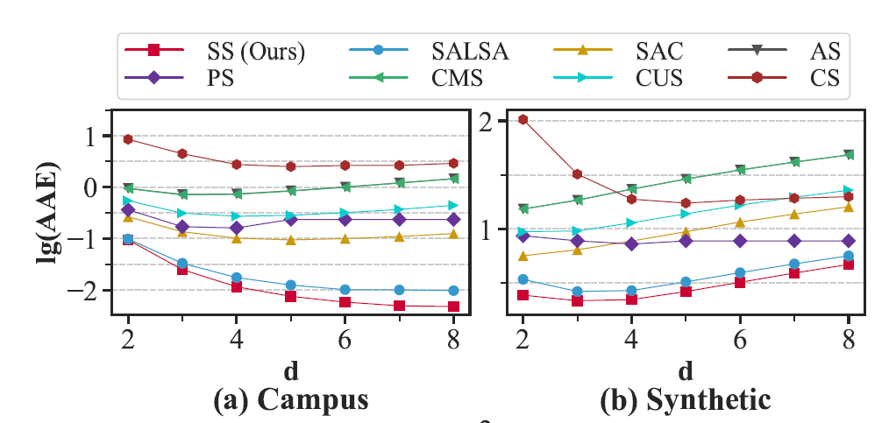
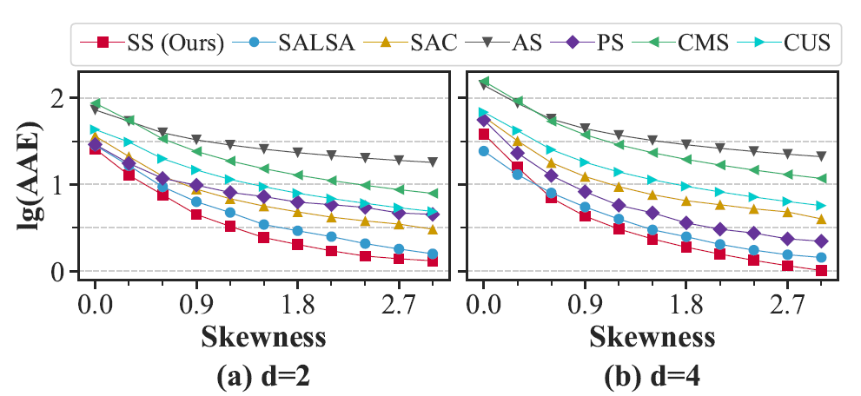
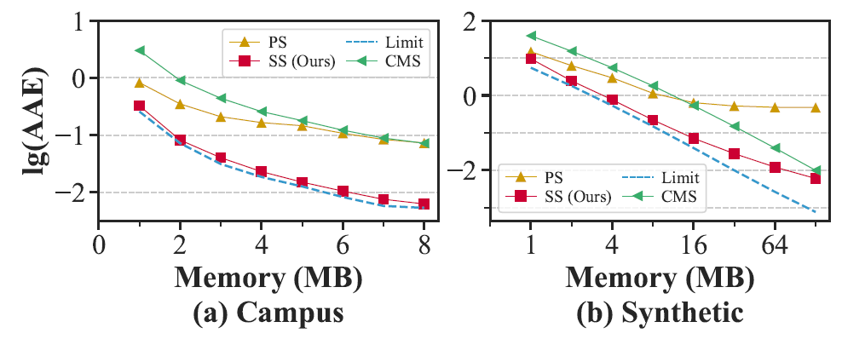
⑥
Experimental Results
Datasets: Campus, Synthetic, Web Stream, CAIDA
Metrics: AAE (Average Absolute Error), AIT (Average Insert Throughput)
AAE of Stingy, Pyramid and Count-min (using d=4 hash functions).
AAE of Stingy and Other Algorithms (Memory = 8 MB).
AAE for Different Skewness of Datasets (Memory = 8 MB).

Slide 61
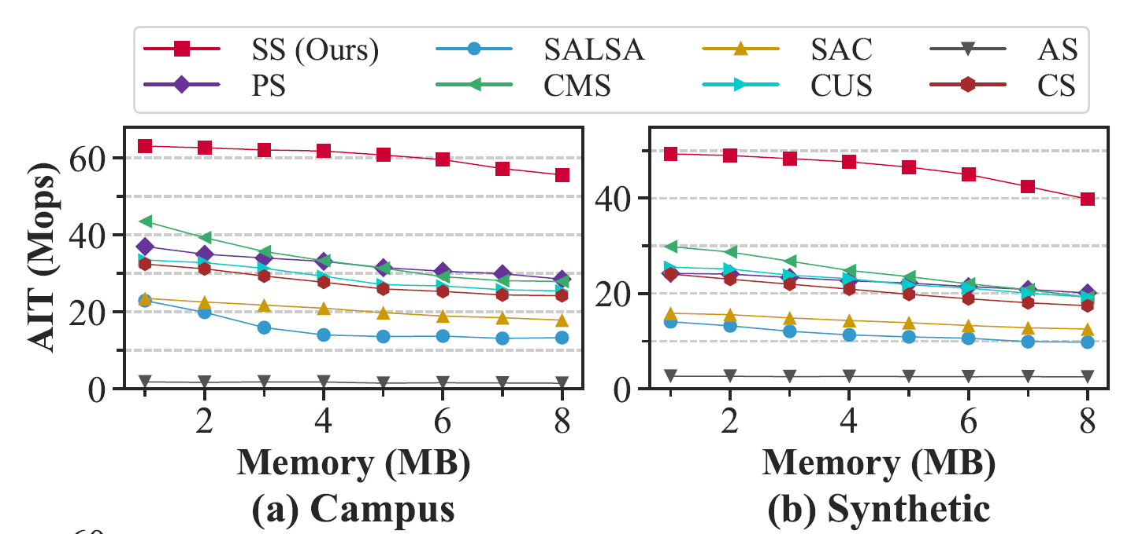
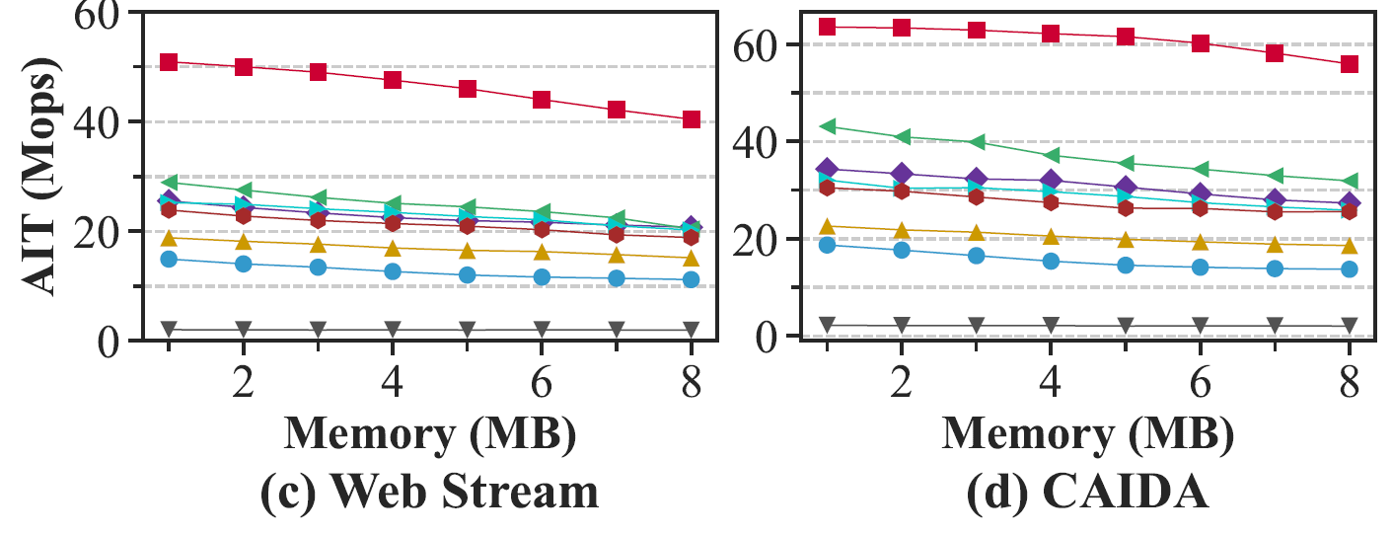
⑥
Experimental Results
Datasets: Campus, Synthetic, Web Stream, CAIDA
Metrics: AAE (Average Absolute Error), AIT (Average Insert Throughput)
AIT of Stingy and Other Algorithms (d=2).

Slide 62
Summary
Stingy Sketch
uses a hierarchical data structure BCTree to reduce memory overhead and thus increase accuracy.
uses PQueue to shorten critical path, which optimizes the processing speed.
uses BHS to reduce hash computation cost without losing much accuracy.

Slide 63
Thanks!
Source code: https://github.com/StingySketch/Stingy-Sketch.
Haoyu Li
Peking University, China

