Slide 1
Acoustic processing and Pattern recognition of Coins
Written by Chi-Young Jeffrey Lii
With thanks to Ted, and the people in MIRLAB
Overseen by Professor Roger Jang

Slide 2
Contents
Goals of research
Definition of Important Terms
Program Process
Research Phase
Implementation Phase
Demonstration
Question Session

Slide 3
Stated Goal
Familiarize self with Matlab by using Matlab on a day-to-day-basis
Learn about signal processing, feature extraction, pattern recognition, and classifier training
Applying research done in the MIRLAB, differentiate what kind of coin is being dropped, from the sound alone

Slide 4

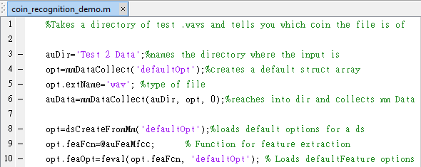
Definition of imporant terms
MATLAB
State-of-the-Art computing environment and programming language
Signal Processing
Feature Extraction
Pattern Recognition
Classifier Training

Slide 5
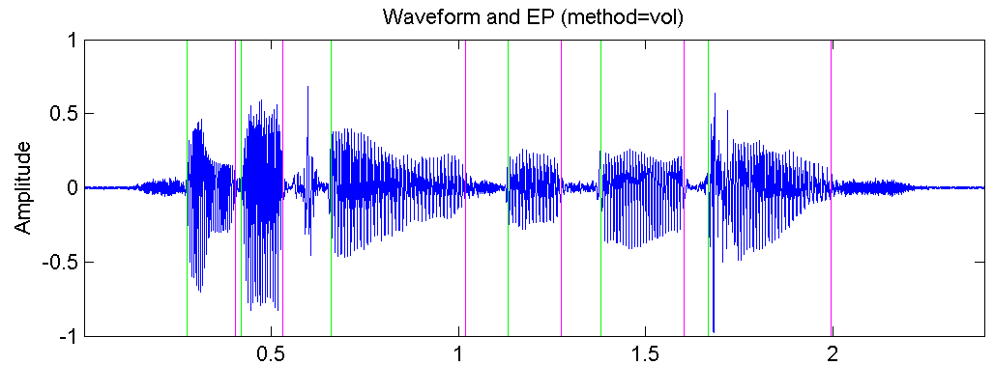
Definition of imporant terms
MATLAB
Signal Processing
Operations on or Analysis of analog and digital signals
Example: Detecting the endpoints of a signal
Feature extraction
Pattern Recognition
Classifier Training

Slide 6
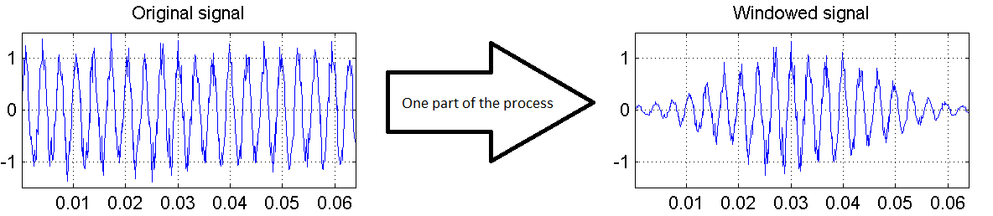
Definition of imporant terms
MATLAB
Signal Processing
Feature Extraction
Transforming a set of raw data into a set of useful features: A long process
Pattern Recognition
Classifier Training

Slide 7
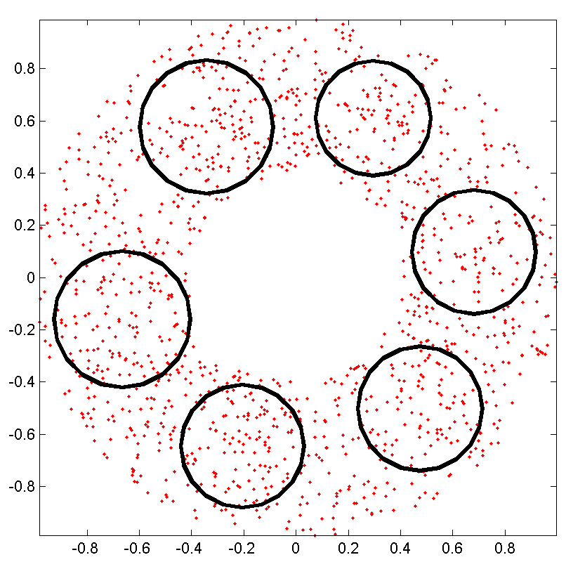
Definition of imporant terms
MATLAB
Signal Processing
Feature Extraction
Pattern Recognition
Study of data patterns and pattern extraction methodology
Example: Gaussian Mixture Model
Classifier Training

Slide 8


Slide 9
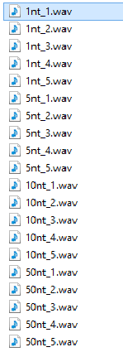
Research Phase
Record the sound of 4 types of coins dropped 5 times in the same way
Process the files: Extract the Mel-Frequency Cepstral Coefficient
Unique thirteen number length vector for each .wav file
Vectors are projected on two vectors for easier analysis (Linear Dimension Analysis)

Slide 10
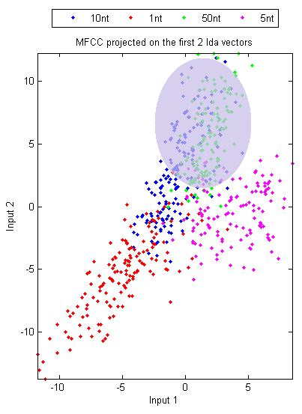
Research Phase Results
5 sound samples of 1nt, 5nt, 10nt, and 50nt
1nt and 5nt have very unique sounds
10nt and 50nt have similar sounds. Overlap area shown in grey
Best classifier tested to be quadratic (‘qc’)

Slide 11
Implementation Phase
Low accuracy
20% accuracy
Everything tested to be 10nt
Gaussian mixture model classifier more reliable than Quadratic
Conclusion: Need more training data – More training data = more accurate

Slide 12
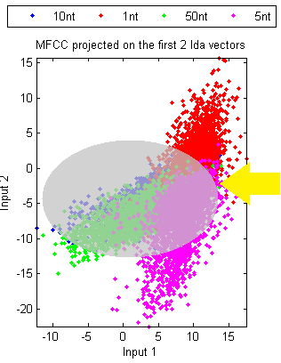
Imlementation Phase – 220 wav files
Recorded additional 50 wav files for each coin type – Total of 220
Significantly increased accuracy – close to 95%
Still some confusion between 10 NT and 50 NT
Shows overlap between all 4 coin types (Yellow Arrow)

