Slide 1
Liima Features

Slide 2
What is Liima? What are it's advantages?
Liima (Finnish for glue) manages the configuration and deployment of applications. It's optimized for configuration reuse.
Main advantages of Liima
Configuration doesn't depend on the technology of the application
Avoids duplication of configuration
Versioning and audit
The configuration is installed with the configuration as one package
Configuration is readable by different teams, secured by role base access control
Easy to integrate with other tools and technologies

Slide 3
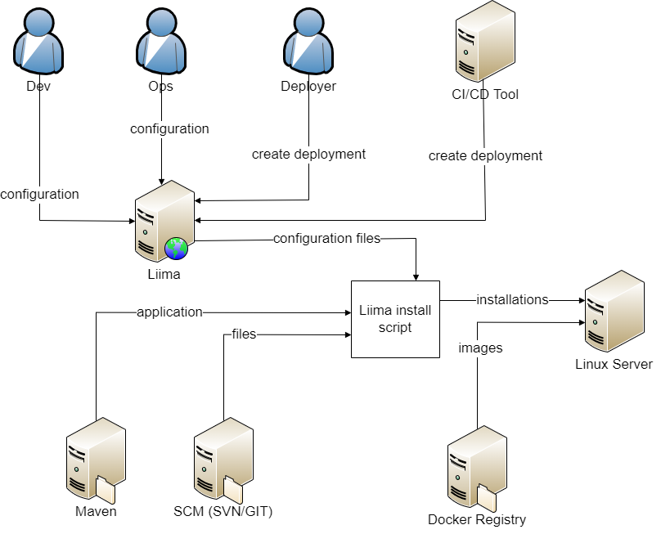
Deployment Prozess mit Liima

Slide 4
Configuration model
Freely definable object model with Liima resources
Modelling of applications with their relations
Freemarker templates convert the model into configuration files
Runtime
standalone.xml - includes other Templates
system.properties
Maven.version=${mavenVersion}
AppServer - Memory Settings
App - Maven Settings
Node - HostName
datasource.xml
<xml …
OracleDB - URL - User - Passwort
Modell
Grundelemente
Templates

Slide 5
Modell: default resources
Default resources are required for each deployment
Runtime
1
AppServer
1..*
App
1..*
Node
Modell
Grundelemente

Slide 6
Model: resources
Resources contain:
Properties descriptors: definition of a property
Property values: value of a property
Templates: convert the properties into configuration
Functions: composition of properties
Relations: reference to other resources for reuse
Ressource
Property Descriptors
Templates
Functions
Property Werte
Relations

Slide 7
Model: inheritance and properties
Every resource has a type
A type can have one parent type
Resources of a type are called instances
The following will be inherited:
property descriptors
property values
templates
functions
Green: defined on that resource
Black: defined on a parent resource type
Parent Resource Typ: Database - user: - password: - datasourceClass:
Resource Typ: Oracle - url: - user: - password: - datasourceClass: oracle.jdbc.xa.*
Instance: sp2 - url: sd02211 - user: - password: - datasourceClass: oracle.jdbc.xa.*

Slide 8
Model: environment hirarchy
Property values are inherited from global to domain (dev, int, prod) to environment
Enables defaulting
Avoids redundancies
On the Liima UI:
Green: defined on this level
Black: inherited from a higher level
Red: validation error
The tooltip (i) shows where a inherited property was overwritten
global
dev
liima01.a-gogo.test
dev1
dev2
dev3
int
liima02.a-gogo.ch
int1
int2
prod
liima03.a-gogo.ch
prod1

Slide 9
Model: relations
Consumed: a foreign resource is consumed
Provided: a resource is provided
Templates can access related resources
Property values can be overwritten in relations
AD
consumes
App - Maven Settings
provides
consumes
WebService - URL
OracleDB - URL - User - Passwort

Slide 10
Model: templates
Templates are use to write configuration
Uses Freemarker: http://freemarker.org/docs/
Templates can be attached to resources, resource types and relations
Templates are always connected to a runtime
standalone.xml - includes other Templates
system.properties
Maven.version=${mavenVersion}
AppServer - Memory Settings
App - Maven Settings
Node - HostName
datasource.xml
<xml …
OracleDB - URL - User - Passwort
Modell
Grundelemente
Templates

Slide 11
Releasing: motivation
A Liima configuration is always valid for all environments
Releasing enables to have different configurations on different environment
Example:
RL-15.04 was released recently, next release is RL-15.10
An application need a different database in RL-15.04
The existing config can't be modified because it would break productions deployments which still need the old database
Workarounds:
Before each deployment change the configuration by hand
Templates with #if and #else
Different Liima configuration per environement

Slide 12
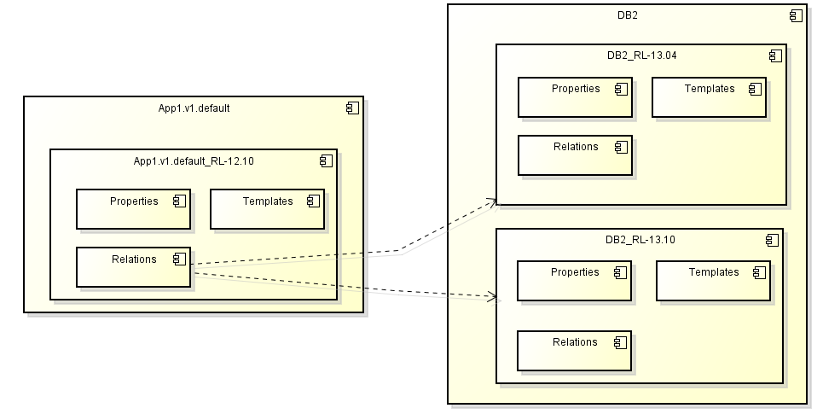
Releasing
A release is a copy of a resource: properties, templates, relations etc.
Different release are shown in Liima as one element
Corresponds to releases of the application
Is similar to a branch in source management
Relations of consumers are extended automatically
At deploy time the matching relation will be selected

Slide 13
Releasing: deployment
The release dropdown in the deployment UI determines which resource releases are selected
The releases in the dropdown depend on the releases of the app server
Applications can deployed with existing releases of an app server or higher

Slide 14
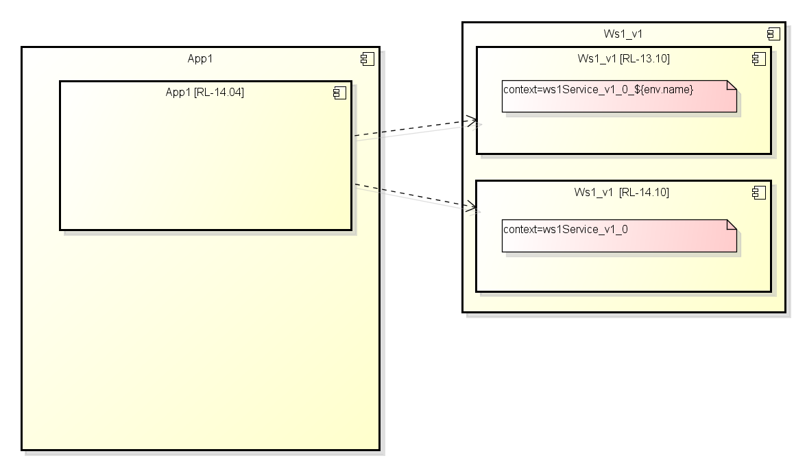
Model: releases
Deployment RL-14.04

Slide 15
Model: releases
Deployment RL-14.10 and higher

Slide 16
Template editor
JavaScript based template editor (CodeMirror)
Built in search function with highlighting
Freemarker syntax highlighting
Row numbers
Fullscreen mode
Most import key shortcuts blow the editor window
Freemarker syntax is check when a template is saved
Validates unclosed bracket and tags
Can't check if variables are missing! Use test generate for this

Slide 17
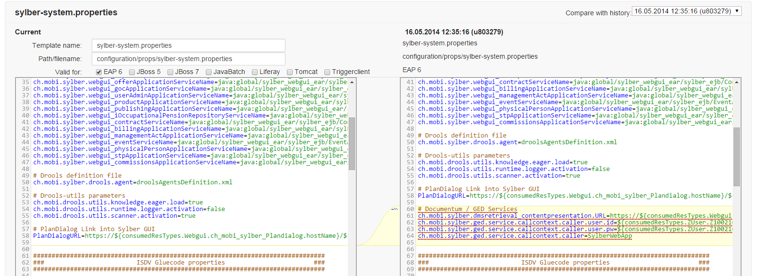
Template editor: compareision
A template can be compared with older versions
Editor shows differences
Supports merging
Time and user of changes are displayed

Slide 18
Test generate
Function reachable via „Test Generation“ button on app or app server
Show rendering errors in templates
Shows the templates after rendering
Is only shown if the user has permissions to deploy to that environment.
Releases can be compared to each other
Uses the diff function of the editor
Can also be used to compare configurations from specific dates

Slide 19
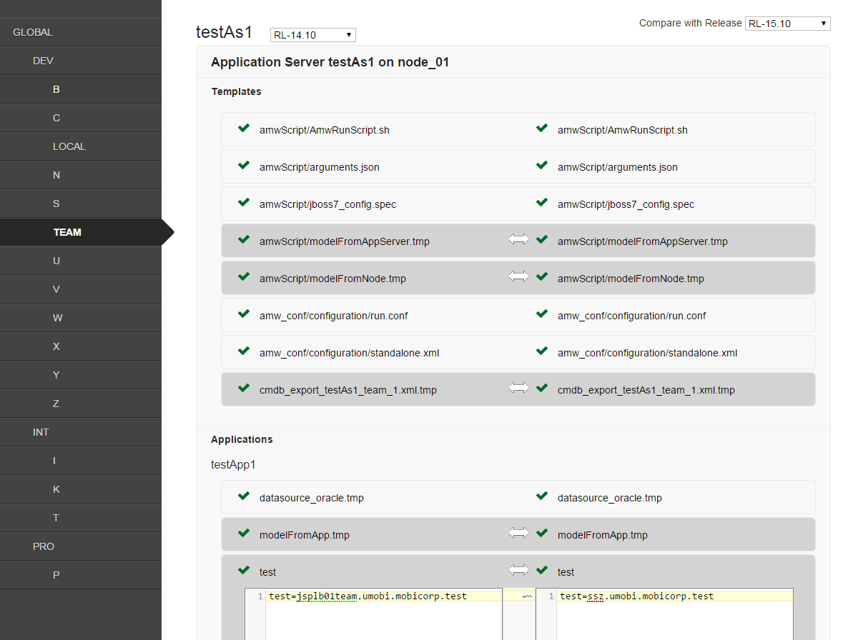
Test generate
Release Selektion
Templates validation
Template differences
Are there differences?

Slide 20



Deployment
Packaging of configuration and application
Installation on the target system
Easily extendable
Files
EAR
system.properties
Werbservice_url=http://…
AmwRunScript.sh
#!/bin/sh
standalone.xml
datasource.xml
<xml …
Liima Templates

Slide 21
Deployment filter
Filter are connected automatically by ANS or OR depending on the filter
Deployment can be exported as CSV
Filter "Latest deployment job for App Server and Env": shows only the latest deployment for one environment

Slide 22
Best practices
Avoid redundancies
Enables central management
Better overview
Properties can contain other properties: ${env.name?lower_case}
Use resources instead of properties
Easier reuse
Dependencies are visible easier
Fill out all environments from the beginning
Less prone to forget configuration
Less errors

