Slide 1
Svelte Basics

Slide 2
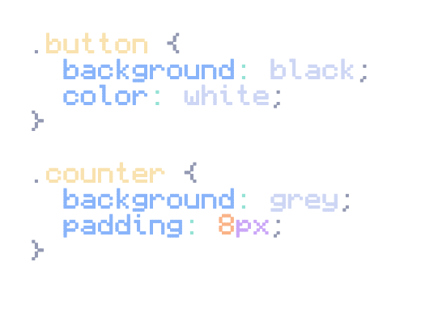


HTML, CSS & JavaScript

Slide 3
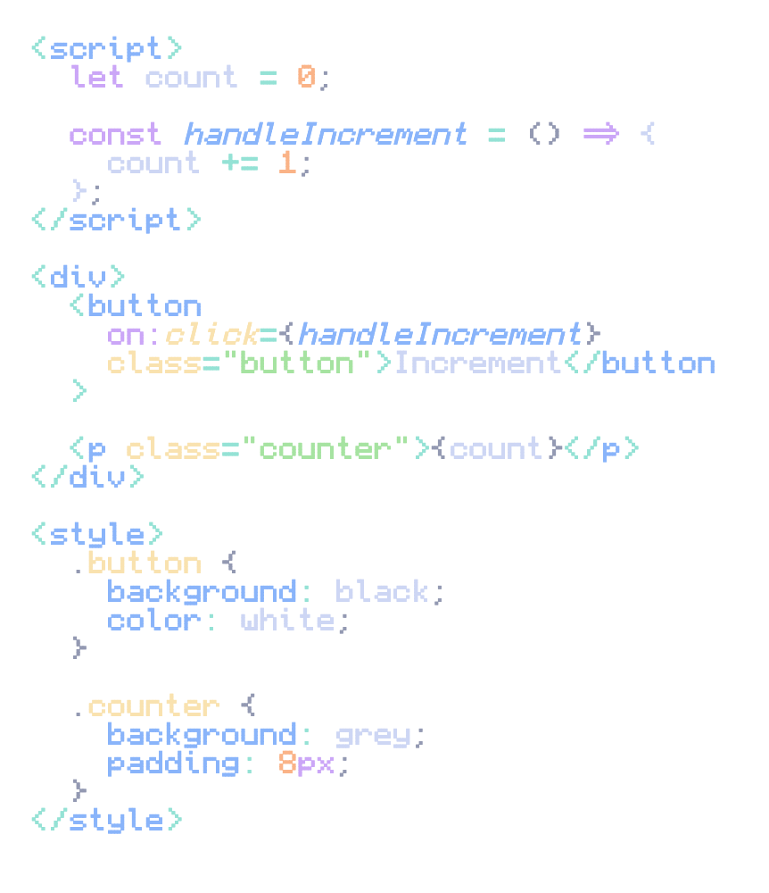
Svelte

Slide 4
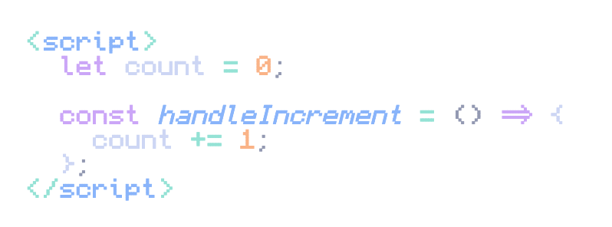
JavaScript

Slide 5
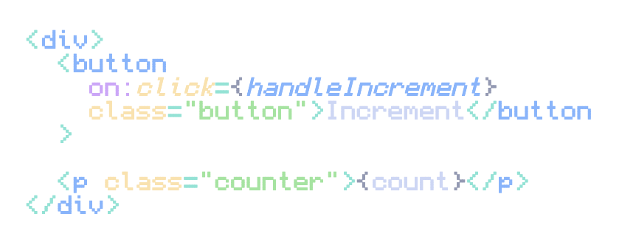
HTML

Slide 6
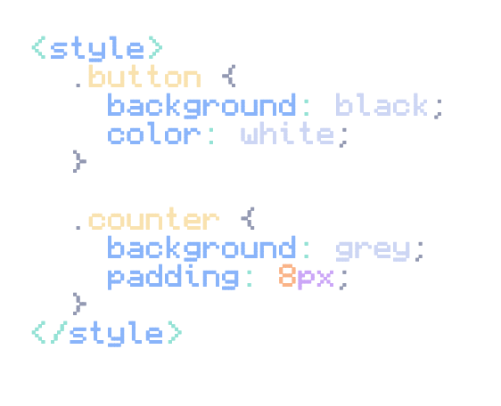
CSS

