Slide 1
sleepissue
<chr>
1 Low
2 Very High
3 High
4 Moderate
5 Very Low/Little
6 NA
7 Not at all
headaches
<chr>
1 High
2 Very High
3 Very Low/Little
4 NA
5 Moderate
6 Not at all
7 Low
8 2
9 5
10 3
11 4
stress
<chr>
1 Moderate
2 Low
3 Very Low/Little
4 NA
5 High
6 Very High
7 Not at all
8 2
9 3
10 1
appetite
<fct>
1 Low
2 Very Low
3 Moderate
4 NA
5 High
6 Very High
exerciselevel
<chr>
1 Low
2 Very Low
3 Moderate
4 NA
5 High
6 Very High
7 Not at all
fatigue
<fct>
1 High
2 Very High
3 Moderate
4 Low
5 NA
6 Not at all
sorebreasts
<chr>
1 Very Low/Little
2 NA
3 Low
4 Moderate
5 Not at all
6 High
7 Very High
moodswing
<fct>
1 Very Low/Little
2 Low
3 NA
4 Not at all
5 Moderate
6 High
7 Very High
bloating
<chr>
1 Very Low/Little
2 NA
3 Not at all
4 Moderate
5 High
6 Low
7 Very High
indigestion
<chr>
1 Very Low/Little
2 NA
3 Low
4 Not at all
5 Moderate
6 High
7 Very High
foodcravings
<chr>
1 Very Low/Little
2 NA
3 Low
4 Not at all
5 Moderate
6 High
7 Very High
cramps
<chr>
1 Very Low/Little
2 NA
3 Moderate
4 High
5 Not at all
6 Low
7 Very High

Slide 2
$appetite
[1] "low" "very low" "moderate" NA "high" "very high" "not at all"
$exerciselevel
[1] "low" "very low" "moderate" NA "high" "very high" "not at all”
headaches
[1] "high" "very high" "very low/little" NA "moderate" "not at all" "low" "2" "5" "3" "4"
$cramps
[1] "very low/little" NA "moderate" "high" "not at all" "low" "very high"
$sorebreasts
[1] "very low/little" NA "low" "moderate" "not at all" "high" "very high"
$fatigue
[1] “high” “very high” “moderate” “low” “very low/little” NA "not at all"
$sleepissue
[1] “low” “very high” “high” “moderate” “very low/little” NA "not at all"
$moodswing
[1] "very low/little" "low" NA "not at all" "moderate" "high" "very high"
$stress
[1] "moderate" "low" "very low/little" NA "high" "very high" "not at all" "2" "3" "1"
$foodcravings
[1] "very low/little" NA "low" "not at all" "moderate" "high" "very high"
$indigestion
[1] "very low/little" NA "low" "not at all" "moderate" "high" "very high"
$bloating
[1] "very low/little" NA "not at all" "moderate" "high" "low" "very high"

Slide 3
$flow_volume
[1] "not at all" NA "very heavy" "somewhat heavy" "moderate" "light" "spotting / very light" "heavy" [9] "somewhat light"
$flow_color
[1] “not at all” NA “bright red” “dark brown / dark red” [5] "other" "pink" "grey" "black" [9] "orange" "yellow"

Slide 5
headaches_score n
<dbl> <int>
1 0 1088
2 1 886
3 2 504
4 3 502
5 4 254
6 5 86
7 NA 2339
>
moodswing_score n
<dbl> <int>
1 0 1032
2 1 780
3 2 544
4 3 612
5 4 268
6 5 84
7 NA 2339
fatigue_score n
<dbl> <int>
1 0 444
2 1 473
3 2 552
4 3 936
5 4 685
6 5 241
7 NA 2328
appetite_score n
<dbl> <int>
1 0 4
2 1 151
3 2 758
4 3 1748
5 4 580
6 5 89
7 NA 2329

Slide 6
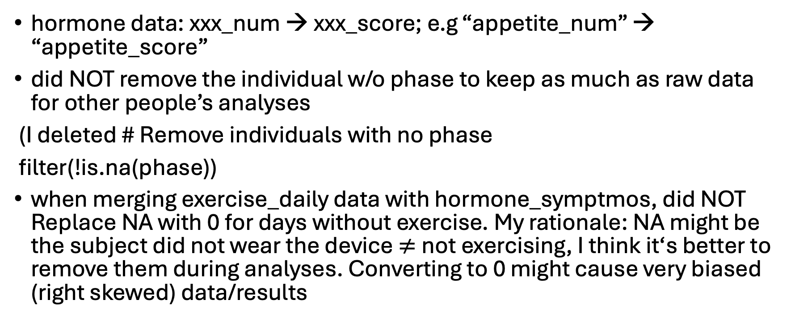
ANU
hormone data: xxx_num → xxx_score; e.g “appetite_num” → “appetite_score”
did NOT remove the individual w/o phase to keep as much as raw data for other people’s analyses
(I deleted # Remove individuals with no phase
filter(!is.na(phase))
when merging exercise_daily data with hormone_symptmos, did NOT Replace NA with 0 for days without exercise. My rationale: NA might be the subject did not wear the device $≠$not exercising, I think it‘s better to remove them during analyses. Converting to 0 might cause very biased (right skewed) data/results

Slide 7
KHUE
Changed `overall_score` from `sleep.csv` to `sleep_score` to distiguish sleep score vs. stress score
Changed `inner_join` to `full_join` to keep all days with any `sleep_score` or `stress_score` records
(changed `sleep_stress_score <- inner_join(sleep_score, stress_score, join_by("id", "study_interval", "day_in_study"))`)
You can still removed the rows with missing values in your interested variables (use `filter(is.na())`), but maybe include a justification (e.g. show the difference in data points number before removing them vs. after removing them, if we still have a lot of data points with complete data you need, then removing those rows with missing values is fine.
Removed duplicates in `sleep_score` by keeping the max score (the lower score might be technical issue of recording).
A lot of questions regaring the `sleep.csv` 😵‍💫

Slide 8
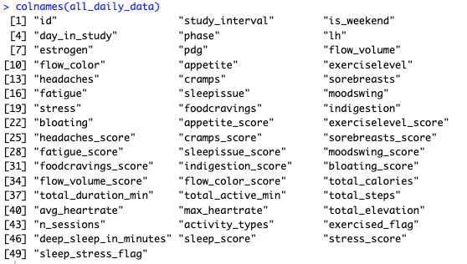
EMILY
Merged dataframe called `all_daily_data`
  Used `hormone_symptoms` as the anchor df, since you are going to treat them as outcome variables.
  Left joined with daily exercise, sleep & stress score data
  NOT including sleep data yet (but you can use sleep score & stress score, maybe this is enough, easier than dealing with other sleep data).
I left flags for you easy filter(flag == 1)
  `exercise_flag = 1` has daily exercise data
  `sleep_stress_flag = 1` has daily sleep stress score flag
All the hormone symptom columns are factor (e.g. cramp, bloating) , and their numeric values are converted into column names as (xxx_score, e.g. cramp_score, bloating_score). You may want to use `xxx_score` for models.
Did NOT merged demographics data (`subject_info`) as each row in `all_daily_data` represents a day. Kind of doesn’t make sense to merge the demographics to it.
  But I kept the commented line of code in the merged dataset section; if you want to make the `all_daily_data` capture all csv files content, just uncomment it (now the `all_daily_data` will have 65 columns

