Slide 1
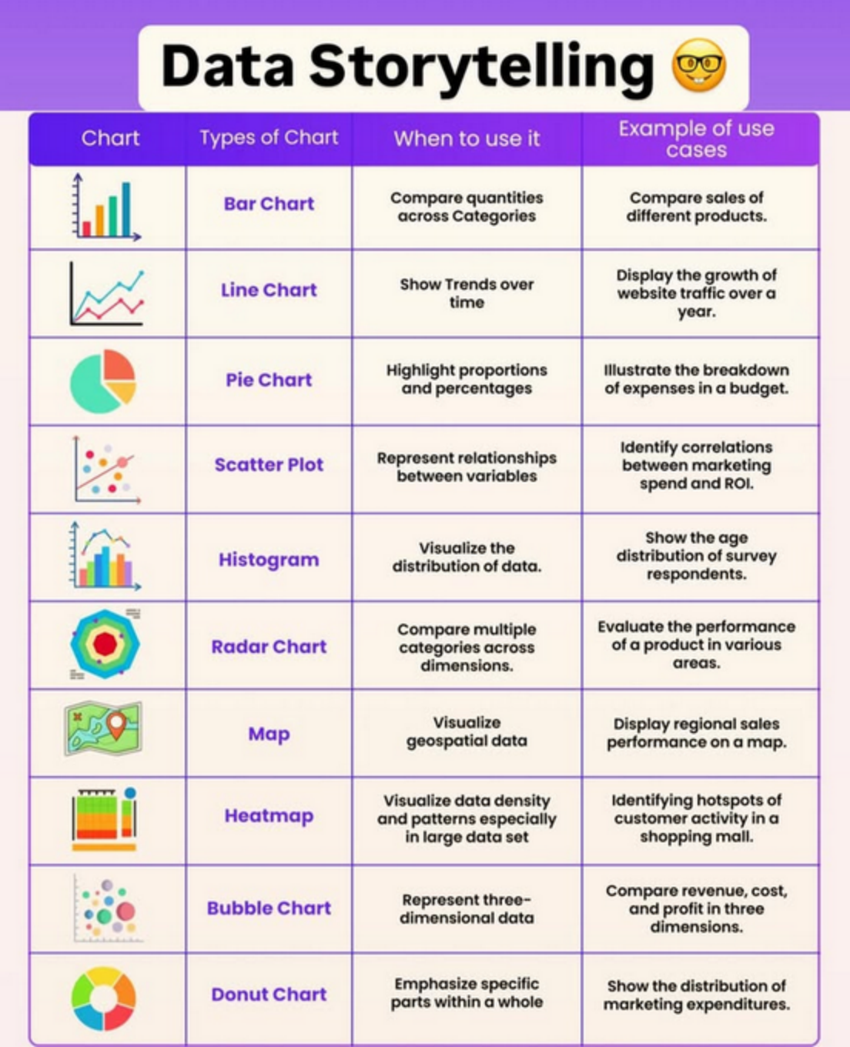
Data Storytelling
chart
Types of Chart
When to use it
Example of use cases
Bar Chart
Compare quantities across Categories
Compare sales of different products.
Line Chart
Show Trends over time
Display the growth of website traffic over a year.
Pie Chart
Highlight proportions and percentages
lllustrate the breakdown of expenses in a budget.
Scatter Plot
Representrelationships between variables
Identify correlations between marketing spend and ROI.
Visualize the distribution of data.
Show the age distribution of survey respondents.
Histoaram
Compare multiple categories across dimensions.
Evaluate the performance of a product in various areas.
RadarChart
Map
Visualize geospatial data
Display regional sales performance on a map.
Heatmap
Visualize data density and patterns especially in large data set
Identifying hotspots of customer activity in a shopping mall.
Bubble Chart
Represent three- dimensionaldata
Compare revenue,cost and profit in three dimensions.
Donut Chart
Emphasize specific parts within a whole
Show the distribution of marketing expenditures.

