Slide 1
Datafest 2018 – kuanju chiu, Xiaoke meng, jiahao li, zelin li
Dataset: | Indeed Job Listings
Variables used
avgOverallCompanyRating | salaryCurrency
numOfRatings | supervisingJob
normTitle | licenseRequiredJob
normTitleCategory | educationRequirement
descriptionWordCount | Average clicks per day
experienceRequired
estimatedSalary

Slide 2
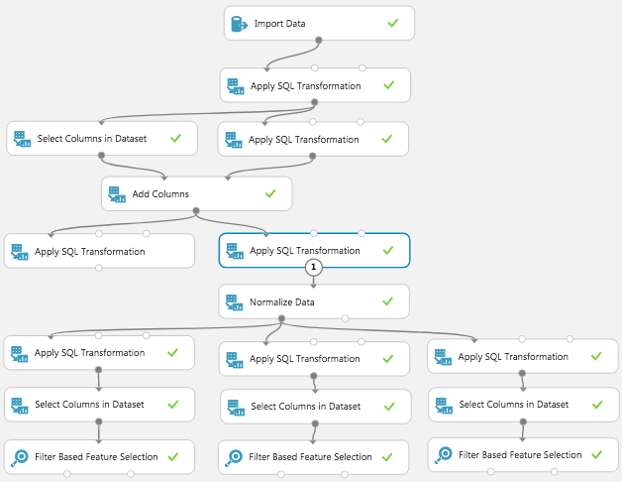
1. How to move between income brackets?
WE ESTIMATE THE FACTORS THAT COULD AFFECT EACH INCOME BRACKET
Convert to USD, remove estimated salaries = 0 (2%), education -> binary, corrected values
assumptions: full time jobs (>15000), {med, admin, management} => 1
Partition salaries into three parts: 15 000 – 50 000 LOW, 50 001 – 100 000 MID, > 100 001 HIGH
Feature selection with Pearson method
LOW:
MID:
HIGH:
License Required | Experience Required | Supervising Job | Number of Reviews
0.170478 | 0.116662 | 0.10424 | 0.081644
Experience Required | License Required | Education | Supervising Job
0.283208 | 0.178312 | 0.128825 | 0.123302
Education | License Required | Experience Required | Supervising Job
0.272652 | 0.262715 | 0.135605 | 0.113997

Slide 3
Thank you very much!

