Slide 1
HGAR: Hybrid Granular Algorithm for Rating Recommendation
http://ailab.ahu.edu.cn/
Fulan Qian¹, Yafan Huang, Jianhong Li, Shu Zhao, Jie Chen,
Xiangyang Wang, and Yanping Zhang
Anhui University
Anhui Electrical Engineering Professional Technique College
¹E-mail:qianfulan@hotmail.com

Slide 2
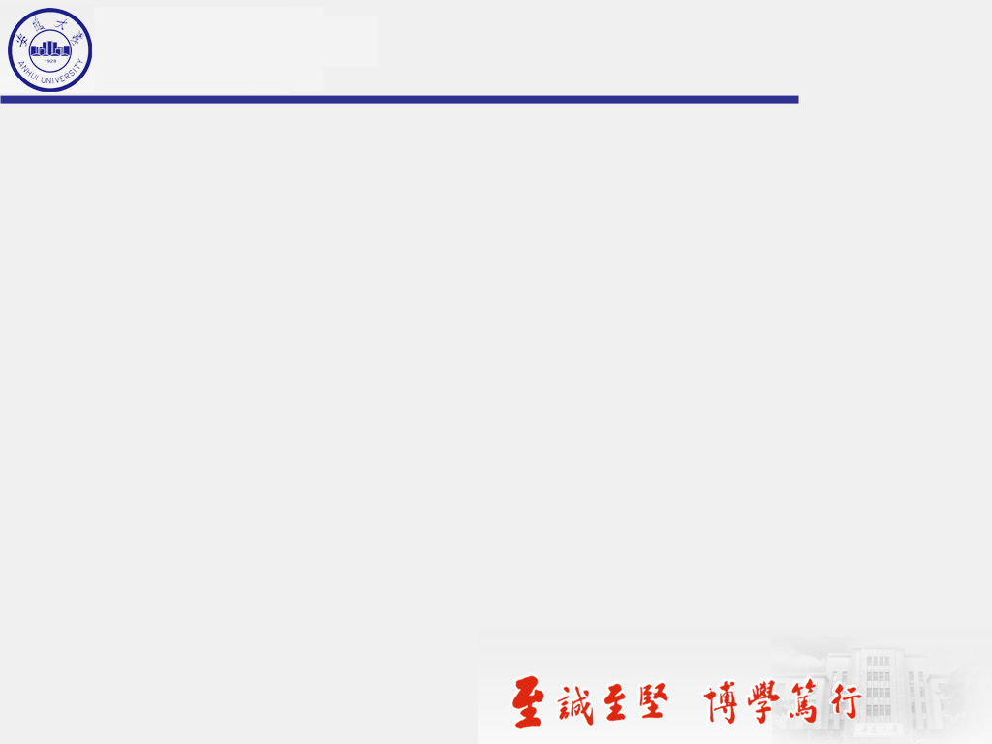
Contents
1. Background
2. Method
3. Experiment
4. Conclution

Slide 3
Background
1

Slide 4
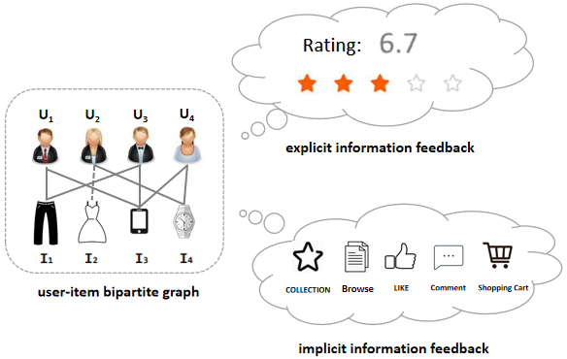
Application scenarios
ratings, purchases, friends, follow-ups, and other information that actually happens.
browsing, clicking, collect, comment, adding to the shopping cart, etc.

Slide 5
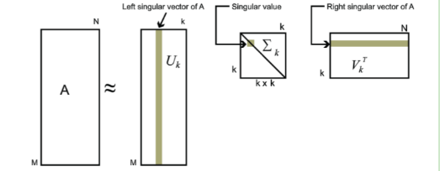

Explicit Information feedback
The core idea of SVD is to decompose the rating matrix into user feature matrix and item feature matrix, and fit the rating matrix by inner product.

Slide 6
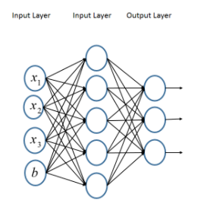

Implicit Information feedback
Due to the powerful capacity of mining implicit information, deep learning
techniques have gained much success in many domains.
MLP is a typical deep learning model. In addition to the input and output layers, it can have multiple hidden layers to obtain implicit information feedback.

Slide 7
Problem
Explicit Information Feedback
Implicit Information Feedback
Pros:
High accuracy and pertinence
Pros:
the data is abundant and easily accessible
Cons:
Explicit feedback data is difficult to obtain, and few users are willing to explicitly rate items or express their liking.
Cons:
There is often a lot of noise and a lot of uncertainty in the performance of user interest.
How to fuse those two information granular?

Slide 8

HGAR: Method
2

Slide 9
PROBLEM DEFINITION
{x₁, x₂, x₃, ..., x_{n}}:
interactive information attribute
X = X₁+X₂:
X contains explicit information granule(X₁) and implicit information granule(X₂)
x_{i} ∈ X_{j},i ∈ {1, 2, 3, ..., n}, j ∈ {1, 2}:
interactive information attribute is classified into explicit and implicit
Y:the domain of the rating values
f : X → Y: a property function
{X_{j}} is a partition of X.
the explicit information granule can be defined as：X₁ = f_{explicit} (x_{i}) ,Y = f (X₁);
the implicit information granule can be defined as：X₂ = f_{implicit} (x_{i}),Y = f (X₂).
the final output Y is defined as: Y = f (x₁) + f (x₂).

Slide 10
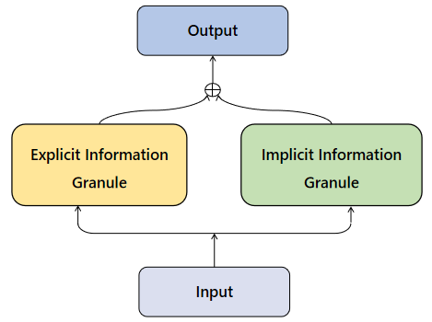
PROBLEM DEFINITION
HGAR is defined as:
X_{j} = {x_{i}|f (x_{i}) ∈ Y } , i ∈ {1, 2, 3, ..., n}, j ∈ {1, 2}

Slide 11
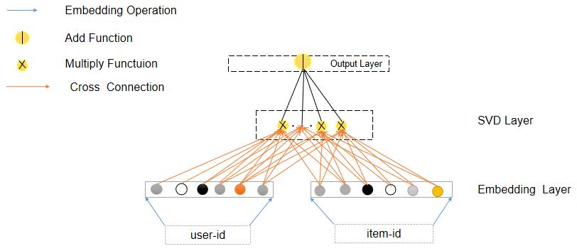
HGAR:Explicit Information Granule
The user's rating of the item by obtained the explicit information:
The output of the SVD layer:

Slide 12
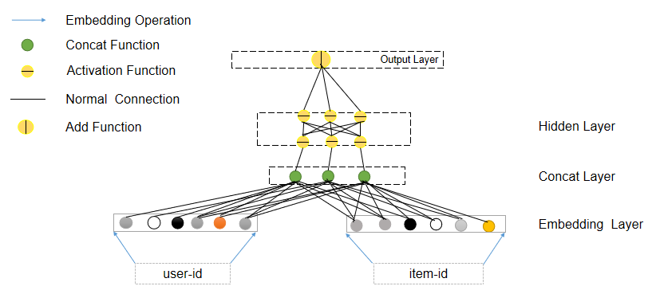
HGAR:Implicit Information Granule
Concatenate uemb and iemb into one vector:
According to the definition of implicit information particles, the hidden layer denotes as:

Slide 13
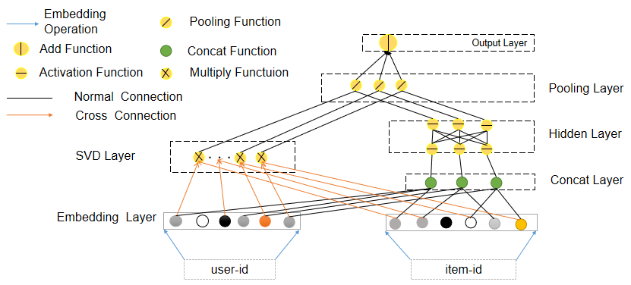
HGAR: Hybrid Granular Algorithm for Rating Recommendation
Convert ratings with sum pooling to descend to 1-dimension:
The output after fusion is formulated as:

Slide 14
Experiment
3

Slide 15
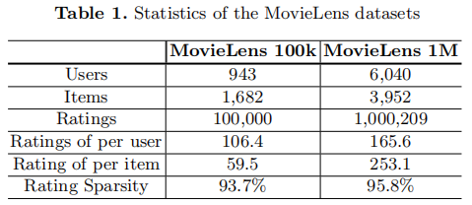
Experiment Settings
Data Sets:
Evaluation Protocols：

Slide 16
Baselines
Categories | Methods
explicit information feedback-based | PMF
 | BPMF
 | RLMC
 | RegSVD
 | PRMF
 | TWDA
implicit information feedback-based | PRA
 | CDAE
 | SR^{imp}
 | SVD++
 | Wide and Deep
 | Hybird IC-CRBMF
 | HACF

Slide 17
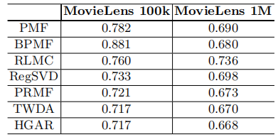
Experimental Results
Table 2. Experimental Performance MAE metrics of HGAR compared to explicit feedback baselines on the MovieLens datasets.
HGAR outperforms all other methods based on explicit information feedback.
The results reveal that other methods only based on explicit feedback cannot obtain higher precision.

Slide 18
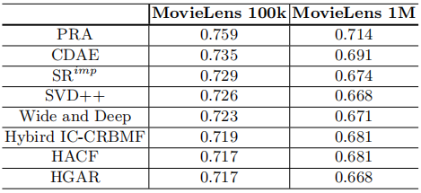
Experimental Results
Table 3. Experimental Performance MAE metrics of HGAR compared to implicit feedback baselines on the MovieLens datasets.
HGAR achieves the best performance in general and obtained improvements over the implicit-based methods.
In particular, the result of HACF on Movielens-100k is the same as HGAR, but on the 1M dataset, our result is better.

Slide 19
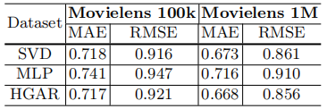
Only Explicit v.s. Only Implicit
Table 4. Experimental Performance of SVD and MLP on the MovieLens datasets.
HGAR makes significant improvements compared to the MLP whatever MAE or RMSE on Movielens-100k or 1M.
Compared to SVD, the RMSE and MAE values of HGAR show good results in Movielens 1M.

Slide 20
4
Conclution

Slide 21
Conclution
Based on granulation computing, we propose a Hybrid Granular Algorithm for Rating Recommendation (HGAR) to explore the multi-granularity of interaction information for both explicit and implicit feedback.
We used SVD model to get explicit information and MLP model to obtain implicit information. In addition, we fused the two part information when the two models are jointly trained.
We conduct extensive experiment on two Movielens datasets to demonstrate the effectiveness and rationality of the proposed HGAR model.

Slide 22
Future work
Under the framework of HGAR, SVD and MLP in the explicit and implicit information granule are replaced by other methods that conform to the properties of the granule.
Consider adding attention mechanisms to HGAR for more fine-grained recommendations
Try experimenting with HGAR on other (larger and more diverse) data sets.

Slide 23
H
N
T
A
K
presented by Yafan Huang

