Slide 1



Approximating Graph Pattern Queries Using Views
Jia Li¹, Yang Cao², Xudong Liu¹
¹Beihang University, China
²University of Edinburgh, UK
University of Edinburgh

Slide 2
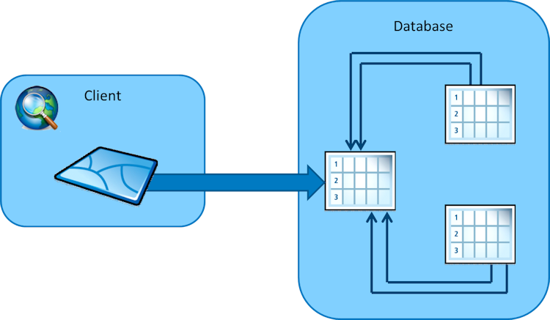

Background
Answering queries using materialized views
materialize views over the database previously
speed up query processing
Application
relational queries
graph pattern queries
SPARQL
graph simulation

Slide 3

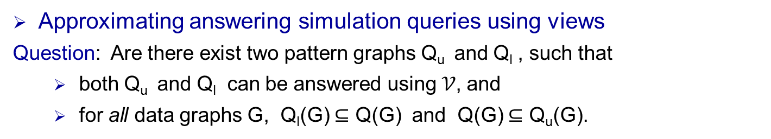
Challenges
Answering simulation queries using views
Input: A simulation pattern query Q, a set 𝒱 of pattern views V₁, V₂, …, V_{n}, data
graph G, the materialized view answers V₁(G), V₂(G), …, V_{n}(G) in G.
Question: Can Q be answered using views 𝒱, i.e. the matches Q(G) to Q in G
can be computed using nodes and edges in the view answers only.
Good news: If so, desirable performance
Bad news: the physical storage is limited, such that the cached views are limited
In many cases, queries cannot be exactly answered using 𝒱
Q can be upper and lower “bounded” via approximations which can be answered using 𝒱
Approximating answering simulation queries using views
Question: Are there exist two pattern graphs Q_{u} and Q_{l} , such that
both Q_{u} and Q_{l} can be answered using 𝒱, and
for all data graphs G, Q_{l}(G) $⊆$ Q(G) and Q(G) $⊆$ Q_{u}(G).
We call Q_{u} and Q_{l} upper and lower approximations of Q w.r.t. 𝒱

Slide 4
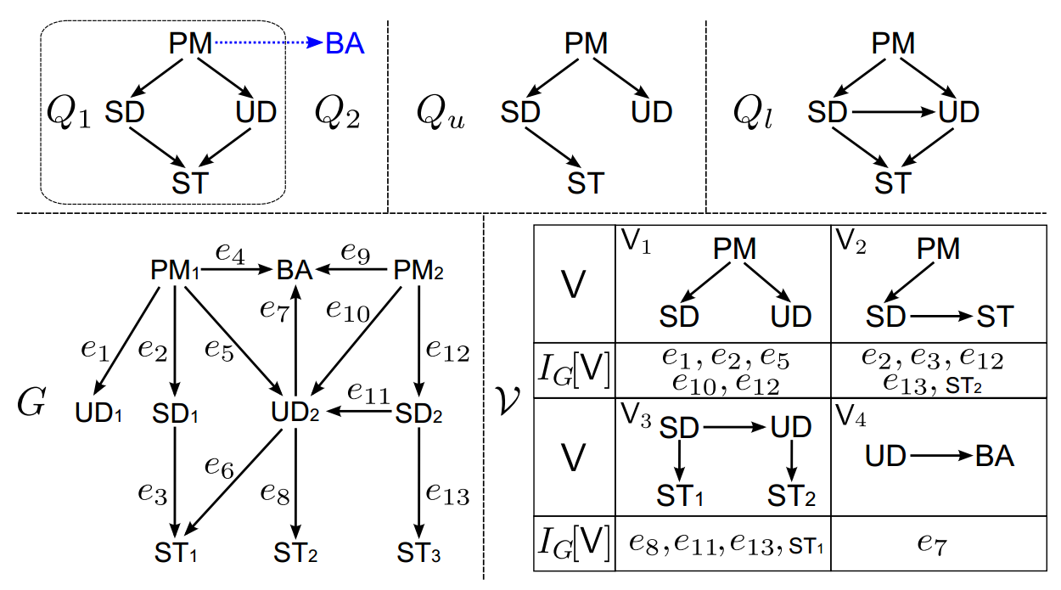
An example: graph pattern queries (graph simulation)
Querying a recommendation network:
(1) Q₁ cannot be answered using view answers.
(2) There exist Q_{u} and Q_{l} can be answered using I_{G}(V₁), I_{G}(V₂) and I_{G}(V₁), I_{G}(V₃).
(3) Q_{l}(G) $⊆$ Q₁(G) $⊆$ Q_{u}(G).
Q₁ is “completely” upper and lower approximated by Q_{u} and Q_{l} w.r.t. 𝒱

Slide 5
An example: graph pattern queries (graph simulation)
Querying a recommendation network:
(1) Q₂ cannot be answered using view answers.
(2) There exist no Q_{u} and Q_{l} that can “completely” upper and lower bound Q₂
(3) The answers to subgraphs of Q₂ can be bounded, i.e. Q_{l}(G) $⊆$ Q₁(G) $⊆$ Q_{u}(G).
Q₂ is “partially” upper and lower approximated by Q_{u} and Q_{l} w.r.t. 𝒱

Slide 6
Overview
Formalization of upper and lower approximation of pattern queries
Simulation queries (graph simulation)
Subgraph queries (subgraph isomorphism)
Investigating fundamental problems for simulation queries
Existence of (complete) upper approximation: EUA, EUA^{c}
Existence of (complete) lower approximation: ELA, ELA^{c}
Closest (complete) upper approximation: CUA, CUA^{c}
Closest (complete) lower approximation: CLA, CLA^{c}
Developing algorithms with provable guarantees for the problems
Extending the study to subgraph queries
Fundamental problems
Answering subgraph queries using views

Slide 7
Formalization of upper and lower approximation of pattern queries

Slide 8
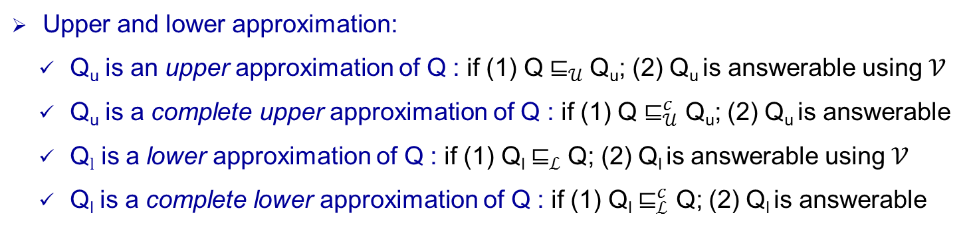
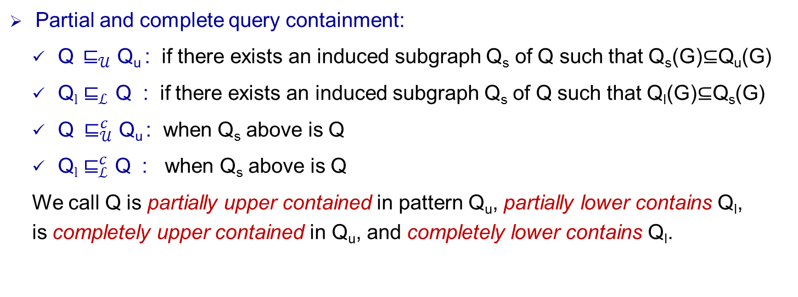
Upper and lower approximation
Query answering using views: A query Q is answerable using views in 𝒱, for any data graph G, if Q(G) can be identified by accessing the answers of views in G only.
Partial and complete query containment:
Q${ ⊑}_{𝒰}$ Q_{u} : if there exists an induced subgraph Q_{s} of Q such that Q_{s}(G)$⊆$Q_{u}(G)
Q$l$ $⊑_{ℒ}$ Q : if there exists an induced subgraph Q_{s} of Q such that Q_{l}(G)$⊆$Q_{s}(G)
Q ${ ⊑}_{𝒰}^{c}$ Q_{u} : when Q_{s} above is Q
Q$l$ ${\text{⊑}}_{ℒ}^{c}$ Q : when Q_{s} above is Q
We call Q is partially upper contained in pattern Q_{u}, partially lower contains Q_{l}, is completely upper contained in Q_{u}, and completely lower contains Q_{l}.
Upper and lower approximation:
Q_{u} is an upper approximation of Q : if (1) Q${ ⊑}_{𝒰}$ Q_{u}; (2) Q_{u} is answerable using 𝒱
Q_{u} is a complete upper approximation of Q : if (1) Q $⊑_{𝒰}^{c}$ Q_{u}; (2) Q_{u} is answerable
Q$l$ is a lower approximation of Q : if (1) Q_{l} ${\text{⊑}}_{ℒ}$Q; (2) Q_{l} is answerable using 𝒱
Q_{l} is a complete lower approximation of Q : if (1) Q_{l} $⊑_{ℒ}^{c}$ Q; (2) Q_{l} is answerable

Slide 9
An example: graph pattern queries (graph simulation)
Querying a recommendation network:
(1) Q₁${ ⊑}_{𝒰}^{c}$Q_{u}, Q_{u} is answerable using 𝒱, Q_{u} is a complete upper approximation of Q₁,
(2) Q₂ $⊑_{𝒰}$ Q_{u}, Q_{u} is answerable using 𝒱, Q_{u} is an upper approximation of Q₂,
(3) Q_{l}${ ⊑}_{ℒ}^{c}$ Q₁, Q_{l} is answerable using 𝒱, Q_{l} is a complete lower approximation of Q₁,
(4) Q_{l} ${ ⊑}_{ℒ}$ Q₂, Q_{l} is answerable using 𝒱, Q_{l} is a lower approximation of Q₂.

Slide 10
Fundamental problems for simulation queries

Slide 11


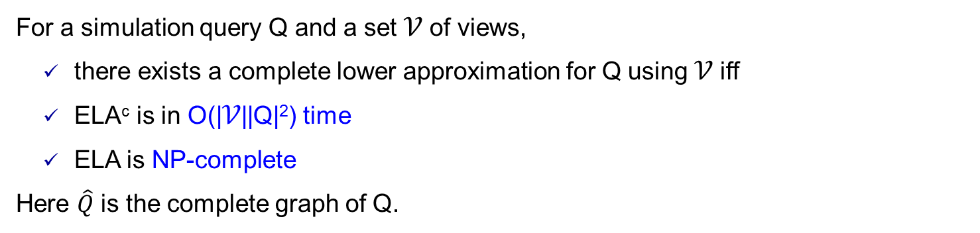
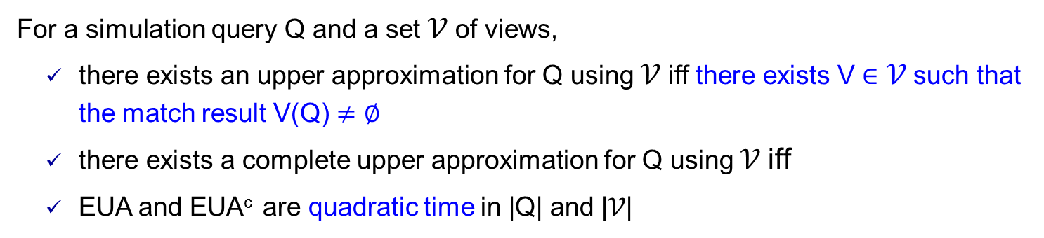
Existence of approximation
Existence of upper approximation (EUA) : Given a simulation query Q and 𝒱, whether there exists an upper approximation Q_{u} for Q w.r.t. 𝒱.
Existence of complete upper approximation (EUA^{c})
For a simulation query Q and a set 𝒱 of views,
there exists an upper approximation for Q using 𝒱 iff there exists V $∈$ 𝒱 such that the match result V(Q) $≠∅$
there exists a complete upper approximation for Q using 𝒱 iff
EUA and EUA^{c} are quadratic time in |Q| and |𝒱|
Existence of lower approximation (ELA)
Existence of complete lower approximation (ELA^{c})
For a simulation query Q and a set 𝒱 of views,
there exists a complete lower approximation for Q using 𝒱 iff
ELA^{c} is in O(|𝒱||Q|²) time
ELA is NP-complete
Here $\hat{Q}$ is the complete graph of Q.

Slide 12
Closest approximation
Closeness: the closeness clo(Q’,Q) of Q’ and Q, is the number of edges in Q’ and Q that are not in the edge-induced maximum common subgraph of Q’ and Q.
Closest upper approximation (CUA): Given a simulation query Q and 𝒱, find the upper approximation Q_{u} that is closest to Q, i.e. for any other Q’_{u}, clo(Q_{u}, Q) $≤$ clo(Q’_{u}, Q).
Complete closest upper approximation (CUA^{c})
Closest lower approximation (CLA)
Complete closest lower approximation (CLA^{c})
For a simulation query Q and a set 𝒱 of views,
CUA and CUA^{c} are quadratic time in |Q| and |𝒱|.
DCLA and DCLA^{c} are NP-complete.
OCLA and OCLA^{c} are not in APX.

Slide 13
Algorithms for problem EUA, EUA^{c}, ELA, ELA^{c}, CUA, CUA^{c}, CLA, CLA^{c}

Slide 14


Computing upper and lower approximation
Algorithms for upper approximation
Algorithm CUASim^{c} and EUASim^{c} is in O(|Q||𝒱|+|V_{Q}|²) time
Algorithm CUASim and EUASim is in O(|Q||𝒱|) time
Algorithms for lower approximation
Algorithm ELASim^{c} is in O(|𝒱||Q|²) time
Algorithm CLASim^{c} is a - approximation algorithm that always returns a complete lower approximation of Q w.r.t. 𝒱 in O(|𝒱||Q|²) time when there exists one
Algorithm CLASim and ELASim is a heuristic algorithm runs in O(|𝒱||Q|²) time

Slide 15
Extending to subgraph queries

Slide 16


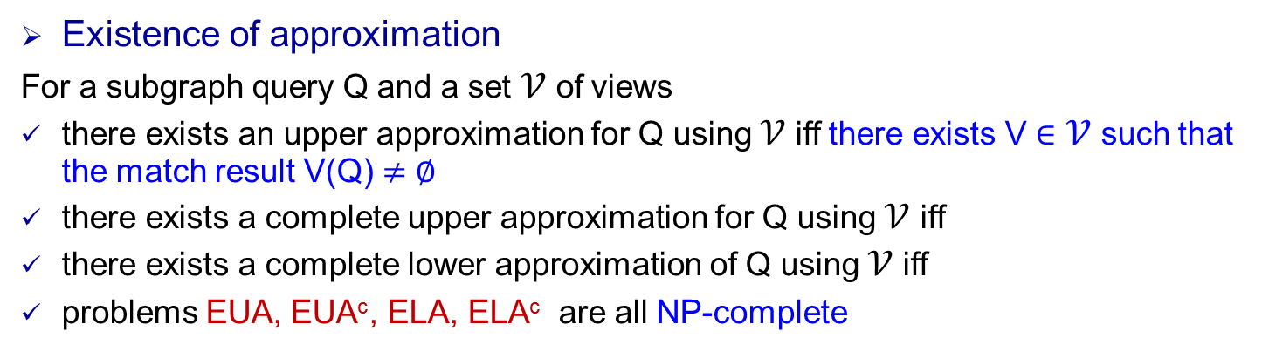
Approximation for subgraph queries
Existence of approximation
For a subgraph query Q and a set 𝒱 of views
there exists an upper approximation for Q using 𝒱 iff there exists V $∈$ 𝒱 such that the match result V(Q) $≠∅$
there exists a complete upper approximation for Q using 𝒱 iff
there exists a complete lower approximation of Q using 𝒱 iff
problems EUA, EUA^{c}, ELA, ELA^{c} are all NP-complete
Closest approximation
For a subgraph query Q and a set 𝒱 of views
pattern graph is the closest upper approximation of Q
if , is the complete closest upper approximation of Q
problems CUA, CUA^{c}, CLA, CLA^{c} are all NP-complete
Subgraph query answering using views
Q can be answered using 𝒱 iff
it is NP-complete to decide whether Q can be answered using 𝒱

Slide 17
Experimental study

Slide 18
Experimental study
Experimental setting
Real-life graphs: (a) DBpedia: (4.43M, 8.43M) (b) YouTube: (2.03M, 12.22M)
Views: designed of sizes (2,1), (3,2), (4,3), (4,4), and varied structure of same sizes view answers in total take 32.58% of DBpedia dataset, and 34.29% of YouTube.
Algorithms: CUAsim^{c}, CUAsim, CLAsim^{c}, CLAsim, CUAiso^{c}, CUAiso, CLAiso^{c}, CLAiso;
QAViso, QAVsim*; gSim*,VF2*;
Experimental results
Percentage of queries approximable using views:
25% of views are used, 65% (53%) simulation (subgraph) queries on DBpedia
75% of views are used, 88% (81%) simulation (subgraph) queries on YouTube
Accuracy of approximation using views:
three measures: F-measure (F), strong F-meadure (F_{s}), weak F-measure (F_{w})
achieve accuracy (F_{w}) above 0.79 and 0.86 in all cases.
Speed up of approximation using views:
scale with million graphs within 0.24s and 2.7s for simulation and subgraph queries, when it takes 42s and 5382s to evaluate queries directly.

Slide 19
Summing up

Slide 20
Approximating Graph Pattern Queries Using Views
A framework of query-driven approximation using views (simulation and subgraph)
Given a pattern query Q and views 𝒱,
first check whether Q can be exactly answered using 𝒱, using algorithm QAViso and QAVsim*;
if so, generate query plans that exactly answer Q using 𝒱 only, by algorithm QAViso and QAVsim*;
otherwise, check whether there exist upper and lower approximations of Q, and find the closest approximations Q_{u} and Q_{l} if exist, via algorithm CUAsim^{c}, CUAsim, CLAsim^{c}, CLAsim, CUAiso^{c}, CUAiso, CLAiso^{c} and CLAiso.
generate query plans that answer Q_{u} and Q_{l} by using 𝒱 only, via algorithm QAViso and QAVsim*.
Conclusion
A notion of upper and lower approximation of pattern queries w.r.t. a set of views
The properties and characterizations
Eight fundamental problems for approximating using views, complexity, approximation-hardness
Efficient exact algorithms, approximation algorithms, effective heuristic algorithms for computing
closest/existence of, complete/general, upper/lower approximations, for simulation/subgraph queries
Experimental results have verified the effectiveness and efficiency of techniques and framework

Slide 21
Thanks!

