Slide 1

Autonomous Helicopter Navigation System 2010

Slide 2
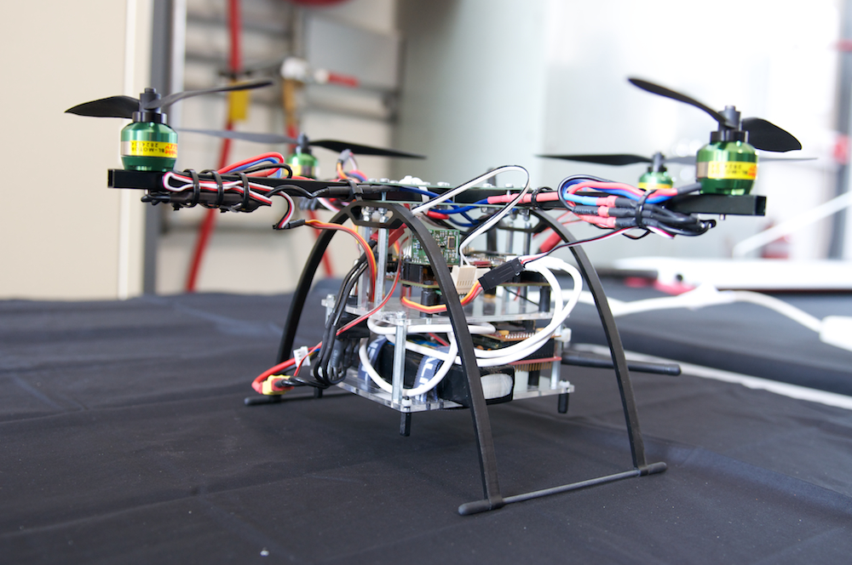
AHNS Project Aim
The Autonomous Helicopter Navigation System 2010 is focused on developing a helicopter system capable of autonomous control, navigation and localising within a GPS denied environment.

Slide 3
Contents
Overview of the Project
Airframe and Hardware
On-board Flight Computer
State Estimation
Ground Control Station
Control Architecture
Hardware Mounting System
Project Summery

Slide 4
Project Overview
Michael Hamilton- 06219314

Slide 5
High Level Objectives
Michael Hamilton- 06219314

Slide 6
High Level Objectives
Michael Hamilton- 06219314
A platform should be developed and maintained to facilitate flight and on board hardware integration.

Slide 7
High Level Objectives
Michael Hamilton- 06219314
The system should be capable of determining its position with the aid of image processing within an indoor environment to an appropriate time resolution.

Slide 8
High Level Objectives
Michael Hamilton- 06219314
A method of estimating the states of the helicopter system should be designed and implemented. The resolution of the estimations should facilitate their employment in the control system design.

Slide 9
High Level Objectives
Michael Hamilton- 06219314
An autopilot system should be developed to enable sustained indoor autonomous hovering flight. The control system should be designed to enable future ingress and egress manoeuvre to longitudinal and hovering flight.

Slide 10
High Level Objectives
Michael Hamilton- 06219314
A ground control station that supports appropriate command and system setting inputs and data display and logging should be developed. The design should be derived from previous AHNS developments and enable future ground station developments.

Slide 11
Project Virtual Demonstration

Slide 12
Systems Engineering Approach

Slide 13
Risk Management
Michael Hamilton- 06219314
Risk Management Plan developed mid-semester one.
After Quad Copter incident, all university engine testing banned indefinitely.
After approval from ARCAA H&S staff, testing continued at Airport hanger.

Slide 14
INSERT OTHERS SLIDES HERE
!!!!!!!!!!!!!!!DO NOT USE IN PRESENTATION!!!!!!!!!!!!!!!!!!!!

Slide 15
Hardware mounting
Michael Hamilton- 06219314

Slide 16
Hardware Mounting System
The design will protect the electronic equipment from striking the ground or other parts of the airframe in the event of a crash.
The frame that supports the equipment will be made of a material that will snap under a large instant force, such as a crash, to prevent this shock damaging the main electronics board or airframe.
The mounting system will be easy and cheap to manufacture, and within a local area to reduce delivery time.
Allow easy access to electronics and line of sight to all LED’s.

Slide 17
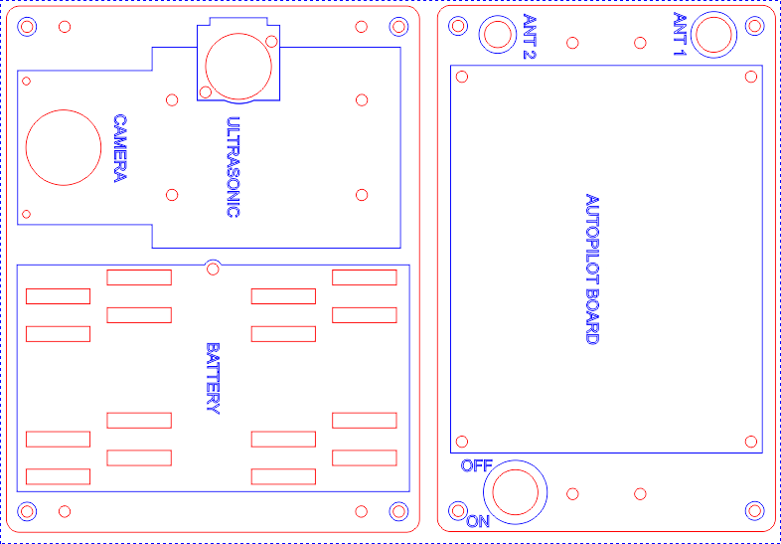
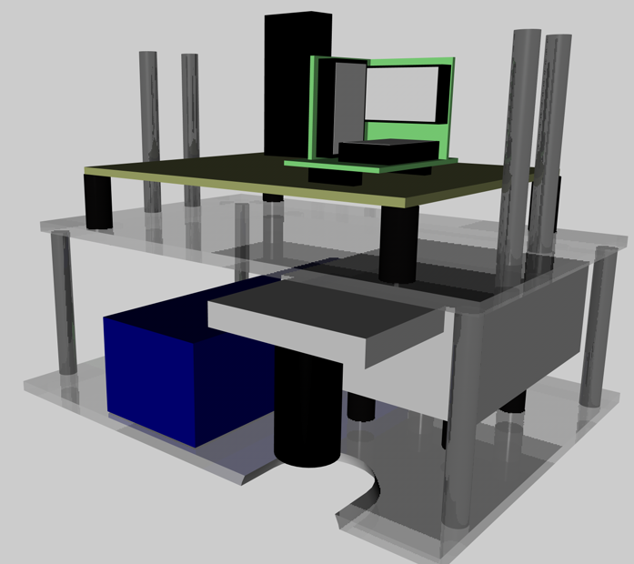
Initial Design
Michael Hamilton- 06219314

Slide 18
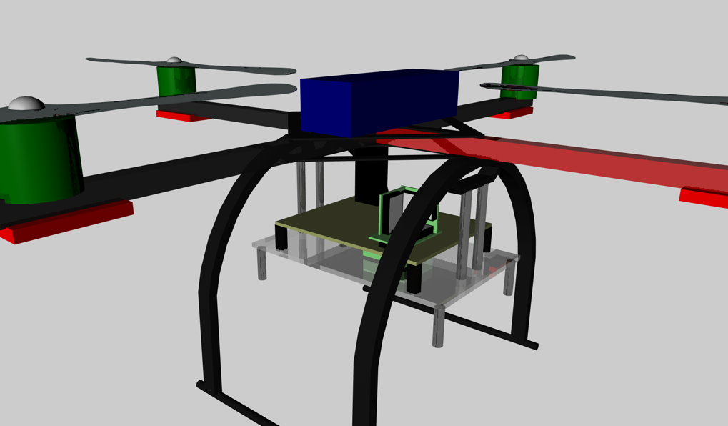
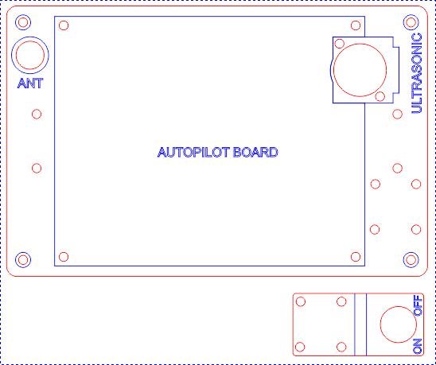
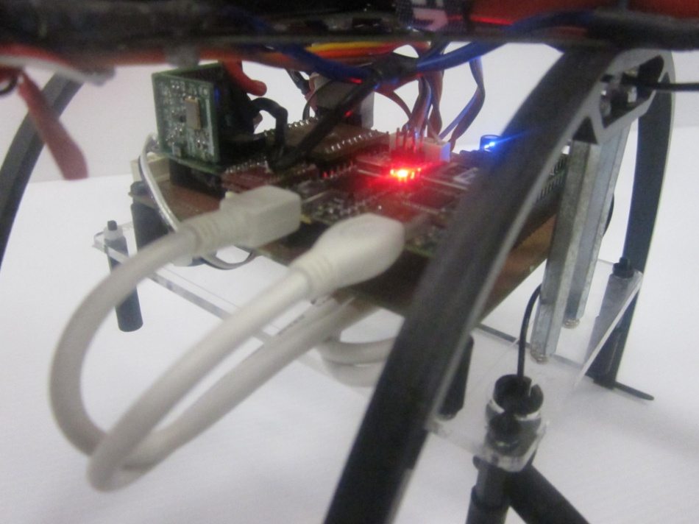
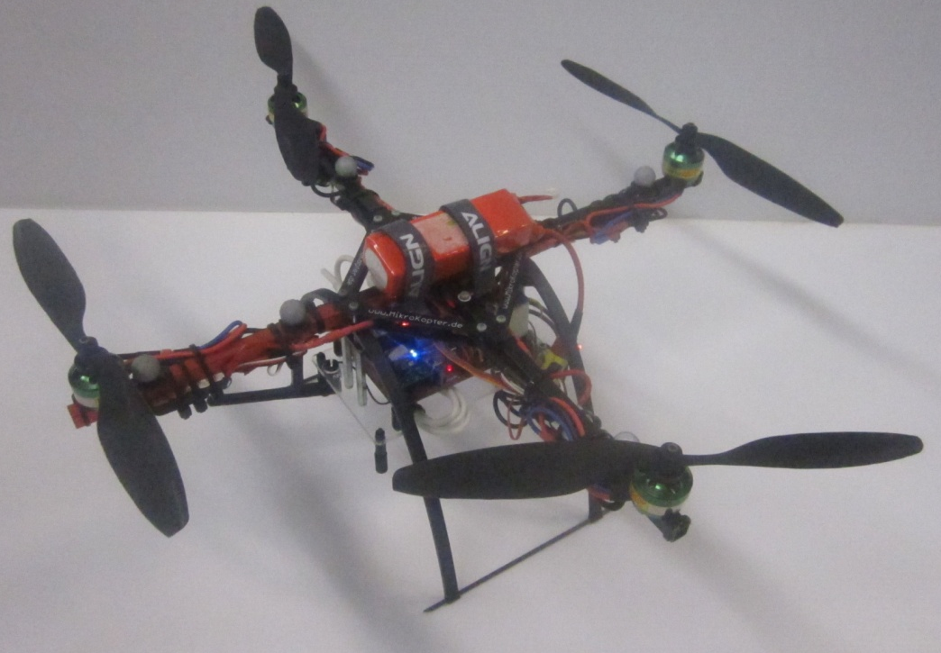
Final Design
Michael Hamilton- 06219314

Slide 19
Project Summery
Michael Hamilton- 06219314

Slide 20
Finial Budget
Company | Items Description | Debit | Credit | Total
QUT | BEE Unit Funds | $0.00 | $400.00 | $400.00
Boeing | Boeing Sponsership | $0.00 | $2000.00 | $2400.00
HiSystems GmBH | Quad Copter Airframe | $759.86 | $0.00 | $1640.14
Surveyor Corporation | Camera | $248.75 | $0.00 | $1391.39
Gumstix inc | Onboard Computer | $395.92 | $0.00 | $995.47
HobbyRama | V-Tail Mixer | $82.00 | $0.00 | $913.47
Bunning’s Warehouse | Glue | $16.03 | $0.00 | $897.44
Eckersley | Wiring Equipment | $29.95 | $0.00 | $867.49
QUT Bookshop | Writing Material | $5.70 | $0.00 | $861.79
Jaycar Autralia | Cable | $10.67 | $0.00 | $851.12
RS Components | Coolum Counter | $37.07 | $0.00 | $814.05
Farnel | Electrical Parts | $138.33 | $0.00 | $675.72
H.E.Supplies Pty Ltd | Metal Components | $44.85 | $0.00 | $630.87
New Generation Hobbies | Motors | $221.55 | $0.00 | $409.32
HobbyKing | ESC | $100.53 | $0.00 | $308.79
 |  |  | Total Remaining | $308.79

Slide 21
Conformance Matrix
Number | Definition | Status | Reference Document
SR-B-01 | The platform shall have the ability to be manually manoeuvred with a radio controller. | Complete | AHNS-2010-PL-TR-002
SR-B-02 | The GCS shall enable autopilot flight mode switching between manual, stability augmented flight, and autonomous station keeping. | Complete | AHNS-2010-GC-TR-001
SR-B-03 | The airborne system shall provide control updates at an average rate of 50Hz. | Complete | AHNS-2010-AP-TR-001
SR-B-04 | The estimator shall provide Euler angle and rate estimation for the system an average rate of 50 Hz. | Complete | AHNS-2010-SE-TR-001
SR-B-05 | The estimator shall provide altitude estimation for the system an average rate of 50 Hz. | Complete | AHNS-2010-SE-TR-001
SR-B-06 | The estimator shall provide x and y estimation in an Earth fixed co-ordinate system an average rate of 50 Hz. | Complete | AHNS-2010-SE-TR-002

Slide 22
Conformance Matrix
Number | Definition | Status | Reference Document
SR-B-07 | The system shall use image processing to aid in state estimation of x and y in an Earth fixed co-ordinate system. | Not Complete | No Document
SR-B-08 | The autopilot system gain and reference parameters shall be updatable in flight using an 802.11g WLAN uplink from the GCS. | Complete | AHNS-2010-GC-TR-001
SR-B-09 | The airborne system shall transmit telemetry data including state data to the GCS using 802.11g WLAN. | Complete | AHNS-2010-AP-TR-002
SR-B-10 | The autopilot control methodology shall be based on cascaded PID control loops. | Complete | AHNS-2010-AP-DD-001
SR-D-01 | The platform shall be capable of maintaining controlled flight with a total payload of 400 grams. | Complete | AHNS-2010-PL-TR-002

Slide 23
Conformance Matrix
Number | Definition | Status | Reference Document
SR-D-02 | A maintenance document shall be used to log airframe flight time, battery cycles and aircraft repairs. | Complete | AHNS-2010-PL-TR-001
SR-D-03 | The autopilot shall provide stability augmented flight. | Complete | AHNS-2010-SY-TR-001 AHNS-2010-SY-TR-002
SR-D-04 | The autopilot shall provide autonomous station keeping capability within a 1 meter cubed volume of a desired position. | Not Complete | AHNS-2010-SY-TR-003 AHNS-2010-SY-TR-004
SR-D-05 | The airborne system shall receive and process measurement data from the state estimation and localisation sensors; supporting IMU, Camera, and Ultrasonic sensor. | Complete | AHNS-2010-AP-TR-002

Slide 24
Conformance Matrix
Number | Definition | Status | Reference Document
SR-D-06 | The airborne system shall collect avionics system health monitoring information in the form of radio control link status, flight mode status and battery level. | Complete | AHNS-2010-AP-TR-002
SR-D-07 | The airborne system shall collect avionics system health monitoring information in the form of radio control link status, flight mode status and battery level. | Complete | AHNS-2010-AP-TR-002
SR-D-08 | The GCS shall log all telemetry and uplink data communications. | Complete | AHNS-2010-GC-TR-001
SR-D-09 | The airborne system shall receive and process measurement data from the state estimation and localisation sensors; supporting IMU, Camera, and Ultrasonic sensor. | Complete | AHNS-2010-GC-TR-001

Slide 25
Conformance Matrix
Number | Definition | Status | Reference Document
SR-D-10 | The GCS shall provide display of avionics system health monitoring including telemetry, uplink, radio control link and battery level status read-outs. | Complete | AHNS-2010-GC-TR-001

Slide 26
Conformance Diagram
HLO 1
HLO 5
HLO 2
HLO 3
HLO 4
SR-B-01
SR-B-07
SR-B-04
SR-B-03
SR-B-02
SR-B-05
SR-B-6
SR-B-10
SR-B-08
SR-B-09
SR-D-01
SR-D-02
SR-D-03
SR-D-05
SR-D-04
SR-D-06
SR-D-07
SR-D-08
SR-D-09
SR-D-10

Slide 27
Conformance Diagram
HLO 1
HLO 5
HLO 2
HLO 3
HLO 4
SR-B-01
SR-B-07
SR-B-04
SR-B-03
SR-B-02
SR-B-05
SR-B-6
SR-B-10
SR-B-08
SR-B-09
SR-D-01
SR-D-02
SR-D-03
SR-D-05
SR-D-04
SR-D-06
SR-D-07
SR-D-08
SR-D-09
SR-D-10

Slide 28
Conformance Diagram
HLO 1
HLO 5
HLO 2
HLO 3
HLO 4
SR-B-01
SR-B-07
SR-B-04
SR-B-03
SR-B-02
SR-B-05
SR-B-6
SR-B-10
SR-B-08
SR-B-09
SR-D-01
SR-D-02
SR-D-03
SR-D-05
SR-D-04
SR-D-06
SR-D-07
SR-D-08
SR-D-09
SR-D-10

Slide 29
Project Summary
Designed and constructed a platform to facilitate flight utilising on board hardware and sensors.
Implemented State Estimation and PID control to enable autonomous flight.
Coded functional ground control station with 2.4 GHz wireless communication to platform.
Tuned gains for stable platform attitude while in flight.
Enabled future development on project to achieve position hold.

Slide 30
Lessons Learnt
System requirements and preliminary designs defined early.
Work breakdown structure organised into large overall tasks, as the project aims, designs and methods will change during the semester.
The testing phase of the project should commence at the beginning of semester two, as the AHNS project requires a lot of time for calibrating the system for flight conditions.
Organise the project time schedule to incorporate other subject assignment due dates, as project productivity was found to drop significantly during this time.
The risk management plan must be completed and approved well before testing commences, and ensure that all possible testing locations has been authorised.
Due to batteries requiring four times longer recharging that the flight time they produce, ensure a large number are available for flight-testing.
Purchase additional electrical hardware components to mitigate schedule delay from broken parts after flight crashes.

Slide 31
System DEMONSTRATION

Slide 32
QUESTIONS? Michael HAMILTON - 06219314 MICHAEL KINCEL - 06219322 Tim MOLLOY - 06332064 Liam O’Sullivan - 06308627

