Slide 1

Autonomous Helicopter Navigation System 2010

Slide 2
Communication
Liam O’Sullivan - 06308627

Slide 3
Previous Years Communications
Used XBee RF 2.4 GHz modules for telemetry
Point to point communication (platform and GCS)
Disadvantages
Serial interface
Closed architecture (hard to expand)
User implemented synchronisation
No interface standard

Slide 4
Communications
HLO-5 Communications
SR-B-08 and 09 Transmit and Receive Telemetry via WLAN
WiFi Communication Design and Architecture

Slide 5
WiFi Communication Design
Server-client architecture
Main server onboard (devices connect to it)
Multiple device/client connections
Standard networking protocol (UDP and TCP)
Utilises ‘Heliconnect’ software library
Common network interface (headers)
Ability to communicate with other projects

Slide 6
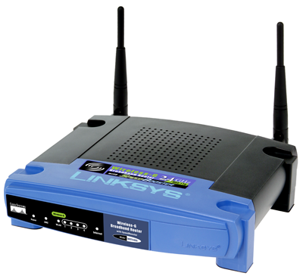
WiFi Architecture
Wireless adhoc network (point to point)
Unstable (particularly for non-Apple products)
Incompatible
Wireless router network
Centralised router
Devices communicate through the router
Uses Linksys WRT54GL
Internet gateway

Slide 7
Wireless Router Network

Slide 8
Communications Summary
WiFi design and architecture implemented
Stable and reliable UDP and TCP connections between server and clients
Multiple SSH connections between platform and clients
Successful connection between UDP server onboard with multiple GCS clients
Successful connection between TCP Blackfin Camera image feed and GCS client

Slide 9
State Estimation
Liam O’Sullivan - 06308627

Slide 10
State Estimation
HLO-3 State Estimation
SR-B-04, 05 and 06 50Hz State update
SR-D-05 Process Measurement Data
States and Sensors
Attitude Estimator and Kalman Filtering

Slide 11
Platform States
17 States to be measured
State | Sensor | State | Sensor
Roll rate | IMU and Vicon | X velocity | IMU* and Vicon
Pitch rate | IMU and Vicon | Y velocity | IMU* and Vicon
Yaw rate | IMU and Vicon | Z velocity | IMU* and Vicon
Roll | IMU* and Vicon | X displacement | IMU* and Vicon
Pitch | IMU* and Vicon | Y displacement | IMU* and Vicon
Yaw | IMU* and Vicon | Z displacement | IMU*, Altitude Sensor and Vicon
X acceleration | IMU and Vicon | X target | Blackfin Camera
Y acceleration | IMU and Vicon | Y target | Blackfin Camera
Z acceleration | IMU and Vicon

Slide 12
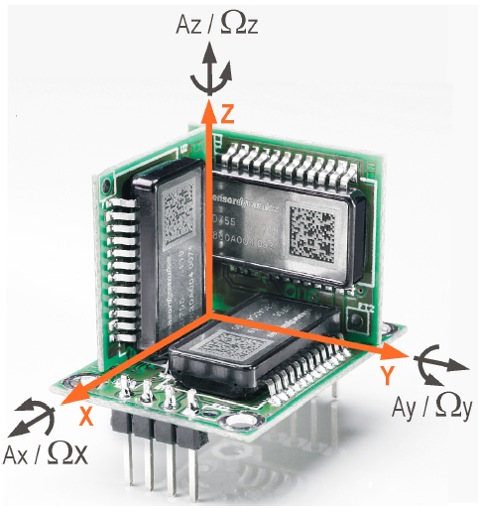
IMU
Sensor Dynamics 6 DOF IMU
3 gyroscopes and 3 accelerometers
Measures
Angular rates
Accelerations
Indirectly measures
Angles
Velocities
Displacements
75Hz update rate
SPI connection (with Overo Fire)
Inherited from AHNS 2009

Slide 13
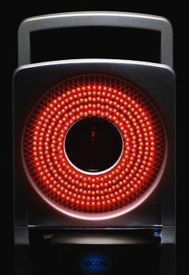
Vicon System
External motion capture system
Tracks reflective spheres with 5 IR cameras
Can measure all required states (except the camera tracking states) with sub mm accuracy
200Hz update rate
Ethernet connection (via GCS)
Not used for low level control (latency)
Verification and Validation tool
Located at the ARCAA building

Slide 14
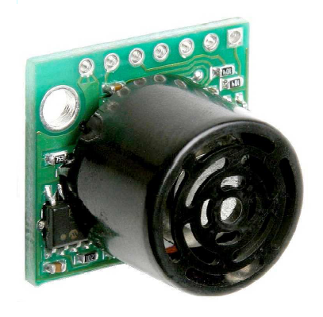
Altitude Sensor
Maxbotix ultrasonic sensor
Measures vertical displacement
Sonar range finder (not IR based)
Replaced by Vicon System
Still incorporated for redundancy
UART connection (with Overo Fire)
Inherited from 3rd year project

Slide 15
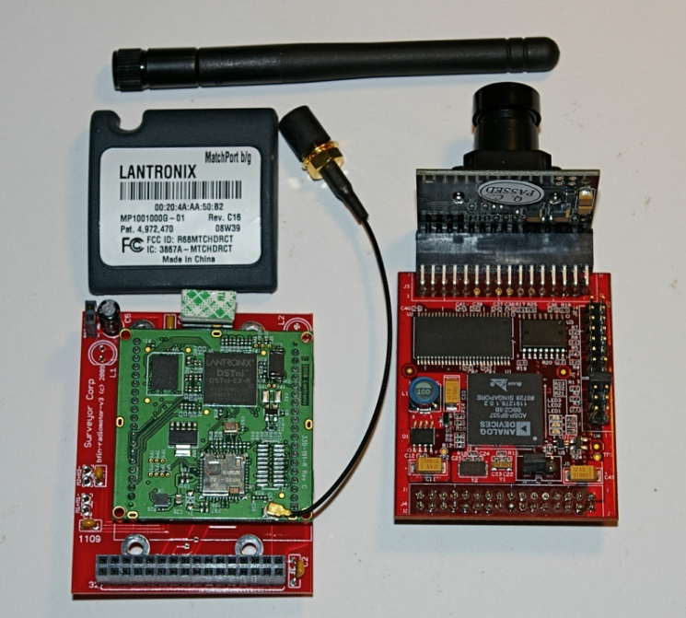
Surveyor SRV-1Blackfin Camera
Blackfin camera with Analog Devices processor
Embedded image processing (IP)
Interface and IP library
Get camera frame
Edge detection
Colour segmentation
Blob detection and others
WiFi connection (camera feed)
SPI connection (IP tracking states)
Recommended by Supervisor

Slide 16
Sensor Architecture

Slide 17
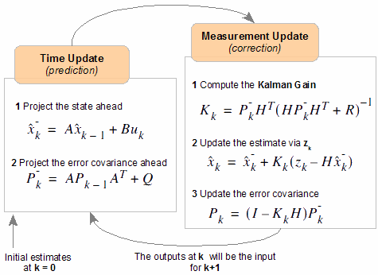
Kalman Filter and Sensor Fusion
IMU measurements are noisy and will drift
Require attitude estimator to correct for this
Will be based on the attitude estimator from AHNS 2009
Basic Kalman filter

Slide 18
Subsystem Progress and Future Work
All sensors are operational
Software interface libraries completed for
IMU (sensor data access through Overo Fire)
Blackfin Camera (image feed and command GCS widget)
Future work
Altitude sensor software interface
Vicon system client
Attitude estimator implementation

Slide 19
Localisation
Liam O’Sullivan - 06308627

Slide 20
Localisation
HLO-2 Localisation
SR-B-07 Estimation of X and Y displacement
Image Processing

Slide 21
Original Purpose
Blackfin Camera mounted underneath platform
Search for cross “blob” to localise itself (via IP)
Dead reckoning navigation from blob centroid (x and y displacement)

Slide 22
Updated Design
Newly integrated Vicon system eliminates need for dead reckoning
Will now perform a path tracking function for autonomous navigation (xt and yt displacement)

Slide 23
Localisation Summary
Success of this subsystem is dependent on all other subsystems
Re-evaluation of subsystem may need to occur if progress stalls on other subsystems

Slide 24
System DEMONSTRATION AND QUESTIONS

