Slide 1
Platform | Pilot
Michael Kincel - 06219322

Slide 2
Platform
Airframe
Power System
Electronics
Mounting System

Slide 3
HLO-1 Platform
SR-B-01 Manual RC Control
SR-D-01 400 Gram Payload
SR-D-02 Maintenance Document
Perform RC Test Flight
Develop Suitable Airframe
Platform

Slide 4
Platform
Airframe
Power System
Electronics
Mounting System

Slide 5
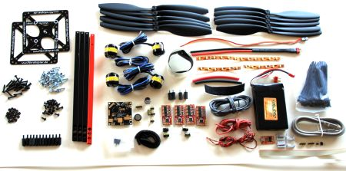
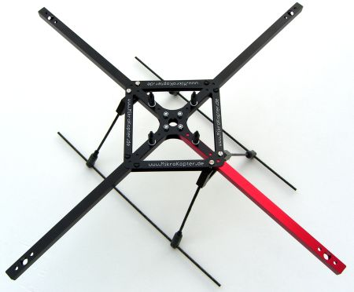
MikroKopter MK40
Readily Available
Lightweight
Durabiltiy
Fulfils Payload Requirements
Airframe

Slide 6
Platform
Airframe
Power System
Electronics
Mounting System

Slide 7
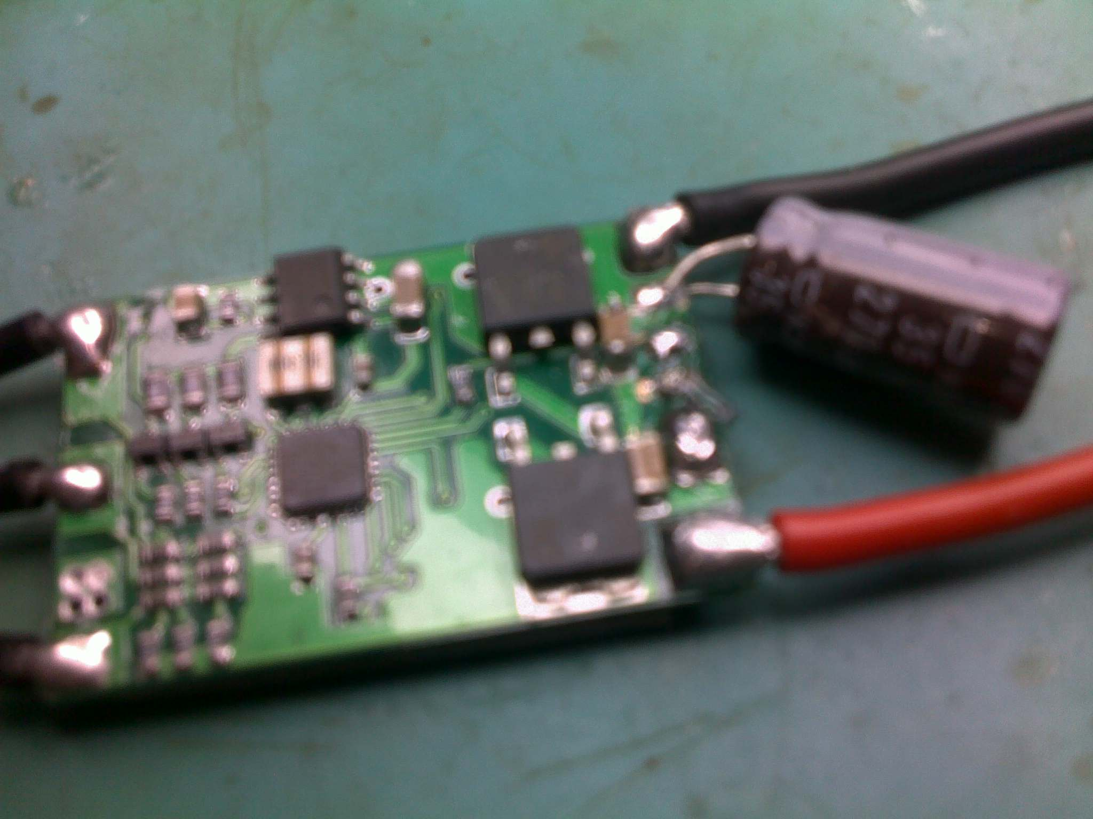
Power System

Slide 8
Platform
Airframe
Power System
Electronics
Mounting System

Slide 9
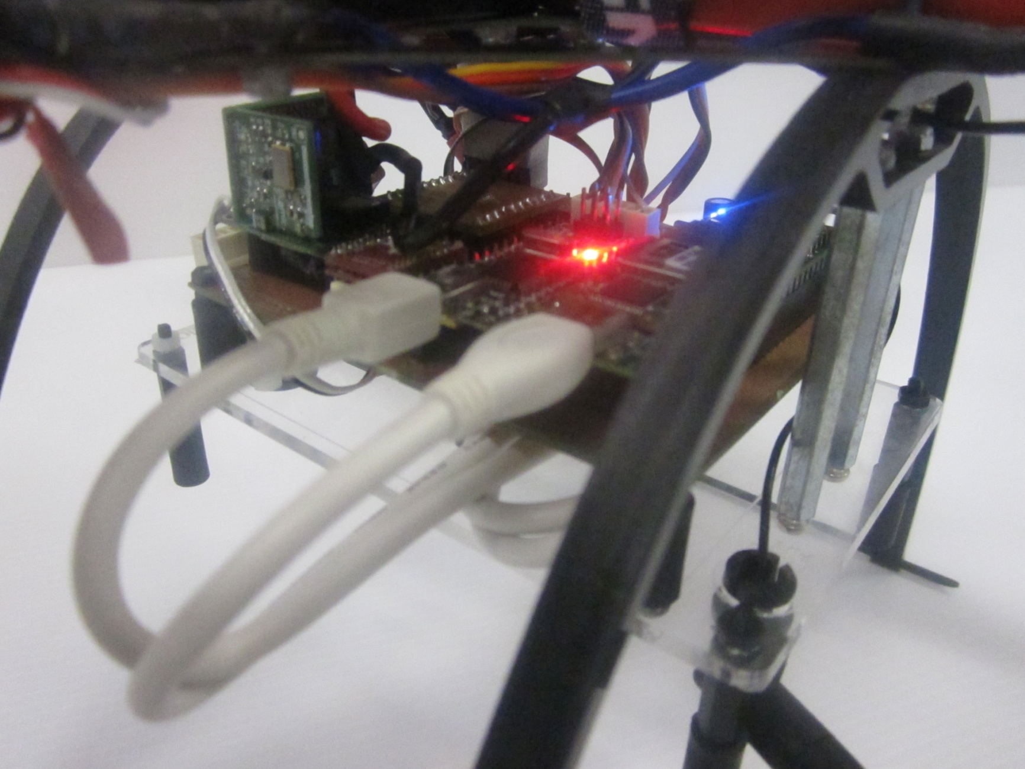
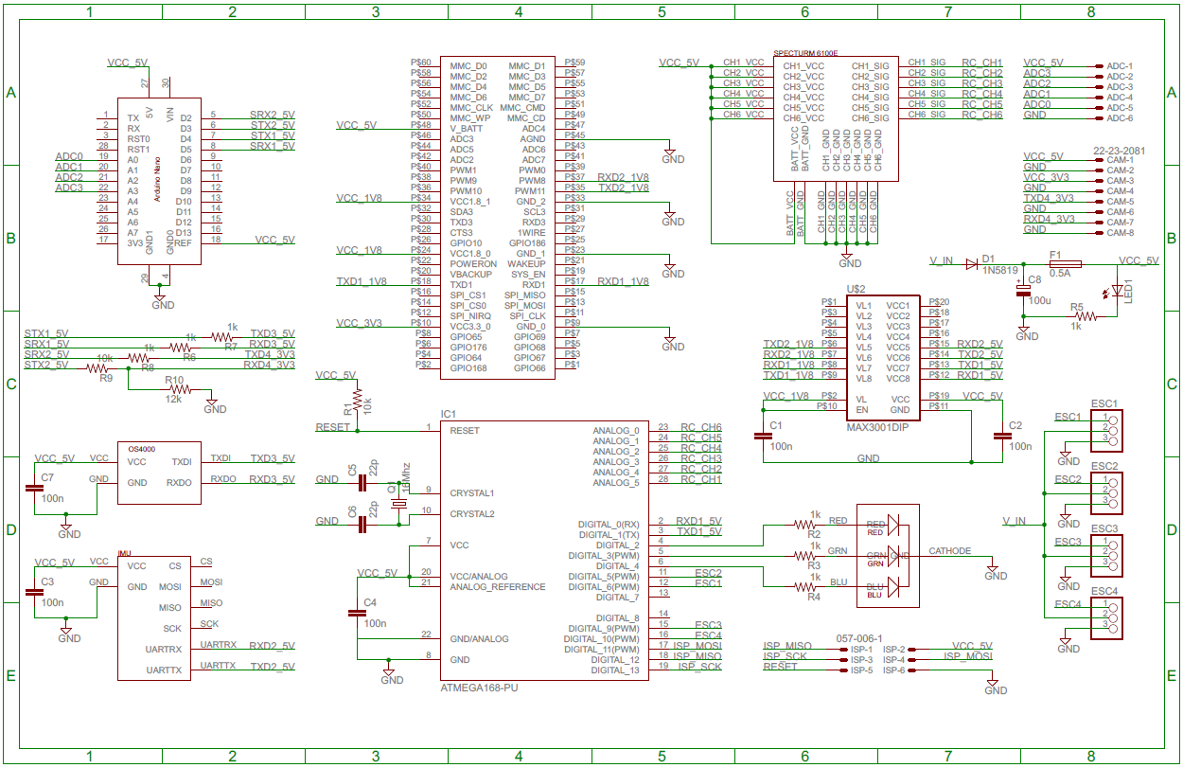
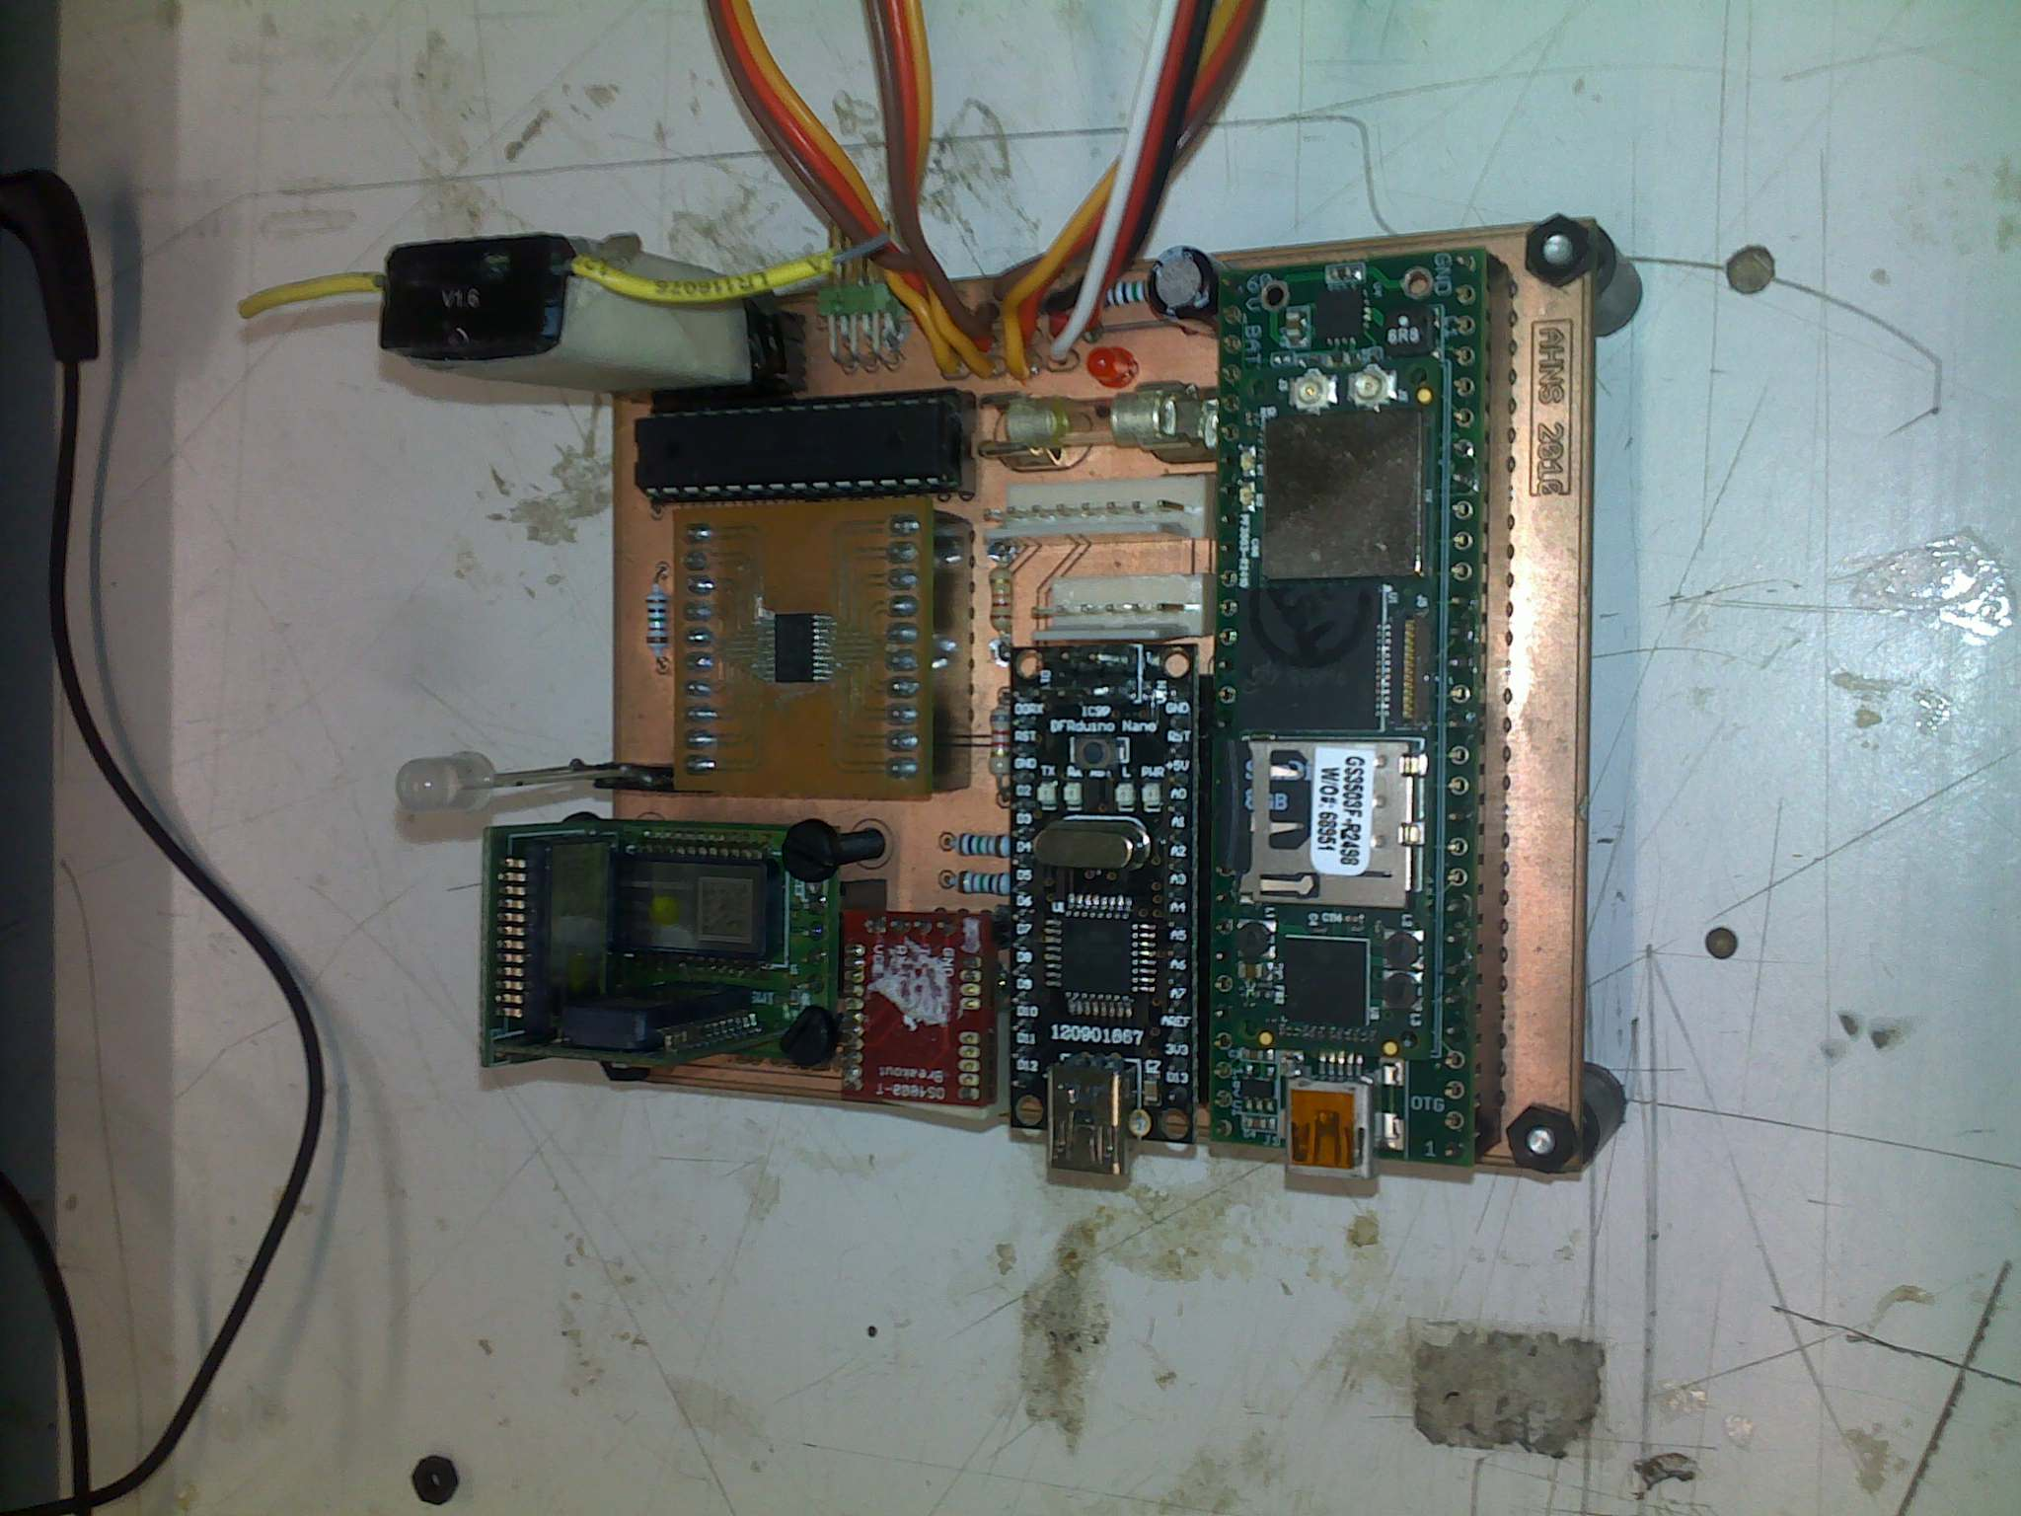
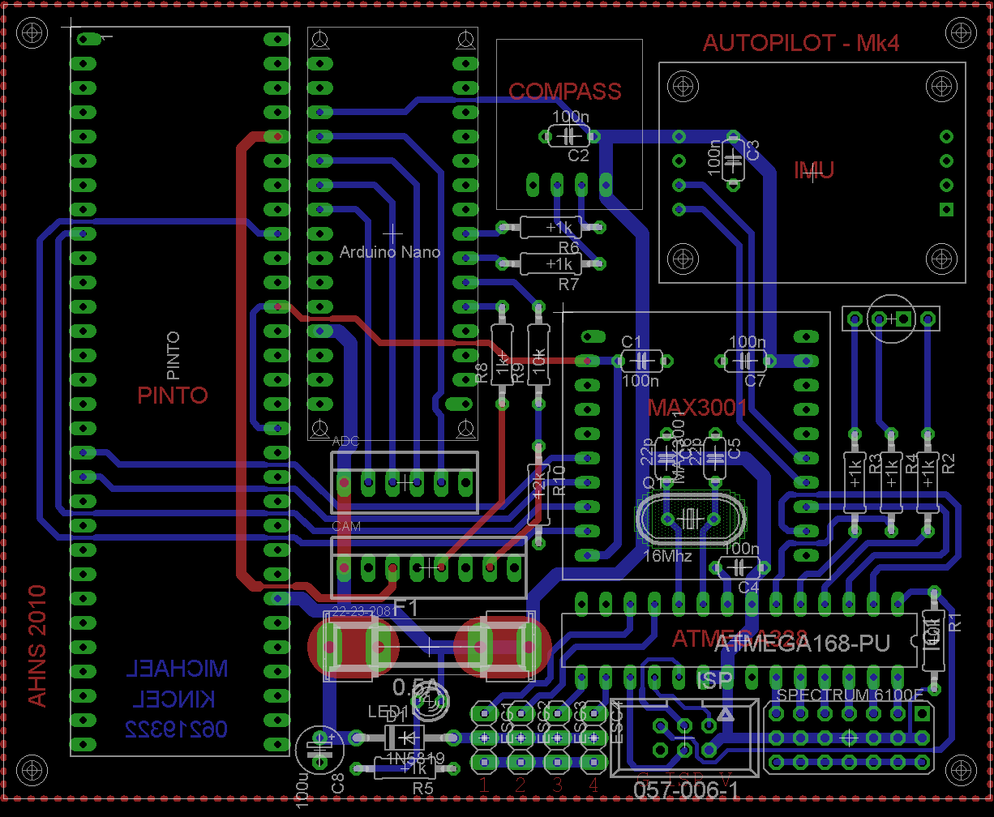
Electronics

Slide 10
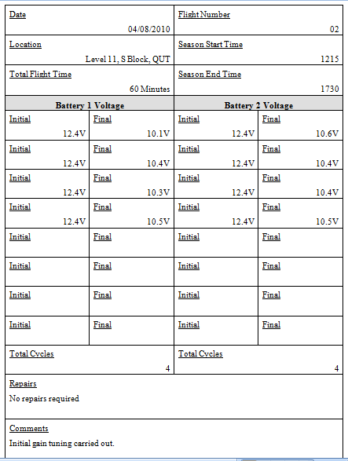
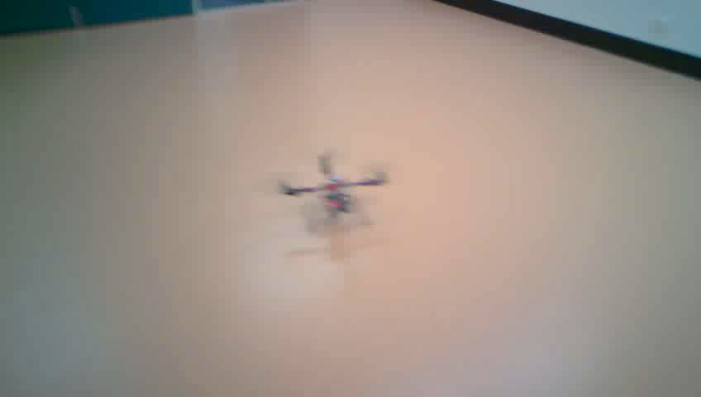
HLO-1 Platform
SR-B-01 Manual RC Control
SR-D-01 400 Gram Payload
SR-D-02 Maintenance Document
AT-01
AT-11
AT-12
Acceptance Testing

Slide 11
Scope
Use commercial hardware if navigation is desired
Hardware Development
Minimum of two people developing hardware
Devote more time to hardware development
Dedicated project
Lessons Learnt

