Slide 1

Autonomous Helicopter Navigation System 2010

Slide 2
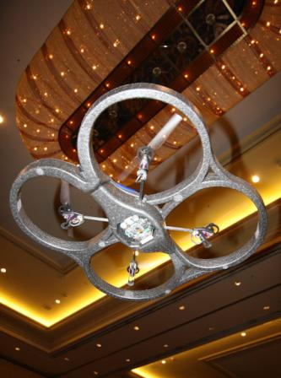
AHNS Project Aim
The Autonomous Helicopter Navigation System 2010 is focused on developing a helicopter system capable of autonomous control, navigation and localising within a GPS denied environment.

Slide 3
Project Management
Michael Hamilton

Slide 4
Contents
Previous Years Achievements
High Level Objectives
Project Outcome Simulation
System Requirements
Project Role Division
Work Breakdown Structure
Finical Budget
Risk Management Plan
Next Semester Plan

Slide 5
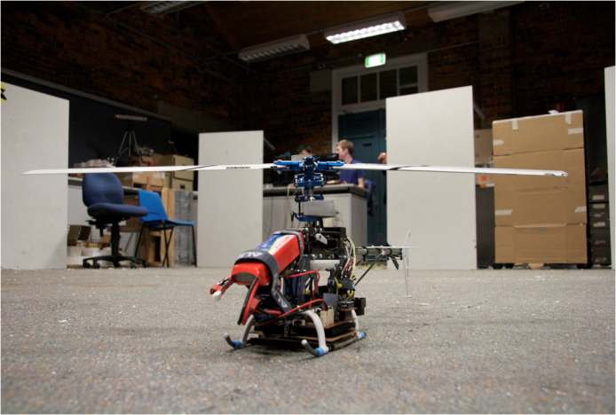
Previous Years Achievements
Autonomous Landing
Stabilisation with z-axis (height) with the use of IR range finder.
Control handled off-board on Ground Station
A human to machine interface developed.
Unsuccessful attempt at remote camera vision localisation.

Slide 6
High Level Objectives
HLO-1 Platform
A platform should be developed and maintained to facilitate flight and on board hardware integration.
HLO-2 Localisation
The system should be capable of determining its position with the aid of image processing within an indoor environment to an appropriate time resolution.
HLO-3 State Estimation
A method of estimating the states of the helicopter system should be designed and implemented. The resolution of the estimations should facilitate their employment in the control system design.

Slide 7
High Level Objectives
HLO-4 Autonomous Hovering Flight
An autopilot system should be developed to enable sustained indoor autonomous hovering flight. The control system should be designed to enable future ingress and egress manoeuvre to longitudinal and hovering flight.
HLO-5 Ground Control Station
A ground control station that supports appropriate command and system setting inputs and data display and logging should be developed. The design should be derived from previous AHNS developments and enable future ground station developments.
HLO-6 Communications
The communications system should enable transfer of control, state and localisation data to the ground control station. It should provide with a flexible wireless data link available on consumer-electronic devices.

Slide 8
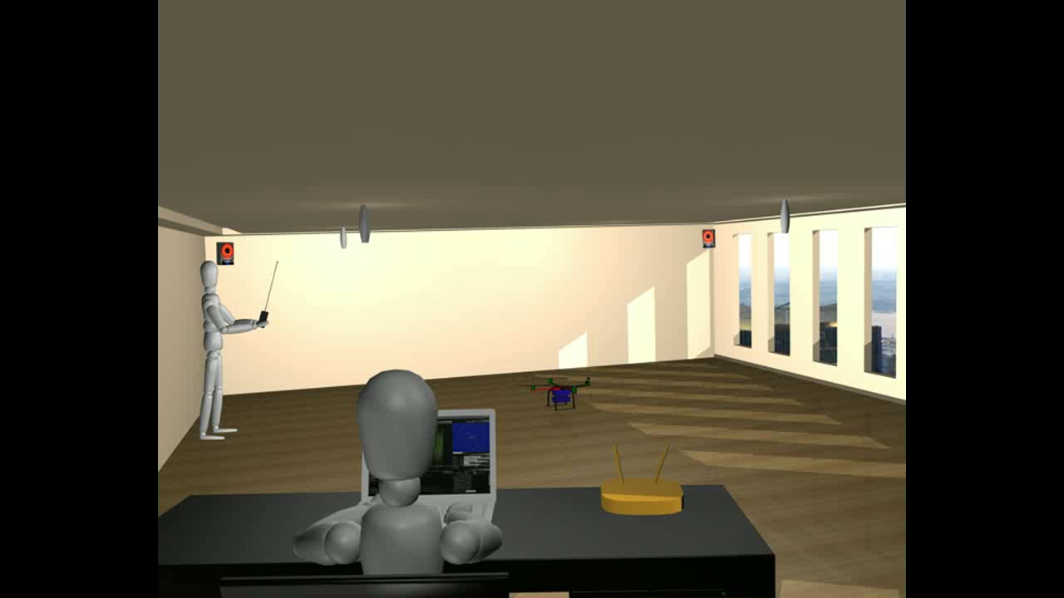
Project Outcome Simulation

Slide 9
Baseline System Requirements
Requirement | Definition
SR-B-01 | The platform shall have the ability to be manually manoeuvred with a radio controller.
SR-B-02 | The GCS shall enable autopilot flight mode switching between manual, stability augmented flight, and autonomous station keeping.
SR-B-03 | The airborne system shall provide control updates at a minimum rate of 50Hz.
SR-B-04 | The estimator shall provide Euler angle and rate estimation for the system at minimum rate of 50 Hz.
SR-B-05 | The estimator shall provide altitude estimation for the system at minimum rate of 50 Hz.
SR-B-06 | The estimator shall provide x and y estimation in an Earth fixed co-ordinate system at minimum rate of 50 Hz.
SR-B-07 | The system shall use image processing to aid in state estimation of x and y in an Earth fixed co-ordinate system.
SR-B-08 | The autopilot system gain and reference parameters shall be updatable in flight using an 802.11g WLAN uplink from the GCS.
SR-B-09 | The airborne system shall transmit telemetry data including state data to the GCS using 802.11g WLAN.
SR-B-10 | The autopilot control methodology shall be based on cascaded PID control loops.

Slide 10
Derived System Requirements
Requirement | Definition
SR-D-01 | The platform shall be capable of maintaining controlled flight with a total payload of 400 grams.
SR-D-02 | A maintenance document shall be used to log airframe flight time, battery cycles and aircraft repairs.
SR-D-03 | The autopilot shall provide stability augmented flight.
SR-D-04 | The autopilot shall provide autonomous station keeping capability within a 1 meter cubed volume of a desired position.
SR-D-05 | The airborne system shall receive and process measurement data from the state estimation and localisation sensors; supporting IMU, Camera, IR, Ultrasonic devices.
SR-D-06 | The airborne system shall collect avionics system health monitoring information in the form of radio control link status, flight mode status and battery level.
SR-D-07 | The airborne system shall transmit all actuator inputs, including radio control inputs, to the GCS.
SR-D-08 | The GCS shall log all telemetry and uplink data communications.
SR-D-09 | Aircraft state data and control inputs received shall be displayable on the GCS along with appropriate time references.
SR-D-10 | The GCS shall provide display of avionics system health monitoring including telemetry, uplink, radio control link and battery level status read-outs.

Slide 11
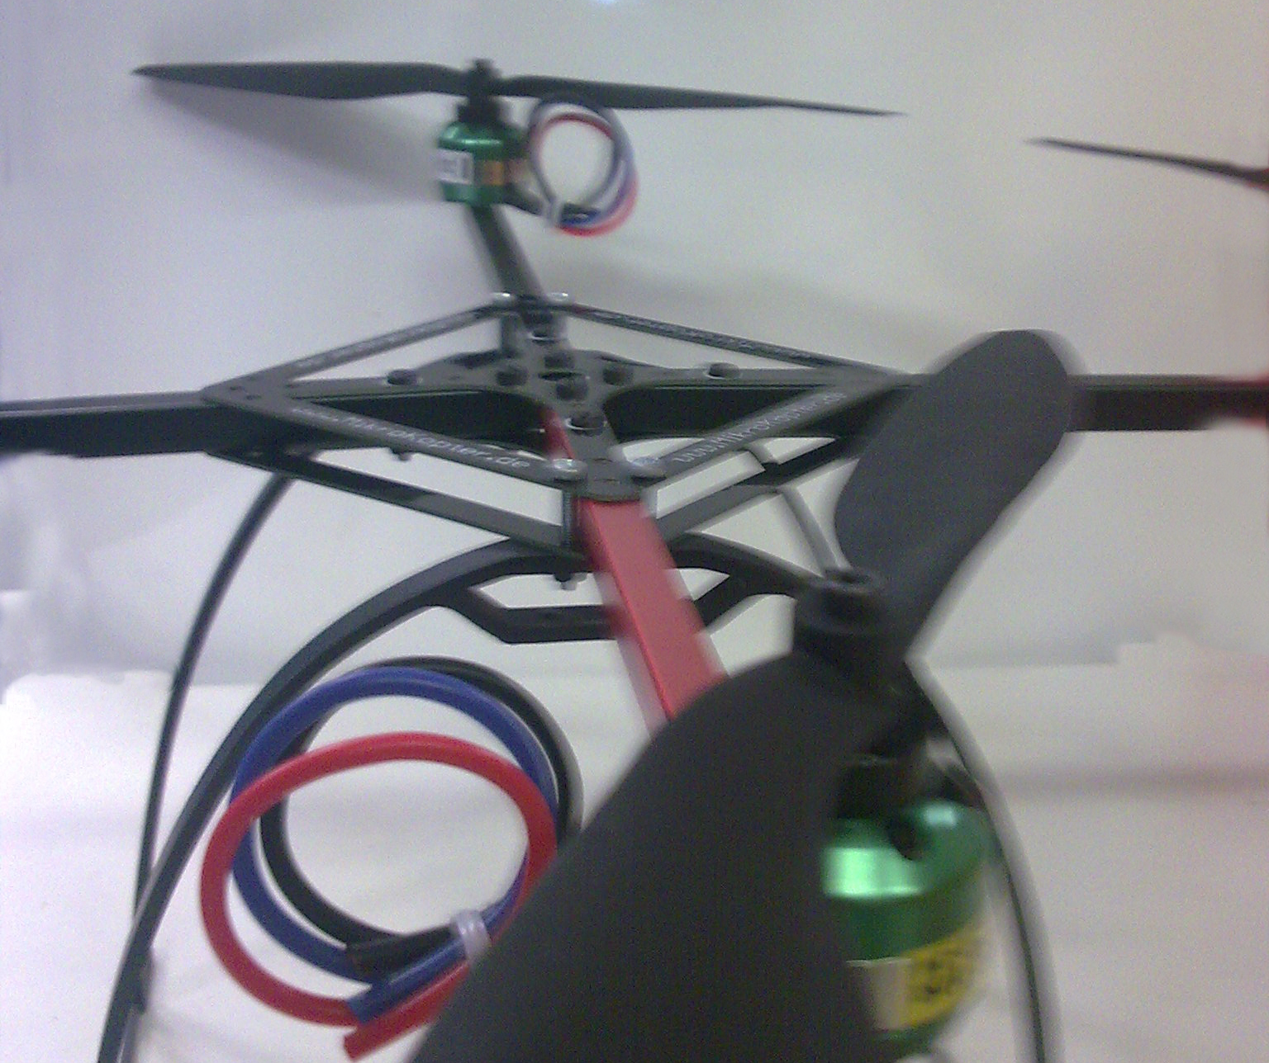
Project Role Division

Slide 12
Work Breakdown Structure
Preliminary Design Document
WP-SY-04
Wireless Communications Test Report
WP-CO-02
STAGE 4: Integration and
Testing
STAGE 5: Deliverables
Airframe Trade Study
WP-PL-01
Airframe RC Test Report
WP-PL-04
Flight Computer Trade Study
WP-AP-01
Design Control System
WP-AP-03
Electronic Test Report
WP-PL-05
Camera Bench Test Report
WP-LO-02
Design Computer Vision System
WP-LO-03
Design Ground Control Station
WP-CG-01
Design Wireless Communications
WP-AP-03
Acquire & Construct Airframe
WP-PL-02
System Requirements Document
WP-SY-02
Acquire Flight Computer
WP-AP-02
Design State Estimation
WP-SE-01
Acquire Platform Electronics
WP-PL-03
Project Management Plan Document
WP-SY-03
Acquire Camera
WP-LO-01
High Level Objective Document
WP-SY-01
STAGE 1: Definition and Research
STAGE 2: Design and Development
STAGE 3: Component Testing

Slide 13
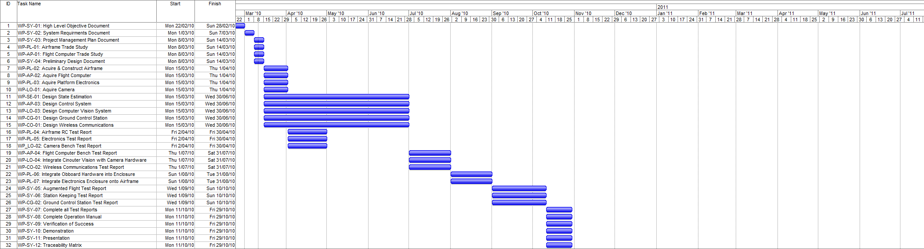
Timeline

Slide 14
Budget
Company | Items Description | Debit | Credit | Total
QUT | BEE Unit Funds | $0.00 | $400.00 | $400.00
Boeing | Boeing Sponsership | $0.00 | $2000.00 | $2400.00
HiSystems GmBH | Quad Copter Airframe | $759.86 | $0.00 | $1640.14
Surveyor Corporation | Camera | $248.75 | $0.00 | $1391.39
Gumstix inc | Onboard Computer | $395.92 | $0.00 | $995.47
HobbyRama | V-Tail Mixer | $19.95 | $0.00 | $975.52
HobbyRama | Cable | $13.00 | $0.00 | $962.52
HobbyRama | Cable | $49.00 | $0.00 | $913.52
Bunning’s Warehouse | Glue | $2.05 | $0.00 | $911.47
Bunning’s Warehouse | Tool | $13.98 | $0.00 | $897.49
Eckersley | Wiring Equipment | $29.95 | $0.00 | $867.54
QUT Bookshop | Writing Material | $5.70 | $0.00 | $861.84
Jaycar Autralia | Cable | $10.67 | $0.00 | $851.17
RS Components | Coolum Counter | $37.07 | $0.00 | $814.10
Farnel | Electrical Parts | $86.55 | $0.00 | $727.55
 |  |  | Total Remaining | $727.55

Slide 15
Risk Management
Risk Hazard Log
Risks Rated within standard “Risk Evaluation Table”
Risks Classified within five categories:
Personal Injury
Property Damage
Schedule
Technical
Budgetary

Slide 16
Next Semester
Integration of all sub-system components during Week 1 and 2.
Most of Semester Two will be devoted towards testing.
Utilising on-board camera to track ground target.
Purchase of secondary platform.

Slide 17
Testing Procedures
Michael Hamilton

Slide 18
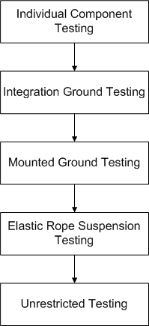
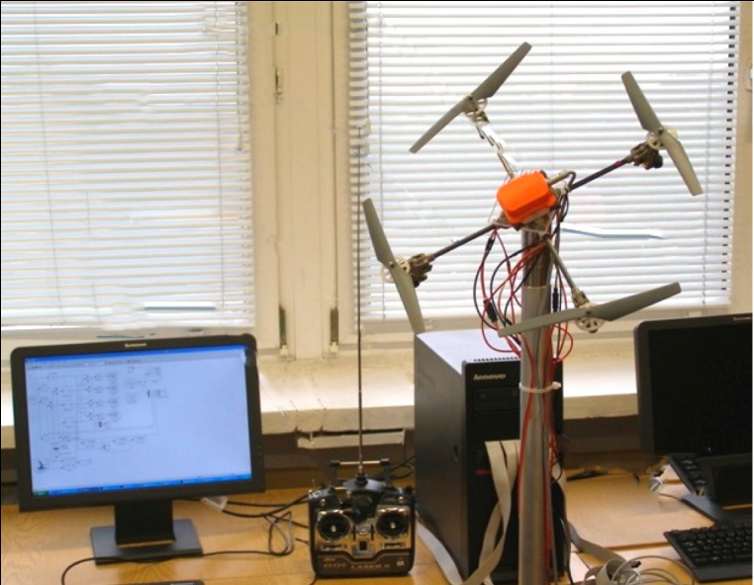
Tier Testing Procedure

