Slide 1

Autonomous Helicopter Navigation System 2010

Slide 2
Contents

Slide 3
Introduction to AHNS 2010

Slide 4
AHNS Project Aim
AHNS: To develop an autonomous indoor helicopter navigation system capable of carrying a payload.

Slide 5
Ground Control Station & Flight control
Tim Molloy

Slide 6
Role of the GCS and Control
HLO-4 Autonomous Hovering Flight
An autopilot system should be developed to enable sustained indoor autonomous hovering flight. The control system should be designed to enable future ingress and egress manoeuvre to longitudinal and hovering flight.
HLO-5 Ground Control Station
A ground control station that supports appropriate command and system setting inputs and data display and logging should be developed. The design should be derived from previous AHNS developments and enable future ground station developments.

Slide 7
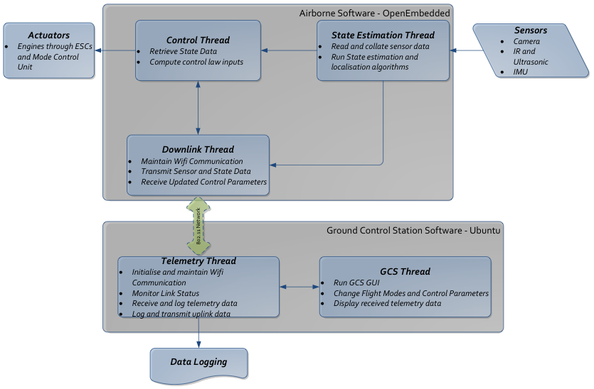
Software Architecture

Slide 8
Ground Control Station

Slide 9
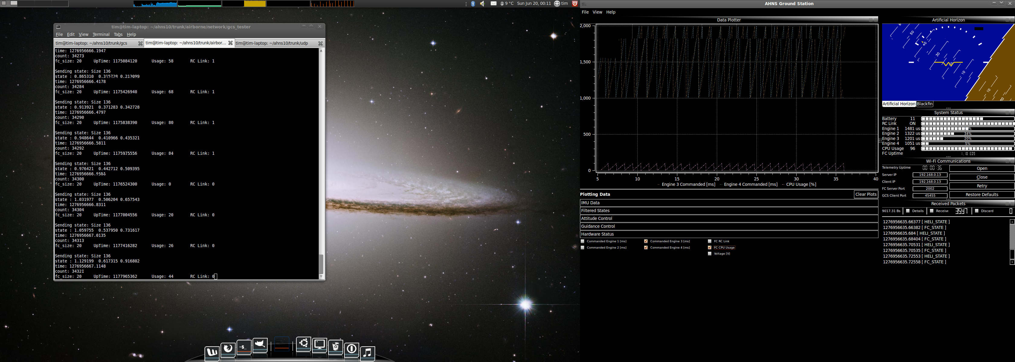
Ground Control Station
Ubuntu 32-bit Operating System
Qt Framework for C++ GUI Development
Focus on:
Code reuse
Creating and using reusable code
User layout customisation
Avoid Static GUI objects
Dockable Widgets
Enable the operator to choose a layout logical to their application
Increases the information which can be displayed

Slide 10
The Widgets
WiFi Communications
Configure, Control and Monitor UDP Telemetry
Received Console
Report telemetry messages and enable inspection
System Status
Provide visual notifications of airborne system status
Data Logger
CSV Log of all Received Airborne Data

Slide 11
Data Plotters & Artificial Horizon
Artificial Horizon
2009 OpenGL Attitude Display
Roll and Pitch
Data Plotter
Real-time data plotting
Raw Sensor Data, State Data, Control Data, System Status…
Support for multiple data plotters

Slide 12
Following Controller Design…
Attitude Control Trims and Bounds
Set the trims and bounds on the roll, pitch and yaw control loops.
Attitude Control Gains
Set the PID control gains on the roll, pitch and yaw control loops.
Guidance Control Gains
Set the PID control gains on the x, y and z position control loops.
Guidance Trims and Bounds
Set the trims and bounds of the x, y and z position control loops.
Flight Control
Set the active control loops and their set points. Enables command of the airborne control.

Slide 13
Flight Control

Slide 14
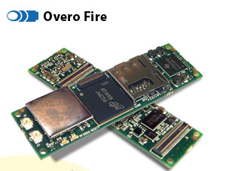
Flight Computer
Trade Study for Computer-on-Module to support
Hardware Integration
Control and State Estimation
Localization
Considered
BeagleBoard
Limited Hardware Interfacing
Gumstix Overo Air
Lacked Support for Image Processing
Gumstix Verdex
No Hardware Floating Point Implementation
Gumstix Overo Fire
6 grams, 600MHz TI CPU

Slide 15
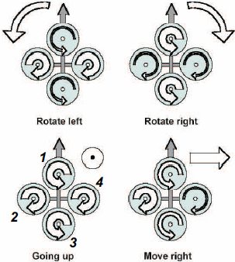
Quadrotor Control
Thrust Altitude Control Forces
Thrust Roll Control Forces
Thrust Pitch Control Forces
Drag Yaw Control Forces
Motor Output Signals

Slide 16
Attitude Control

Slide 17
Guidance

