Slide 1
Flight Computer (FC)
Liam O’Sullivan - 06308627

Slide 2
Flight Computer
HLO-4 Autonomous Hovering Flight
SR-D-05 and 06
Receive and process sensor data (50 Hz)
IMU Compass Ultrasonic MCU Battery voltage

Slide 3
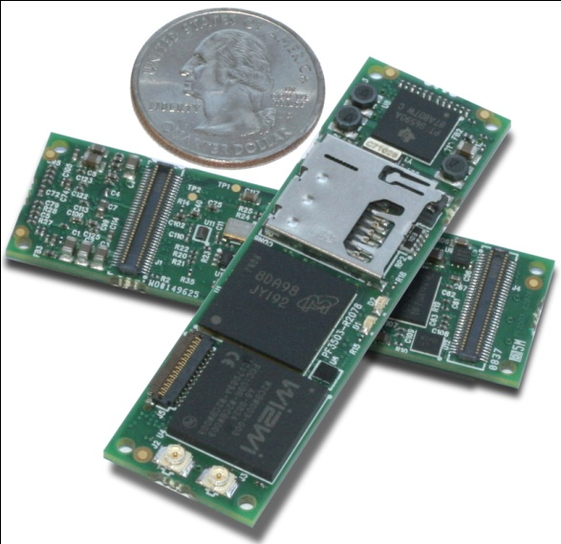
FC Design (Hardware)
Implemented on the Gumstix Overo Fire
Specification | Overo Fire
Processor | ARM Cortex-A8 OMAP3530
Clock speed | 720 MHz
Memory | 256MB RAM / 256MB Flash
Weight | 5.6g
Size | 17mm x 58mm x 4.2mm
Wireless Connectivity | Bluetooth WiFi
Features | I2C PWM (6) A/D(6) UART USB host
Overo Fire

Slide 4
FC Design (Software Architecture)
Use this text format...
FC Software Architecture

Slide 5
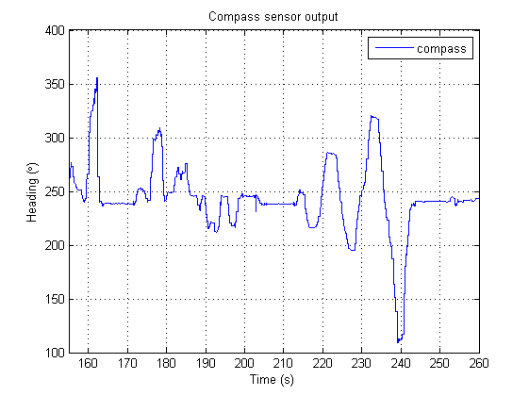
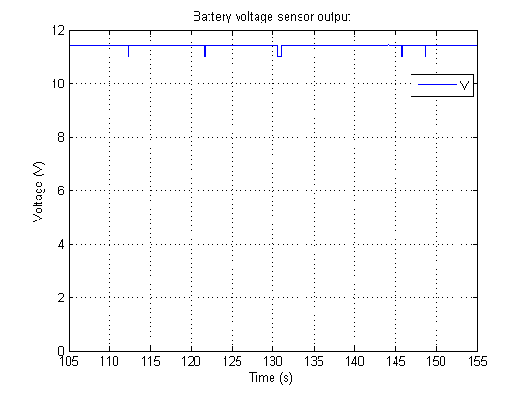
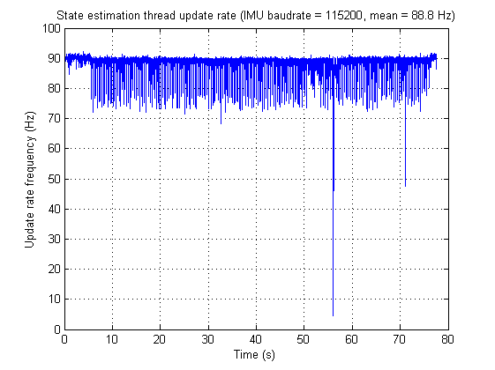
FC Acceptance Testing
HLO-4 Autonomous Hovering Flight
SR-D-05 and 06
Receive and process sensor data (50 Hz)
AT-15
AT-16
Collected compass, IMU, ultrasonic data
Processed at 50Hz
Collected battery voltage, flight status
Processed at 50Hz

Slide 6
State Estimation (SE)
Liam O’Sullivan - 06308627

Slide 7
State Estimation
HLO-3 State Estimation
SR-B-05
Altitude estimate at 50Hz
SR-B-04
Attitude estimate at 50Hz
Vicon
Ultrasonic sensor
IMU
Compass
Kalman Filtering
SR-B-06
X and Y estimate at 50Hz
Vicon

Slide 8
SE Design
15 states to be measured
State | Sensor | State | Sensor
Roll rate | X rate gyro (IMU) | Z acceleration | Z accelerometer (IMU)
Pitch rate | Y rate gyro (IMU) | X velocity | Vicon*
Yaw rate | Z rate gyro (IMU) | Y velocity | Vicon*
Roll | IMU* | Z velocity | Ultrasonic and Vicon*
Pitch | IMU* | X displacement | Vicon
Yaw | IMU* and compass | Y displacement | Vicon
X acceleration | X accelerometer (IMU) | Z displacement | Ultrasonic and Vicon
Y acceleration | Y accelerometer (IMU)
* indirect measurement

Slide 9
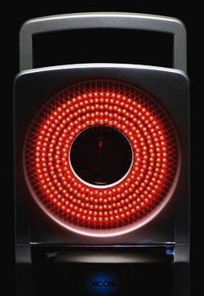
SE Design (Position and Velocity)
Vicon motion capture system
External motion capture system
Measures object translation and rotation with sub mm accuracy
200Hz update rate
Ethernet connection (via GCS)
Located at the ARCAA building
Vicon IR camera

Slide 10
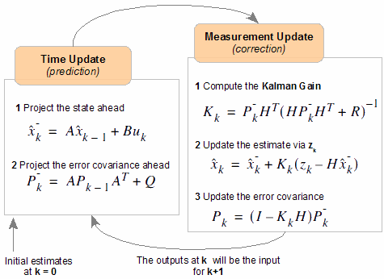
SE Design (Attitude)
Attitude estimated by 3 Kalman Filters (KF)
1 KF for each Euler angle
IMU rate data (Time Update)
IMU acc data
(Measurement Update)
Compass data
(Ψ Measurement Update)

Slide 11
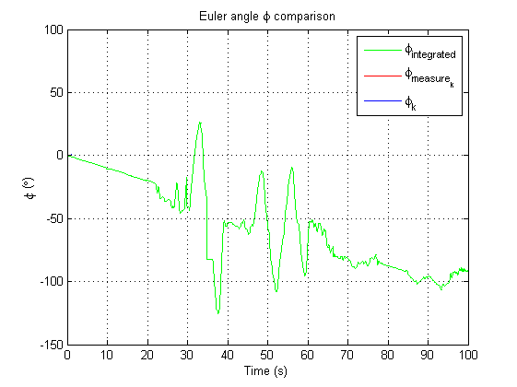
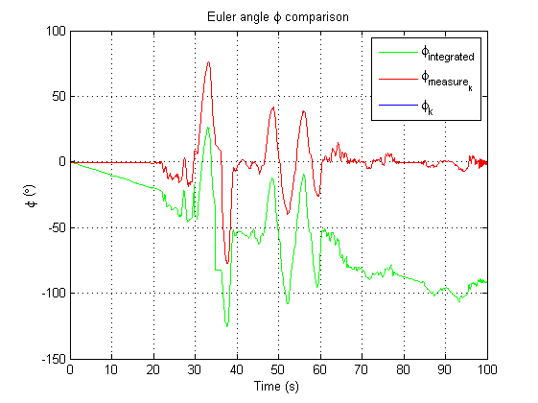
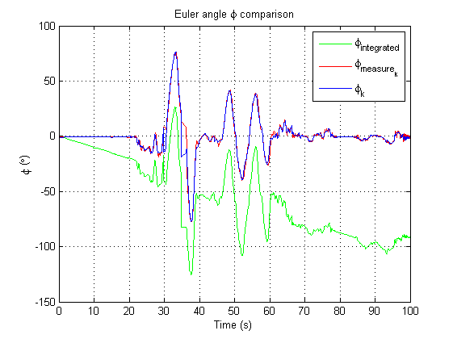
SE Design (Attitude)
Example: Estimating φ via KF

Slide 12
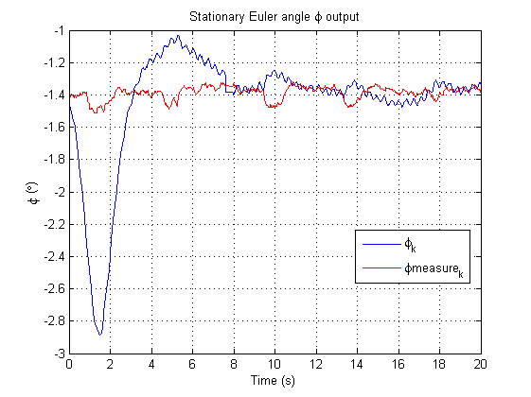
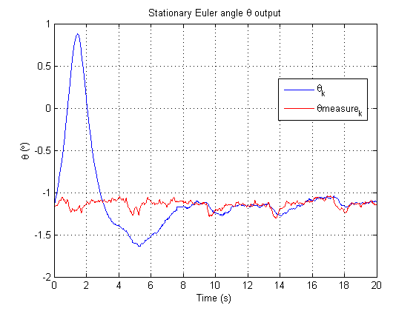
SE Testing Outcomes (Attitude)
IMU mounting error in both φ (-1.4°) and θ (-1.2°)

Slide 13
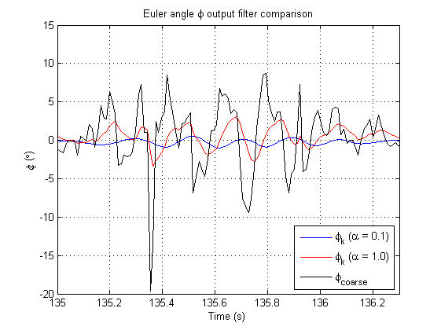
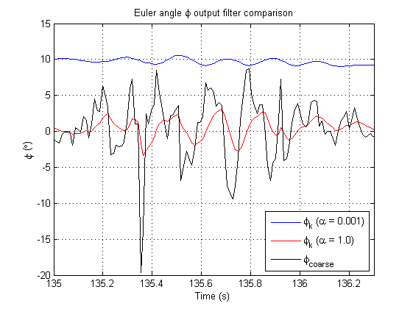
SE Testing Outcomes (Attitude)
Accelerometer low pass filtering

Slide 14
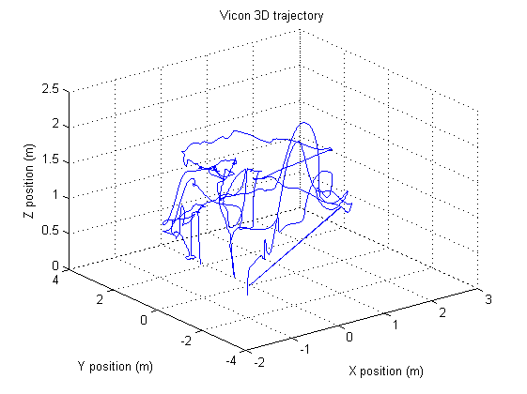
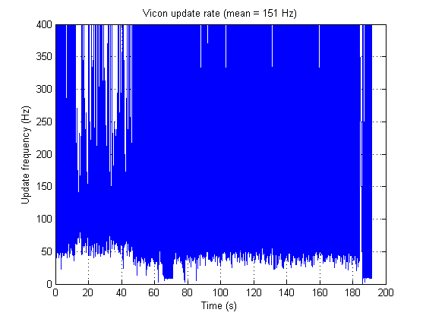
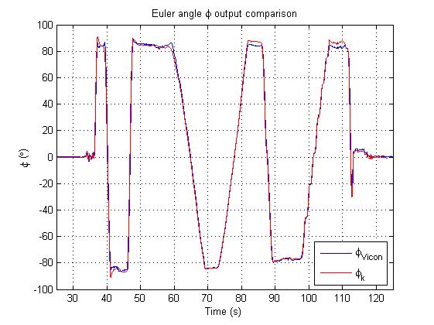
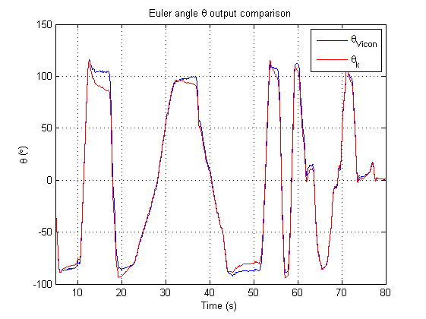
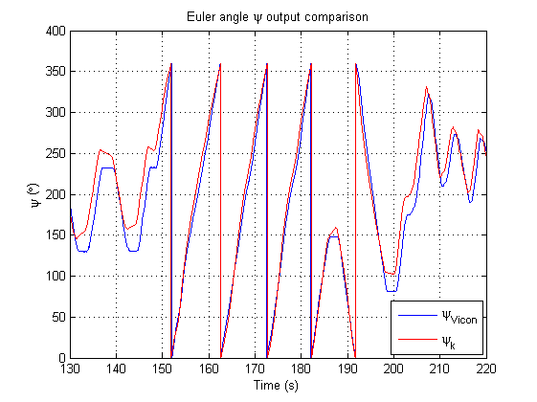
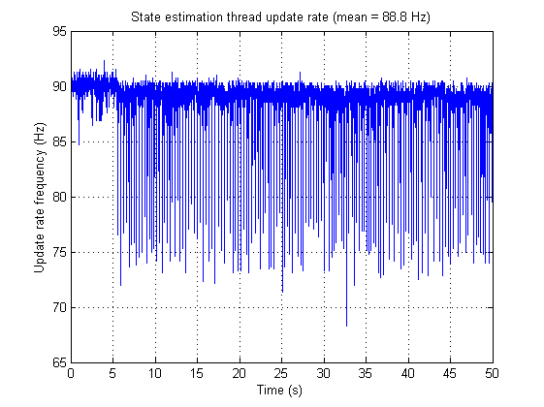
SE Acceptance Testing
HLO-3 State Estimation
SR-B-05
Altitude estimate at 50Hz
SR-B-04
Attitude estimate at 50Hz
AT-05
AT-07
SR-B-06
X and Y estimate at 50Hz
AT-06
Estimated Z position with Vicon
50Hz update
Estimated X and Y position with Vicon
50Hz update
Estimated Euler angles with IMU
50Hz update

Slide 15
Lessons Learnt
Flight computer
Too much operating system overhead
State estimation
Accelerometer data needs filtering
Ψ requires KF bound checking
Difficult to design visual control within a year (without a platform)

