Slide 1

Autonomous Helicopter Navigation System 2010

Slide 2
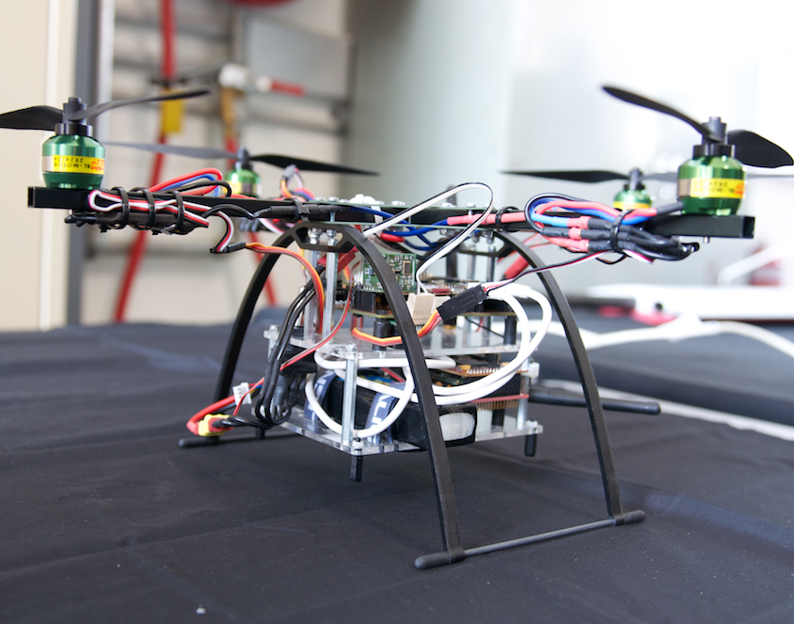
AHNS Project Aim
The Autonomous Helicopter Navigation System 2010 is focused on developing a helicopter system capable of autonomous control, navigation and localising within a GPS denied environment.

Slide 3
Insert Subject Here
Insert Name Here- Insert Student Number Here

Slide 4
Insert Subject Name Here
Use this text format...

Slide 5
Insert Subject Here
Insert Name Here- Insert Student Number Here

Slide 6
Insert Subject Name Here
Use this text format...

Slide 7
Lessons Learnt
First Lesson Learnt
Second Lesson Learnt

Slide 8
System DEMONSTRATION AND QUESTIONS

Slide 9
Michael HAMILTON - 06219314 MICHAEL KINCEL - 06219322 Tim MOLLOY - 06332064 Liam O’Sullivan - 06308627

