Slide 1

Autonomous Helicopter Navigation System 2010

Slide 2
Contents

Slide 3
Introduction to AHNS 2010

Slide 4
AHNS Project Aim
AHNS: To develop an autonomous indoor helicopter navigation system capable of carrying a payload.

Slide 5
Ground Control Station Flight control
Tim Molloy

Slide 6
Ground Control Station
HLO-5 Ground Control Station
SR-B-02 Flight Mode Switching
SR-B-09 and 08 Receive and Transmit Telemetry via WLAN
SR-D-08 Log Telemetry and Uplink Commands
SR-D-09 Display of State and Control Data
SR-D-10 System Status Display
Received Console and Data Logger
Data Plotters
System Status
WiFi Communications

Slide 7
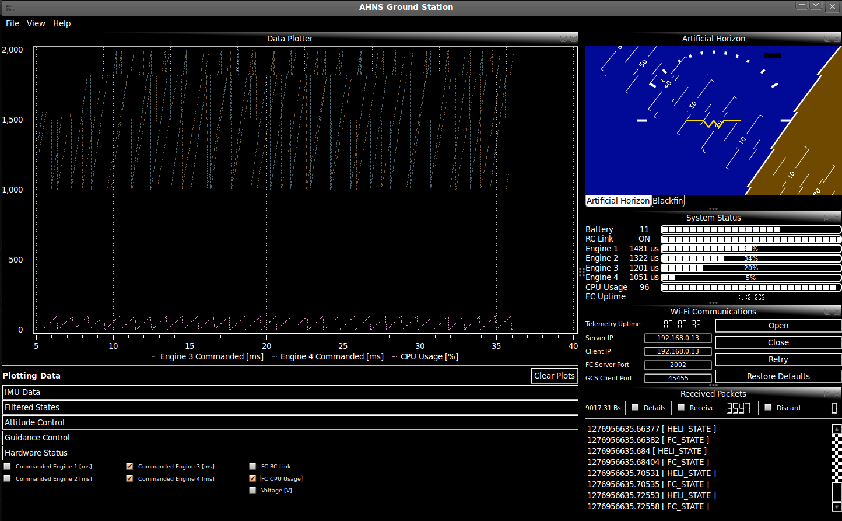
Ground Control Station

Slide 8
Flight Control
HLO-4 Autonomous Hovering Flight
SR-B-03 50Hz Control Rate
SR-B-10 PID Control Methodology
SR-D-03 Stability Augmented Flight
SR-D-04 Autonomous Station Keeping
Flight Computer
Quadrotor Control
Attitude Control
Guidance

