Slide 1

Autonomous Helicopter Navigation System 2010

Slide 2
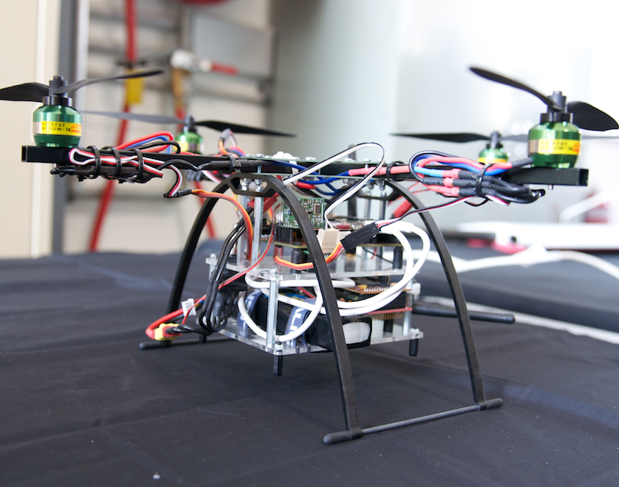
AHNS Project Aim
The Autonomous Helicopter Navigation System 2010 is focused on developing a helicopter system capable of autonomous control, navigation and localising within a GPS denied environment.

Slide 3
Platform | Pilot
Michael Kincel - 06219322

Slide 4
Platform
Airframe
Power System
Electronics
Enclosures

Slide 5
HLO-1 Platform
SR-B-01 Manual RC Control
SR-D-01 400 Gram Payload
SR-D-02 Maintenance Document
Perform RC Test Flight
Develop Suitable Airframe
Platform

Slide 6
Platform
Airframe
Power System
Electronics
Enclosures

Slide 7
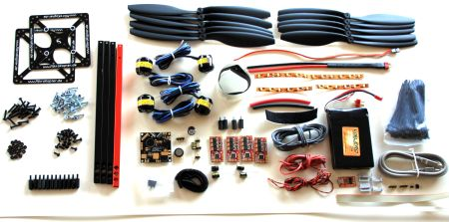
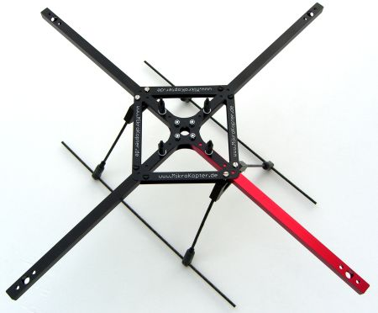
MikroKopter MK40
Readily Available
Lightweight
Durabiltiy
Fulfils Payload Requirements
Airframe

Slide 8
Platform
Airframe
Power System
Electronics
Enclosures

Slide 9
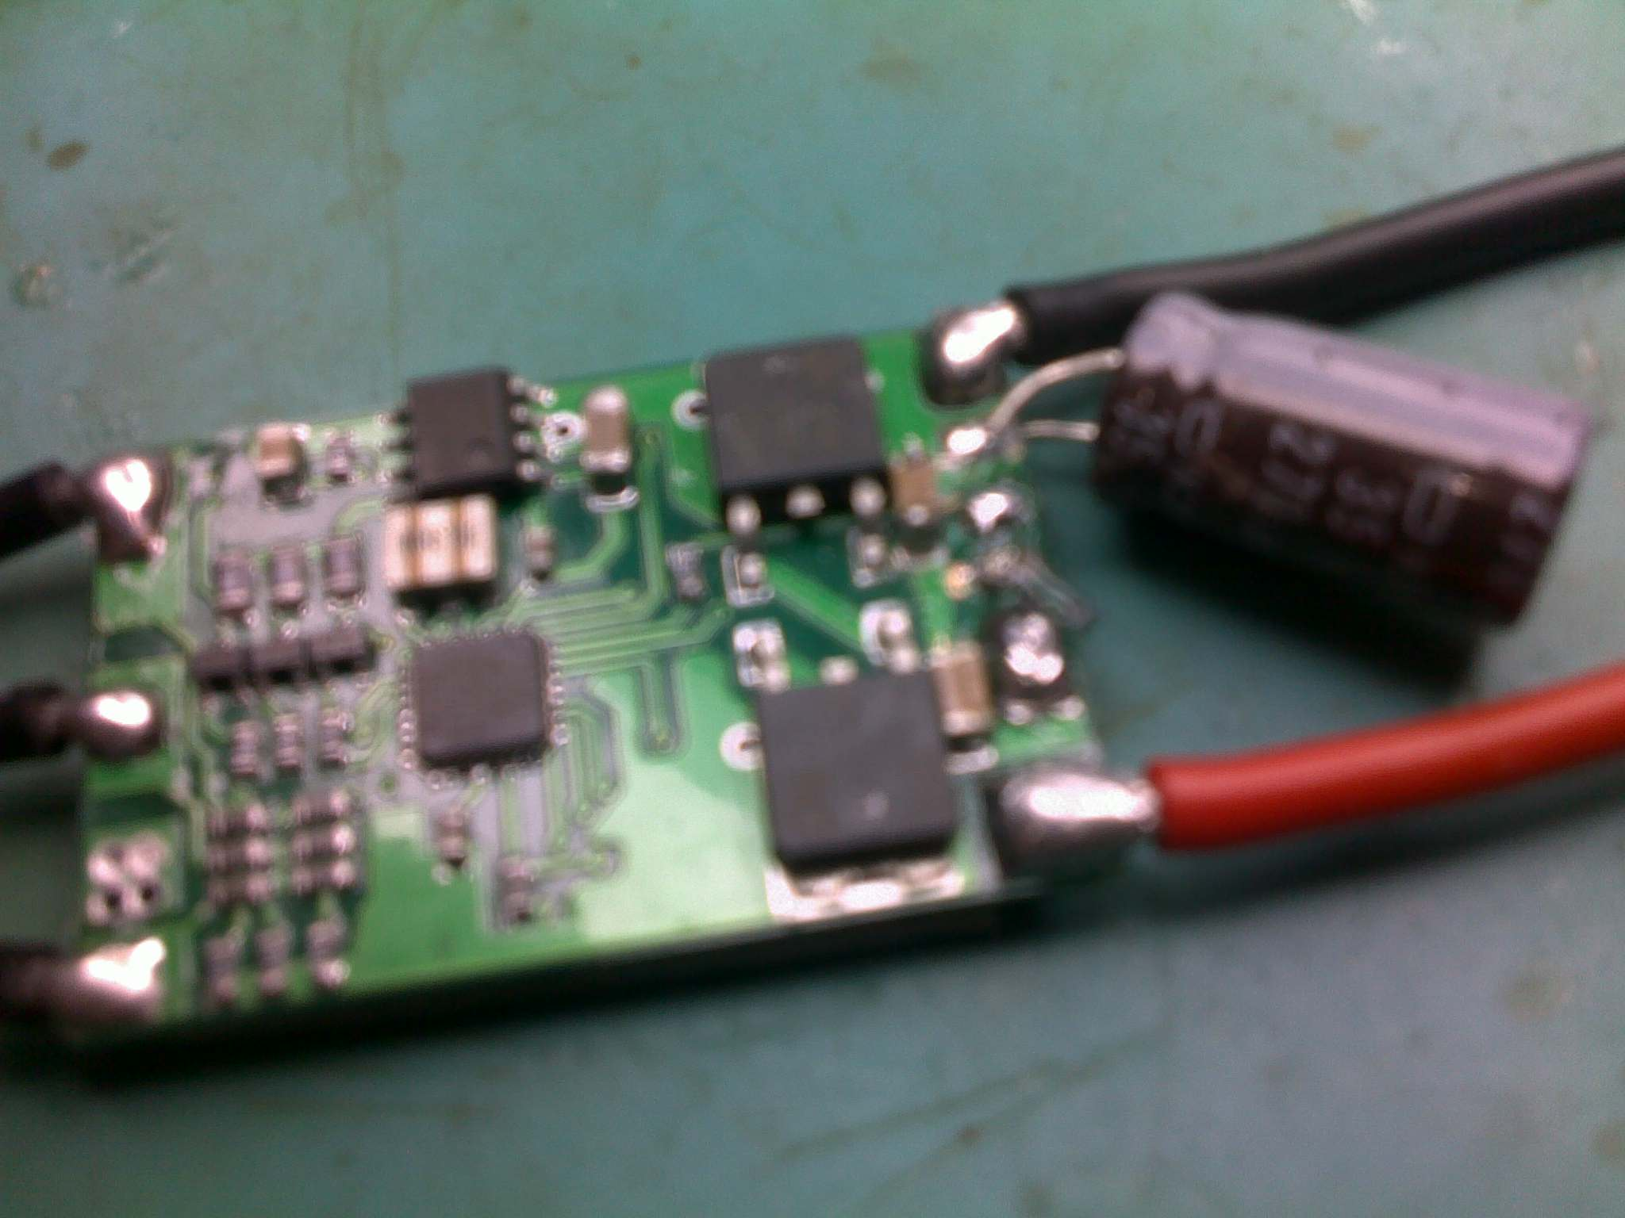
Power System

Slide 10
Platform
Airframe
Power System
Electronics
Enclosures

Slide 11
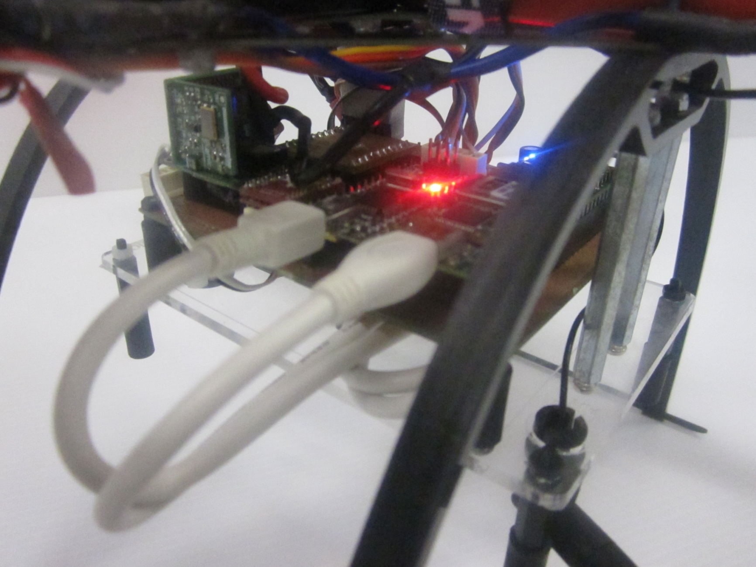
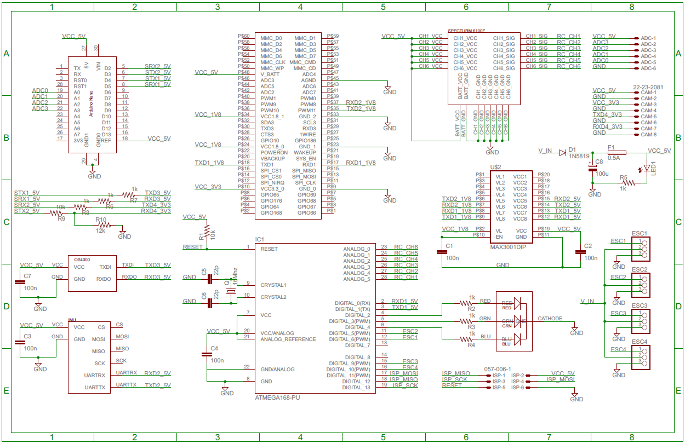
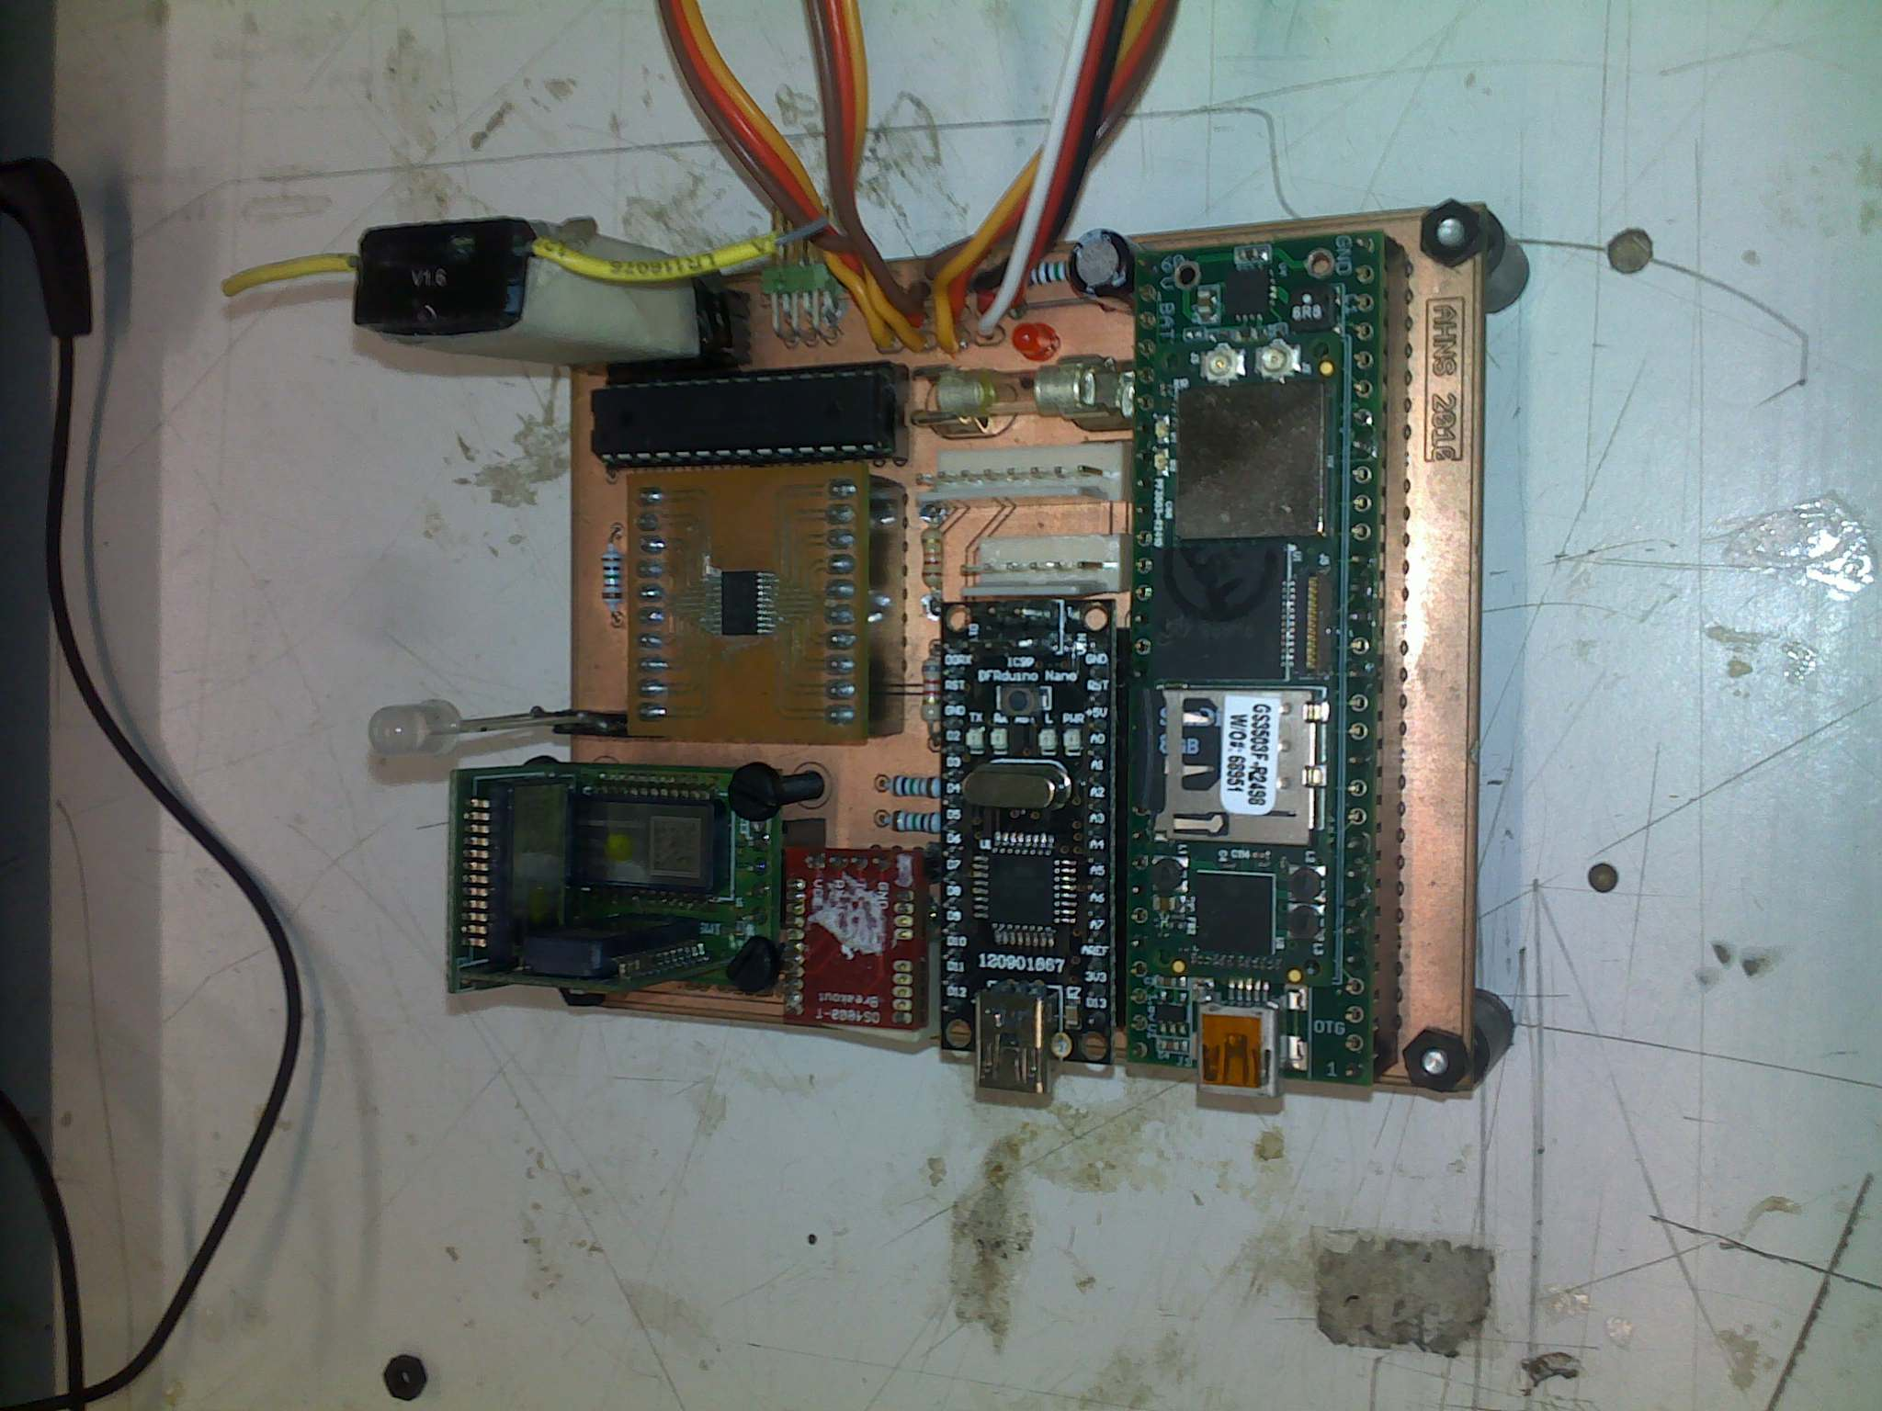
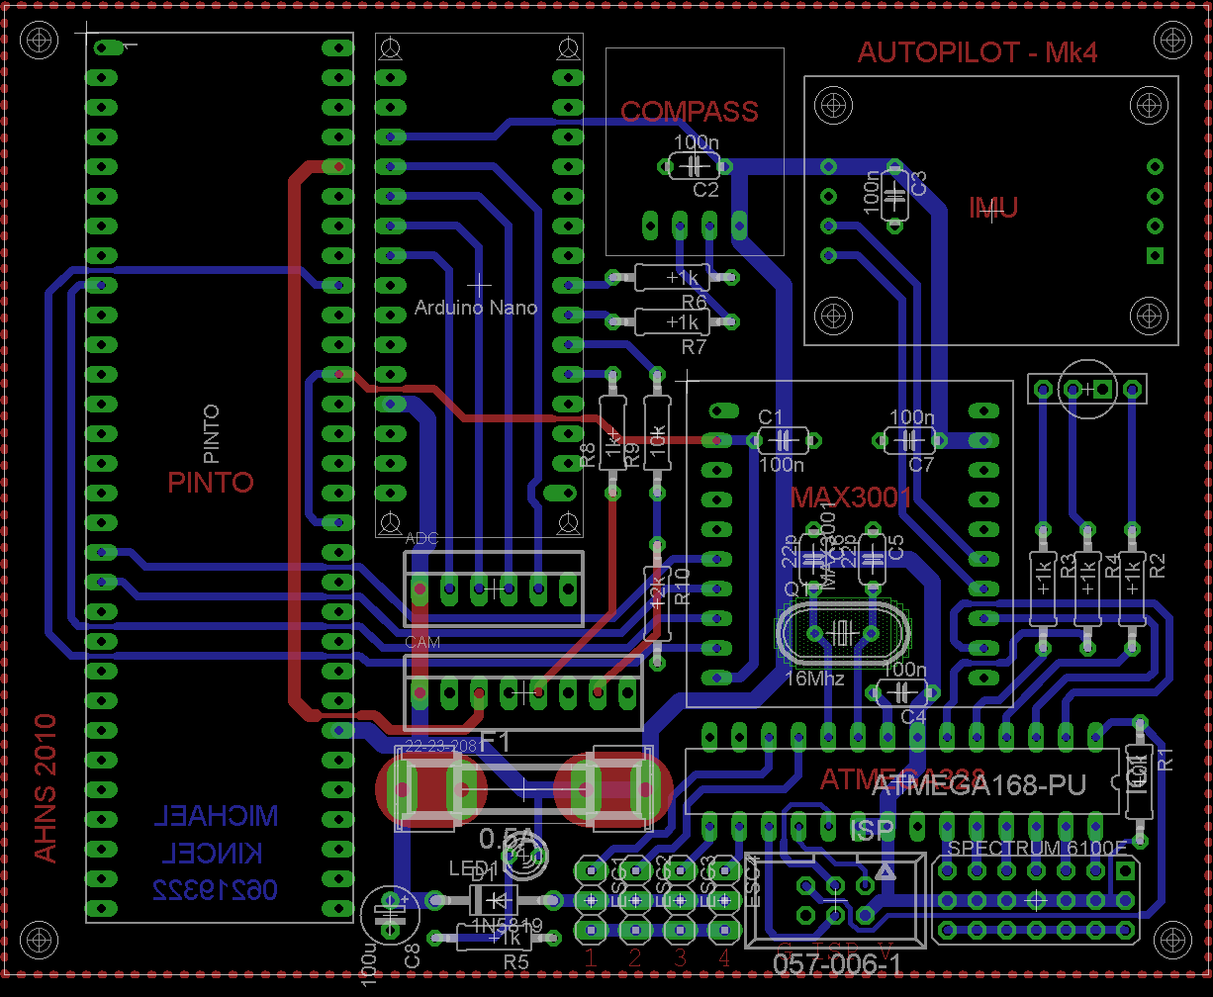
Electronics

Slide 12
Acceptance Testing

Slide 13
Lessons Learnt
First Lesson Learnt
Second Lesson Learnt

Slide 14
System DEMONSTRATION AND QUESTIONS

Slide 15
Michael HAMILTON - 06219314 MICHAEL KINCEL - 06219322 Tim MOLLOY - 06332064 Liam O’Sullivan - 06308627

