Slide 1
Platform pilot
Michael Kincel - 06219322

Slide 2
Platform
HLO-1 Platform
SR-B-01 Manual RC Control
SR-D-01 400 Gram Payload
SR-D-02 Maintenance Document
Mode Control Unit
Airframe Trade Study

Slide 3
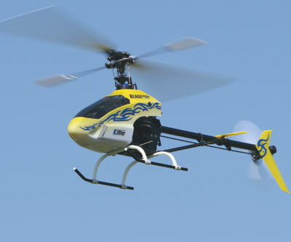
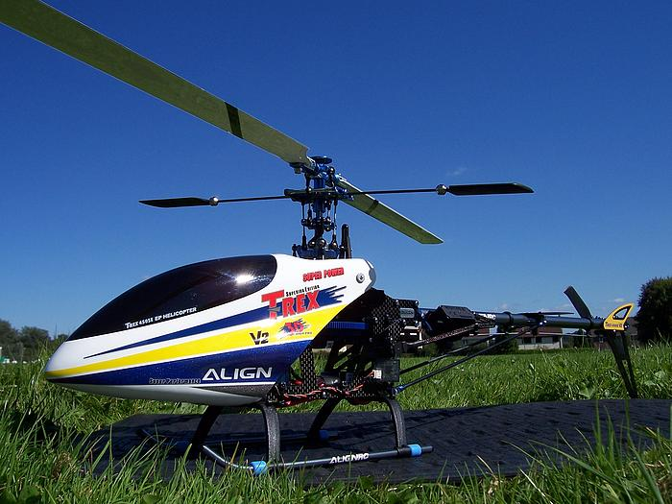
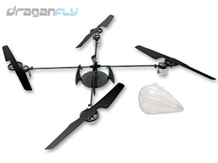
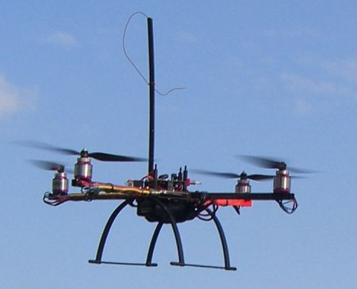
Airframe Trade Study
Mikrokopter MK40
 |  | Score (/5)
 | Weighting | 5 | 4 | 3 | 2 | 1
Initial Cost | 10% | < $700 | $700 – 799 | $800 - 899 | $900 - 999 | > $1000
Configuration | 20% | Airframe designed to have components mounted to it. | Components can be mounted to airframe with no modifications. | Components can be mounted to the airframe with minor modifications. | Components can be mounted to the airframe with major modifications | Impossible to mount components to airframe.
Acquisition and Maintenance | 15% | Can be acquired commercially and rarely requires simple repair. | Can be acquired commercially and repairable. | Can be bought however repair and maintenance expensive. | Not available commercially and difficult to build and repair. | Impractical to acquire; repair limited to rebuilding.
Vibration | 10% | Airframe generates minor vibrations but is designed with vibration dampeners. | Airframe generates minor vibrations and can have vibration dampeners installed. | Airframe generates major vibrations but is designed with vibration dampeners. | Airframe generates major vibrations but can have vibration dampeners installed. | Airframe generates major vibrations but cannot have vibration dampeners installed.
[SR-D-01] Payload | 30% | > 500g | 450 – 500g | 400 – 449g | 350 – 399g | < 350g
Safety | 10% | Airframe has no exposed moving parts. | Airframe has small exposed moving parts with low kinetic energy. | Airframe has small exposed moving parts with high kinetic energy. | Airframe has large exposed moving parts with small kinetic energy. | Airframe has large exposed moving parts with high kinetic energy.
Construction Material | 5% | Airframe is predominantly constructed out of light weight carbon fibre. | Airframe is predominantly constructed out of lightweight metal. | Airframe is predominantly constructed of heavyweight metal. | Airframe is predominantly constructed out of lightweight plastic. | Airframe is predominantly constructed out of heavyweight plastic

Slide 4
Hardware Architecture
Flight
Computer
Flight Control
Primary Sensors
Secondary
Sensor

Slide 5

Electronics Design
All circuits designed using Eagle PCB
Single circuit board design
Minimises weight and size
Minimises complexity through reduction in wire count
Difficult to debug
Difficult to modify prototype
Larger prototype stack verified first
Subsequent adaptation to single small PCB

Slide 6
Electronics Design
Development Stack Architecture
Main Board
MCU
IMU
Ultrasonic Sensor
Flight Computer
ADC

Slide 7
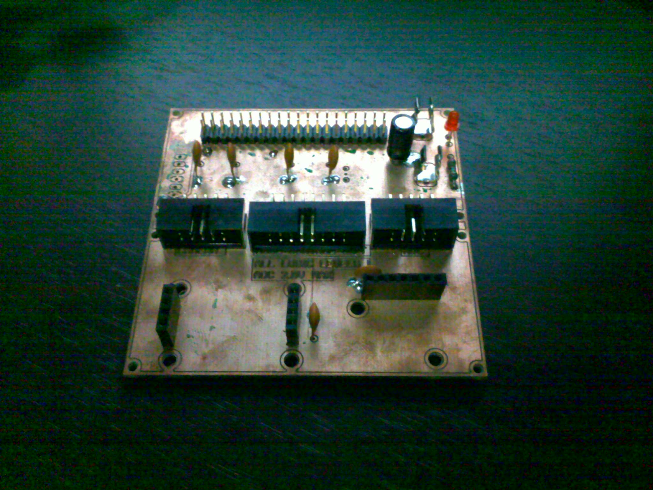
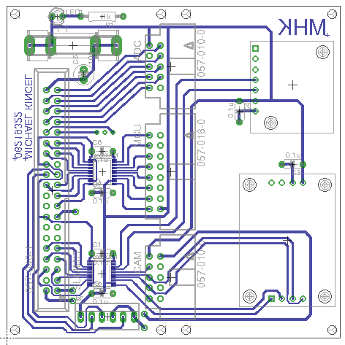
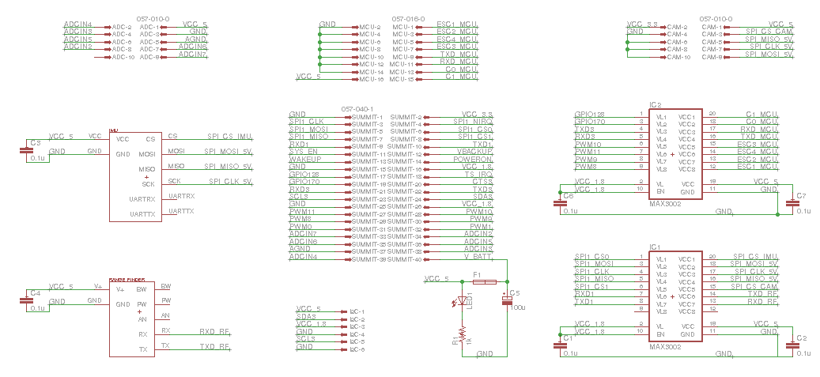
Electronics Design
Main Development Board

Slide 8
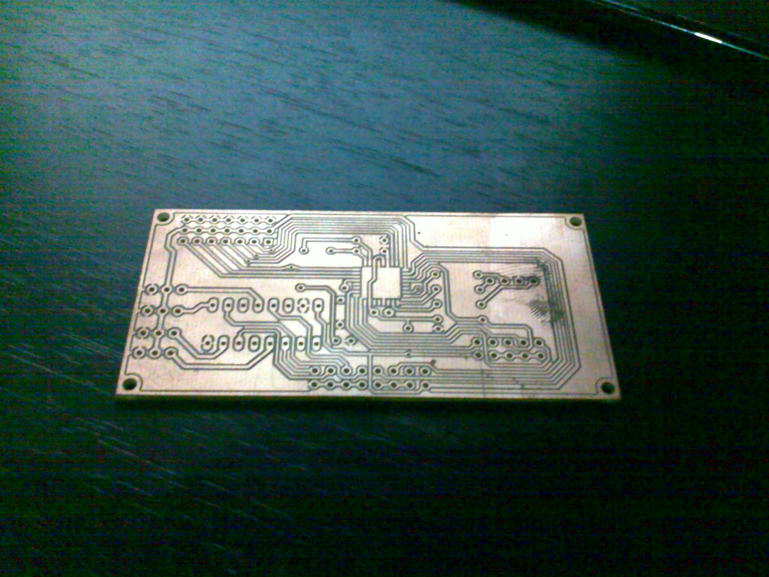
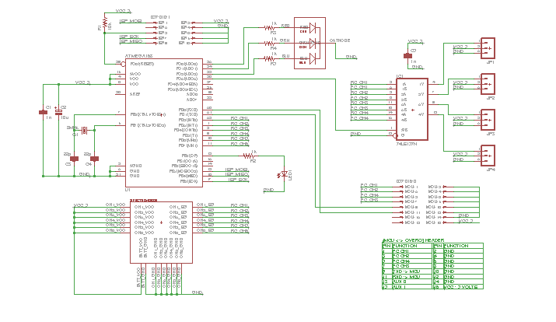
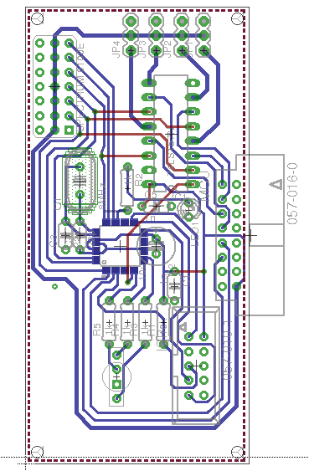
Electronics Design
Mode Control Unit

Slide 9
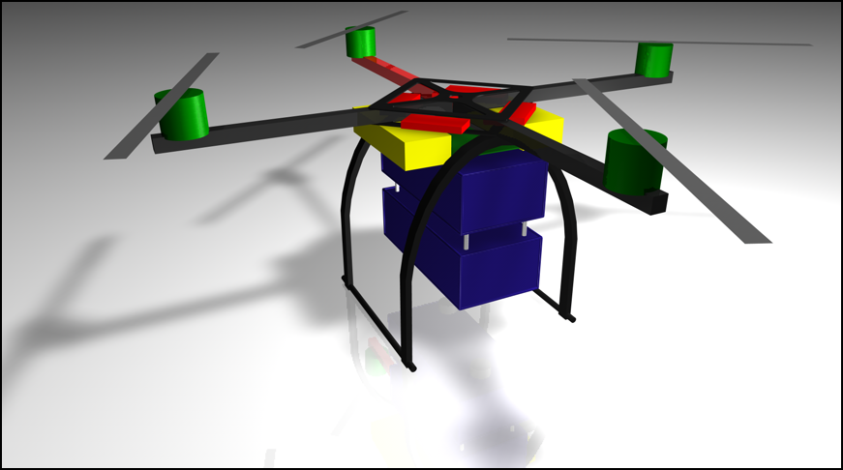
Enclosure Design

Slide 10
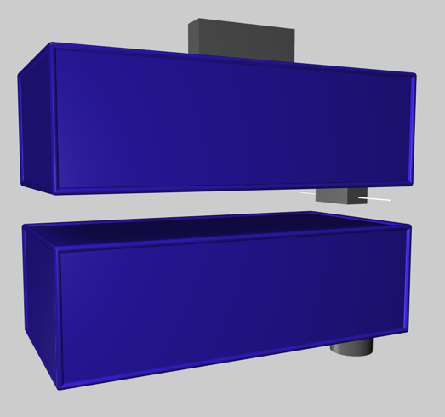
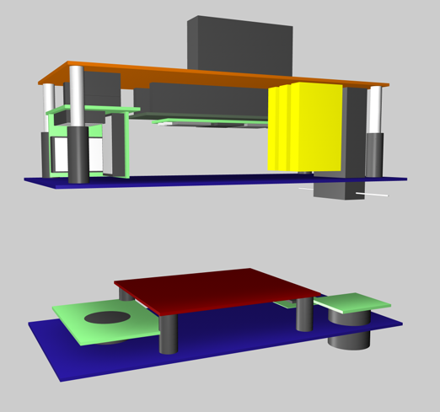
Enclosure Design

Slide 11
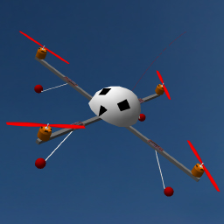
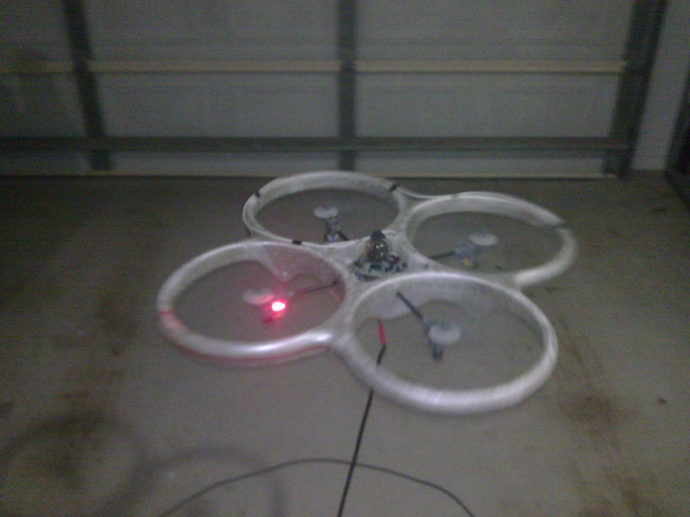
Piloting
RC Simulator
Weekly flights to maintain skill level
Practise recovery manoeuvres
Use of a practise aircraft
More resilient to damage
Less likely to incur damage

