Slide 1

Autonomous Helicopter Navigation System 2010

Slide 2
Contents

Slide 3
Introduction to AHNS 2010

Slide 4
AHNS Project Aim
AHNS: To develop an autonomous indoor helicopter navigation system capable of carrying a payload.

Slide 5
Ground Control Station & Flight control
Tim Molloy

Slide 6
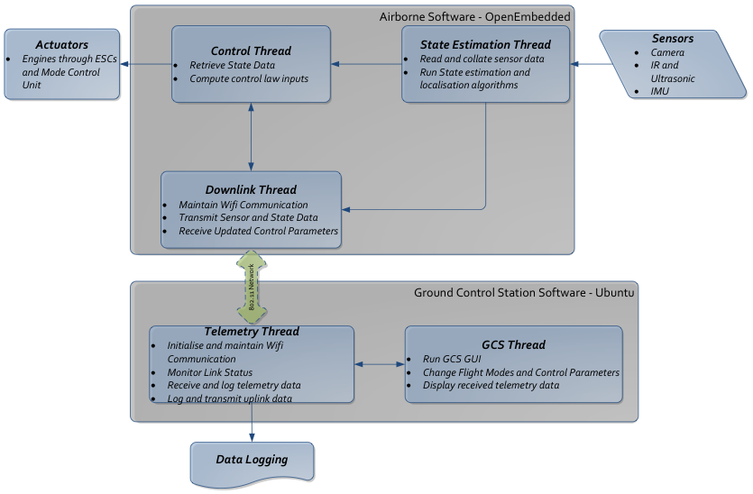
Software Architecture

Slide 7
Ground Control Station

Slide 8
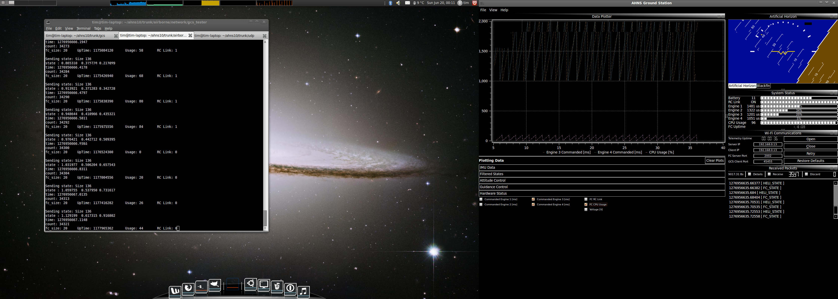
GCS GUI
Ubuntu 32-bit Operating System
Qt Framework for C++ GUI Development
Focus on:
Code reuse
Creating and using reusable code
User layout customisation
Avoid Static GUI objects
Dockable Widgets
Enable the operator to choose a layout logical to their application
Increases the information which can be displayed

Slide 9
The Widgets
WiFi Communications
Configure, Control and Monitor UDP Telemetry
Received Console
Report telemetry messages and enable inspection
System Status
Provide visual notifications of airborne system status
Data Logger
CSV Log of all Received Airborne Data

Slide 10
Data Plotters & Artificial Horizon
Artificial Horizon
2009 OpenGL Attitude Display
Roll and Pitch
Data Plotter
Real-time data plotting
Raw Sensor Data, State Data, Control Data, System Status…
Support for multiple data plotters

Slide 11
Following Controller Design…
Attitude Control Trims and Bounds
Set the trims and bounds on the roll, pitch and yaw control loops.
Attitude Control Gains
Set the PID control gains on the roll, pitch and yaw control loops.
Guidance Control Gains
Set the PID control gains on the x, y and z position control loops.
Guidance Trims and Bounds
Set the trims and bounds of the x, y and z position control loops.
Flight Control
Set the active control loops and their set points. Enables command of the airborne control.

Slide 12
Flight Control

Slide 13
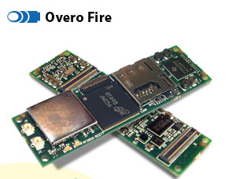
Flight Computer
Trade Study for Computer-on-Module to support
Hardware Integration
Control and State Estimation
Localization
Considered
BeagleBoard
Limited Hardware Interfacing
Gumstix Overo Air
Lacked Support for Image Processing
Gumstix Verdex
No Hardware Floating Point Implementation
Gumstix Overo Fire
6 grams, 600MHz TI CPU

Slide 14
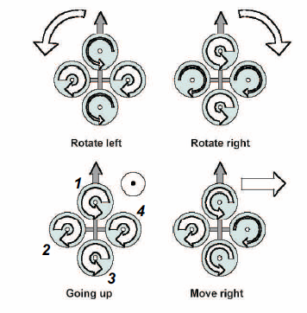
Quadrotor Control
Thrust Altitude Control Forces
Thrust Roll Control Forces
Thrust Pitch Control Forces
Drag Yaw Control Forces

Slide 15
Quadrotor Control
Drag and Thrust forces are proportional to the square of the engine speeds which are in turn proportional to the motor control signals:
This is the mixing relationship between the altitude, roll, pitch or yaw controller outputs and the individual motor control signals.

Slide 16
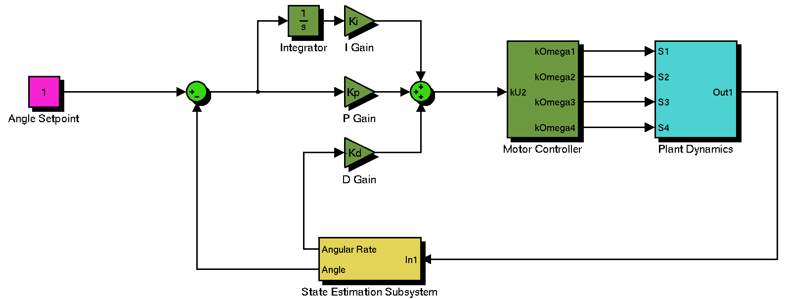
Quadrotor Control
Abstraction of motor thrust and drag control force variation reduces attitude control to three angular loops whose outputs are proportional to the required control forces, U2, U3 or U4.

Slide 17
Guidance Progress
Three Angular Loops for Attitude Control plus up to Three Positional control loops
Altitude Control with input U1
x-inertial position with roll and pitch loop setpoint
y-inertial position with roll and pitch loop setpoint
x and y position control presents some challenges
Requires use of Body and Inertial Reference Frames
Velocity Control using pitch and roll angle bounding
Options to decouple position errors or treat as cross-track error problem based on heading

Slide 18
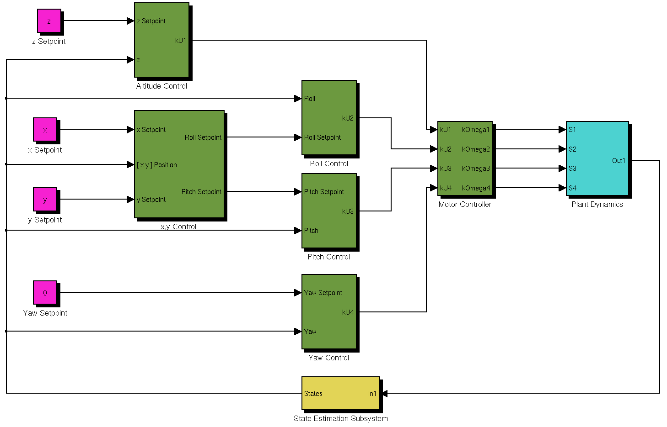
Cascaded PID Guidance And Control

