Slide 1
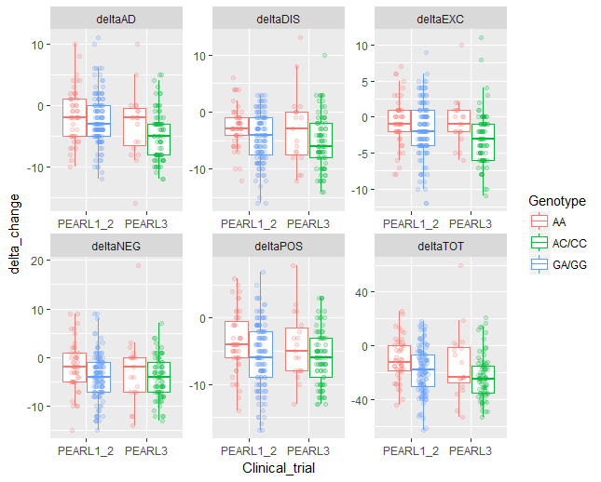
Figure 1. Boxplots of association between rs6295, tagged by rs6449693 (Pearl 1,2) or rs358532 (Pearl 3), and delta change in PANSS Total and five subscales in SCZ patients with European ancestry after six weeks of treatment with lurasidone in Pearl1,2 and Pearl3 trials. The Δ change or % change in PANSS Total and five subscales was calculated with last observation carried forward (LOCF). Δ change = PANSS_{LOCF6wk} – PANSS_{Baseline}. % change = Δ change/ PANSS_{Baseline} × 100%.
P = 0.675
P = 0.251
P = 0.031
P = 0.048
P = 0.645
P = 0.027
Tag SNPs
for rs6295
rs358532
P = 0.021
P = 0.208
P = 0.041
P = 0.094
P = 0.046
P = 0.036
rs6449693

Slide 2
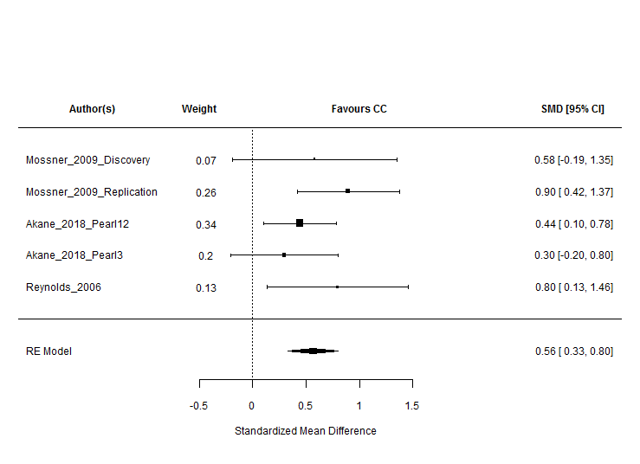
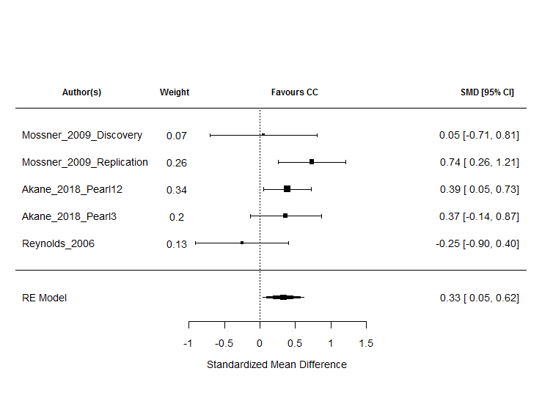
Figure 2. Forest plots of the association between HTR1A functional polymorphism, rs6295, and improvement in PANSS negative symptom (2A) and positive symptom (2B) after treatment with antipsychotic drugs in patients with SCZ of European ancestry. This is a summary statistics of the meta-analyses of five independent datasets.
2A
2B
(p <0.0001)
(p <0.0023)
Random-Effects Model (k = 5; tau^2 estimator: REML)
tau^2 (estimated amount of total heterogeneity): 0.0072 (SE = 0.0498)
tau (square root of estimated tau^2 value): 0.0851
I^2 (total heterogeneity / total variability): 9.64%
H^2 (total variability / sampling variability): 1.11
Test for Heterogeneity:
Q(df = 4) = 3.886, p-val = 0.422
Model Results:
estimate se zval pval ci.lb ci.ub
0.564 0.120 4.714 <.0001 0.329 0.798 ***
Random-Effects Model (k = 5; tau^2 estimator: REML)
tau^2 (estimated amount of total heterogeneity): 0.0367 (SE = 0.0736)
tau (square root of estimated tau^2 value): 0.192
I^2 (total heterogeneity / total variability): 35.38%
H^2 (total variability / sampling variability): 1.55
Test for Heterogeneity:
Q(df = 4) = 6.450, p-val = 0.168
Model Results:
estimate se zval pval ci.lb ci.ub
0.331 0.145 2.276 0.0229 0.0459 0.615 *

Slide 3
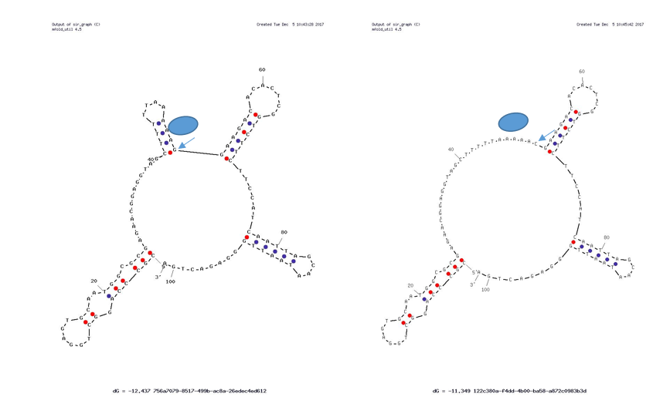
Figure 3.
DRN
PFC/VTA
DRN: Dorsal raphe nucleus
PFC: Prefrontal cortex
VTA: ventral tegmental area
rs6295; C
Dopaminergic neuron
Dopamine
Release (VTA)
Enhanced inhibition
Pre-synaptic
auto-receptors
PV+ Fast-spiking
interneuron
Clinical response
Protein
Serotonergic neuron
Better improvement
Dopamine
Release (PFC)
DNA
Positive symptoms
Negative symptoms
Disorganization
Pyramidal neuron
DRN
PFC/VTA
Less improvement
Dopaminergic neuron
rs6295; G
inhibition
PV+ Fast-spiking
interneuron
5-HT1A presynaptic auto-receptor
5-HT1A postsynaptic hetero-receptor
5-HT2A receptor
NMDA receptor
Dopamine D2 receptor
5-HT release
Dopamine release
Transcriptional factor
Protein
Serotonergic neuron
DNA
Pyramidal neuron

