Slide 1
eXtreme Gradient Boosting aka. XGBoost
Noah Peart & Li Jiang

Slide 2
What is XGBoost
Supervised learning
Ensemble method for decision trees
Classification / Regression - operates on structured data with known outcomes
Can have very good performance - commonly used by large companies, eg. Uber, Amazon, etc.
Used to win a number of recent Kaggle competitions
Created by Tianqi Chen, open source on github
Bindings for many languages: C++, Python, R, Julia, etc.

Slide 3
Ensemble Learning with Trees
Like ensemble methods discussed last week for clustering
Take a bunch of ‘weak’ learning algorithms, eg. Classification trees and find clever ways to combine lots of them to getter better results.
Classification/Regression decision trees have all the good, bad, and ugly features that were discussed in lecture
They don’t tend to make great predictions and are prone to overfitting, aren’t robust - small change in data => big change in tree, etc.
Various ensemble techniques to remedy tree classification: bagging, boosting, and random forests
All ways of averaging the results of many trees to come to a consensus

Slide 4
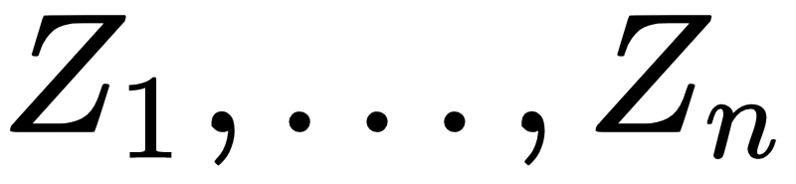
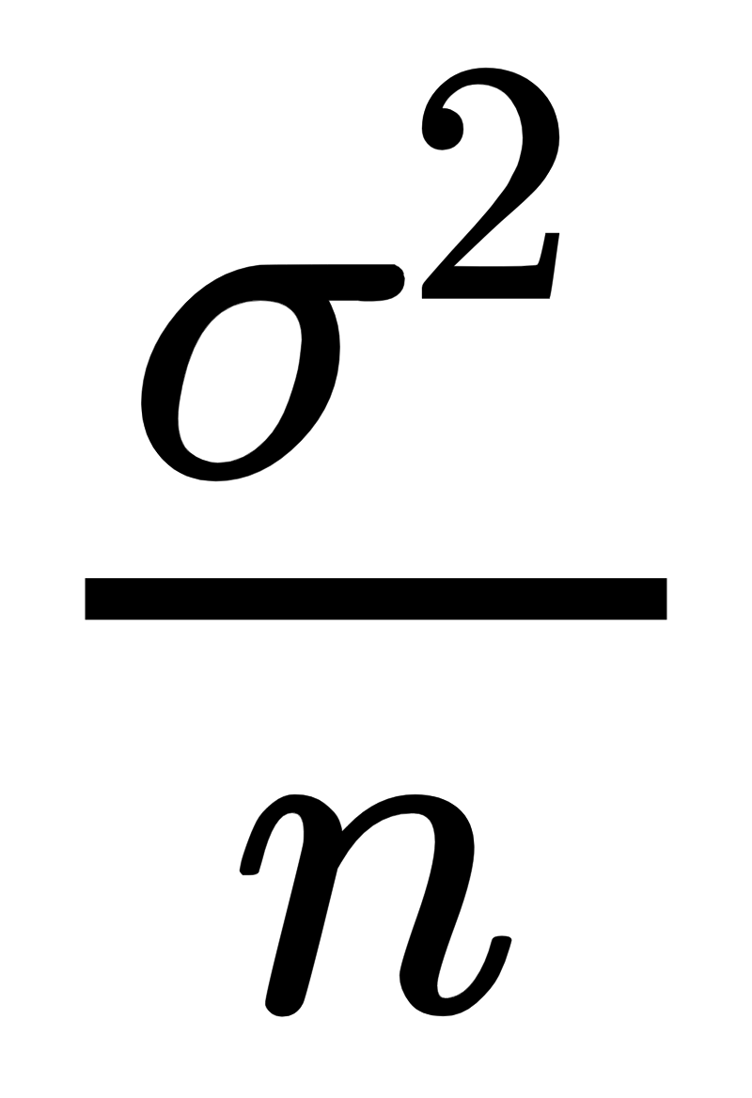
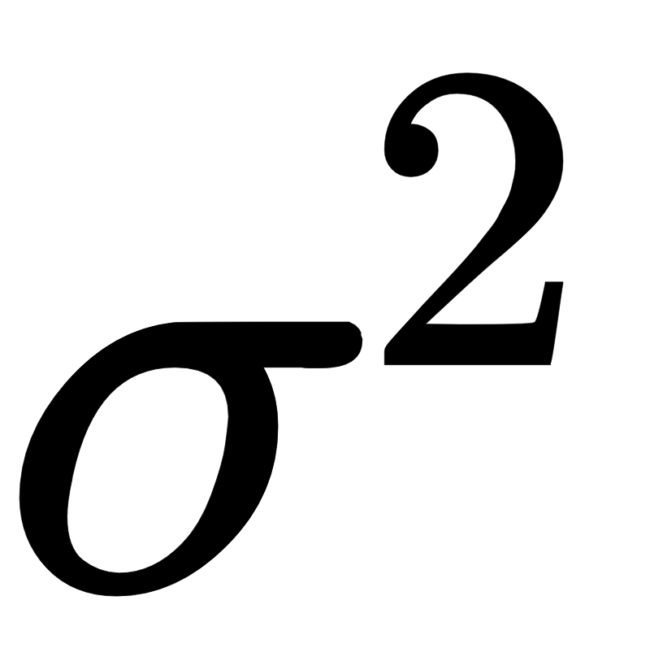
Bagging
Bagging is a method of addressing the high variance problem associated with decision trees
Given a bunch of independent random variables,
each with a variance , variance of mean is
Same idea with averaging a bunch of trees => reduce the variance of the model, the more uncorrelated the trees the better
Need multiple training datasets => bootstrap data, train decision tree on each set, growing deep high variance trees w/o pruning

Slide 5
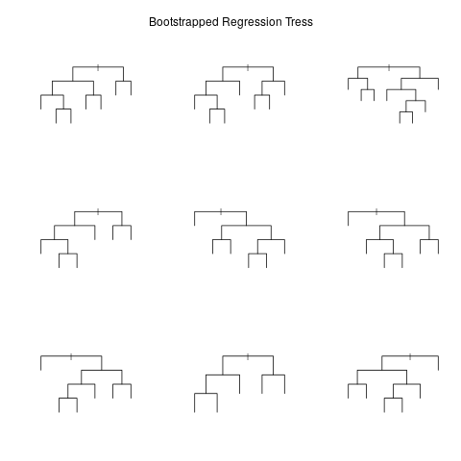
Bootstrapping Trees
Example: bootstrapping a bunch of trees in R
Bootstrap sample WITH replacement
Each tree ends up using ~⅔ of the data

Slide 6
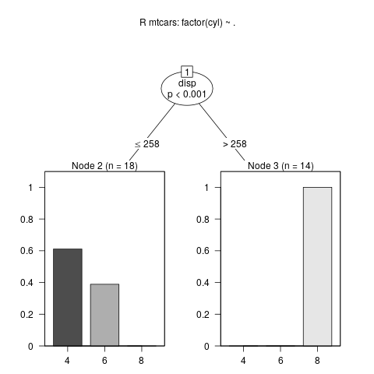
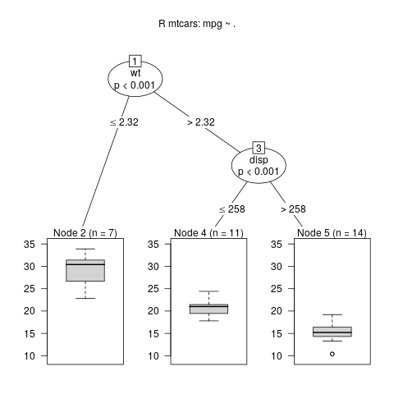
Combine Trees
Regression: average predictions (each leaf’s prediction is its mean for a continuous variable) probabilities
Classification: take majority vote for each data point or average class probabilities

Slide 7
Random Forests
Simple improvement on bagging
Instead of considering all predictors for splitting each tree, consider only a subset -- this is the main difference b/w RF and Bagging
Why is this a good idea?
If there is a strong predictor, all the trees will look the same, eg. be highly correlated and thus lead to smaller reduction in the variance of the final model.
Allows for more varied trees, so other predictors that weren’t quite as strong will also get some representation

Slide 8
Bagging/RF Good and Bad
Good
Better predictions than decision trees
Reduced variance - more so with RF
More trees doesn’t lead to overfitting, so just need a sufficiently large number of trees to minimize test error
Get estimates of test error for free -- test errors can be computed on the left-out sets for each bootstrapped tree (aka. Out-Of-Bag (OOB) error)
Bad
Harder to interpret than simple decision trees
Slower - have to compute a tree for each bootstrap
Overfitting resulting from tree depth

Slide 9
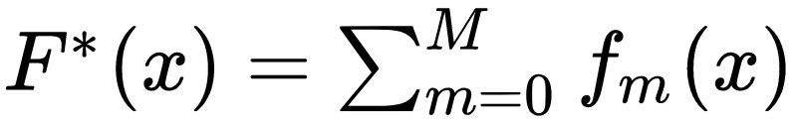
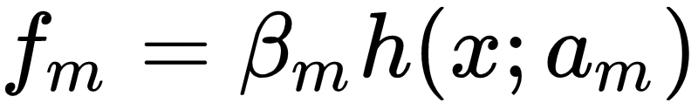
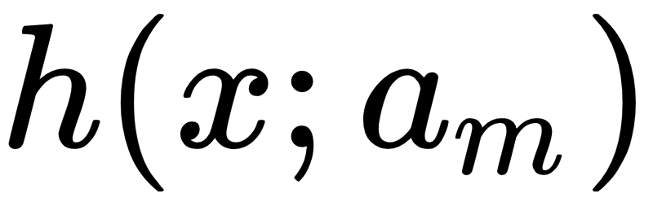
Boosting
Like bagging, fits a bunch of weak learners (eg. trees, linear models)
However, each iteration is fit to reweighted versions of training data where the misclassified points are more heavily weighted.
Iterative, additive model, looks like a GAM, but model and parameters are not estimated simutaneuosly:
Where F*(x) is a family of parameterized functions and f_0(x) is the the initial guess, with each additive function referred to as a “boost”.
For trees, where is a tree and the parameters, a, are those of a tree - eg, splitting features, locations, etc. See this paper on gradient boosting machine for gritty details.

Slide 10
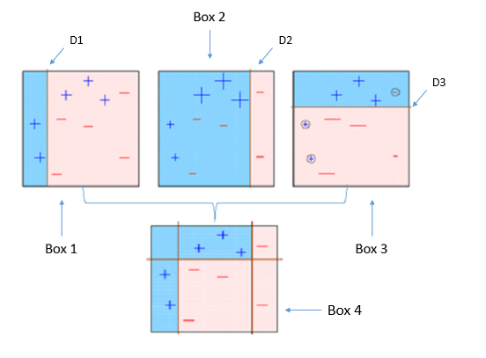
Example Updates
This example is actually for Adaboost (tree-boosting model) available in sklearn.ensemble.
Each iteration a stump (tree of depth 1) is fit.
The larger points are weighted more heavily in next step.
https://www.analyticsvidhya.com/blog/2015/11/quick-introduction-boosting-algorithms-machine-learning/

Slide 11
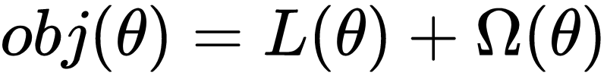
XGBoost Algorithm
Gradient descent
Objective function: Loss + Regularization
The regularization function, used to reduce complexity of model, could be composed of #leaves and L2 norm of leaf scores (eg. penalize the tree depth and leaf weights)

Slide 12
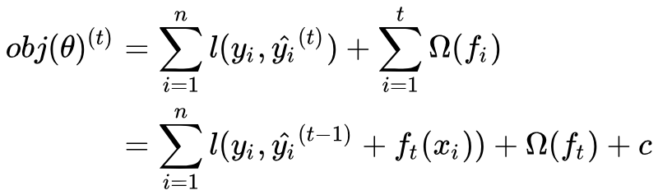
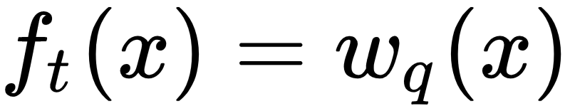
XGBoost Algorithm
Optimize the loss function at time t, by finding f_t to minimize:
Involves partial derivatives of Taylor expansion to a couple of terms => gradient, hessian
Trees defined as vectors of leaf weights,

Slide 13
XGBoost Algorithm Summary
Fixing the structure of the tree, the optimal weights of the leaves can be computed using the previous eqns.
Each iteration
First compute gradient and hessian
Greedily grow a tree by splitting each node using optimal weights (this is steepest descent)
Add new tree to model * learning rate (shrinkage)
The learning rate slows down optimization and prevents overfitting

Slide 14
Boosting Benefits
Better predictions
Robust - invariant under monotone transformations of input variables, eg. xi, log(xi), sqrt(xi), yield same results
So, consequently, robust to long-tailed distributions and outliers
Handle missing values well, no need for imputation
Ignore redundant variables
Scales well, after sorting inputs, linear in #obs, #iterations, ~log(tree depth). Classification linear in #classes or better
Small trees are better - usually depth 2-3
Depth of trees corresponds to interactions between predictors
XGBoost does tree-building in parallel, however the algorithm is inherently iterative, so can’t be fully parallelized like random forests’
XGBoost models can be updated with new data any time

Slide 15
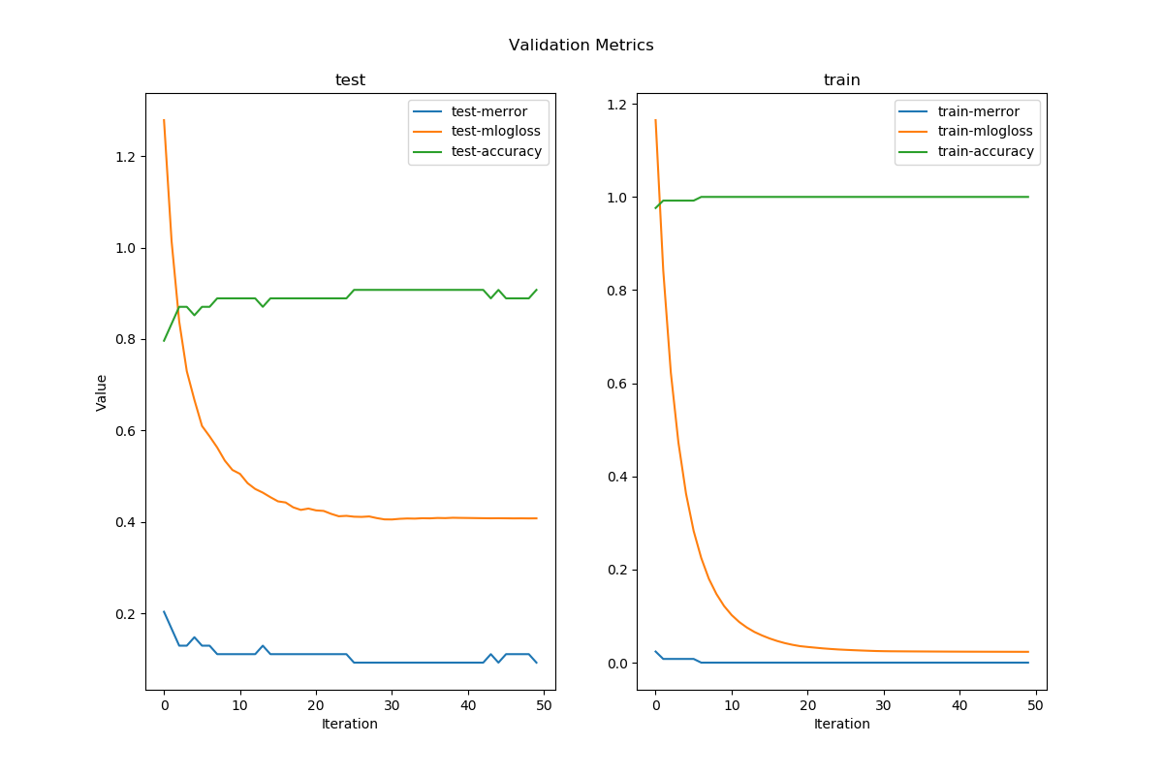
XGBoost Validation
Can watch validation metrics as model is being fitted

Slide 16
XGBoost Parameters
Loss function: function to be minimized to determine splits
Objective function: function to maximize + regularization
With XGBoost, these are both customizable
Learning rate - the shrinkage parameter
Number of rounds of boosting
Parameters to the weak learner, eg. trees or linear models
Callback functions - customizable functions that are called either before or after an iteration. These can be used for early-stopping, eg. the error hasn’t decreased for a while, or for resetting the learning rate, etc.
Lots of additional customization parameters.

Slide 17
Interpreting Results
Variable Importance Plot:
Meant to deal with interpretability problem of agglomerative model => the bagged model is no longer a single tree with easy to interpret splits
Summarizes the importance of each predictor on the outcome by the reduction in loss function when splitting on the predictor
Reductions are averaged over all trees
For regression this could be reduction in RSS/RMSE, for classification reduction in Gini index

Slide 18
Python XGBoost Interface
XGBoost uses its own optimized data structure called a DMatrix to store features and labels. These can be created from Pandas DataFrames or from scipy.sparse types - see conversion example.
Very general interface: many builtin objective functions, metric evaluation functions.
Allows user customize objective/loss functions (need to define the gradient / hessian)
There is an interface that implements scikit-learn API - XGBModel, although it doesn’t support all the same functionality. For example, custom validation functions, `feval` are passed to the booster object, so it appears they must be implemented at the C level.

Slide 19
References
Chen, Tianqi. Introduction to Boosted Trees
XGBoost docs
Friedman, Jerome. Greedy Function Approximation: Gradient Boosting Machines
https://www.slideshare.net/ShangxuanZhang/xgboost
https://www.analyticsvidhya.com/blog/2015/11/quick-introduction-boosting-algorithms-machine-learning

