Slide 1

Day 39
SSD与FPN
多尺度目标检测的里程碑
计算机视觉 100 天学习计划
Notes:
Welcome to Day 39 of the Computer Vision 100-Day Learning Plan. Today we explore two landmark architectures in multi-scale object detection: SSD (Single Shot MultiBox Detector) and FPN (Feature Pyramid Network). These methods revolutionized how detectors handle objects at different scales, forming the foundation for modern detection systems.

Slide 2
目录
8个章节概览
01
历史背景
02
SSD原理
03
FPN原理
04
SSD vs FPN
2016年前检测范式
架构与Default Box
特征金字塔融合
六维度全面对比
05
RetinaNet
06
科学家故事
07
实验验证
08
下节预告
Focal Loss
Liu与Lin
代码与性能
Anchor-Free
CV 100 Days | Day 39
2 / 20
Notes:
Today's lecture covers 8 sections. We start with the historical context before 2016, dive into SSD's multi-scale detection, then explore FPN's top-down feature fusion. We compare both approaches, discuss RetinaNet and Focal Loss, learn about the scientists behind these innovations, and end with code examples and a preview of Anchor-Free detection.

Slide 3
历史背景（一）
2016年前的目标检测：两阶段 vs 单阶段
两阶段检测器
单阶段检测器
R-CNN (2014) — Selective Search + CNN + SVM
Fast R-CNN (2015) — RoI Pooling 共享特征
Faster R-CNN (2015) — RPN 替代 Selective Search
YOLO (2015) — 全图网格回归，实时检测
YOLOv2 (2016) — 引入Anchor机制
SSD (2016) — 多尺度特征图检测
精度高、速度慢（5-17 FPS）
精度逐步提升、速度极快（45-59 FPS）
核心矛盾
在SSD之前，目标检测面临一个关键挑战：如何高效检测不同尺度的目标？两阶段方法精度高但太慢，单阶段方法快但精度不足。更关键的是，深层特征图对小目标不友好，浅层特征图对大目标不精确。SSD和FPN从不同角度解决了这个多尺度难题。
CV 100 Days | Day 39
3 / 20
Notes:
Before 2016, object detection was dominated by the two-stage paradigm (R-CNN family) that achieved high accuracy but was slow. Single-stage detectors like YOLO were fast but had lower accuracy. The key challenge was multi-scale detection: deep features lose spatial resolution for small objects, while shallow features lack semantic information for accurate classification. SSD and FPN both addressed this problem but with fundamentally different approaches.

Slide 4
历史背景（二）
SSD和FPN的提出时间线与历史意义
2014
2015
2016
2017
2020+
R-CNN
Fast/Faster
R-CNN, YOLO
SSD
(Wei Liu)
FPN, RetinaNet
(T.-Y. Lin)
Anchor-Free
CenterNet
SSD的历史意义
FPN的历史意义
首次在单阶段检测器中系统性地利用多尺度特征图，通过Default Box在不同分辨率上直接预测。VOC2007 mAP达77.2%，速度59 FPS，实现了精度与速度的新平衡。
提出自顶向下特征金字塔结构，通过横向连接融合不同层级特征。成为COCO竞赛冠军方案标配组件，深刻影响了几乎所有后续检测器设计（Mask R-CNN, RetinaNet等）。
CV 100 Days | Day 39
4 / 20
Notes:
The timeline shows the evolution from R-CNN (2014) to modern detectors. SSD in 2016 was the first single-stage detector to systematically use multi-scale feature maps. FPN in 2017 introduced top-down feature pyramid construction with lateral connections. Both papers were published at top venues (ECCV 2016 for SSD, CVPR 2017 for FPN) and have accumulated thousands of citations.

Slide 5
SSD原理概述
核心创新思想：多尺度特征图直接检测
核心创新
SSD的核心思想是：在基础网络的不同层级特征图上，分别设置不同尺度和比例的Default Box（先验框），直接对这些先验框进行分类和位置微调。无需生成候选区域（RPN），一步到位完成检测。
多尺度特征图
Default Box
单阶段检测
利用6个不同尺寸的特征图(38x38到1x1)。浅层检测小目标，深层检测大目标。
在每个特征点预设多个不同尺度和宽高比的先验框，类似Anchor机制。
直接在特征图上预测类别置信度和边界框偏移，无需RPN和RoI Pooling。
CV 100 Days | Day 39
5 / 20
Notes:
SSD's key innovation is multi-scale feature maps for detection. Unlike previous approaches that only use the last feature map, SSD extracts features at 6 different scales. At each location, it places Default Boxes of various sizes and aspect ratios. Each predicts class scores and box refinements in a single pass, eliminating the need for a separate region proposal stage.

Slide 6
SSD架构详解
6层特征图结构与Default Box机制
特征图层 | 尺寸 | Default Box数 | 检测目标
conv4_3 | 38x38 | 4 | 小目标
fc7 (conv7) | 19x19 | 6 | 中目标
conv8_2 | 10x10 | 6 | 中目标
conv9_2 | 5x5 | 6 | 大目标
conv10_2 | 3x3 | 4 | 大目标
conv11_2 | 1x1 | 4 | 最大目标
Default Box 机制详解
尺度规则: s_k = s_min + (s_max - s_min)*k/(m-1)，s_min=0.2, s_max=0.9
宽高比: a_r in {1, 2, 3, 1/2, 1/3}，每特征点4-6个Default Box
总框数: 8732个 (38x38x4 + 19x19x6 + 10x10x6 + 5x5x6 + 3x3x4 + 1x1x4)
匹配: Jaccard >= 0.5的GT框与最佳Default Box配对
CV 100 Days | Day 39
6 / 20
Notes:
SSD uses 6 feature maps of different resolutions. The smallest (38x38) detects small objects with 4 default boxes per location, while larger feature maps detect bigger objects. Default box scales follow a geometric progression from 0.2 to 0.9 relative to image size. In total, SSD300 has 8732 default boxes across all feature maps.

Slide 7
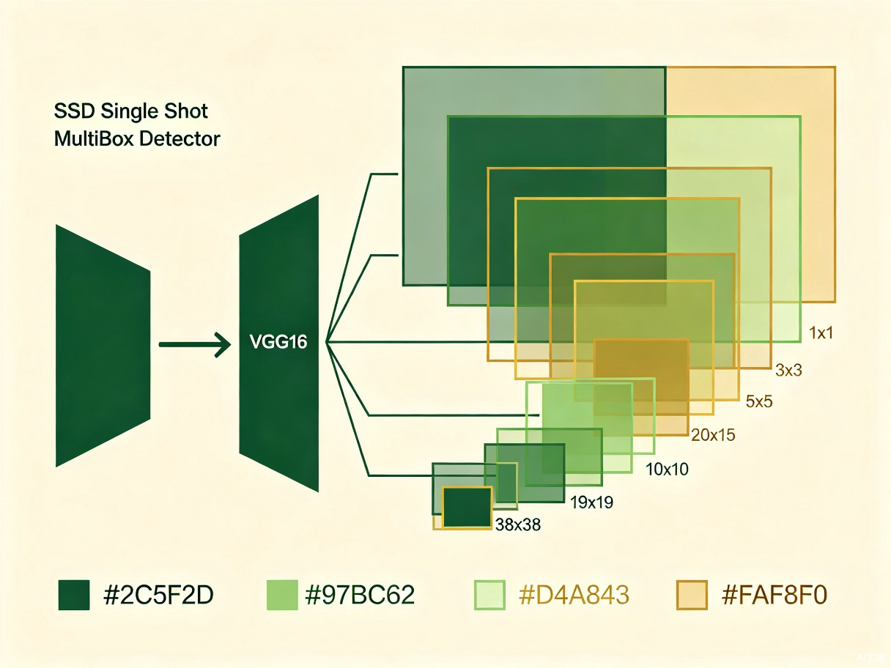
SSD检测流程
从输入图像到NMS的完整Pipeline
1
输入图像
300x300 RGB，数据增强
2
基础网络
VGG16 truncated
3
辅助卷积层
5个额外conv层
4
多尺度检测
分类+回归预测
5
NMS后处理
过滤+非极大值抑制
Loss = 分类损失(交叉熵) + 回归损失(Smooth L1)，仅在正样本上计算回归
CV 100 Days | Day 39
7 / 20
Notes:
The SSD pipeline takes a 300x300 input, processes through truncated VGG16, adds 5 auxiliary conv layers. At each of the 6 feature map levels, 3x3 convolutions produce class predictions and box offsets for each default box. After collecting all predictions, confidence thresholding and NMS (IoU threshold 0.45) produce final detections.

Slide 8
SSD关键设计
浅层 vs 深层特征图的分工
浅层特征图 (conv4_3)
深层特征图 (conv11_2)
尺寸: 38x38 (大特征图)
感受野小，空间分辨率高
擅长检测小目标
Default Box尺度: 0.1~0.3
局限: 语义信息较弱
尺寸: 1x1 (小特征图)
感受野大，语义信息丰富
擅长检测大目标
Default Box尺度: 0.7~0.9
局限: 空间分辨率低
设计洞察
SSD巧妙地利用CNN自然形成的特征金字塔：浅层分辨率高但语义弱，深层语义强但分辨率低。通过在不同层级分别检测，自然实现多尺度。然而浅层语义弱是固有限制——这正是FPN要解决的问题：通过自顶向下路径增强浅层特征的语义信息。
CV 100 Days | Day 39
8 / 20
Notes:
SSD leverages the CNN's inherent feature hierarchy. Shallow layers like conv4_3 (38x38) have high spatial resolution but weak semantics. Deep layers like conv11_2 (1x1) have strong semantics but low resolution. The key limitation is that shallow features lack rich semantics, limiting small object detection accuracy. This is what FPN solves by enhancing shallow features with top-down semantic information.

Slide 9
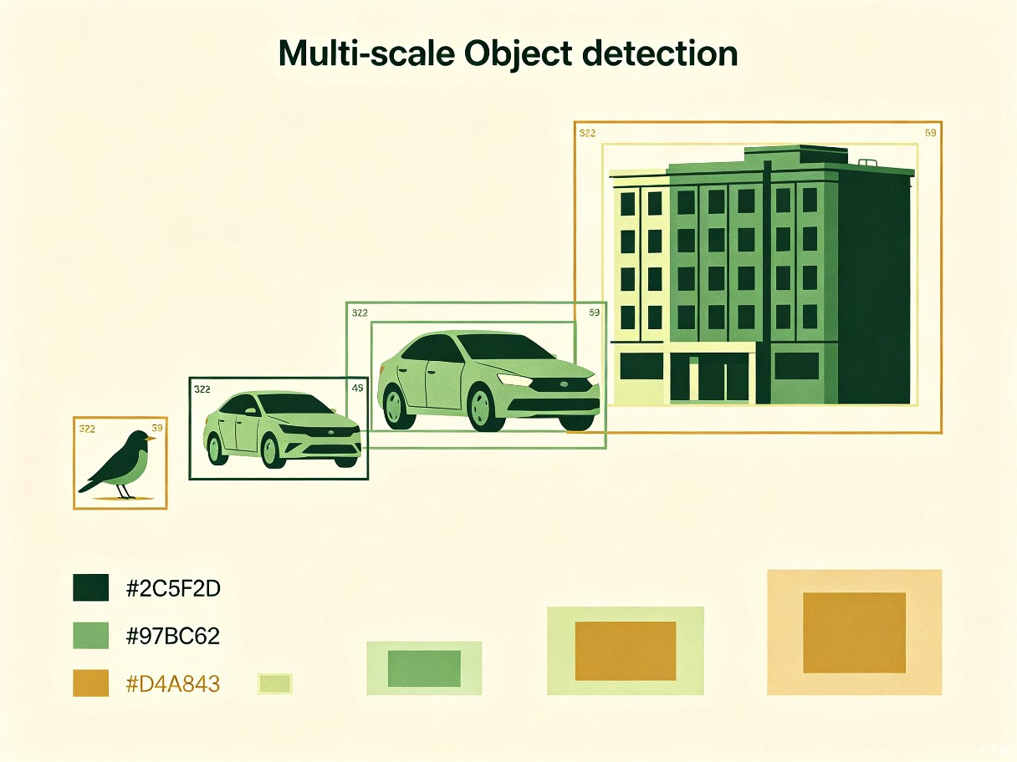
FPN原理概述
特征金字塔网络：核心思想
核心思想
传统问题:
仅在顶层特征图检测，小目标信息丢失严重
FPN方案:
构建自顶向下的特征金字塔，将高层语义通过上采样传递到低层，结合横向连接保留空间信息
核心优势:
所有层级的特征图同时具备强语义和高分辨率
CV 100 Days | Day 39
9 / 20
Notes:
Feature Pyramid Network (FPN) was proposed by Tsung-Yi Lin et al. at FAIR in 2017. The core idea is a top-down pathway that upsamples semantically strong features from higher layers and combines them with spatially precise features from lower layers via lateral connections. This creates feature maps at every level with both rich semantics and high spatial resolution.

Slide 10
FPN三要素
自底向上、自顶向下、横向连接
自底向上
(Bottom-Up)
自顶向下
(Top-Down)
横向连接
(Lateral)
标准CNN前向传播
特征图逐渐缩小
语义信息逐渐增强
例: ResNet C2->C5
上采样(2x最近邻)
高层语义传到低层
P5->P4->P3->P2
渐进增强
1x1卷积降维后
逐元素相加融合
P_i = M_i + Up(P_{i+1})
保留空间信息
CV 100 Days | Day 39
10 / 20
Notes:
FPN has three key components: 1) Bottom-up pathway - standard CNN feedforward. 2) Top-down pathway - 2x upsampling to propagate semantics. 3) Lateral connections - 1x1 convolutions + element-wise addition. The result is enhanced feature maps P2-P5 with both strong semantics and high resolution.

Slide 11
FPN数学表达
特征融合策略的数学形式化
特征融合公式
横向连接: M_i = Conv1x1(C_i) // 通道数降为256维
自顶向下: P_i = ReLU(M_i + Upsample2x(P_{i+1}))
最高层: P_5 = Conv1x1(C_5) // 无上采样
关键设计选择
1. 为何用1x1卷积？消除通道数差异(C2=256, C4=1024, C5=2048)，统一到256维
2. 为何逐元素相加？通道已对齐，相加比拼接更轻量且效果相当
3. 为何最近邻上采样？简单高效，避免转置卷积的棋盘格效应
FPN输出: P2(1/4) -> P3(1/8) -> P4(1/16) -> P5(1/32) -> P6(1/64)，所有层统一256通道
CV 100 Days | Day 39
11 / 20
Notes:
FPN fusion: bottom-up features C_i are first passed through 1x1 conv to 256 channels (M_i), then top-down upsampled P_{i+1} is added element-wise with ReLU. Highest level P_5 only applies 1x1 conv. Output is feature pyramid P2-P6, all 256 channels at different resolutions.

Slide 12
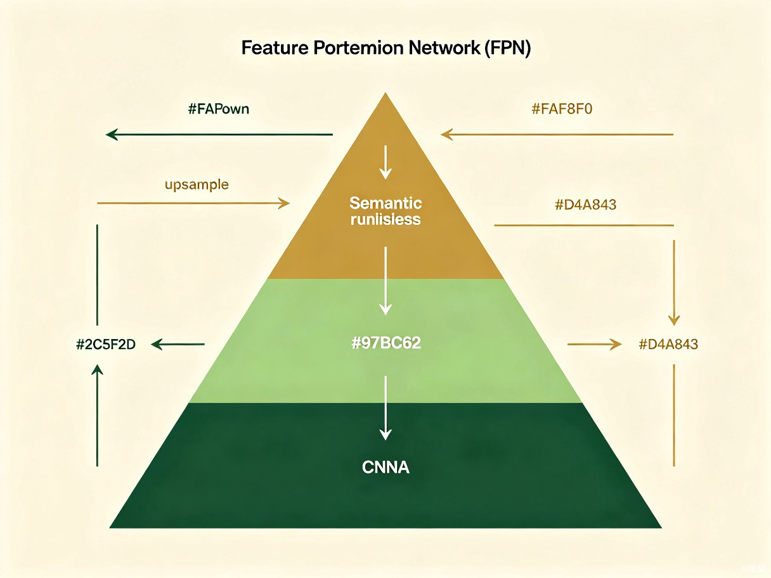
FPN架构图解
特征金字塔网络完整结构
自底向上
(Backbone)
自顶向下
(Upsample)
横向连接
(1x1+Add)
检测头
(RPN/Retina)
FPN可与Faster R-CNN或RetinaNet等检测器无缝集成，在所有金字塔层级上独立检测
CV 100 Days | Day 39
12 / 20
Notes:
The FPN architecture shows three components: bottom-up backbone (ResNet), top-down pathway with 2x upsampling, and lateral connections via 1x1 convolutions and element-wise addition. Detection heads are attached to each pyramid level, compatible with both two-stage (Faster R-CNN) and one-stage (RetinaNet) frameworks.

Slide 13
SSD vs FPN 对比
六维度全面对比分析
维度 | SSD | FPN
多尺度策略 | 不同层级原始特征图 | 增强型特征金字塔
特征融合 | 无融合，各层独立 | 自顶向下+横向连接
检测方式 | 单阶段端到端 | 可结合单/两阶段
小目标性能 | 一般(语义弱) | 优秀(语义增强)
计算开销 | 低(VGG16) | 中等(需上采样+卷积)
灵活性 | 固定架构 | 通用组件
CV 100 Days | Day 39
13 / 20
Notes:
SSD vs FPN across 6 dimensions. SSD uses original features without fusion - limiting small object performance. FPN actively enhances all levels through top-down + lateral connections. FPN is also more flexible, compatible with any backbone and detection framework. SSD is a complete detector; FPN is a feature enhancement module.

Slide 14
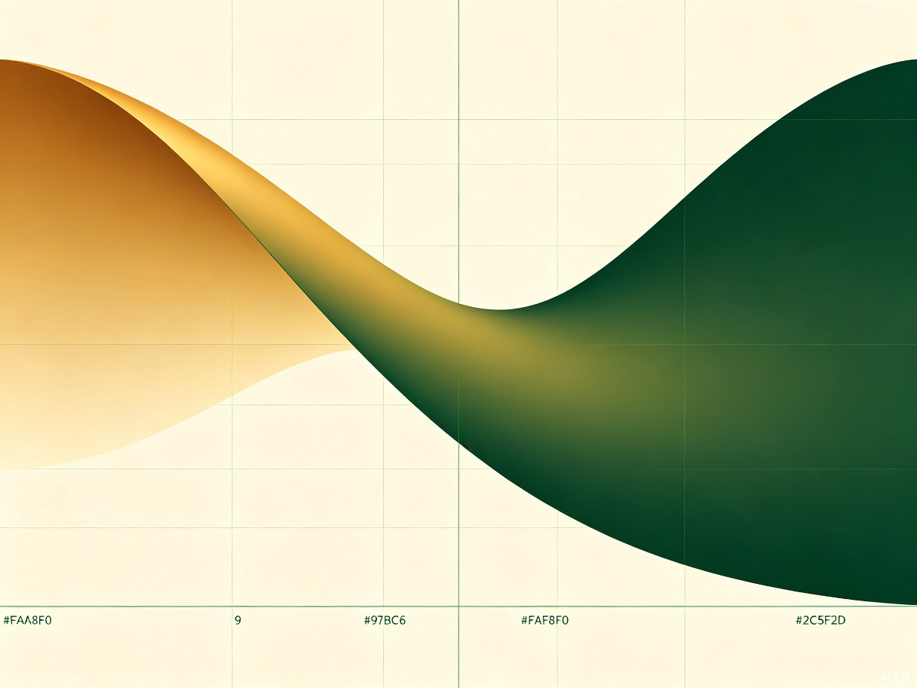
RetinaNet与Focal Loss
类别不平衡问题与解决方案
类别不平衡问题
问题根源:
背景负样本远多于正样本(~1000:1)，交叉熵损失被易分类负样本主导
Focal Loss:
FL(p_t) = -alpha(1-p_t)^gamma * log(p_t)
核心: 调制因子(1-p_t)^gamma降低易分类样本权重。gamma=2时p_t=0.9的损失降低100倍，让模型聚焦难分类样本。
CV 100 Days | Day 39
14 / 20
Notes:
RetinaNet (ICCV 2017) addressed class imbalance in single-stage detection. Focal Loss introduces modulating factor (1-p_t)^gamma that down-weights easy examples. With gamma=2, easy negatives contribute 100x less loss, allowing the model to focus on hard examples while maintaining single-stage speed.

Slide 15
Focal Loss数学公式
核心洞察与参数分析
Focal Loss 定义
FL(p_t) = -alpha_t (1 - p_t)^gamma * log(p_t)
p_t = p (y=1) 或 1-p (y=0)，alpha_t为类别平衡权重，gamma为聚焦参数
gamma 参数分析
alpha 平衡权重
gamma = 0: 标准交叉熵
gamma = 1: 中等聚焦
gamma = 2: 最佳平衡(推荐)
gamma = 5: 过度聚焦
gamma越大，易分类样本损失指数级下降
alpha_t: 正负样本权重
gamma控制易/难样本
alpha控制正/负样本
实验最优: alpha=0.25, gamma=2
CV 100 Days | Day 39
15 / 20
Notes:
Focal Loss has two hyperparameters: gamma (focusing) and alpha (class balance). The modulating factor (1-p_t)^gamma exponentially reduces loss from easy examples. Alpha balances positive/negative class importance. Optimal: alpha=0.25, gamma=2.

Slide 16
性能对比表格
VOC/COCO mAP + 推理速度对比
模型 | Backbone | VOC07 | VOC07+12 | COCO | FPS
Faster R-CNN | VGG16 | 78.8 | 75.9 | 21.2 | 7
YOLO | GoogLeNet | 63.4 | 57.2 | - | 45
SSD300 | VGG16 | 77.2 | 75.5 | 25.1 | 46
SSD512 | VGG16 | 81.6 | 80.0 | 28.8 | 22
FPN+FRCNN | ResNet-101 | - | - | 36.2 | 6
RetinaNet | ResNet-101-FPN | - | - | 39.1 | 5
RetinaNet首次在单阶段检测器上超越两阶段检测器精度，同时保持更快速度
CV 100 Days | Day 39
16 / 20
Notes:
RetinaNet achieves highest COCO mAP (39.1%), surpassing two-stage detectors for the first time. SSD300 balances speed (46 FPS) and accuracy (77.2% VOC07 mAP). FPN+Faster R-CNN at 36.2% COCO shows FPN's enhancement effect on two-stage methods.

Slide 17
科学家故事
Wei Liu 与 Tsung-Yi Lin
Wei Liu (刘伟)
Tsung-Yi Lin
SSD提出者 | UNC Chapel Hill
- 2016年提出SSD (ECCV)
- 论文引用超20,000次
- 首次单阶段多尺度检测
- 后续提出DSSD, RefineSSD
- 在Google从事AI研究
FPN/Focal Loss/RetinaNet | FAIR
- Facebook AI Research
- 2017年提出FPN和Focal Loss
- COCO数据集创建者之一
- FPN引用超30,000次
- 现任Apple ML Lead
CV 100 Days | Day 39
17 / 20
Notes:
Wei Liu proposed SSD during his PhD at UNC Chapel Hill (ECCV 2016, 20000+ citations). Tsung-Yi Lin at FAIR had an incredible 2017 - publishing both FPN (CVPR) and Focal Loss (ICCV), and co-creating the COCO dataset. Both researchers made lasting contributions to computer vision.

Slide 18
经典实验代码示例
Focal Loss PyTorch实现
Focal Loss — PyTorch
import torch, torch.nn as nn, torch.nn.functional as F
class FocalLoss(nn.Module):
def __init__(self, alpha=0.25, gamma=2.0):
super().__init__()
self.alpha = alpha
self.gamma = gamma
def forward(self, inputs, targets):
BCE = F.binary_cross_entropy_with_logits(
inputs, targets, reduction='none')
pt = torch.exp(-BCE)
loss = self.alpha * (1-pt)**self.gamma * BCE
return loss.mean()
# Usage: criterion = FocalLoss(alpha=0.25, gamma=2.0)
# pred = torch.randn(4, 80, 10, 10) # batch x cls x H x W
# loss = criterion(pred, target) # backward & optimize
要点: binary_cross_entropy_with_logits保持数值稳定; pt=exp(-BCE); (1-pt)^gamma聚焦因子
CV 100 Days | Day 39
18 / 20
Notes:
Clean PyTorch Focal Loss implementation. Key: 1) Use binary_cross_entropy_with_logits for numerical stability. 2) pt=exp(-BCE) computes class probability. 3) (1-pt)^gamma modulating factor down-weights easy examples. 4) alpha balances positive/negative importance.

Slide 19
思考题与下节预告
Day 40: Anchor-Free检测
思考题
1. SSD使用VGG16作为backbone，替换为ResNet-50性能如何变化？
2. FPN中不使用横向连接，仅靠自顶向下上采样，结果如何？
3. Focal Loss的gamma=0和gamma=无穷分别对应什么行为？
4. 能否将FPN思想应用到语义分割任务中？
Day 40 预告: Anchor-Free检测
告别Anchor：从CenterNet到FCOS
CenterNet: 目标建模为中心点关键点检测
FCOS: 逐像素预测到边界框四边的距离
Anchor-Free vs Anchor-Based 设计哲学对比
CV 100 Days | Day 39
19 / 20
Notes:
Review questions and preview of Day 40. Q1: ResNet-50 would improve accuracy due to deeper features and residual connections. Q2: Without lateral connections, precise spatial information is lost. Q3: gamma=0 gives standard CE; gamma=infinity makes all losses zero. Q4: Yes, FPN is widely used in segmentation (UPerNet). Next: Anchor-Free detection with CenterNet and FCOS.

Slide 20

感谢观看
Day 39: SSD与FPN — 多尺度目标检测的里程碑
参考资料
SSD: Liu et al., ECCV 2016
FPN: Lin et al., CVPR 2017
RetinaNet: Lin et al., ICCV 2017
Notes:
Thank you for joining Day 39. References: SSD (Liu et al., ECCV 2016), FPN (Lin et al., CVPR 2017), RetinaNet/Focal Loss (Lin et al., ICCV 2017). Next: Anchor-Free detection with CenterNet and FCOS.

