Slide 1
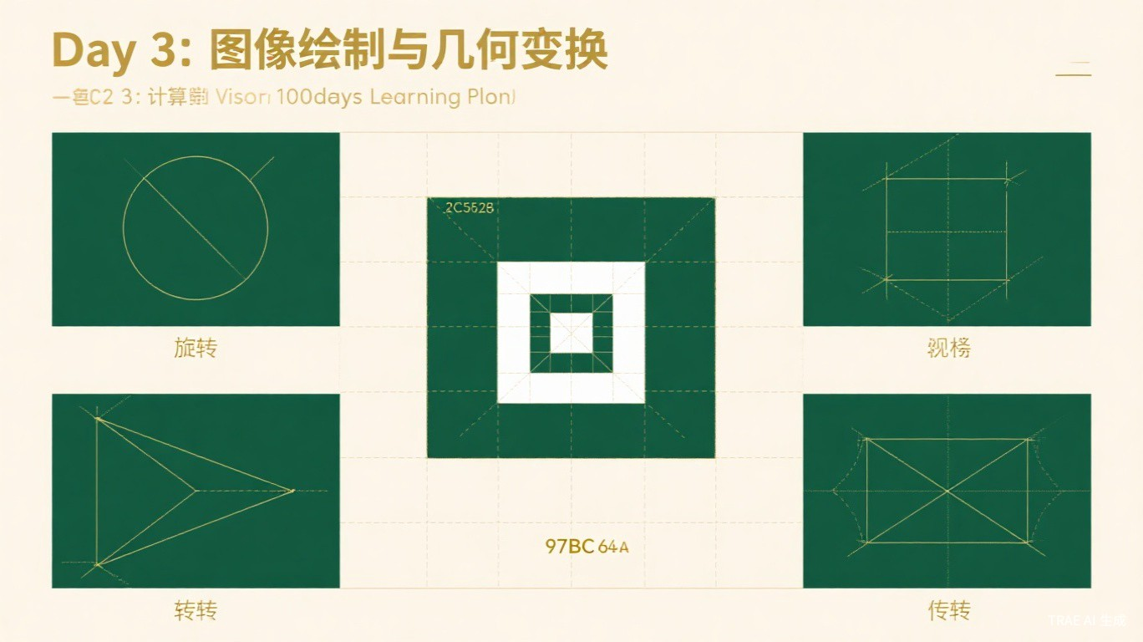
Day 3
Image Drawing & Geometric Transformations
图像绘制与几何变换
Computer Vision 100 Days Learning Plan
2026-05-28

Slide 2
Table of Contents
11 sections overview
01
Historical Background
02
Image Drawing Basics
Mathematical roots & computer era
Line, rectangle, circle, ellipse, text
03
Image Scaling
04
Image Rotation
Resize & interpolation methods
Rotation matrix & warpAffine
05
Image Translation
06
Affine Transformation
Translation matrix
6-DOF geometric transform
07
Perspective Transformation
08
Affine vs Perspective
8-DOF homography
Comparison & use cases
09
Cropping & Border Padding
10
Scientists & Literature
ROI extraction & border modes
Dürer, Bradski & key papers
11
Experiments & Exercises
Document scanner & thinking questions
Day 3 | Computer Vision 100 Days
2 / 20

Slide 3
Historical Background (1)
Mathematical roots of geometric transformations
~300 BC
Euclidean Geometry
Euclid laid the foundation of planar geometry. Translation, rotation, and reflection concepts were born.
17th Century
Cartesian Coordinates
Descartes invented coordinate systems, converting geometric problems into algebraic ones, enabling matrix representation of transforms.
18-19th Century
Projective Geometry
Development of projective geometry provided the theoretical framework for perspective transformations.
Day 3 | Computer Vision 100 Days
3 / 20

Slide 4
Historical Background (2)
Image transformations in the computer age
1960s
Apollo Program
NASA used affine transforms to correct satellite and spacecraft imagery - one of the earliest large-scale applications.
1970s-80s
Medical Imaging
Geometric transforms became essential for image registration, aligning medical images from different modalities.
1990s
Image Stitching
With digital cameras, panorama stitching emerged. Geometric transforms became the core technology.
2000s+
OpenCV Era
OpenCV provided comprehensive geometric transform APIs. Autonomous driving, AR, and drone mapping rely heavily on these techniques.
Day 3 | Computer Vision 100 Days
4 / 20

Slide 5
Core Concept (1)
Image drawing basics: line, rectangle, circle
Drawing Lines & Rectangles
Drawing Circles
import cv2, numpy as np
canvas = np.zeros((500,500,3), np.uint8)
# Line: cv2.line(img, pt1, pt2, color, thickness)
cv2.line(canvas, (50,50), (450,50), (0,255,0), 3)
# Rectangle: cv2.rectangle(img, pt1, pt2, color, thickness)
cv2.rectangle(canvas, (100,100), (300,300), (0,255,0), 2)
cv2.rectangle(canvas, (150,150), (350,350), (0,0,255), -1)
# thickness=-1 means filled
# Circle: cv2.circle(img, center, radius, color, thickness)
cv2.circle(canvas, (250,250), 80, (255,0,0), 2)
cv2.circle(canvas, (250,250), 40, (0,255,255), -1)
# Parameters:
# center - (x, y) tuple
# radius - integer in pixels
# color - (B, G, R) tuple
# thickness - line width (-1 = fill)
• OpenCV uses BGR color format (Blue, Green, Red)• Red=(0,0,255) Green=(0,255,0) Blue=(255,0,0)• thickness = -1 fills the shape with solid color
• Center is specified as (x, y) coordinates• Negative thickness fills the circle• Anti-aliasing: use cv2.LINE_AA for smoother edges• Combine shapes to create complex annotations
Day 3 | Computer Vision 100 Days
5 / 20

Slide 6
Core Concept (2)
Drawing ellipses and text annotations
Drawing Ellipses
Drawing Text (putText)
# cv2.ellipse(img, center, axes, angle,
# startAngle, endAngle, color, thickness)
cv2.ellipse(canvas, (250,250), (150,80),
30, 0, 360, (255,0,255), 2)
# Parameters:
# center - (x, y) center point
# axes - (major_axis, minor_axis)
# angle - rotation in degrees
# startAngle / endAngle - arc range
font = cv2.FONT_HERSHEY_SIMPLEX
cv2.putText(canvas, "OpenCV", (80,480),
font, 1.2, (255,255,255), 2)
# Common Fonts:
# FONT_HERSHEY_SIMPLEX - Normal sans-serif
# FONT_HERSHEY_PLAIN - Small sans-serif
# FONT_HERSHEY_COMPLEX - Normal serif
# FONT_HERSHEY_TRIPLEX - Complex serif
# FONT_HERSHEY_SCRIPT_SIMPLEX - Handwriting
• Axes define the semi-major and semi-minor lengths• Angle rotates the ellipse orientation• Use partial arcs by setting start/end angles
• OpenCV does not support CJK characters natively• Use PIL/Pillow for Chinese text rendering• fontScale controls text size (not pixel size)
Day 3 | Computer Vision 100 Days
6 / 20

Slide 7
Core Concept (3)
Image scaling and interpolation methods
Resize Methods
Interpolation Methods Comparison
# Method 1: Specify target size
resized = cv2.resize(img, (800, 600))
# Method 2: Scale by factor
resized = cv2.resize(img, None, fx=0.5, fy=0.5,
interpolation=cv2.INTER_AREA)
Method | Constant | Best For
Nearest | INTER_NEAREST | Speed priority
Bilinear | INTER_LINEAR | General use (default)
Bicubic | INTER_CUBIC | Enlarging images
Lanczos4 | INTER_LANCZOS4 | High quality enlarge
Pixel Area | INTER_AREA | Shrinking images
Key Points
• INTER_NEAREST: Fastest but lowest quality• INTER_LINEAR: Best balance of speed and quality• INTER_AREA: Best anti-aliasing when shrinking• INTER_CUBIC/LANCZOS4: Best quality when enlarging• Default interpolation is INTER_LINEAR
Day 3 | Computer Vision 100 Days
7 / 20

Slide 8
Core Concept (4)
Image rotation with rotation matrix
Rotation with warpAffine
Rotation Concepts
import cv2, numpy as np
img = cv2.imread('image.jpg')
h, w = img.shape[:2]
center = (w // 2, h // 2)
# Get 2D rotation matrix
angle = 45 # degrees (positive = CCW)
scale = 1.0
M = cv2.getRotationMatrix2D(center, angle, scale)
# Apply rotation
rotated = cv2.warpAffine(img, M, (w, h))
# Rotation matrix formula:
# | cos(theta) sin(theta) | | tx |
# |-sin(theta) cos(theta) | | ty |
• Rotation Center: • Default is image center (w/2, h/2)• Scale Factor: • Can combine rotation with scaling• Content Clipping: • Default warpAffine may clip corners• Full Rotation: • Calculate new canvas size to avoid clipping• Mathematical Basis: • 2D rotation matrix (orthogonal transform)• Preserves distances and angles• OpenCV Functions: • getRotationMatrix2D() -> 2x3 matrix• warpAffine() applies the transform
• Positive angle = counter-clockwise rotation
Day 3 | Computer Vision 100 Days
8 / 20

Slide 9
Core Concept (5)
Image translation
Translation Matrix
Key Concepts
import cv2, numpy as np
img = cv2.imread('image.jpg')
h, w = img.shape[:2]
# Translation: shift right 100px, down 50px
tx, ty = 100, 50
M = np.float32([[1, 0, tx],
[0, 1, ty]])
translated = cv2.warpAffine(img, M, (w, h))
# Matrix form:
# T = | 1 0 tx | (2x3 affine matrix)
# | 0 1 ty |
• Translation moves every pixel by (tx, ty)• tx > 0: shift right; tx < 0: shift left• ty > 0: shift down; ty < 0: shift up• Pixels moved outside the frame are lost• Empty areas are filled with black (default)• Use borderMode to control fill behavior
Translation Matrix Visualization
[x'] [1 0 tx] [x] x' = x + tx
[y'] = [0 1 ty] [y] => y' = y + ty
[1 ] [0 0 1 ] [1]
Day 3 | Computer Vision 100 Days
9 / 20

Slide 10
Core Concept (6)
Affine transformation (6 degrees of freedom)
Affine Transform Code
Properties of Affine Transform
import cv2, numpy as np
img = cv2.imread('image.jpg')
h, w = img.shape[:2]
# 3 point pairs define the transform
pts1 = np.float32([[50,50],[200,50],[50,200]])
pts2 = np.float32([[10,100],[200,50],[100,250]])
# Get affine matrix (2x3)
M = cv2.getAffineTransform(pts1, pts2)
# Apply affine transform
result = cv2.warpAffine(img, M, (w, h))
• Preserves: • Collinearity (lines stay lines)• Parallelism (parallel lines stay parallel)• Includes: • Translation, rotation, scaling, shearing• Requires: • 3 pairs of corresponding points• Matrix: • 2x3 matrix (6 DOF)
Affine Transformation Matrix
[x'] [a b tx] [x] Combines: rotation (a,b),
[y'] = [c d ty] [y] scaling (a,d), shearing (b,c),
[1 ] [0 0 1 ] [1] translation (tx,ty)
Day 3 | Computer Vision 100 Days
10 / 20

Slide 11
Core Concept (7)
Perspective transformation (homography, 8 DOF)
Perspective Transform Code
Properties
import cv2, numpy as np
img = cv2.imread('image.jpg')
# 4 point pairs define perspective transform
pts1 = np.float32([[56,65],[368,52],
[28,387],[389,390]])
pts2 = np.float32([[0,0],[300,0],
[0,300],[300,300]])
# Get perspective matrix (3x3)
M = cv2.getPerspectiveTransform(pts1, pts2)
# Apply perspective transform
result = cv2.warpPerspective(img, M, (300, 300))
• Preserves: • Collinearity (straight lines stay straight)• Does NOT preserve: • Parallelism (parallel lines may converge)• Requires: • 4 pairs of corresponding points• Matrix: • 3x3 homography matrix (8 DOF)• Also called: • Homography, projective transform
Homography Matrix (3x3)
H = | h11 h12 h13 | [x'] ~ H * [x] Uses homogeneous coordinates
| h21 h22 h23 | [y'] [y] 8 independent parameters
| h31 h32 h33 | [w ] [1] (h33 typically normalized to 1)
Day 3 | Computer Vision 100 Days
11 / 20

Slide 12
Core Concept (8)
Affine vs Perspective: a detailed comparison
Feature Comparison
Feature | Affine Transform | Perspective Transform
Corresponding Points | 3 pairs | 4 pairs
Matrix Dimension | 2x3 | 3x3
Degrees of Freedom | 6 | 8
Parallelism | Preserved | May change
Collinearity | Preserved | Preserved
Typical Applications | Rotation, scaling, shearing | Perspective correction, doc scan
OpenCV Function | warpAffine() | warpPerspective()
Matrix Function | getAffineTransform() | getPerspectiveTransform()
Key Insight:
Affine is a special case of perspective. When h31=h32=0, the homography degenerates into an affine transform. Use affine when parallelism must be preserved; use perspective when you need to correct viewing angle distortion.
Day 3 | Computer Vision 100 Days
12 / 20

Slide 13
Core Concept (9)
Image cropping and border padding
Image Cropping (NumPy Slicing)
Border Padding (copyMakeBorder)
import cv2
img = cv2.imread('image.jpg')
# Crop ROI: [y1:y2, x1:x2]
cropped = img[100:400, 200:500]
# Simple, fast, no interpolation needed
# cv2.copyMakeBorder(img, top, bottom,
# left, right, borderType)
BORDER_CONSTANT = cv2.copyMakeBorder(
img, 50, 50, 50, 50,
cv2.BORDER_CONSTANT, value=(0,0,255))
Border Types
Border Type | Description | Example
BORDER_CONSTANT | Fill with specified color | aaaa|abcdefgh|aaaa
BORDER_REPLICATE | Replicate edge pixel | aaaa|abcdefgh|hhhh
BORDER_REFLECT | Mirror reflection | dcba|abcdefgh|gfed
BORDER_REFLECT_101 | Reflect without edge dup | dcba|abcdefgh|gfed
BORDER_WRAP | Periodic tiling | cdef|abcdefgh|abcde
Day 3 | Computer Vision 100 Days
13 / 20

Slide 14
Scientists
Albrecht Durer & Gary Bradski
Albrecht Durer (1471-1528)
Gary Bradski
• German Renaissance master artist• Published 'Underweysung der Messung' (1525)• Systematically described perspective projection• Designed mechanical devices for perspective drawing• Essentially solved what we do with getPerspectiveTransform()• Laid intuitive geometric understanding for projective geometry
• Founded OpenCV at Intel in 1999• Vision: create standardized CV tools• warpAffine & warpPerspective designed by his team• Made complex geometric transforms accessible• Author of 'Learning OpenCV' (O'Reilly)• Lowered the barrier to CV technology worldwide
"Geometry is the foundation of all painting."
"OpenCV makes computer vision accessible to everyone."
Day 3 | Computer Vision 100 Days
14 / 20

Slide 15
Key Literature
5 essential references
1
Multiple View Geometry in Computer Vision
Hartley & Zisserman, 2003 | Classic CV geometry textbook. Covers projective geometry, homography matrices, and multi-view relationships in depth.
2
Computer Vision: Algorithms and Applications (2nd Ed.)
Szeliski, 2022 | Authoritative CV textbook covering geometric transforms, image stitching, and more. Free online edition available.
3
Learning OpenCV 3 Computer Vision with Python
Kaehler & Bradski, 2017 | Practical OpenCV guide with rich drawing and transformation examples for hands-on learning.
4
Digital Image Processing (4th Ed.)
Gonzalez & Woods, 2018 | Classic image processing textbook. Theoretical foundation for geometric transformations.
5
OpenCV Documentation: Geometric Transforms
OpenCV.org | Official reference for all geometric transformation functions including warpAffine and warpPerspective.
Day 3 | Computer Vision 100 Days
15 / 20

Slide 16
Classic Experiment
Automatic document scanner using perspective correction
Technical Pipeline
Grayscale
Conversion
->
Edge
Detection
->
Contour
Finding
->
Quad
Approximation
->
Corner
Ordering
->
Perspective
Transform
Core Implementation
Key Points
def four_point_transform(image, pts):
rect = order_points(pts) # TL, TR, BR, BL
(tl, tr, br, bl) = rect
# Compute new image dimensions
widthA = np.sqrt((br[0]-bl[0])**2 + (br[1]-bl[1])**2)
widthB = np.sqrt((tr[0]-tl[0])**2 + (tr[1]-tl[1])**2)
maxWidth = max(int(widthA), int(widthB))
heightA = np.sqrt((tr[0]-br[0])**2 + (tr[1]-br[1])**2)
heightB = np.sqrt((tl[0]-bl[0])**2 + (tl[1]-bl[1])**2)
maxHeight = max(int(heightA), int(heightB))
dst = np.array([[0,0],[maxWidth-1,0],
[maxWidth-1,maxHeight-1],[0,maxHeight-1]],
dtype=np.float32)
M = cv2.getPerspectiveTransform(rect, dst)
return cv2.warpPerspective(image, M, (maxWidth, maxHeight))
• Canny edge detection finds document boundaries• findContours locates the page outline• approxPolyDP approximates to 4 corners• Corner ordering ensures correct mapping• Perspective transform flattens the document• Real-world application in mobile scanning apps
Day 3 | Computer Vision 100 Days
16 / 20

Slide 17
Behind the Scenes
The perspective transform behind QR code scanning
How QR Code Scanning Works
From Durer to OpenCV
When you scan a QR code with your phone, even if photographed from an angle, the QR code appears as a trapezoid in the image. The phone system detects three position detection patterns (the large squares in three corners), computes the perspective transformation matrix, and "flattens" the deformed QR code into a standard square for decoding.
This process happens billions of times per second worldwide - couriers scanning packages, cashiers processing payments, visitors scanning museum tickets... Perspective transform technology makes all of this possible.
In 1525, Albrecht Durer built the world's first "perspective drawing machine" using strings and wooden frames. 500 years later, we achieve the same transformation in one line of code.
One Line of Code
M = cv2.getPerspectiveTransform(
src_pts, dst_pts)
result = cv2.warpPerspective(
img, M, (w, h))
Day 3 | Computer Vision 100 Days
17 / 20

Slide 18
Thinking Questions
4 exercises to test your understanding
Q1: warpAffine vs warpPerspective
Basic
What is the difference between cv2.warpAffine and cv2.warpPerspective? When should you use affine vs perspective transformation?
Q2: Interpolation Methods
Intermediate
Explain the principles of bilinear and bicubic interpolation. Why is INTER_AREA recommended for shrinking images?
Q3: Matrix Dimensions
Advanced
Why is the affine matrix 2x3 while the perspective matrix is 3x3? Explain the essential mathematical difference between affine and perspective transforms.
Q4: Design Challenge
Open-ended
Design an automatic document scanner program. What steps are needed? Consider challenges like uneven lighting, blurry edges, and complex backgrounds.
Day 3 | Computer Vision 100 Days
18 / 20

Slide 19
Glossary
Core terminology reference
Term | English | Description
Geometric Transform | Geometric Transformation | Mathematical transformation of pixel positions
Scaling | Resize / Scaling | Changing image pixel dimensions
Rotation | Rotation | Rotating image around a center point
Translation | Translation | Moving image along x/y axes
Affine Transform | Affine Transformation | Preserves parallelism (6 DOF)
Perspective Transform | Perspective Transform | Can alter parallel lines (8 DOF)
Homography Matrix | Homography Matrix | 3x3 matrix for perspective transform
Interpolation | Interpolation | Method for computing new pixel values
Bilinear Interp. | Bilinear Interpolation | Weighted average of 4 neighbors
Bicubic Interp. | Bicubic Interpolation | Higher-order using 16 neighbors
Crop | Crop | Extract rectangular ROI from image
Border Padding | Border Padding | Adding pixel fill around image edges
Projective Geometry | Projective Geometry | Geometry of perspective and projection
Image Registration | Image Registration | Aligning images to same coordinate system
Day 3 | Computer Vision 100 Days
19 / 20

Slide 20
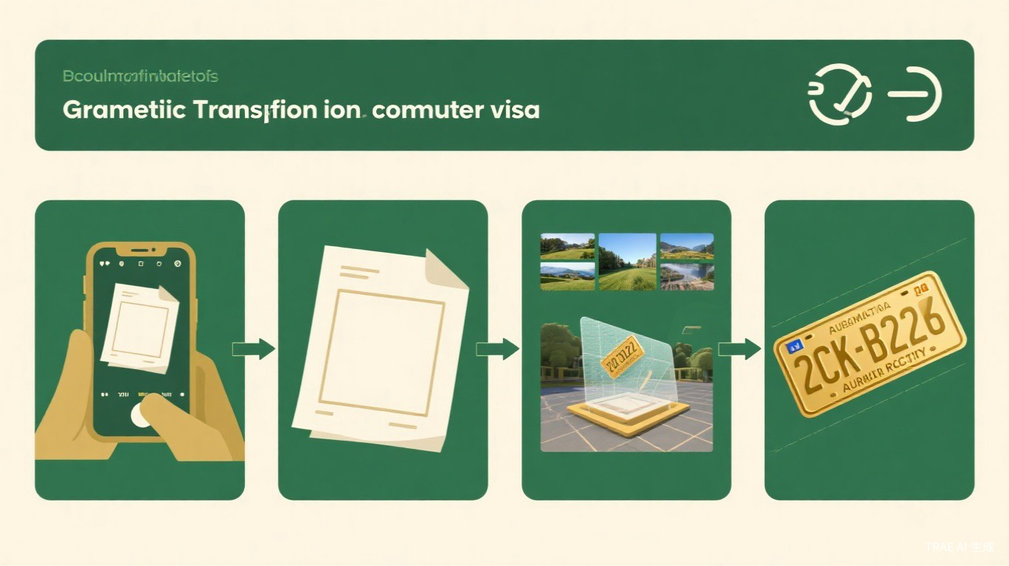
Coming Next
Day 4
Image Filtering & Enhancement
Topics to cover:
- Convolution operation principles
- Mean filter, Gaussian filter, Median filter
- Bilateral filter for edge-preserving smoothing
- Image sharpening and edge enhancement
- Spatial domain filtering mechanisms
Geometric transforms let us manipulate image shape; filtering lets us manipulate image content.
Day 3 | Computer Vision 100 Days

