Slide 1
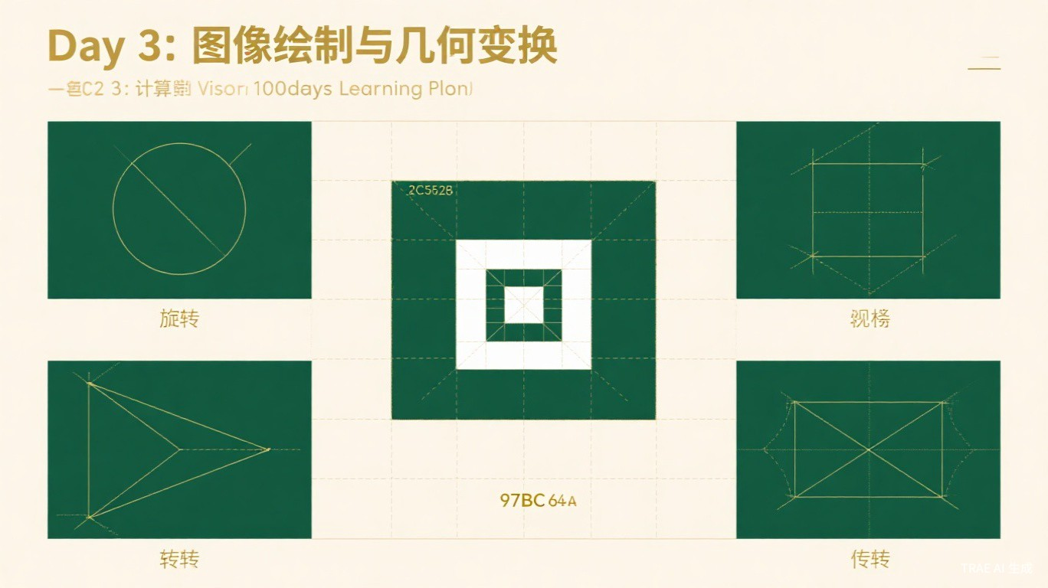
Day 3
Image Drawing &
Geometric Transformations
Computer Vision 100-Day Learning Plan
2026-05-28
TRAE AI 生成

Slide 2
Agenda
Today's learning roadmap
01
02
03
04
Historical Background
Image Drawing
Scaling & Rotation
Translation & Affine
From Euclid to OpenCV
line / rectangle / circle / ellipse / putText
Interpolation methods & rotation matrix
Transformation matrices
05
06
07
08
Perspective Transform
Crop & Border Padding
Scientists & Experiments
Review & Preview
4-point homography
ROI extraction & border types
Durer, Bradski & document scanner
Exercises, glossary & Day 4 preview
TRAE AI 生成

Slide 3
Historical Background
From Euclid to OpenCV
~300 BC
Euclidean Geometry
17th C.
Cartesian Coordinates
18-19th C.
Projective Geometry
Foundation of geometric transformations
Algebra meets geometry
Theoretical framework for perspective
1960s
NASA Apollo Program
1999
OpenCV Founded
2000s+
AR & Autonomous Driving
First large-scale use of affine transforms
Bradski creates the open-source CV library
Geometric transforms everywhere
TRAE AI 生成

Slide 4
Image Drawing
OpenCV drawing primitives
cv2.line()
cv2.rectangle()
cv2.circle()
img, pt1, pt2, color, thickness
img, pt1, pt2, color, thickness
img, center, radius, color, thickness
Draw a straight line between two points
Draw rectangle; -1 for filled
Draw circle at given center
cv2.ellipse()
cv2.putText()
img, center, axes, angle, start, end
img, text, org, font, scale, color
Draw ellipse with rotation
Render text on image (Hershey fonts)
TRAE AI 生成

Slide 5
Image Scaling
Interpolation methods comparison
Method | Constant | Best For | Quality
Nearest | INTER_NEAREST | Speed priority | Lowest
Bilinear | INTER_LINEAR | General use (default) | Medium
Bicubic | INTER_CUBIC | Enlargement | High
Lanczos | INTER_LANCZOS4 | High-quality enlarge | Highest
Area | INTER_AREA | Shrinking (anti-alias) | Best for shrink
Rule of thumb: Use INTER_AREA for shrinking, INTER_CUBIC or INTER_LANCZOS4 for enlarging. INTER_LINEAR is the safe default.
TRAE AI 生成

Slide 6
Image Rotation
Rotation matrix & full-image rotation
Standard Rotation
Full-Image Rotation
M = cv2.getRotationMatrix2D(center, angle, scale)
rotated = cv2.warpAffine(img, M, (w, h))
cos = abs(M[0,0]); sin = abs(M[0,1])
new_w = int(h*sin + w*cos)
new_h = int(h*cos + w*sin)
May crop corners when rotating large angles
Adjusts canvas size to keep all content
Rotation Matrix (2x3)
M = [ cos(theta) sin(theta) tx ]
[ -sin(theta) cos(theta) ty ]
Positive angle = counter-clockwise
TRAE AI 生成

Slide 7
Image Translation
Shifting images along X and Y axes
Translation Matrix
Code Example
T = [[1, 0, tx],
[0, 1, ty]]
tx > 0 : shift right
ty > 0 : shift down
tx, ty = 100, 50
M = np.float32([[1,0,tx],
[0,1,ty]])
result = cv2.warpAffine(
img, M, (w, h))
Key Insight
Translation is the simplest affine transform. Pixels shifted outside the image boundary are either discarded or filled based on border mode (BORDER_CONSTANT, BORDER_REFLECT, etc.).
TRAE AI 生成

Slide 8
Affine Transformation
Three points determine the transform
Properties
Code
Preserves:
Straight lines (collinearity)
Parallelism
Ratios of distances
Includes: translation, rotation,
scaling, shearing & combinations
pts1 = np.float32([[50,50],
[200,50],
[50,200]])
pts2 = np.float32([[10,100],
[200,50],
[100,250]])
M = cv2.getAffineTransform(pts1,pts2)
result = cv2.warpAffine(img,M,(w,h))
Matrix: 2x3 | Degrees of Freedom: 6 | Function: cv2.getAffineTransform() + cv2.warpAffine()
TRAE AI 生成

Slide 9
Perspective Transformation
Four points determine the homography
Key Properties
Code Example
Can represent "near = large, far = small"
Preserves: straight lines
May break: parallelism
Matrix: 3x3 (8 DOF)
Also called: Homography
pts1 = np.float32([
[56,65],[368,52],
[28,387],[389,390]])
pts2 = np.float32([
[0,0],[300,0],
[0,300],[300,300]])
M = cv2.getPerspectiveTransform(pts1,pts2)
result = cv2.warpPerspective(img,M,(300,300))
Applications: document scanning, QR code rectification, augmented reality, panorama stitching, sports analytics
TRAE AI 生成

Slide 10
Affine vs Perspective
Side-by-side comparison
Feature | Affine Transform | Perspective Transform
Point Pairs | 3 pairs | 4 pairs
Matrix Size | 2 x 3 | 3 x 3
Degrees of Freedom | 6 | 8
Parallelism | Preserved | May break
Straight Lines | Preserved | Preserved
OpenCV Function | warpAffine() | warpPerspective()
Typical Use | Rotation, scaling, shearing | Document scan, AR, panorama
Affine is a subset of perspective. If parallelism is preserved, affine suffices; otherwise, use perspective.
TRAE AI 生成

Slide 11
Cropping & Border Padding
ROI extraction and edge extension
Border Type | Description | Effect
BORDER_CONSTANT | Fill with a constant color | aaaa|abcdefgh|aaaa
BORDER_REPLICATE | Replicate last edge pixel | aaaaa|abcdefgh|hhhhh
BORDER_REFLECT | Mirror reflection (duplicates edge) | fedcba|abcdefgh|gfedcb
BORDER_REFLECT_101 | Mirror (no edge duplication) | gfedcb|abcdefgh|gfedcb
BORDER_WRAP | Periodic tiling | cdefgh|abcdefgh|abcdef
Crop: img[y1:y2, x1:x2] (NumPy slicing)
Padding: cv2.copyMakeBorder(img, top, bottom, left, right, borderType)
TRAE AI 生成

Slide 12
Scientists Behind the Scenes
Pioneers of perspective and computer vision
Albrecht Durer
Gary Bradski
1471 - 1528 | Perspective Geometry Pioneer
b. 1960s | Founder of OpenCV
German Renaissance artist who published "Underweysung der Messung" (1525), systematically describing perspective projection. He designed mechanical devices to project 3D scenes onto 2D canvas -- solving the same problem we solve today with perspective transform matrices.
Started OpenCV at Intel in 1999, creating the world's most widely used computer vision library. His team designed the warpAffine() and warpPerspective() APIs that make complex geometric transforms accessible with just a few lines of code.
"Geometry is the foundation of all painting."
"Making CV accessible to everyone."
TRAE AI 生成

Slide 13
Classic Experiment
Automatic Document Scanner (Perspective Correction)
1
2
3
4
5
6
Grayscale
Edge Detect
Find Contours
Approx Poly
Sort Corners
Warp
cv2.cvtColor(img, COLOR_BGR2GRAY)
cv2.Canny(gray, 75, 200)
cv2.findContours(edged, ...)
cv2.approxPolyDP(contour, ...)
order_points(pts) -> TL TR BR BL
cv2.warpPerspective(img, M, size)
How It Works
1. Convert to grayscale and detect edges with Canny
2. Find the largest 4-point contour (the document)
3. Order corners: top-left, top-right, bottom-right, bottom-left
4. Compute new dimensions from corner distances
5. Apply perspective transform to get a flat, rectangular scan
TRAE AI 生成

Slide 14
Thinking Exercises
Test your understanding
Basic
Intermediate
Q1: warpAffine vs warpPerspective
Q2: Interpolation Methods
What is the essential difference? When should you use each?
Explain bilinear vs bicubic interpolation. Why use INTER_AREA for shrinking?
Analytical
Open-ended
Q3: Matrix Dimensions
Q4: Document Scanner Design
Why is affine 2x3 but perspective 3x3? Explain from a mathematical perspective.
Design an auto document scanner. Consider uneven lighting, blurry edges, complex backgrounds.
TRAE AI 生成

Slide 15
Glossary
Core terminology quick reference
Term | English | Explanation
Geometric Transform | Geometric Transformation | Mathematical transform of pixel positions
Affine Transform | Affine Transformation | Preserves parallelism (6 DOF)
Perspective Transform | Perspective / Homography | May break parallelism (8 DOF)
Interpolation | Interpolation | Method to compute new pixel values
Homography Matrix | Homography Matrix | 3x3 matrix for perspective transform
Border Padding | Border Padding | Adding pixels at image edges
Image Registration | Image Registration | Aligning images to same coordinate system
Projective Geometry | Projective Geometry | Geometry of perspective and projection
TRAE AI 生成

Slide 16
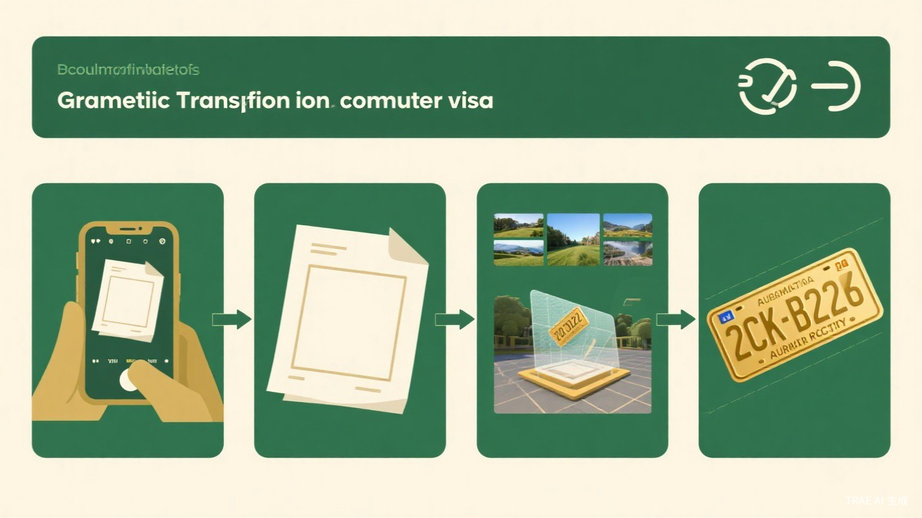
Day 4 Preview
Image Filtering
& Enhancement
Convolution fundamentals
Mean, Gaussian, Median, Bilateral filters
Image sharpening & edge enhancement
Spatial domain filtering mechanisms
Day 3 / 100
Geometric transforms let us manipulate shape;
filtering lets us manipulate content.
TRAE AI 生成

