Slide 1

Day 39
SSD & FPN
Multi-scale Object Detection Milestones
Computer Vision 100-Day Learning Plan | Talk Mode
AI 生成
Notes:
Welcome to Day 39! Today we explore two landmark architectures in object detection: SSD (Single Shot MultiBox Detector) and FPN (Feature Pyramid Networks). These methods revolutionized how we handle multi-scale detection.

Slide 2
Today's Roadmap
6 chapters, 16 slides
01
Historical Context
02
SSD Deep Dive
03
FPN Deep Dive
2016 Detection Landscape
Single Shot MultiBox Detector
Feature Pyramid Networks
04
Comparison & Focal Loss
05
Performance Benchmarks
06
Summary & Next Steps
SSD vs FPN, RetinaNet
Speed vs Accuracy Trade-offs
Key Takeaways, Day 40 Preview
AI 生成
2 / 16
Notes:
We have 6 chapters today. We start with the 2016 landscape, then deep dive into SSD, then FPN. We compare them, discuss Focal Loss, review benchmarks, and wrap up with Day 40 preview on Anchor-Free detection.

Slide 3
Background
2016: The Detection Landscape
Two paradigms dominated the field
Two-Stage Detectors
Single-Stage Detectors
Faster R-CNN (2015)Region Proposal + ClassificationHigh accuracy, slower speedmAP ~73.2 on VOC2007
YOLO (2016), SSD (2016)Direct prediction, no proposalsFaster, slightly lower accuracyReal-time potential
Core Challenge: How to detect objects at vastly different scales efficiently?
AI 生成
3 / 16
Notes:
In 2016, object detection had two main paradigms. Two-stage detectors like Faster R-CNN achieved high accuracy but were slow. Single-stage detectors like YOLO were fast but less accurate. The key challenge was multi-scale detection: objects can be tiny or huge, and handling all scales efficiently was the bottleneck.

Slide 4
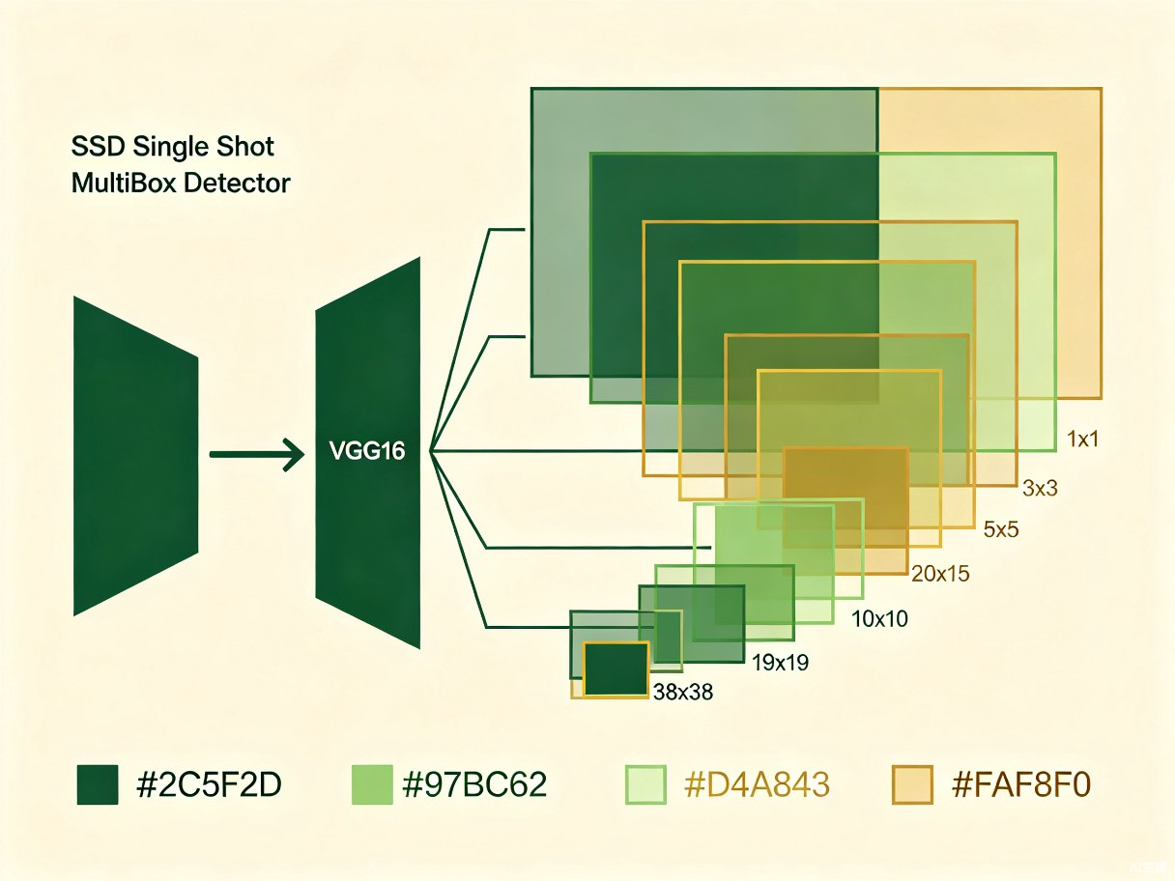
SSD
SSD: Core Idea
Single Shot MultiBox Detector (ECCV 2016)
Multi-scale feature maps
Default boxes (priors)
No region proposals
Single network, single shot
AI 生成
4 / 16
Notes:
SSD's core innovation is using multiple feature map layers at different resolutions for detection. Instead of generating region proposals, it places default boxes (priors) at every spatial location on each feature map. This enables multi-scale detection in a single forward pass. The image shows the SSD architecture with feature maps at different scales.

Slide 5
SSD
SSD Architecture Details
6 feature maps, 8732 default boxes (SSD300)
Feature Map | Size | Default Boxes | Detects
Conv4_3 | 38x38 | 4 | Small objects
Conv7 | 19x19 | 6 | Medium-small
Conv8_2 | 10x10 | 6 | Medium
Conv9_2 | 5x5 | 6 | Medium-large
Conv10_2 | 3x3 | 4 | Large objects
Conv11_2 | 1x1 | 4 | Very large
8,732
Total Default Boxes
59 FPS
Inference Speed
77.2%
mAP VOC2007
AI 生成
5 / 16
Notes:
SSD300 uses 6 feature maps from conv4_3 to conv11_2, with sizes decreasing from 38x38 to 1x1. Each feature map has different numbers of default boxes per location. Total of 8,732 default boxes. Key results: 77.2% mAP on VOC2007 at 59 FPS. Note that smaller feature maps detect larger objects.

Slide 6
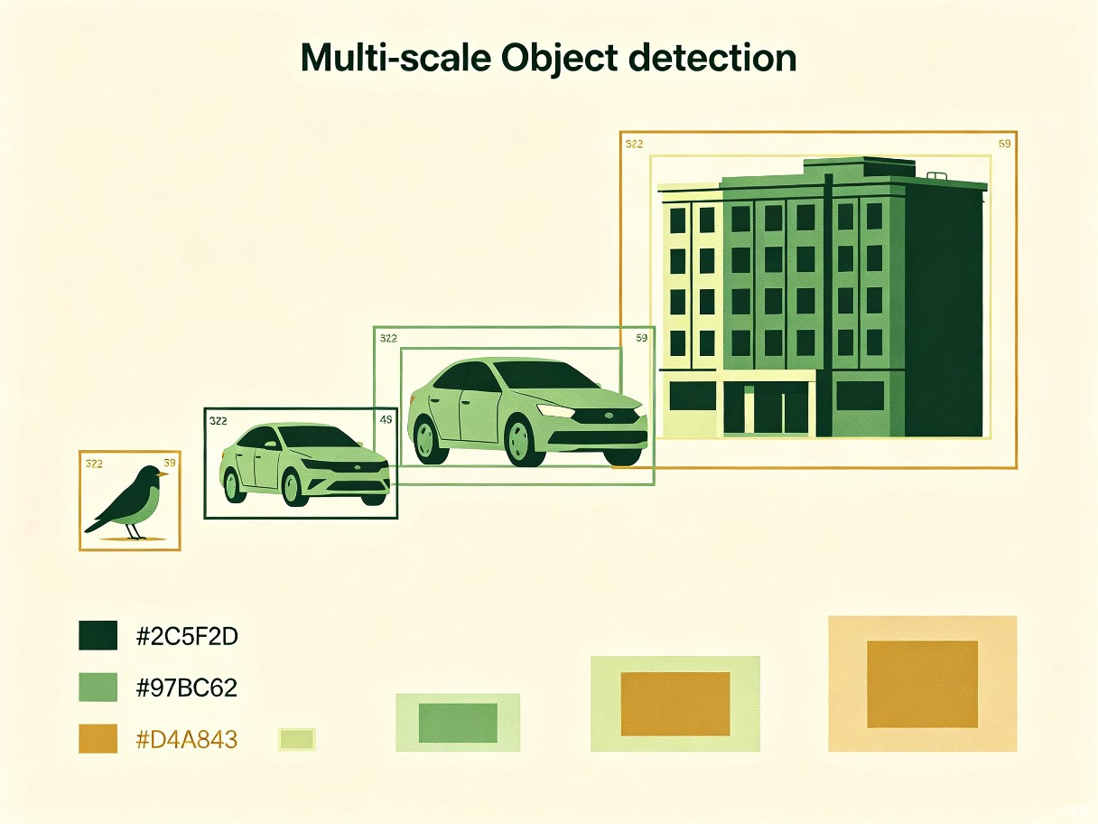
FPN
FPN: Core Idea
Feature Pyramid Networks (CVPR 2017)
Top-down pathway with upsampling
Lateral connections merge features
Strong semantics at all scales
Nearly free: adds < 0.2s/image
AI 生成
6 / 16
Notes:
FPN's key insight: instead of using only the last layer of a CNN for detection, build a top-down pathway that upsamples semantically strong features and merges them with higher-resolution lower-level features via lateral connections. This gives every level both strong semantics and appropriate resolution. It adds almost no computational cost.

Slide 7
FPN
FPN: Three Key Components
Building the pyramid step by step
Bottom-Up Pathway
Top-Down Pathway
Lateral Connections
Standard CNN backboneFeature maps shrink spatiallySemantics grow deepere.g. ResNet stages C2-C5
Upsample deeper features2x nearest-neighborPropagate strong semanticsHigher resolution at each level
1x1 conv to reduce channelsElement-wise additionMerge spatial + semantic3x3 conv to reduce aliasing
▶
▶
AI 生成
7 / 16
Notes:
FPN has three key components. First, the bottom-up pathway is just the standard CNN backbone like ResNet. Second, the top-down pathway upsamples the deeper, semantically rich features to higher resolution. Third, lateral connections use 1x1 convolutions to match channels and element-wise addition to merge the upsampled features with the corresponding bottom-up features. A final 3x3 convolution reduces aliasing.

Slide 8
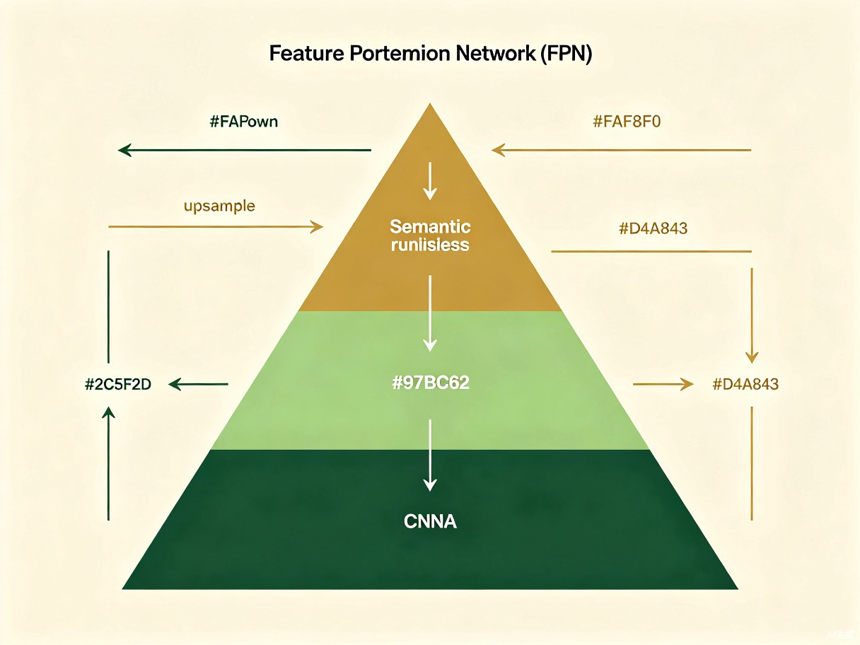
FPN
FPN Architecture Visualization
Feature Pyramid with lateral connections
P2 (256ch)
High res, fine detail
P3 (256ch)
Balanced
P4 (256ch)
Medium resolution
P5 (256ch)
Strong semantics
AI 生成
8 / 16
Notes:
This slide shows the full FPN architecture. The bottom-up pathway goes from C2 to C5 in ResNet. The top-down pathway upsamples P5 to P4, P3, P2. Lateral connections (1x1 conv + add + 3x3 conv) merge features at each level. All pyramid levels have 256 channels. P2 through P5 are used for detection at different scales.

Slide 9
SSD vs FPN: Key Differences
Two approaches to multi-scale detection
Dimension | SSD | FPN
Multi-scale Strategy | Different feature map layers | Top-down pyramid fusion
Feature Fusion | None (independent layers) | Lateral + top-down merge
Anchor Strategy | Default boxes (fixed aspect ratios) | Anchor boxes (same across levels)
Detection Head | Per-layer, simple conv | Shared across pyramid
Framework | Single-stage only | Pluggable (1-stage or 2-stage)
Semantic Quality | Weak at shallow layers | Strong at all levels
FPN's top-down fusion gives stronger semantics at every scale, making it a general-purpose backbone enhancement.
AI 生成
9 / 16
Notes:
This table compares SSD and FPN across key dimensions. SSD uses independent feature layers without fusion, so shallow layers have weak semantics. FPN fuses features top-down, giving all levels strong semantic information. FPN is also more flexible: it can be plugged into both single-stage and two-stage detectors. This is why FPN became a foundational component in modern detection frameworks.

Slide 10
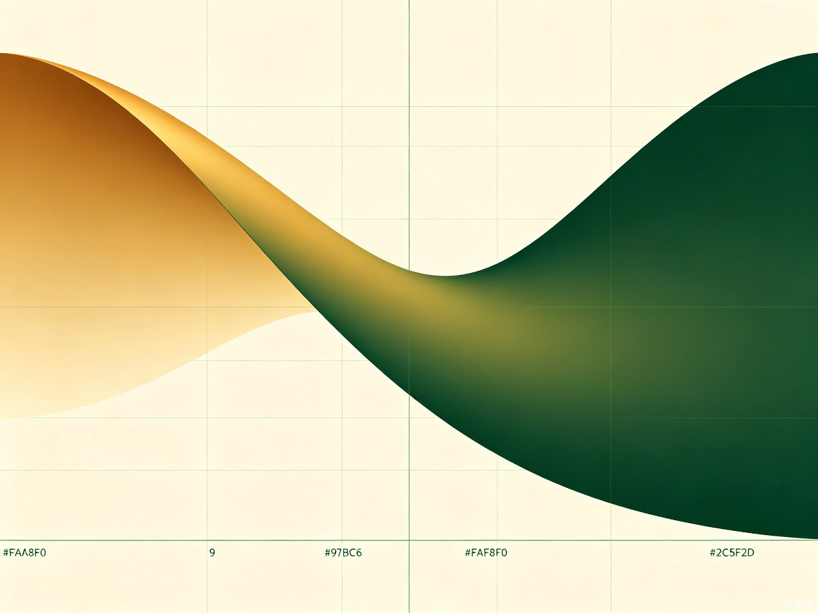
Focal Loss
RetinaNet & Focal Loss
Addressing class imbalance in single-stage detectors (ICCV 2017)
Single-stage detectors lag behind two-stage
Root cause: extreme foreground-background imbalance
Most anchors are easy negatives
Easy negatives overwhelm the loss
Focal Loss down-weights easy examples
RetinaNet: FPN backbone + Focal Loss
AI 生成
10 / 16
Notes:
RetinaNet identifies that the reason single-stage detectors lag behind two-stage ones is extreme class imbalance. In a typical image, there are maybe 10 objects but 100,000 anchor locations. Most anchors are easy negatives that contribute no useful learning signal but overwhelm the loss. Focal Loss solves this by down-weighting easy examples, allowing the model to focus on hard examples. RetinaNet combines FPN backbone with Focal Loss to surpass two-stage detectors.

Slide 11
Focal Loss
Focal Loss: Formula & Intuition
FL(pt) = -(1 - pt)^gamma * log(pt)
FL(pt) = -(1 - pt)^gamma * log(pt)
Standard cross-entropy when gamma = 0 | Default: gamma = 2.0
Easy Examples
Hard Examples
Alpha Balancing
High pt (e.g., 0.9)(1-pt)^2 = 0.01Loss weighted by 0.01=> Effectively ignored
Low pt (e.g., 0.1)(1-pt)^2 = 0.81Loss nearly unchanged=> Focus on these
alpha_t balances pos/neg ratioTypically alpha = 0.25Works with gamma = 2Complementary effect
AI 生成
11 / 16
Notes:
The Focal Loss formula: FL(pt) = -(1-pt)^gamma * log(pt). When gamma=0, it reduces to standard cross-entropy. With gamma=2, easy examples (high pt) have their loss scaled down by (1-pt)^2, effectively near zero. Hard examples keep most of their loss. The alpha parameter balances positive/negative examples. Together, they solve the class imbalance problem elegantly.

Slide 12
Performance Benchmarks
COCO test-dev results comparison
Model | Backbone | Input Size | mAP | FPS
SSD300 | VGG16 | 300x300 | 25.1 | 59
SSD512 | VGG16 | 512x512 | 28.8 | 22
FPN+Faster RCNN | ResNet-101 | 800x1333 | 36.2 | ~6
RetinaNet-101 | ResNet-101-FPN | 800x1333 | 39.1 | ~5
Key Takeaways
SSD: Best real-time performance, good accuracy FPN: Boosts any detector's multi-scale capability RetinaNet: First single-stage to surpass two-stage detectors
AI 生成
12 / 16
Notes:
Performance comparison on COCO test-dev. SSD300 achieves 25.1 mAP at 59 FPS - excellent for real-time. SSD512 improves to 28.8 but drops to 22 FPS. FPN combined with Faster R-CNN achieves 36.2 mAP. RetinaNet-101 with FPN backbone and Focal Loss reaches 39.1 mAP, surpassing all two-stage detectors while being a single-stage detector. The trade-off is speed: RetinaNet runs at about 5 FPS.

Slide 13
Key Contributors
The researchers behind the breakthroughs
WL
TL
Wei Liu
Tsung-Yi Lin
UNC Chapel Hill
Facebook AI Research
SSD (ECCV 2016) Pioneered multi-scale
feature map detection
FPN (CVPR 2017) Also: RetinaNet, COCO
author, Mask R-CNN
AI 生成
13 / 16
Notes:
Wei Liu from UNC Chapel Hill proposed SSD in 2016, pioneering the use of multi-scale feature maps for direct detection. Tsung-Yi Lin from Facebook AI Research is one of the most impactful researchers in computer vision - he contributed FPN, RetinaNet, the COCO dataset, and was a co-author on Mask R-CNN. His work on feature pyramids fundamentally changed how we build detection systems.

Slide 14
Focal Loss: PyTorch Implementation
Clean, production-ready code
1
import torch
2
import torch.nn as nn
3
import torch.nn.functional as F
4
5
class FocalLoss(nn.Module):
6
def __init__(self, alpha=0.25, gamma=2.0):
7
super().__init__()
8
self.alpha = alpha
9
self.gamma = gamma
10
11
def forward(self, inputs, targets):
12
BCE = F.binary_cross_entropy_with_logits(
13
inputs, targets, reduction='none')
14
pt = torch.exp(-BCE)
15
focal = self.alpha * (1-pt)**self.gamma * BCE
16
return focal.mean()
17
18
# Usage
19
criterion = FocalLoss(alpha=0.25, gamma=2.0)
20
loss = criterion(preds, targets)
AI 生成
14 / 16
Notes:
Here is a clean PyTorch implementation of Focal Loss. Key points: use binary_cross_entropy_with_logits with reduction='none' to get per-sample loss, compute pt as exp(-BCE), then apply the modulating factor (1-pt)^gamma and the alpha weighting. The default values alpha=0.25 and gamma=2.0 follow the original paper. This is a 20-line implementation that you can directly use in your projects.

Slide 15
Discussion Questions
Think about these before Day 40
Q1: Why does FPN improve small object detection more than large?
Hint: Think about feature resolution vs semantics
Q2: Can we design detectors without predefined anchors?
Hint: Anchor-Free detection is coming next...
Q3: What are the limitations of SSD's independent layer approach?
Hint: No cross-layer feature reuse
Day 40 Preview: Anchor-Free Detection | CornerNet, CenterNet, FCOS
AI 生成
15 / 16
Notes:
Three discussion questions to think about. First, FPN helps small objects most because small objects need high-resolution features, and FPN adds strong semantics to those high-resolution features. Second, the anchor-free question leads directly into Day 40 - we will explore CornerNet, CenterNet, and FCOS which eliminate predefined anchors entirely. Third, SSD's independent layer approach means each layer works in isolation without sharing learned features across scales.

Slide 16

Thank You!
Day 39: SSD & FPN - Multi-scale Object Detection Milestones
SSD: Liu et al., "SSD: Single Shot MultiBox Detector", ECCV 2016
FPN: Lin et al., "Feature Pyramid Networks", CVPR 2017
RetinaNet: Lin et al., "Focal Loss for Dense Object Detection", ICCV 2017
Computer Vision 100-Day Learning Plan
AI 生成
Notes:
Thank you for following along! Today we covered SSD and FPN, two landmark approaches to multi-scale object detection. Key references are listed on screen. Tomorrow in Day 40, we will explore Anchor-Free detection methods including CornerNet, CenterNet, and FCOS. See you then!

