Slide 1
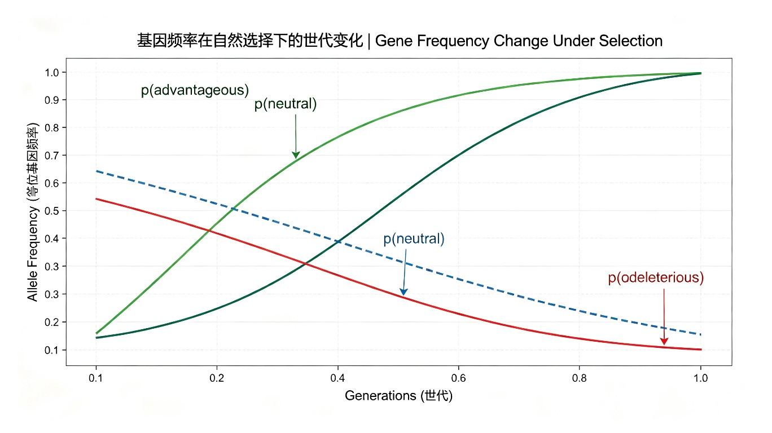
Day 52
基因频率与进化
Gene Frequency and Evolution
遗传学100天学习计划 | 2026-07-05
Notes:
Cover slide. Welcome to Day 52! Today: Gene Frequency and Evolution. Part 5 of 100-day plan (Days 46-60). Key figures: Fisher, Haldane, Wright. Cover image: allele frequency changes over generations under natural selection.

Slide 2
目录 Table of Contents
11 sections for today
01
历史背景
Three pioneers
02
R.A. Fisher贡献
1918, Fundamental Thm
03
J.B.S. Haldane贡献
Selection coefficient
04
Sewall Wright贡献
Drift, Ne
05
核心概念1:基因频率
Allele frequency
06
核心概念2:基因型频率
H-W equilibrium
07
核心概念3:进化定义
4 forces table
08
核心概念4:适合度
Fitness & s
09
核心概念5:选择模式
Selection modes
10
经典实验&故事
Melanism, DDT
11
文献/术语/思考/资源
Summary
Day 52 | Gene Frequency and Evolution | 2/20
Notes:
TOC. 11 sections: history (3-6), five core concepts (7-11), experiments/stories (12-14), literature/glossary (15-16), discussion/resources (17-18), anecdote (19), preview (20). Duration: 60-90 min.

Slide 3
历史背景 Historical Background
The birth of population genetics (1900s-1930s)
基因频率与进化的定量研究是20世纪初群体遗传学诞生的直接产物。核心问题: 孟德尔遗传定律如何与达尔文的自然选择理论相统一？1908年，Hardy和Weinberg各自独立提出哈迪-温伯格平衡定律（Hardy-Weinberg Equilibrium），证明在没有进化力量作用时，群体中的基因频率和基因型频率在世代间保持恒定，为衡量进化提供了零假设。三位群体遗传学奠基人：
R.A. Fisher (1918) - 连续变异可用孟德尔基因累加效应解释，统一孟德尔遗传与生物统计学派
J.B.S. Haldane (1924-1932) - 系统计算选择强度、突变压力和迁移对基因频率的影响
Sewall Wright (1931) - 引入有效群体大小、遗传漂变和适应度景观三位科学家的工作共同构成了现代进化综合论（Modern Synthesis）的数学基础。
Day 52 | Gene Frequency and Evolution | 3/20
Notes:
Historical Background. After Mendel rediscovery in 1900: How to reconcile Mendelian inheritance with Darwinian evolution? H-W equilibrium (1908) = null hypothesis. Fisher, Haldane, Wright built the math framework. Discussion: biometricians vs Mendelians debate.

Slide 4
R.A. Fisher 贡献
Sir Ronald Aylmer Fisher (1890-1962)
1918年划时代论文"The Correlation between Relatives on the Supposition of Mendelian Inheritance" - 证明连续变异可用孟德尔因子累加效应解释，终结了孟德尔学派与生物统计学派的争论。1930年奠基之作"The Genetical Theory of Natural Selection" - Fisher基本定理：任何时刻，适合度的增加率等于适合度的遗传方差。其他重要贡献
方差分析（ANOVA）
最大似然估计方法
Fisher信息量与充分统计量Fisher性格刚烈，与Haldane和Wright的学术分歧持续数十年，但三人的竞争与合作推动了现代进化综合论的诞生。
Day 52 | Gene Frequency and Evolution | 4/20
Notes:
Fisher. Born London 1890. 1918 paper: unified Mendelian + biometric schools. 1930: Fundamental Theorem of Natural Selection = Newton's 2nd Law for evolution. Also: ANOVA, maximum likelihood, Fisher information.

Slide 5
J.B.S. Haldane 贡献
John Burdon Sanderson Haldane (1892-1964)
选择系数（Selection Coefficient, s）的提出者Haldane在1924-1932年间系统计算了自然选择强度、突变压力和迁移对基因频率变化的影响。核心公式推导 (1924-1932)在"A Mathematical Theory of Natural and Artificial Selection"中推导了各种选择模式的精确公式。
显性/隐性等位基因的选择 dynamics
杂合子优势的平衡频率计算
突变-选择平衡理论1932年著作与Haldane困境"The Causes of Evolution"提出Haldane困境：多基因座同时受选择时，替代时间可能超过物种存活时间。Haldane是著名博学家，晚年移居印度。
Day 52 | Gene Frequency and Evolution | 5/20
Notes:
Haldane. 'The last man who knew everything'. Selection coefficient s (W=1-s). Papers 1924-1932 on mathematical selection theory. Haldane dilemma: cost of substitution across many loci. Why does selection have a cost?

Slide 6
Sewall Wright 贡献
Sewall Wright (1889-1988)
三大核心概念的提出者1. 遗传漂变（Genetic Drift）随机抽样效应导致的基因频率变化。小群体中尤为显著。2. 有效群体大小（Effective Population Size, Ne）对漂变影响等价的理想群体个体数。实际N与Ne往往不同。3. 适应度景观（Adaptive Landscape）基因型空间→适应度的三维可视化工具。1931年经典论文"Evolution in Mendelian Populations"（PNAS）引入F统计量和岛模型。Wright漂变理论与Fisher大群体选择理论形成长期对立，但最终在现代群体遗传学中统一。
Day 52 | Gene Frequency and Evolution | 6/20
Notes:
Wright. Three concepts: 1) Genetic drift - random changes, important in small pops. 2) Effective pop size Ne - crucial in conservation genetics. 3) Adaptive landscape - visualization. Fisher-Wright debate: both correct under different conditions.

Slide 7
核心概念1: 基因频率计算
Allele Frequency Calculation
p = 某等位基因拷贝数 / 该位点全部等位基因总拷贝数
Allele Frequency = count of specific allele / total alleles at locus
计算示例 / Calculation Example二倍体群体，基因座A有等位基因 A 和 a：AA = 36个, Aa = 48个, aa = 16个, N = 100, 总等位基因 = 200A频率: p = (2x36 + 48) / 200 = 120/200 = 0.6a频率: q = (2x16 + 48) / 200 = 80/200 = 0.4p + q = 1.0 (两个等位基因频率之和恒等于1)关键点: 基因频率是群体水平的特征，不是个体水平的特征。
Day 52 | Gene Frequency and Evolution | 7/20
Notes:
Allele Frequency. Formula: p = count / total. Work through example step by step. Emphasize: allele frequency is POPULATION-LEVEL, not individual. p + q = 1 for biallelic loci. Practice exercise for students.

Slide 8
核心概念2: 基因型频率
Genotype Frequency & Hardy-Weinberg Equilibrium
P(AA) = p² P(Aa) = 2pq P(aa) = q²
Under HWE: p² + 2pq + q² = 1
HWE Five Conditions
无突变 (No Mutation)
无选择 (No Selection) - 所有基因型适合度相同
无迁移 (No Migration) - 封闭群体
随机交配 (Random Mating)
无限群体 (Infinite Population)实践意义: HWE是检测进化力量是否作用的零假设。偏离HWE暗示进化力量的存在。Example: p=0.6, q=0.4 → AA=0.36, Aa=0.48, aa=0.16
Day 52 | Gene Frequency and Evolution | 8/20
Notes:
Genotype Frequency & HWE. HWE formula: p^2+2pq+q^2=1. Five conditions must ALL hold. HWE as null hypothesis for detecting evolution. Deviation from HWE suggests evolutionary forces at work. Work through example: p=0.6, q=0.4. Ask: why is HWE useful in medical genetics (carrier frequency estimation)?

Slide 9
核心概念3: 进化的遗传学定义
Definition of Evolution - 4 Evolutionary Forces
进化被定义为群体中基因频率随时间的变化。当p(A)在世代间发生变化时，进化就在发生。
进化力量 / Force | 作用机制 / Mechanism | 速度 / Speed
自然选择 Natural Selection | 差异化生存与繁殖 | 可快可慢
遗传漂变 Genetic Drift | 随机抽样效应 | 小群体中显著
基因流 Gene Flow | 群体间个体迁移 | 取决于迁移率
突变 Mutation | 等位基因随机改变 | 通常非常缓慢
Day 52 | Gene Frequency and Evolution | 9/20
Notes:
Definition of Evolution. Key insight: evolution = change in allele frequency over generations. Four forces: natural selection (directional), genetic drift (random, stronger in small pops), gene flow (migration between pops), mutation (creates new variation). Stress: all four can change p, but at very different rates. Quiz: which force is fastest?

Slide 10
核心概念4: 适合度与选择系数
Fitness & Selection Coefficient
W = 1 - s (Fitness = 1 - Selection Coefficient)
W = 适合度 (Fitness) s = 选择系数 (Selection Coefficient)
适合度（Fitness, W）衡量某基因型个体将等位基因传递给下一代的能力。计算示例:若杂合子适合度 W(Aa)=0.9，隐性纯合子 W(aa)=0.7，显性纯合子 W(AA)=1.0则隐性选择系数 s = 1 - 0.7 = 0.3绝对适合度 vs 相对适合度:
绝对适合度: 实际存活和繁殖数量
相对适合度: 与最适基因型的比值（最常用）适合度是连接基因型与自然选择的桥梁。
Day 52 | Gene Frequency and Evolution | 10/20
Notes:
Fitness & Selection Coefficient. W = 1 - s. Work through calculation example. Distinguish absolute vs relative fitness. Fitness connects genotype to natural selection. Discussion: Can fitness be measured directly? What are the challenges?

Slide 11
核心概念5: 选择模式
Selection Modes - Positive, Purifying, Balancing
正向选择
Positive Selection
纯化选择
Purifying Selection
平衡选择
Balancing Selection
有利等位基因频率逐渐增加。新的有益突变被保留并传播。
例: DDT抗性基因的快速传播。
有害等位基因频率逐渐降低。大多数新突变被清除。
例: 致死突变的消除。
维持多态性。包括杂合子优势和频率依赖选择。
例: 镜刀形细胞贫血症与疟疾抗性。
Day 52 | Gene Frequency and Evolution | 11/20
Notes:
Selection Modes. Three modes: 1) Positive selection - advantageous alleles increase. 2) Purifying selection - deleterious alleles removed. 3) Balancing selection - maintains polymorphism. Heterozygote advantage is key example. Formula for positive selection: delta_p ~ spq^2. Discussion: why is balancing selection evolutionarily important?

Slide 12
经典实验1: 工业黑化
Industrial Melanism - Peppered Moth (Biston betularia)
背景 / Background19世纪工业革命使英国树木被煤烟熏黑。桦尺蝠Biston betularia种群中黑色型（carbonaria）频率急剧上升。关键证据 / Key EvidenceKettlewell (1955) 标记-重捕实验:
伯明翰污染区: 黑色型存活率远高于浅色型 (typica)
多塞特未污染区: 浅色型存活率远高于黑色型基因频率变化记录:
1848年: 黑色型突变等位基因频率接近0
1895年: 曼彻斯特地区黑色型频率达到98%
1960年代后: 随着空气治理，浅色型开始回升完美展示了自然选择如何改变基因频率。
Day 52 | Gene Frequency and Evolution | 12/20
Notes:
Industrial Melanism. Classic example of natural selection changing allele frequencies. Kettlewell's mark-recapture experiment (1955). Timeline: 1848 ~0% black, 1895 98% in Manchester, 1960s reversal after clean air. This is a textbook case showing directional selection in action.

Slide 13
经典实验2: DDT抗性实验
DDT Resistance Experiment - Rapid Selection
实验过程 / Experimental Process对果蝇群体施用DDT杀虫剂：
1. 初始群体中几乎不存在抗性等位基因
2. 绝大多数个体死亡，极少数携带隐性抗性基因的个体存活
3. 存活个体交配后，抗性等位基因频率急剧上升
4. 经过数代选择后，整个群体产生高度抗性结论 / Conclusion强大的定向选择可以在短短数代内将极低频率的有利等位基因提升到高频率——这被称为“选择的快车道”。现实意义: 这解释了为什么抗菌素耐药性和抗虫剂耐药性迅速出现——警示我们必须理性使用药物。
Day 52 | Gene Frequency and Evolution | 13/20
Notes:
DDT Resistance. Demonstrates 'fast lane of selection' - strong directional selection can raise allele frequency from near-zero to fixation in just a few generations. Real-world relevance: antibiotic resistance and pesticide resistance. Discussion: what does this mean for public health and agriculture?

Slide 14
科学家故事: Fisher基本定理
Fisher's Fundamental Theorem - A Story of Mathematical Insight
罗纳德·艾尔默·费舍尔 (1890-1962)Fisher出生于伦敦，从小展现非凡数学天赋。在剑桥大学学习数学和物理学期间，受到孟德尔遗传学重新发现的启发。关键贡献:
1918年论文: 证明连续变异可用大量孟德尔因子累加效应解释，终结学派争论。
1930年基本定理: 适合度变化率 = 适合度的遗传方差。
发明方差分析（ANOVA）、最大似然估计等统计工具。个人特质:Fisher性格刚烈，与Haldane和Wright间学术分歧持续数十年。但正是三人的竞争与合作推动了现代进化综合论的诞生。Haldane评价："Fisher的基本定理就像是牛顿第二定律对进化生物学的意义。"
Day 52 | Gene Frequency and Evolution | 14/20
Notes:
Fisher Story. Born London 1890. Extraordinary math talent. At Cambridge, inspired by Mendel's rediscovery. Key contributions: 1918 paper, 1930 Fundamental Theorem, ANOVA. Fisher was famously combative - long-standing disputes with Haldane and Wright. Haldane's quote about the theorem being like Newton's Second Law for evolution.

Slide 15
重要文献 Key Literature
6 Landmark Papers
文献 Literature | 作者 Author | 年份 Year | 核心贡献 Contribution
Mendel Heredity | Fisher | 1918 | 连续变异的孟德尔基础
Mathematical Theory of Selection | Haldane | 1924-32 | 选择对基因频率影响
Evolution in Mendelian Populations | Wright | 1931 | 漂变、有效群体大小
Genetical Theory of Natural Selection | Fisher | 1930 | 群体遗传学奠基之作
The Causes of Evolution | Haldane | 1932 | Haldane困境
Genetics and Origin of Species | Dobzhansky | 1937 | 现代进化综合论
Day 52 | Gene Frequency and Evolution | 15/20
Notes:
6 landmark papers. Fisher 1918, Haldane 1924-32, Wright 1931, Fisher 1930, Haldane 1932, Dobzhansky 1937. All foundational.

Slide 16
术语表 Glossary
14 Key Terms
术语 Term | English | Definition
基因频率 | Allele Frequency | 等位基因占全部的比例
基因型频率 | Genotype Frequency | 某基因型占总体数的比例
适合度 | Fitness (W) | 传递基因给后代的能力
选择系数 | Selection Coeff. (s) | 1 - W
有效群体大小 | Effective Pop. Size | 漂变等价理想群体大小
遗传漂变 | Genetic Drift | 随机抽样导致频率变化
基因流 | Gene Flow | 群体间迁移引起频率变化
术语 Term | English | Definition
固定 | Fixation | 等位基因频率变为1
丢失 | Loss | 等位基因频率变为0
多态性 | Polymorphism | 同基因座多个等位基因
杂合子优势 | Heterozygote Advantage | 杂合子>纯合子适合度
Fisher基本定理 | Fisher Fund. Thm | 适合度变率=遗传方差
现代进化综合论 | Modern Synthesis | 遗传学+进化论框架
连锁不平衡 | Linkage Diseq. | 基因座非随机关联
Day 52 | Gene Frequency and Evolution | 16/20
Notes:
14 key terms. Master all distinctions: allele vs genotype freq, fitness vs selection coeff, effective vs census pop, fixation vs loss.

Slide 17
思考题 Discussion Questions
5 Questions
Q1 Calculation1000人, MN: MM=200, MN=500, NN=300. 计算M和N频率，检验HWE。Q2 Theory小岛50个个体 vs 大陆10万，漂变影响有何不同？Q3 Analysis自然选择能否创造新等位基因？新变异从哪里来？Q4 DiscussionHaldane困境如何被现代遗传学解决？Q5 Application疟疾区HbS频率达15%，用杂合子优势解释并计算各基因型频率。
Day 52 | Gene Frequency and Evolution | 17/20
Notes:
Q1: M=0.45, N=0.55. Q2: drift much stronger in island. Q3: no, mutation creates variation. Q4: soft sweeps, linked selection. Q5: heterozygote advantage maintains HbS.

Slide 18
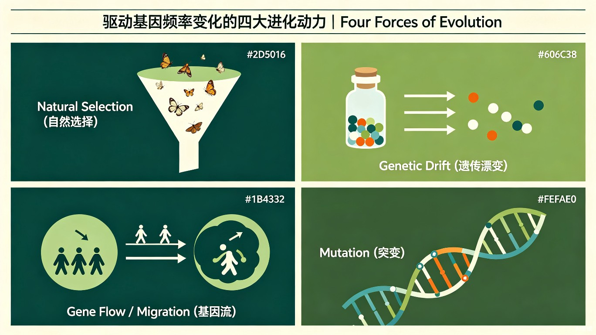
学习资源汇总 Learning Resources
Videos, Books, Databases
视频 Video Resources
文献 Literature
- Khan Academy: Gene Frequency
- Bilibili: 群体遗传学入门
- YouTube: HWE Explained
- YouTube: Population Genetics
- NCBI Bookshelf: Pop Genetics
- NCBI: Genetic Variation
- Stanford: Modern Synthesis
- Nature: Pop Genetics Collection
进化力量全景图 Forces Panorama
数据库 Databases
- NCBI: Pop Genetics
- Ensembl: VEP
- ALFRED: Allele Freq DB
- 1000 Genomes Project
Day 52 | Gene Frequency and Evolution | 18/20
Notes:
Video: Khan Academy, Bilibili, YouTube. Literature: NCBI, Nature. Databases: NCBI, Ensembl, ALFRED, 1000 Genomes.

Slide 19
小故事 Anecdote
"Fisher的对数" - Fisher Logarithm
"Fisher的对数"与基本定理Fisher在构思基本定理时，在剑桥花园散步时突然意识到：适合度的对数（log fitness）可以线性分解为基因的平均效应之和。他激动地跑回办公室，在一张餐巾纸上写下了关键公式。核心洞察:在对数尺度上，每个基因位点对适合度的贡献是近似独立的。这使得自然选择可以同时作用于多个位点。为多基因同时进化提供坚实理论基础，解释为什么进化通常是渐进的。Haldane评价: "Fisher的基本定理就像是牛顿第二定律对进化生物学的意义。"
Day 52 | Gene Frequency and Evolution | 19/20
Notes:
Anecdote: Fisher Logarithm. During a walk in Cambridge, Fisher realized log(fitness) decomposes linearly into average gene effects. This explains gradual evolution. Haldane compared it to Newton Second Law.

Slide 20
下节预告
Day 53 Preview: 自然选择与遗传 Natural Selection & Genetics
明天将深入探讨自然选择在遗传学层面的作用:
选择的不同模式: 定向、稳定、分裂选择
选择的单位之争: 基因 vs 个体 vs 群体
Haldane的选择代价理论
分子层面的自然选择: dN/dS比值
人工选择与自然选择的比较预习: 复习Day 51 H-W定律，阅读Haldane 1924年论文。
Thank You! | 谢谢大家! | Day 52/100 Complete
Day 52 | Gene Frequency and Evolution | 20/20
Notes:
Closing slide. Preview Day 53: Natural Selection modes (directional, stabilizing, disruptive), level of selection debate, Haldane cost theory, molecular selection evidence (dN/dS), artificial vs natural selection. Remind students to review Day 51 H-W equilibrium and read Haldane 1924 paper. Thank students for their attention!

