Slide 1
Day 52
基因频率与进化
Gene Frequency and Evolution
遗传学100天学习计划 | 2026-07-05
Talk / 演讲版
AI 生成
Notes:
Welcome to Day 52 of the Genetics 100-Day Study Plan. Today we explore gene frequency and evolution, bridging Mendelian genetics with Darwinian natural selection through population genetics. 欢迎来到遗传学100天学习计划第52天。今天我们探索基因频率与进化，通过群体遗传学连接孟德尔遗传学与达尔文自然选择。

Slide 2
目录 | Table of Contents
Overview of today's topics
01
历史背景
Historical Background
02
核心概念：基因频率与基因型频率
Gene Frequency & Genotype Frequency
03
核心概念：四大进化动力
Four Evolutionary Forces
04
核心概念：适合度与选择
Fitness & Selection
05
选择模式 Selection Modes
Positive, Purifying, Balancing
06
经典案例 Classic Experiments
Industrial Melanism, DDT, Heterozygote Advantage
07
Fisher基本定理与文献
Fisher's Theorem & Key Literature
AI 生成
Notes:
Today's lecture covers 7 sections. We begin with the three founders of population genetics, move through core concepts of gene frequency, evolutionary forces, fitness, and selection modes, then examine classic experiments and Fisher's fundamental theorem. 今天的讲座涵盖7个部分。从三位奠基人开始，经过核心概念到经典案例和Fisher基本定理。

Slide 3
历史背景 | Historical Background
三位奠基人 — Three Founders of Population Genetics
R.A. Fisher
J.B.S. Haldane
Sewall Wright
1890-1962
1892-1964
1889-1988
Unified Mendelian genetics with biometrics; Fisher's Fundamental Theorem (1930)
统一孟德尔遗传与生物统计学
Systematically calculated selection intensity; proposed selection coefficient (1924-1932)
系统推导选择系数概念
Introduced effective population size (Ne), genetic drift, adaptive landscape (1931)
引入有效群体大小与遗传漂变
AI 生成
Notes:
Three founders established the mathematical foundations of population genetics in the early 20th century. Fisher unified Mendelism with biometrics in his 1918 paper. Haldane systematically calculated how natural selection changes gene frequencies. Wright introduced genetic drift and effective population size. Together, their work formed the Modern Synthesis. 三位奠基人在20世纪初建立了群体遗传学的数学基础，共同构成了现代进化综合论的基石。

Slide 4
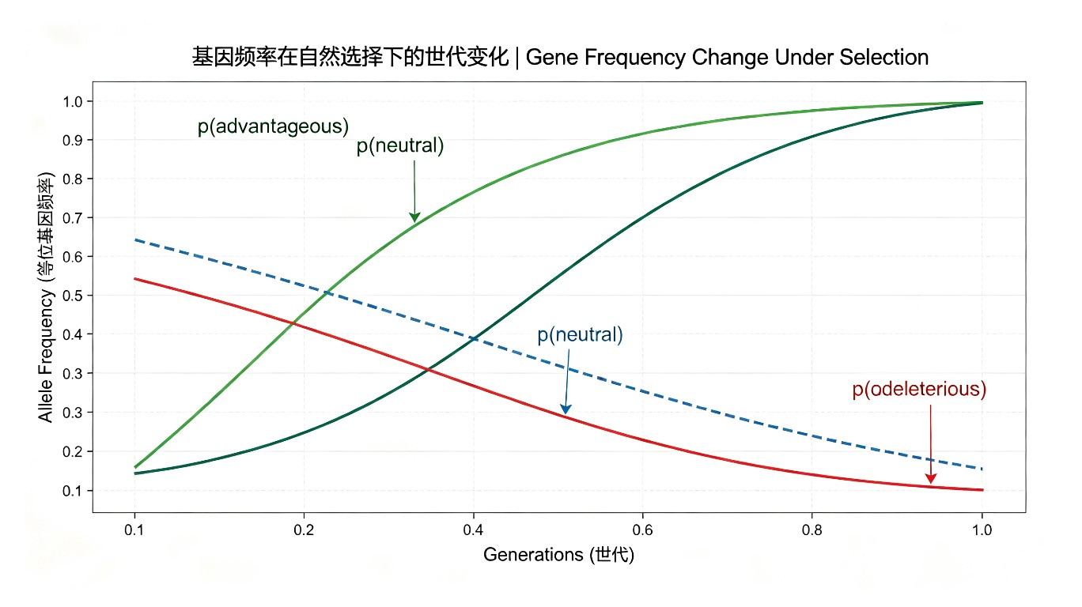
核心概念：基因频率 | Gene Frequency
基因频率与基因型频率的计算
公式 Formula
示例 Example
Allele Frequency:
p = (2×AA + Aa) / 2N
Genotype Frequency (HWE):
P(AA) = p² P(Aa) = 2pq P(aa) = q²
N=100: AA=36, Aa=48, aa=16
p = (72+48)/200 = 0.60
q = (32+48)/200 = 0.40
p + q = 1.0
AI 生成
Notes:
Gene frequency is the proportion of a specific allele at a locus among all alleles in a population. For a diploid population: p(A) = (2*AA_count + Aa_count) / (2N) Under HWE: P(AA)=p^2, P(Aa)=2pq, P(aa)=q^2 基因频率是群体中特定等位基因占全部等位基因的比例。在哈迪-温伯格平衡下，基因型频率为p^2, 2pq, q^2。

Slide 5
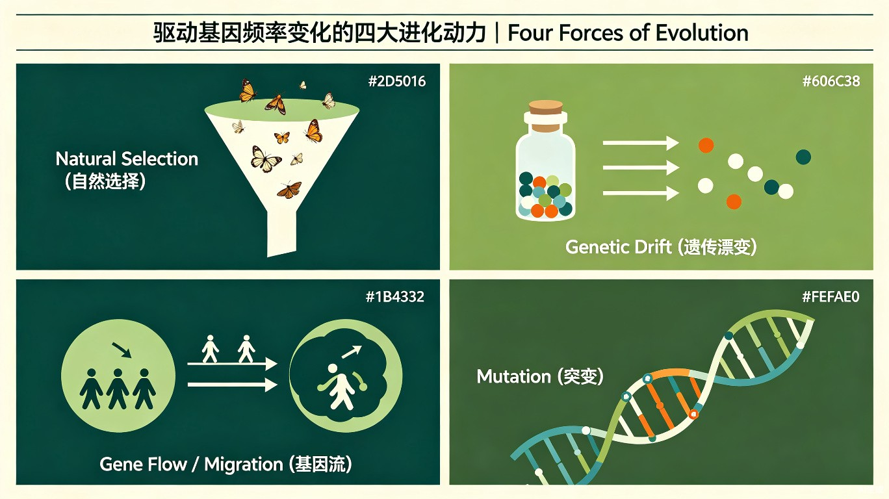
核心概念：四大进化动力 | Four Evolutionary Forces
驱动基因频率变化的四种力量
自然选择
Selection
遗传漂变
Drift
基因流
Migration
突变
Mutation
差异生存与繁殖
随机抽样效应
群体间个体迁移
等位基因随机改变
AI 生成
Notes:
Four forces drive changes in gene frequency: 1. Natural Selection: differential survival and reproduction 2. Genetic Drift: random sampling effects, strongest in small populations 3. Gene Flow (Migration): movement of individuals between populations 4. Mutation: random changes in alleles (usually very slow) 四大进化动力驱动基因频率变化：自然选择、遗传漂变、基因流、突变。

Slide 6
适合度与选择 | Fitness & Selection
W = 1 - s
适合度公式 Fitness Formula
计算示例 Example
Fitness:
W = 1 - s
W = fitness of a genotype
s = selection coefficient
(s = strength of selection against genotype)
Genotype: AA Aa aa
Fitness: 1.0 0.90 0.70
Sel. Coef: 0 0.10 0.30
s(AA) = 1 - 1.0 = 0
s(Aa) = 1 - 0.9 = 0.1
s(aa) = 1 - 0.7 = 0.3
Key Point 要点
Fitness (W) measures how well a genotype passes alleles to the next generation. The selection coefficient (s = 1 - W) quantifies selection strength.
AI 生成
Notes:
Fitness (W) measures how well a genotype passes alleles to the next generation. W = 1 - s, where s is the selection coefficient. If s = 0, the genotype has maximum fitness (W = 1). Higher s means stronger selection against the genotype. 适合度衡量基因型将等位基因传递给下一代的能力。选择系数s衡量选择压力的强度。

Slide 7
选择模式 | Selection Modes
三种主要选择类型 Three Main Types
正向选择
Positive Selection
负向选择
Purifying Selection
平衡选择
Balancing Selection
Favors beneficial alleles
有利等位基因频率增加
Δp ≈ spq²/(1-sq²)
Removes deleterious alleles
有害等位基因频率降低
Also called negative
or purifying selection
Maintains polymorphism
维持多态性
Heterozygote advantage:
W(Aa) > W(AA), W(aa)
AI 生成
Notes:
Three main modes of selection: 1. Positive Selection: beneficial alleles increase in frequency. 2. Purifying Selection: deleterious alleles are removed. 3. Balancing Selection: maintains genetic diversity. Heterozygote advantage (sickle cell/malaria) is a classic example. 三种选择模式：正向选择、负向选择、平衡选择（杂合子优势是经典案例）。

Slide 8
经典案例：工业黑化 | Industrial Melanism
桦尺蠖的自然选择 Peppered Moth (Biston betularia)
基因频率变化时间线 Timeline
关键数据 Key Data
1848
黑色等位基因频率 ~0%
Black allele: ~0%
Polluted area (Birmingham):
Black morph: higher survival
Light morph: lower survival
Clean area (Dorset):
Light morph: higher survival
Black morph: lower survival
=> Directional selection
changes gene frequency
1895
曼彻斯特黑色型 ~98%
Manchester: ~98% black
1955
Kettlewell标记-重捕实验
Mark-recapture experiment
1960s+
浅色型频率开始回升
Light form recovering
AI 生成
Notes:
Industrial Melanism: During the Industrial Revolution, tree bark was darkened by soot. In polluted areas: dark (carbonaria) moths had higher survival than light (typica) moths. In clean areas: the reverse was true. Kettlewell's 1955 mark-recapture experiment confirmed directional natural selection was changing gene frequency. 工业黑化：工业革命期间煤烟污染使树皮变黑。污染区深色型存活率高，清洁区浅色型存活率高。Kettlewell的标记-重捕实验证实了定向自然选择正在改变基因频率。

Slide 9
经典案例 | Classic Experiments
DDT抗性与杂合子优势 DDT Resistance & Heterozygote Advantage
DDT抗性实验 DDT Resistance
杂合子优势 Heterozygote Advantage
1. 初始群体：抗性等位基因频率极低
2. 施用DDT：绝大多数个体死亡
3. 极少数隐性抗性个体存活
4. 存活者交配：抗性频率急剧上升
=> The "fast lane" of selection
Classic example: Sickle Cell & Malaria
Genotype: AA AS SS
Malaria: No Yes Yes
Anemia: No Mild Severe
Fitness: Low HIGH Low
W(AS) > W(AA), W(SS)=> Heterozygote maintains both alleles
AI 生成
Notes:
DDT Resistance: Powerful directional selection can raise a beneficial allele from very low frequency to high frequency in just a few generations — the "fast lane" of selection. Heterozygote Advantage: Sickle cell carriers (AS) have resistance to malaria without severe anemia. Both homozygotes (AA, SS) have lower fitness. This is classic balancing selection. DDT抗性：强大的定向选择可在短短数代内将低频有利等位基因提升至高频。 杂合子优势：镰刀形细胞携带者(AS)抗疟疾且无严重贫血，是平衡选择的经典案例。

Slide 10
Fisher基本定理 | Fisher's Fundamental Theorem
群体遗传学的基石 The Cornerstone of Population Genetics
The Fundamental Theorem of Natural Selection
"The rate of increase in fitness of any organism at any time is equal to its genetic variance in fitness at that time."
适合度的增加率等于该时刻适合度的遗传方差
核心思想 Core Idea
Haldane's comment 评价
Evolution proceeds as fast as genetic variation allows. More genetic variance = faster adaptation.
遗传变异越多，适应速度越快。
"Like Newton's Second Law for evolutionary biology."
"如同牛顿第二定律对进化生物学的意义。"
AI 生成
Notes:
Fisher's Fundamental Theorem (1930): The rate of increase in fitness equals the additive genetic variance in fitness. Key insight: evolution can only proceed as fast as genetic variation allows. This is analogous to Newton's Second Law (F=ma) — genetic variance is the 'force' driving evolutionary change. Log fitness can be decomposed into average effects of individual genes, meaning selection can act on multiple loci simultaneously. Fisher基本定理：适合度的增加率等于适合度的遗传方差。进化速度取决于遗传变异的量。Haldane评价其如同牛顿第二定律。

Slide 11
重要文献 | Key Literature
6 Foundational Papers 六篇奠基文献
1918
Fisher
1924
Haldane
Correlation between Relatives on the Supposition of Mendelian Inheritance
A Mathematical Theory of Natural and Artificial Selection
Unified Mendel + biometrics
Selection coefficient concept
1930
Fisher
1931
Wright
The Genetical Theory of Natural Selection
Evolution in Mendelian Populations (PNAS)
Fundamental theorem
Genetic drift, Ne
1932
Haldane
1937
Dobzhansky
The Causes of Evolution
Genetics and the Origin of Species
Cost of natural selection
Modern Synthesis classic
AI 生成
Notes:
Six foundational papers in population genetics: 1. Fisher 1918: Unified Mendelian inheritance with biometric variation 2. Haldane 1924: Mathematical theory of selection 3. Fisher 1930: The Genetical Theory — Fundamental Theorem 4. Wright 1931: Genetic drift and effective population size 5. Haldane 1932: Cost of natural selection (Haldane's dilemma) 6. Dobzhansky 1937: Classic statement of Modern Synthesis 六篇奠基文献奠定了群体遗传学和现代进化综合论的基础。

Slide 12
术语表 | Glossary
Key terms in population genetics
English Term | 中文术语 | Definition
Gene/Allele Frequency | 基因频率 | Proportion of a specific allele
Genotype Frequency | 基因型频率 | Proportion of a genotype
Fitness (W) | 适合度 | Ability to pass alleles to offspring
Selection Coeff. (s) | 选择系数 | s = 1 - W
Effective Pop. Size (Ne) | 有效群体大小 | Ideal population equivalent for drift
Genetic Drift | 遗传漂变 | Random sampling effects on allele freq.
Gene Flow | 基因流 | Migration between populations
Fixation / Loss | 固定/丢失 | Allele freq reaches 1 or 0
Polymorphism | 多态性 | Multiple alleles at a locus
Heterozygote Advantage | 杂合子优势 | Heterozygote > both homozygotes
Fisher's Fundamental Theorem | Fisher基本定理 | dW/dt = genetic variance
Modern Synthesis | 现代进化综合论 | Genetics + evolution framework
AI 生成
Notes:
Key terms in population genetics: - Gene/Allele Frequency: proportion of a specific allele - Fitness (W): ability to pass alleles to offspring; s = 1 - W - Genetic Drift: random changes, strongest in small populations (Ne) - Heterozygote Advantage: heterozygote has higher fitness than both homozygotes - Fisher's Fundamental Theorem: rate of fitness increase = genetic variance in fitness - Modern Synthesis: the integration of genetics with evolutionary theory 群体遗传学核心术语。

Slide 13
思考题 | Discussion Questions
三个关键问题 Three Key Questions
1
基因频率计算 | Gene Frequency Calculation
In a population of 1000 people: MM=200, MN=500, NN=300. Calculate M and N allele frequencies, and test HWE.
在1000人群体中，MN血型分布如上，计算等位基因频率并检验HWE。
2
遗传漂变效应 | Genetic Drift Effects
Compare drift effects: an island insect population of 50 vs. mainland population of 100,000. How do they differ?
小岛50只昆虫 vs 大陆10万只，遗传漂变的影响有何不同？
3
选择与变异来源 | Selection & Sources of Variation
Can natural selection create new alleles? If not, where does new genetic variation come from?
自然选择能否创造新的等位基因？如果不能，新的遗传变异从何而来？
AI 生成
Notes:
Three key discussion questions: 1. Gene Frequency Calculation: Practice computing p and q from genotype counts, and test Hardy-Weinberg Equilibrium using chi-square test. 2. Genetic Drift Effects: Compare the impact of drift in small (N=50) vs. large (N=100,000) populations. Small populations experience much stronger random fluctuations. 3. Selection & Variation Sources: Natural selection CANNOT create new alleles — it only filters existing variation. New alleles arise from mutation. 三个思考题涵盖基因频率计算、遗传漂变效应、以及选择与变异来源的关系。

Slide 14
小故事 | Anecdote
Fisher的对数与基本定理 Fisher's Logarithm & The Fundamental Theorem
The Story
While walking in the Cambridge gardens, Fisher suddenly realized that log fitness can be linearly decomposed into the sum of average effects of individual genes.
He rushed back to his office and wrote the key formula on a napkin.
核心洞察 Core Insight:
Although fitness itself is nonlinear (involving genotype interactions), on a logarithmic scale, each locus contributes approximately independently. This allows natural selection to act on multiple loci simultaneously.
Haldane: "Like Newton's Second Law for evolutionary biology."
AI 生成
Notes:
The Anecdote: Fisher was walking in the Cambridge gardens when he realized that log fitness can be linearly decomposed into the sum of average gene effects. This insight is profound because fitness is inherently nonlinear (involving epistasis between genotypes), but on a logarithmic scale, each gene locus contributes approximately independently. This explains why evolution is typically gradual rather than saltational. Haldane compared this discovery to Newton's Second Law — a unifying principle that explains how natural selection works at the genetic level. Fisher在剑桥花园散步时突然意识到适合度的对数可以线性分解为基因的平均效应之和。这一洞察解释了为什么进化通常是渐进的。

Slide 15
学习资源与预告 | Resources & Preview
学习资源 + Day 53预告
学习资源 Resources
Day 53 预告 Preview
Video Resources:
Khan Academy - Gene Frequency
Hardy-Weinberg Equilibrium Explained
Text Resources:
NCBI Bookshelf - Population Genetics
Stanford Encyclopedia - Modern Synthesis
自然选择与遗传
Natural Selection & Genetics
Selection modes: directional, stabilizing, disruptive
Unit of selection debate
Haldane's cost of selection
Molecular evidence: dN/dS ratio
Artificial vs. natural selection
AI 生成
Notes:
Resources for further study: - Video: Khan Academy gene frequency and Hardy-Weinberg equilibrium - Text: NCBI Bookshelf on population genetics, Stanford Encyclopedia on Modern Synthesis Day 53 Preview: We will dive deeper into natural selection, covering: - Three modes of selection (directional, stabilizing, disruptive) - The unit of selection debate (gene vs. individual vs. group) - Haldane's cost of selection - Molecular evidence: dN/dS ratio analysis - Artificial vs. natural selection 学习资源推荐及Day 53预告：自然选择与遗传。

Slide 16
Thank You
谢谢 | 谢谢聆听
Day 52 | Gene Frequency and Evolution | 基因频率与进化
遗传学100天学习计划 | 遗传学100天学习计划
Questions? 问题讨论
AI 生成
Notes:
Thank you for joining today's lecture on Day 52: Gene Frequency and Evolution. Key takeaways: 1. Three founders (Fisher, Haldane, Wright) established population genetics 2. Gene frequency (p, q) and genotype frequency (p^2, 2pq, q^2) are fundamental 3. Four evolutionary forces: selection, drift, migration, mutation 4. Fitness W = 1 - s; selection acts on existing variation 5. Fisher's Fundamental Theorem: dW/dt = genetic variance Next time: Day 53 — Natural Selection & Genetics 感谢参加Day 52的学习。下次我们将深入探讨自然选择与遗传。

